Slide 1
INSTITUTE OF TECHNOLOGY OF CAMBODIA
Department of Applied Mathematics and Statistics
Data Engineering Pipeline
for Credit Risk Modelling
Architecture · Technology Stack · Six DAG Pipelines · IFRS 9 / Basel III · RAG Chat Interface
SOPHON Rachana · LOT Soklang · DUK Pagnarith · LENG Devid
Supervisor: Lecturer Vesal Khean
Academic Year 2025–2026

Slide 2
THE PROBLEM
OUR OBJECTIVES
Academic credit risk papers produce models
— but ignore production infrastructure.
O1
Design a 6-DAG Airflow pipeline: raw CSV → regulatory outputs
No automated orchestration
O2
Build a 5-schema PostgreSQL medallion data warehouse
No reproducible audit trail
No real-time scoring API
O3
Train & calibrate PD, LGD, and EAD models tracked in MLflow
No PSI/CSI model monitoring
No regulatory reporting pipeline
O4
Compute IFRS 9 ECL and Basel III AIRB capital per loan
"A Gini of 0.387 is worthless
without the pipeline around it."
O5
Deploy a RAG chat interface for natural language data queries

Slide 3
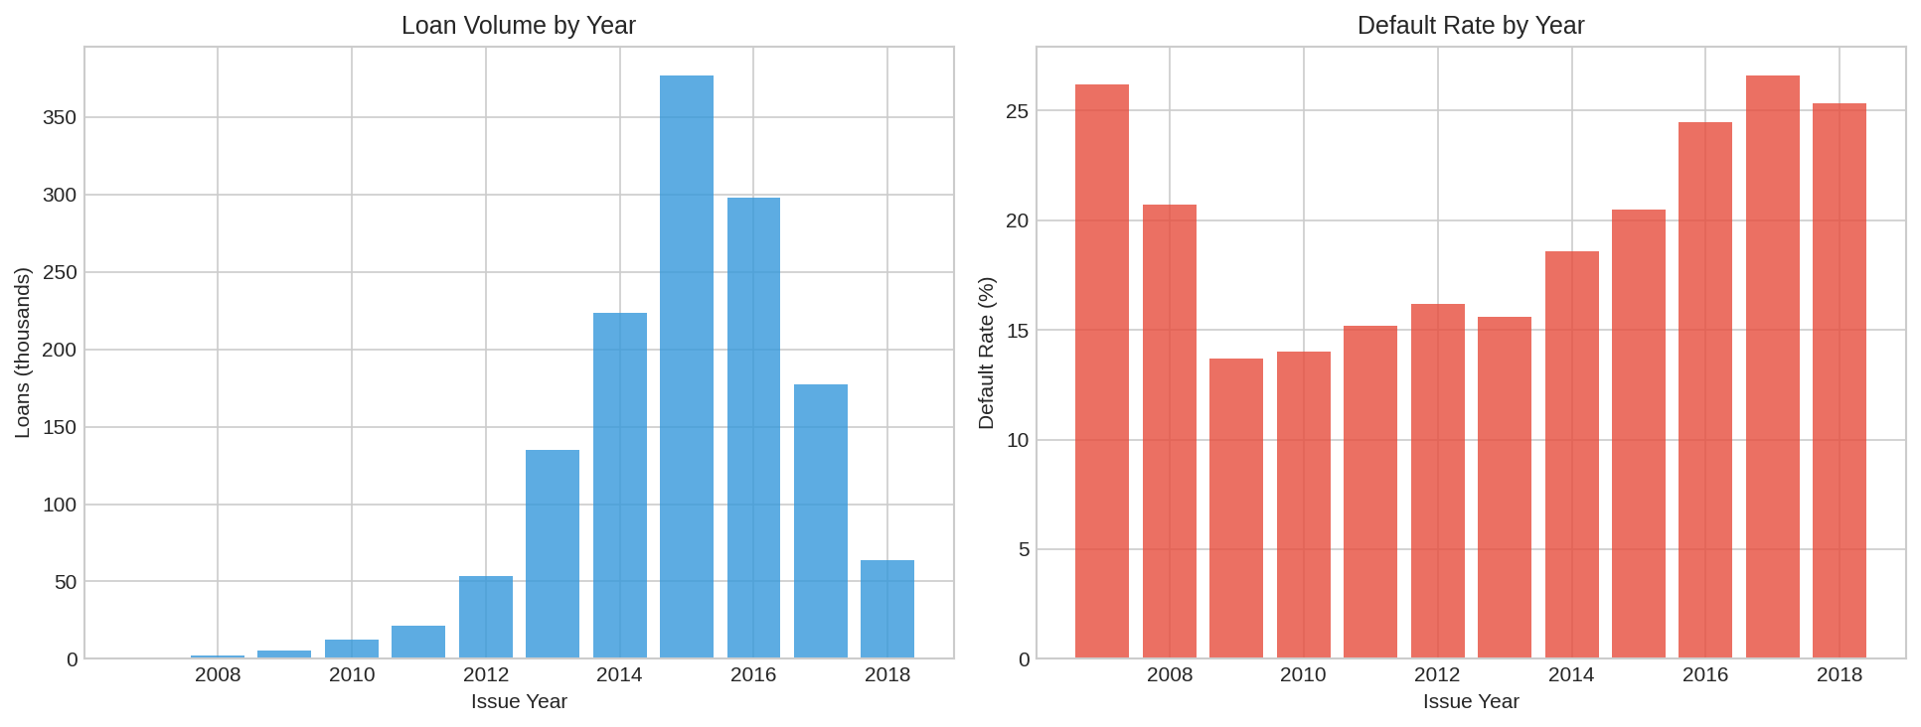
The Dataset — Where It All Starts
Lending Club peer-to-peer lending data · 2007–2018
2,260,668
151
1.6 GB
11 Years
Total Loans
Raw Columns
Raw CSV Size
2007 – 2018
TRAIN 831K loans (2007–2015) · DR 18.62%
TEST (OOT) 538K loans (2016–2018) · DR 25.27%
DR shift +6.65 pp ↑

Slide 4
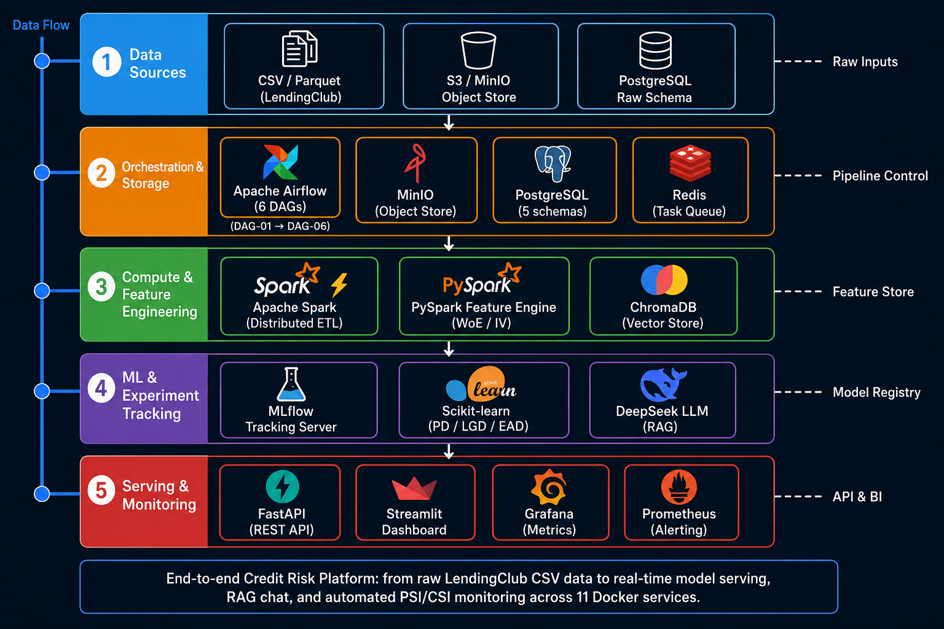
The System We Built — Five Layers
11 Docker services · docker compose up -d and the whole platform is running

Slide 5
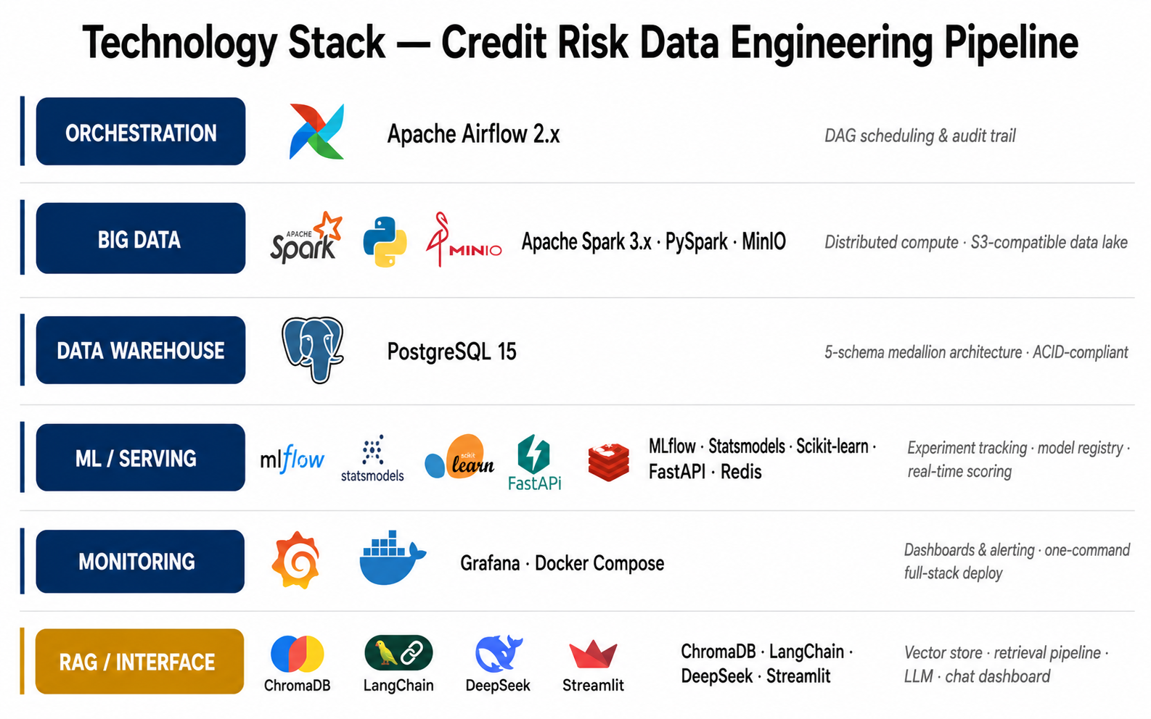
The Technology Stack
Every tool chosen deliberately — one concern per layer

Slide 6
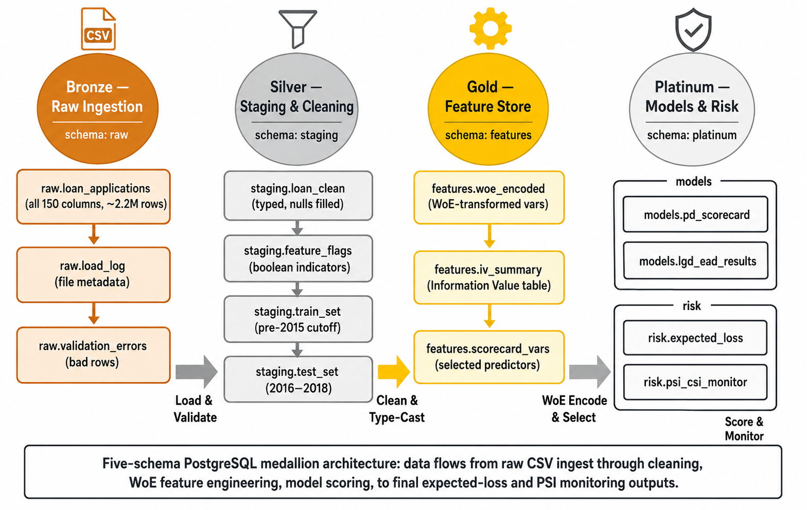
Data Has a Lifecycle — The Medallion Architecture
Five PostgreSQL schemas · data only moves forward, never backward
BRONZE raw · append-only
SILVER cleaned · validated
GOLD models · risk outputs

Slide 7
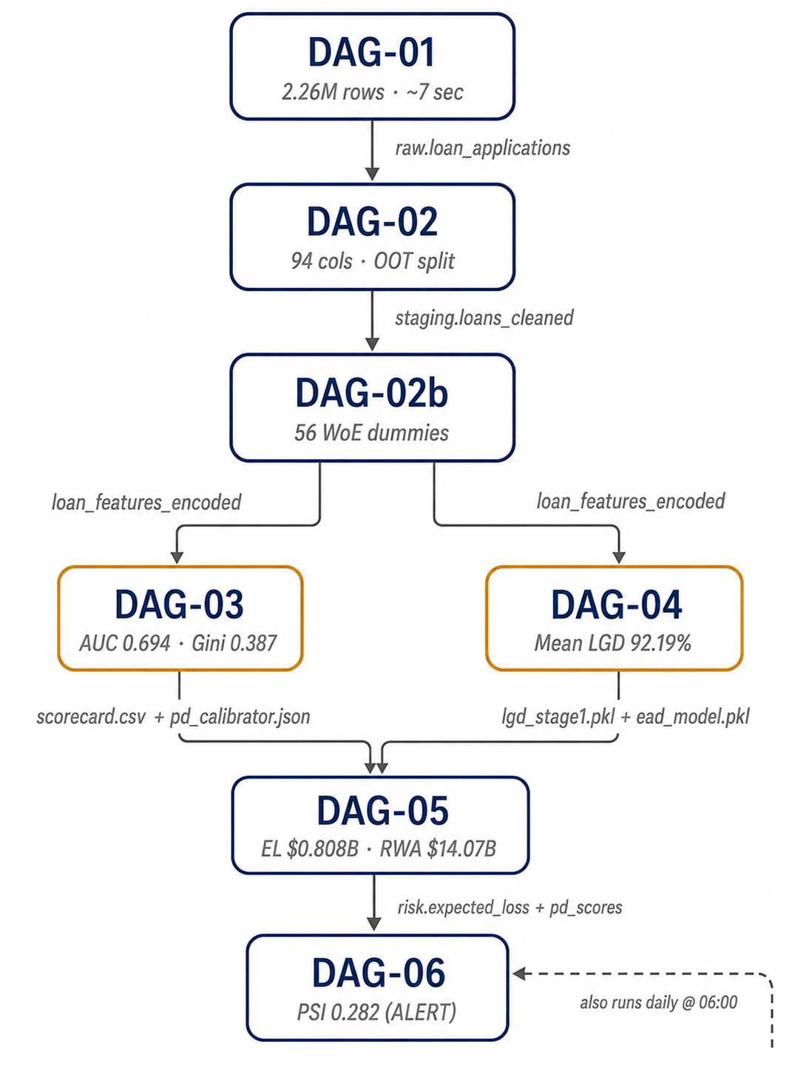
Six Pipelines — One for Each Engineering Concern
Each DAG owns exactly one stage · DAGs are sequentially dependent, never skip a step
DAG-01 Ingest
DAG-02 Validate
DAG-03 Features
DAG-04 Train / Register
DAG-05 Score / ECL
DAG-06 Monitor

Slide 8
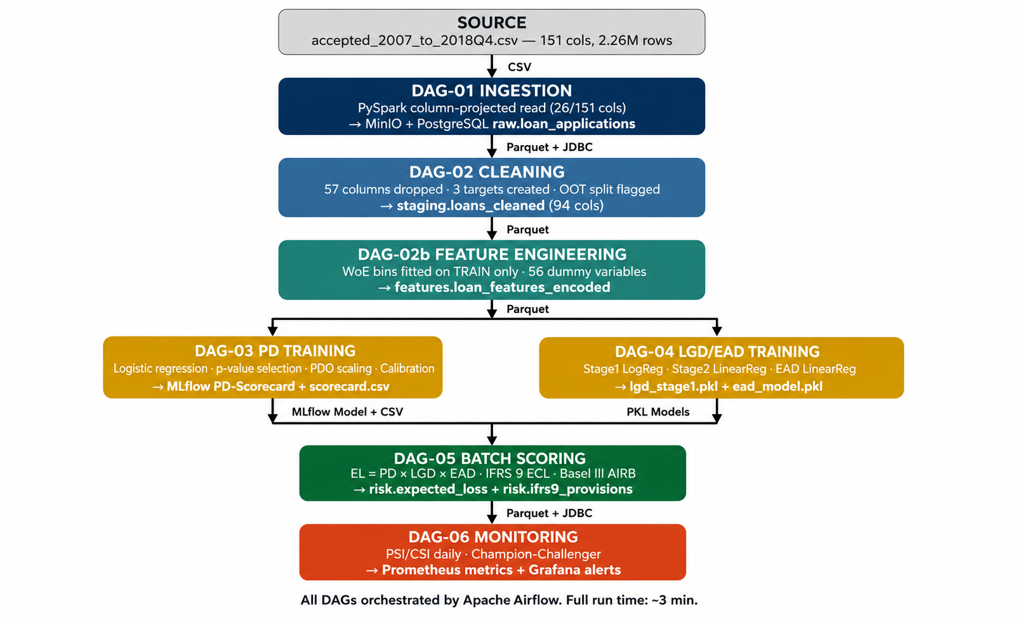
End-to-End Data Flow
Raw CSV → provisions and capital in under 3 minutes

Slide 9
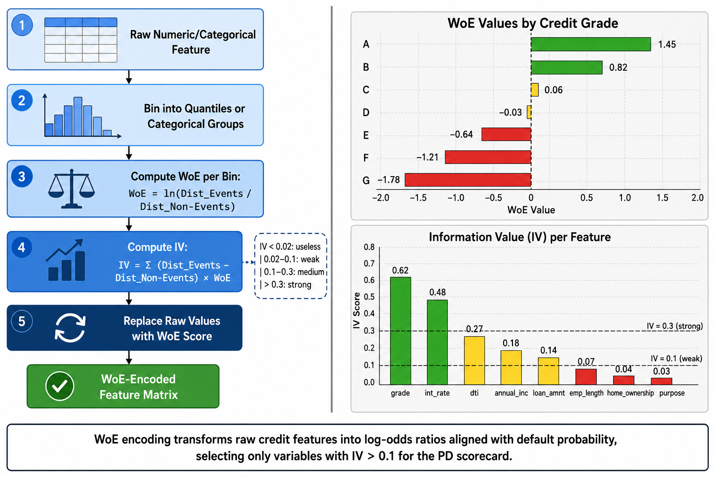
Feature Engineering — The Discipline That Protects the Model
16 raw predictors → 56 WoE dummy variables · IV > 0.02 threshold
WoE bins fitted on 831,152 TRAINING loans ONLY — applied unchanged to 538,515 OOT test loans to prevent look-ahead bias

Slide 10
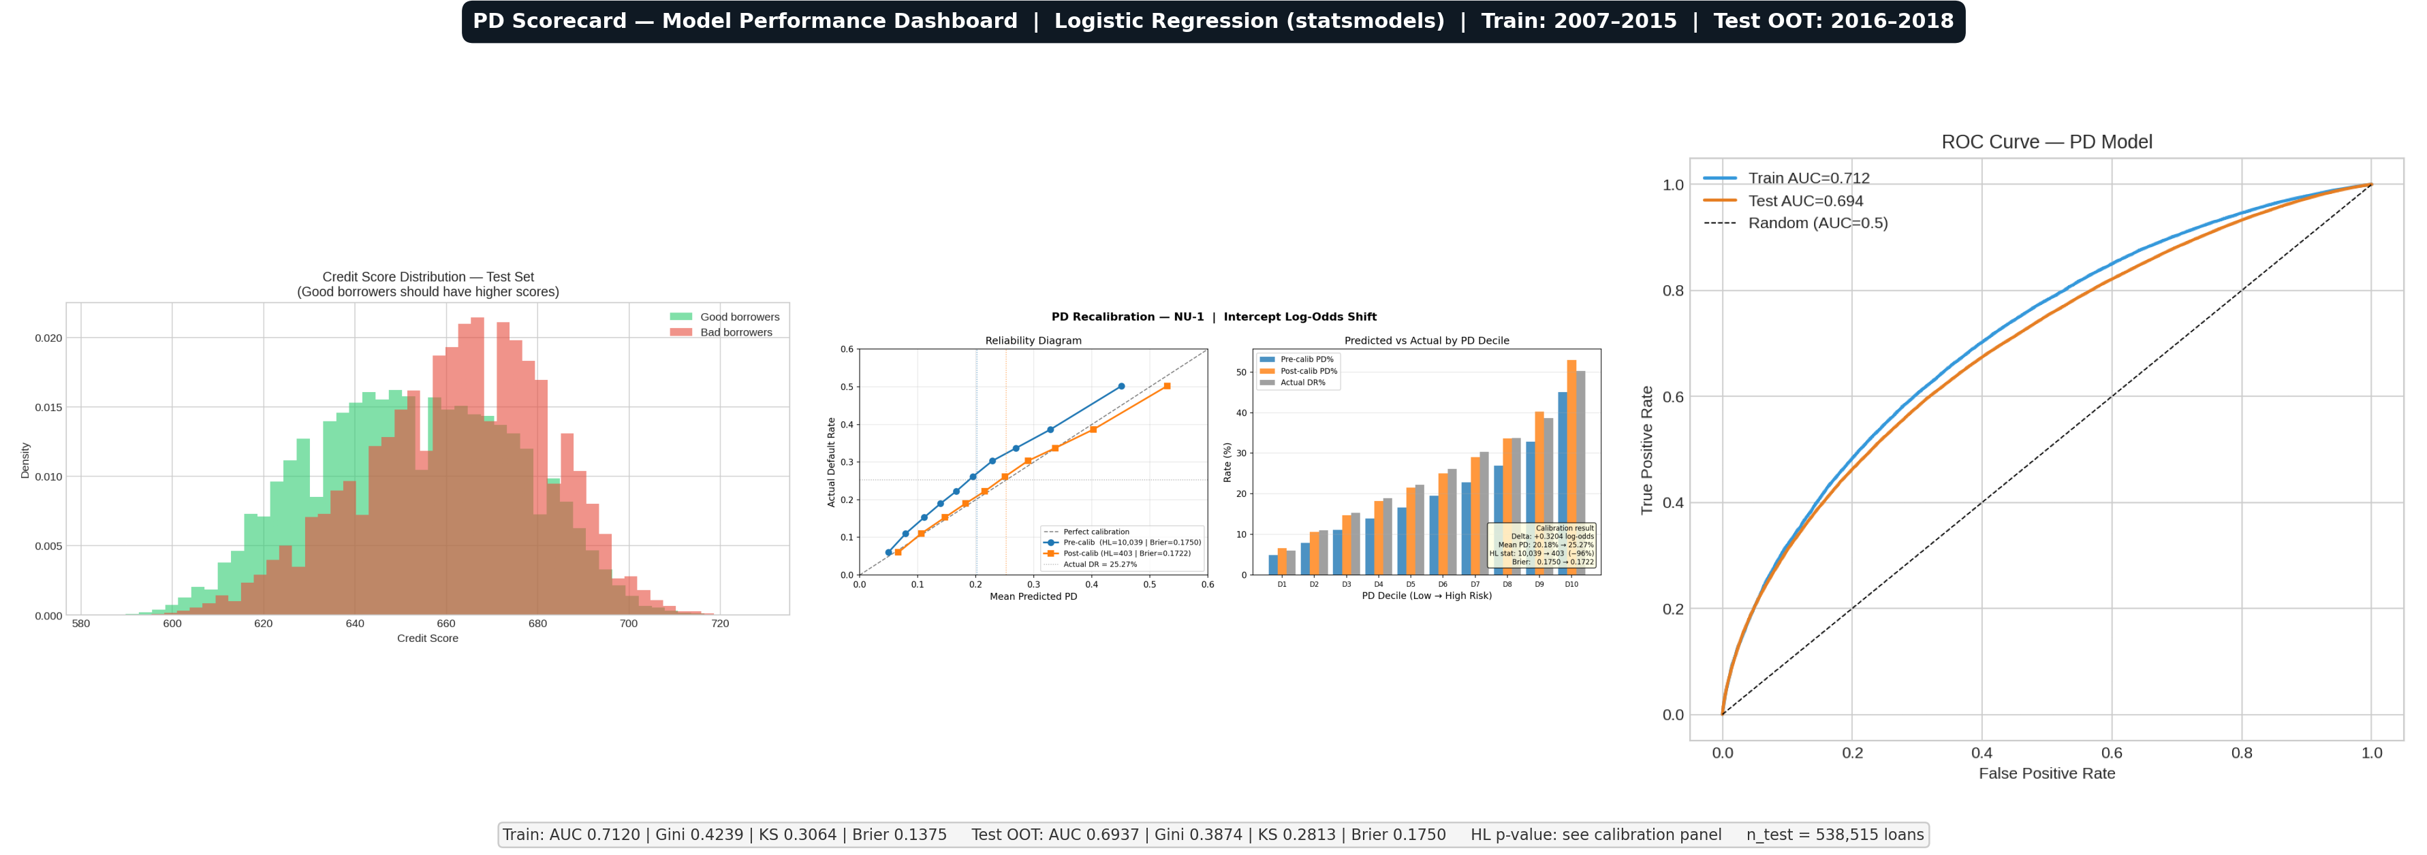
The PD Scorecard — Does It Actually Work?
Tested on 538,515 loans the model never saw during training
0.694
0.387
0.281
0.172
AUC (OOT)
Gini (OOT)
KS (OOT)
Brier Score

Slide 11
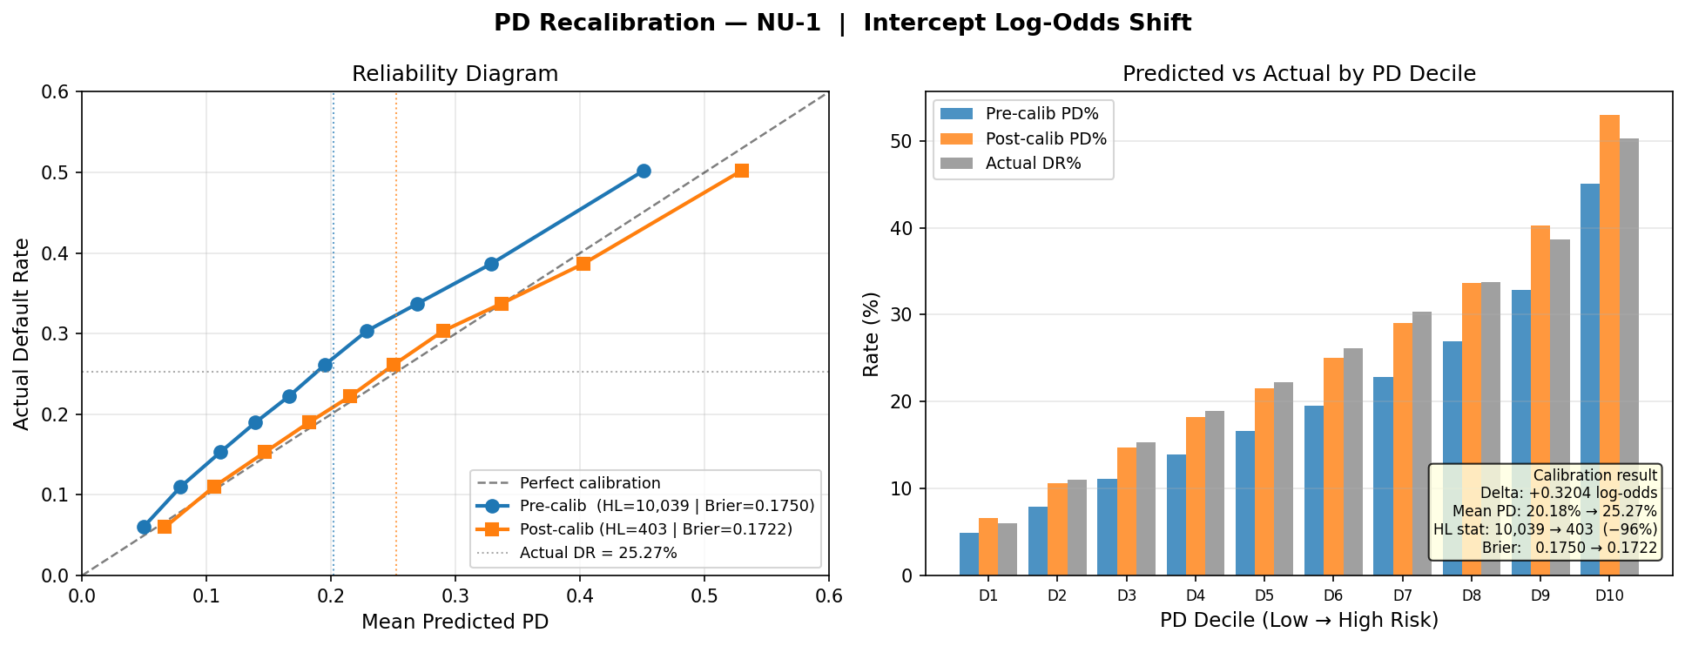
Calibration — Making the Model Tell the Truth
Hosmer-Lemeshow statistic dropped 96% after intercept shift · model now matches reality
20.18%
25.27%
δ = +0.3204
(intercept shift)
Raw Model PD (under-predicts default)
Actual OOT Default Rate (calibration target)
P_calib = σ( logit(P_raw) + δ ) where δ = +0.3204
Hosmer-Lemeshow: 10,039 → 403 after calibration (−96%)
PiT PD → 25.27% (IFRS 9 current conditions) · TtC PD → 15.0% long-run DR (Basel III through-the-cycle)

Slide 12
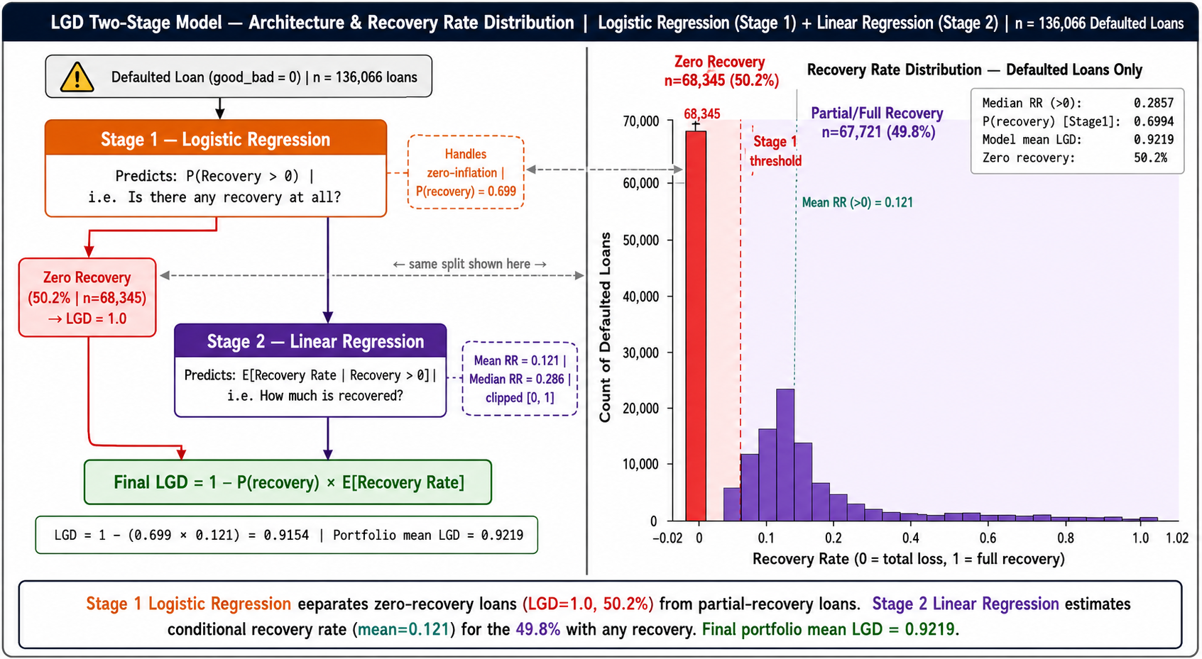
Loss Given Default — Two Models, One Answer
50.2% of defaults recovered nothing · bimodal recovery distribution needs two stages
50.2% Zero Recovery
92.19% Mean LGD
93.76% Downturn LGD
136K Defaulted Loans

Slide 13
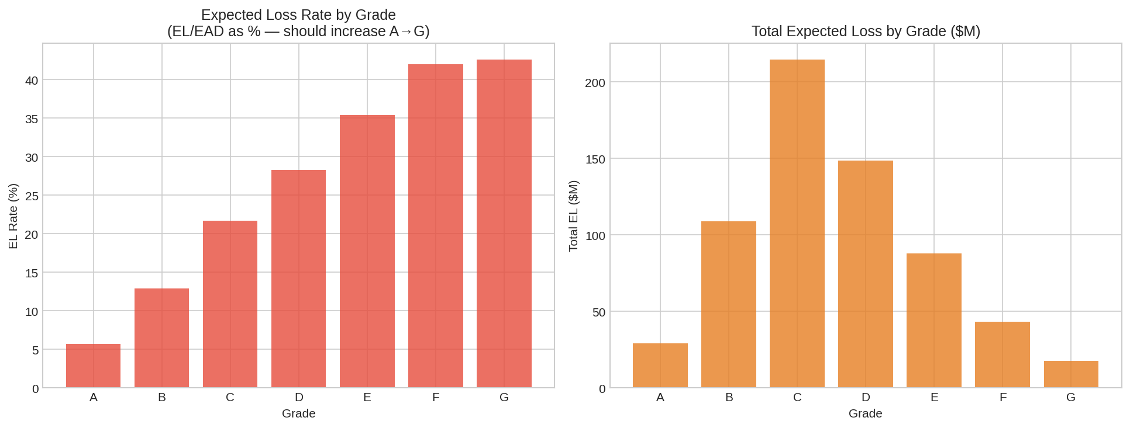
What the Pipeline Produced — The Numbers
538,515 loans scored · computed loan-by-loan in under 3 minutes
$3.26B
$0.808B
Total Exposure at Default
12-month Expected Loss
$1.646B
$1.13B
IFRS 9 Weighted ECL (3-stage)
Basel III Minimum Capital

Slide 14
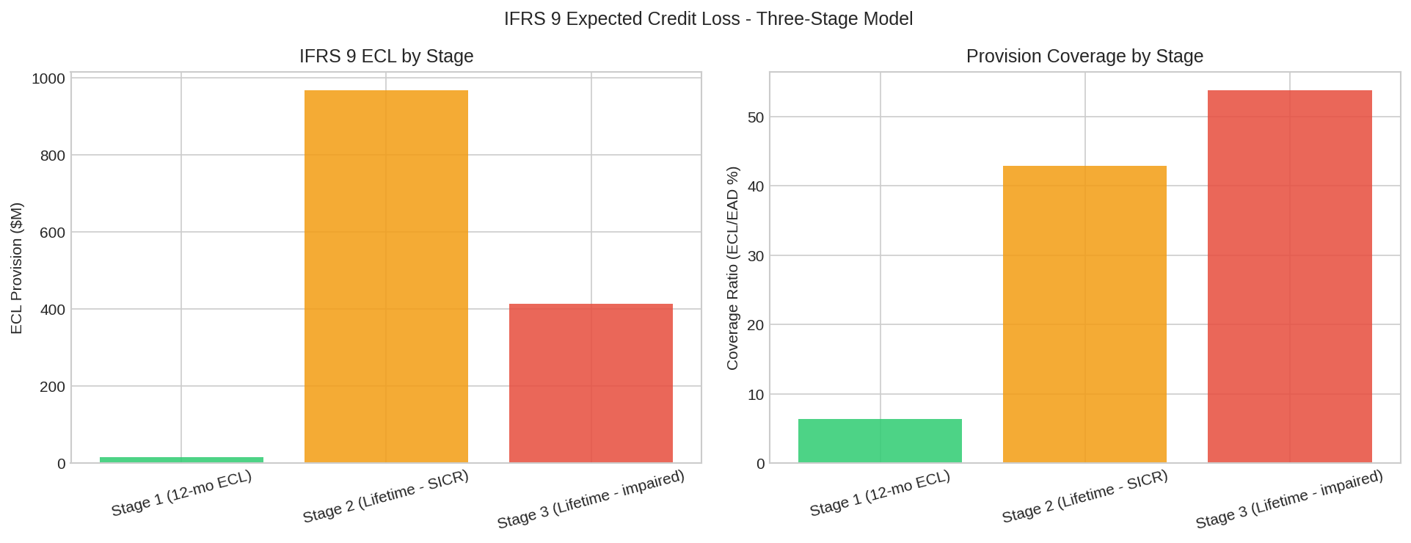
IFRS 9 — The Cost of Looking Forward
Lifetime ECL is $838M more than 12-month EL — the cost of ignoring future default risk
Stage 1
12-month ECL
Stage 2
Lifetime ECL (SICR)
Stage 3
Lifetime ECL (default)
+$838M uplift
+104% vs 12-month EL

Slide 15
Every Model is Governed — MLflow Registry
No model reaches production without passing quality gates and human sign-off (SR 11-7 aligned)
Training
Run
MLflow
(None)
Quality
Gates
Staging
Human
Approval
Production
Quality Gates: AUC > 0.65 · Brier ≤ 0.20 · Monotonic decile ordering · p-values < 0.05 · KS > 0.20
DAG-05 always loads the current Production model version for batch scoring — no hardcoded paths
8 MLflow Experiments: PD-Scorecard · LGD-Stage1 · LGD-Stage2 · EAD-CCF · Portfolio-EL · IFRS9-ECL · Basel-Capital · ScoreCard-Monitoring
Champion-Challenger already implemented: incumbent vs. challenger evaluated monthly on latest OOT window

Slide 16
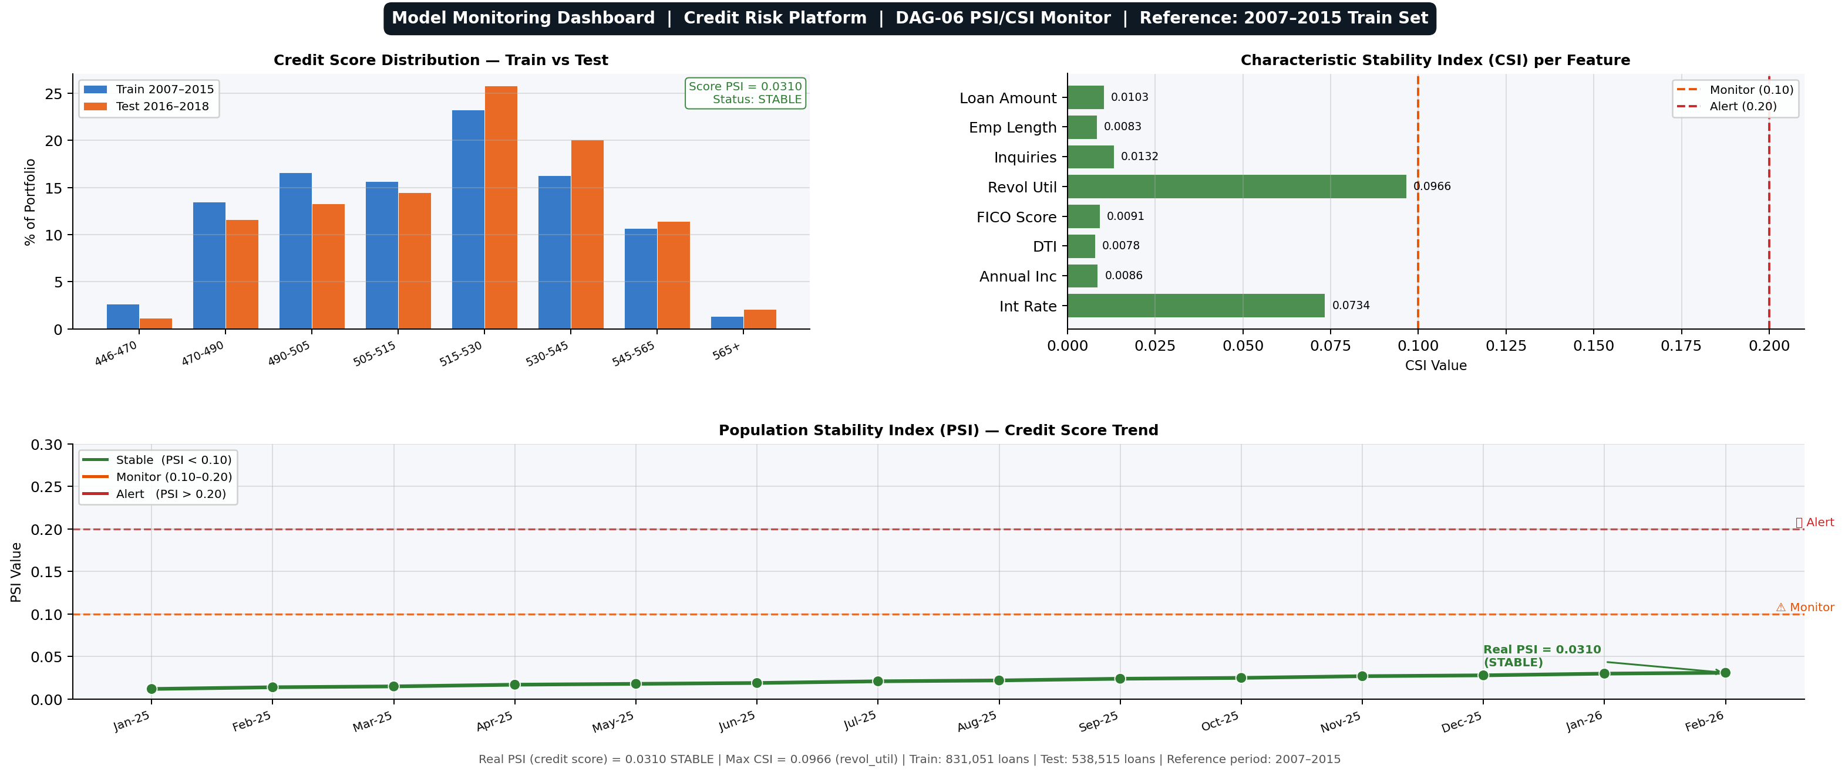
The Model Monitors Itself — PSI Alert Fired
DAG-06 runs at 06:00 daily · automatic alert when population shifts beyond threshold
⚠ PSI = 0.282
Exceeds threshold 0.25
PSI < 0.10 → STABLE
0.10 – 0.25 → MONITOR
PSI > 0.25 → ALERT ← We are here

Slide 17
Real-Time Credit Decisions — Any Loan, Under 200 ms
POST /score → Full credit decision returned before the applicant finishes typing
{
"pd": 0.0421,
< 200ms
"lgd": 0.6200,
"ead": 12500.00,
p99 Latency (FastAPI)
"expected_loss": 326.55,
"credit_score": 672,
~2 ms
"risk_class": "BB",
"decision": "APPROVE",
"ifrs9_stage": 1,
Redis Cache Hit
"adverse_action": [],
"model_version": "2.0",
ECOA
"calc_date": "2026-06-07"
}
Adverse Action Codes

Slide 18
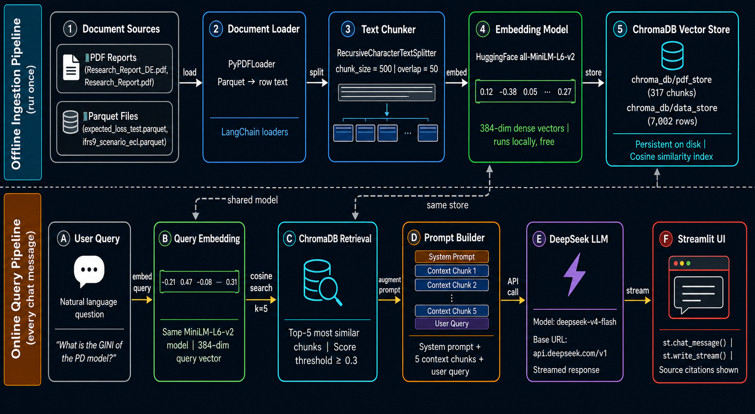
Ask the Pipeline Anything — RAG Chat Interface
ChromaDB · LangChain · DeepSeek · Streamlit · data never leaves the environment
Example Queries
"What is our Gini coefficient on OOT data?"
"Explain the LGD two-stage model."
"Average expected loss for Grade G loans?"
317 PDF chunks + 7,000+ loan-level records
indexed in ChromaDB vector store

Slide 19
Three Things to Remember
01
We built the whole thing — end to end
Ingestion · Cleaning · Feature Engineering · Training · Calibration · Scoring · Monitoring · Real-Time API · RAG Chat
02
Every engineering decision has a business consequence
Column projection saved 53 s/run · OOT-only WoE prevented look-ahead bias · Calibration corrected a 5 pp prediction error
03
PSI = 0.282 is a success, not a failure
An alert firing means the monitoring system is working exactly as designed · The model can now be retrained with confidence

Slide 20
Questions?
We are happy to demo the live Streamlit dashboard or the RAG chat interface.
SOPHON Rachana · LOT Soklang · DUK Pagnarith · LENG Devid
Supervisor: Lecturer Vesal Khean
Department of Applied Mathematics and Statistics · ITC · 2025–2026

