Slide 1
Mondrian Conformal Prediction for Uncertainty
Quantification in ER Discrete-Event Simulation Surrogates
Full Project Results + Publication-Rigor Upgrade
G Venugopalan (CB.AI.U4AID25115) | Vipin Sudhakar (CB.AI.U4AID25166) | Rithvik Arulprakash (CB.AI.U4AID25148) | Harshith Kv (CB.AI.U4AID25119)
Course: 23AID201

Slide 2
MOTIVATION
Problem Statement
• Surrogate models are fast, learned approximations of expensive simulations, increasingly used to guide decisions in stochastic service systems - ER staffing, queueing networks, etc.
• A point prediction alone isn't enough for a decision like "will adding 2 more doctors bring wait time down enough?" - that needs a calibrated interval, not just a number.
• Gaussian Processes are the established way to get one, but are expensive to train and rely on distributional assumptions rather than a finite-sample guarantee.
• Conformal Prediction (CP) is distribution-free with a finite-sample coverage guarantee and is cheap to calibrate - but it's only been validated for surrogate models in a narrow set of domains so far.
2 / 21

Slide 3
LITERATURE
Research Gap
Gopakumar et al. (2026) validate Conformal Prediction for surrogate-model UQ —
but only in physics domains: PDEs, magnetohydrodynamics (MHD), weather, fusion.
The paper states two explicit limitations:
• Marginal coverage only — no guarantee of coverage within specific subgroups/conditions.
• Relies on an exchangeability assumption between calibration and test data — untested under distribution shift.
Neither limitation has been tested outside physics simulation. Discrete-event / queueing systems are a fundamentally different domain — stochastic discrete arrivals and departures, resource contention, priority scheduling — not continuous PDE fields. This is the gap this project sits in.
3 / 21

Slide 4
APPROACH
Why Mondrian CP
The problem with standard CP
What Mondrian CP does about it
• Standard CP calibrates one pooled quantile across every scenario in the calibration set — only guarantees coverage on average.
• A pooled interval is calibrated on average difficulty, so it can badly fail exactly the scenarios that matter most (understaffed + high demand), while wasting width on easy ones (overstaffed + low demand).
• Averaged coverage can look fine while specific operating conditions quietly fail.
• Calibrates a separate quantile per category — here, staffing tercile x arrival-rate tercile — instead of one pooled quantile.
• Each category gets its own, individually honest coverage guarantee instead of borrowing strength from categories that don't resemble it.
• Directly targets Gopakumar et al.'s marginal-coverage limitation — the first place it's been tested outside physics simulation.
4 / 21

Slide 5
PIPELINE
Methodology Overview
Discrete-Event Simulation
SimPy, calibrated on real ED data
Surrogate Model
Gradient boosting, trained on DES scenario sweep
Uncertainty Quantification
GP baseline vs. Standard CP vs. Mondrian CP
Each stage validated against the previous before moving on:
• DES output validated against real aggregated ED statistics (91.0% match to real daily volume).
• Surrogate accuracy validated against DES outputs held out from training (MAE / RMSE / R²).
• GP baseline, standard CP, Mondrian CP all evaluated on the same fixed test split and target coverage (α = 0.1), so every method is directly comparable.
• Standard/Mondrian CP calibrated on a separate 1200-scenario set — never the surrogate's own training data, since reusing training residuals would understate the true residual spread.
5 / 21

Slide 6
DATA
Real-World Data Used
Hospital Triage and Patient History Data (Kaggle, maalona)
Yale New Haven Health System, retrospective study, March 2014 – July 2017
560,486
972
3
258.2 / day
total ED visits
variables per visit
EDs (1 academic + 2 community)
calibrated rate, Dept. A
What we extracted — real vs. literature-calibrated (disclosed explicitly, not blended silently):
From real data
From literature (not in dataset)
• Arrival pattern by 4-hour bin, day of week, month
• ESI acuity mix (triage severity distribution)
• Department-level daily visit rate
• Service/treatment time per ESI level (log-normal)
• Dataset has no discharge timestamp — confirmed by
‒ exhaustive search across all 972 columns
6 / 21

Slide 7
RESULTS
DES Validation
Metric (200 simulated days) | Value
Real visits/day (Dept. A) | 258.2
Simulated mean visits/day | 235.1
Match | 91.0%
The ~9% shortfall is expected, not a calibration flaw: patients still queued when a simulated 24h day ends are right-censored out of that day's stats rather than carried into a "next day," since each run is meant to be one independent sample for surrogate training, not a continuous rollout. This censoring effect resurfaces later in the exchangeability stress test (Slide 13).
7 / 21

Slide 8
RESULTS
Surrogate Model Accuracy
Target | MAE | RMSE | R²
n_patients | 9.90 | 12.59 | 0.929
mean_wait_minutes | 8.86 | 13.23 | 0.787
mean_total_minutes | 9.88 | 13.61 | 0.762
p95_wait_minutes | 66.94 | 102.47 | 0.647
Gradient boosting (HistGradientBoostingRegressor), trained on 5000 DES scenarios sweeping staffing and arrival-rate combinations. p95_wait_minutes fits worst — a tail statistic from one noisy simulated day depends heavily on the specific stochastic realization, not just the two scenario parameters. This matters later in the exchangeability stress test.
8 / 21

Slide 9
RESULTS
GP Baseline (the benchmark)
Target | Target coverage | Empirical coverage | Mean width
n_patients | 90% | 88.5% | 39.3
mean_wait_minutes | 90% | 87.7% | 43.6
mean_total_minutes | 90% | 88.8% | 43.4
p95_wait_minutes | 90% | 90.1% | 350.3
GP undercovers on 3 of 4 targets — expected, since it relies on distributional assumptions rather than a finite-sample guarantee. This is the gap the rest of the project tests whether CP / Mondrian CP can close.
9 / 21

Slide 10
RESULTS
Standard Conformal Prediction
Target | Sym. coverage | Sym. width | Asym. coverage | Asym. width
n_patients | 92.1% | 43.6 | 92.0% | 43.6
mean_wait_minutes | 89.0% | 47.2 | 88.7% | 47.2
mean_total_minutes | 90.2% | 46.4 | 89.6% | 47.2
p95_wait_minutes | 90.8% | 362.9 | 89.7% | 355.6
Two nonconformity measures tested: symmetric |y − yhat|, and an asymmetric version using separate upper/lower residual quantiles for skewed targets. CP already lands closer to the 90% target than GP, with no systematic undercoverage bias — but it's still a single pooled quantile, so it only guarantees coverage on average, not within any specific scenario.
10 / 21

Slide 11
RESULTS — CORE FINDING
Mondrian CP Closes the Gap
Target | Pooled coverage (staff=Low / arrival=High) | Mondrian coverage (same category) | Target
mean_wait_minutes | 68.2% | 90.9% | 90%
mean_total_minutes | 80.7% | 92.0% | 90%
p95_wait_minutes | 72.7% | 92.0% | 90%
The worst pooled-CP category is consistently staff=Low/arrival=High — understaffed during a demand surge, the scenario that matters most operationally. A pooled quantile is calibrated on average difficulty, so it silently fails exactly this scenario while overcovering the easy one (staff=High/arrival=Low hits 100% pooled coverage — wasted width). Mondrian gives the hard category an honestly wider interval instead of pretending it's as easy as the rest.
n_patients is the one target where Mondrian does not help — its pooled coverage was already fairly uniform across categories (87–99%), so there was no real conditional gap to fix, and splitting into 9 smaller calibration cells just adds finite-sample noise. That's an honest, expected Mondrian CP tradeoff, not a failure.
11 / 21

Slide 12
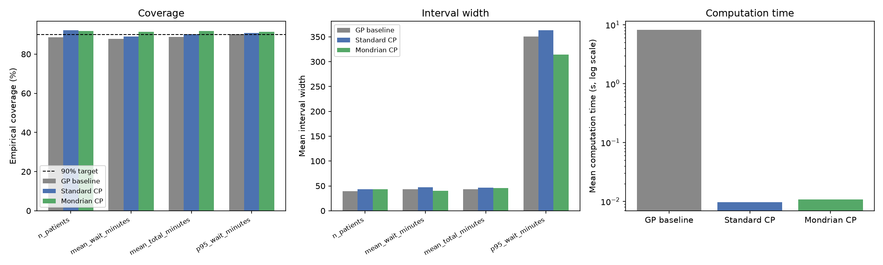
RESULTS
GP vs. Standard CP vs. Mondrian CP
CP calibrates ~650–1000x faster than GP (~0.01s vs. 7–11.5s). Mondrian CP's marginal coverage matches or beats standard CP's despite ~9x smaller per-category calibration slices, and is also usually narrower — pooling was wasting width in easy categories. (Single-split result — see the 30-repeat validated version on the next slide.)
12 / 21

Slide 13
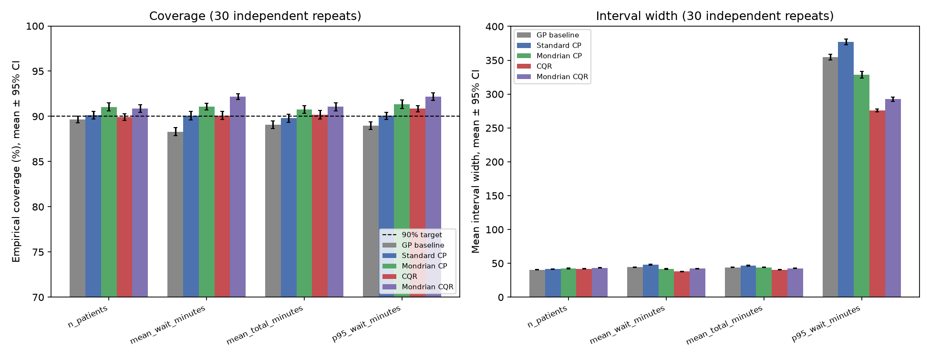
RESULTS — VALIDATED
All 5 Methods, 30 Independent Repeats
Error bars are 95% CI on the mean across 30 independent calibration/test draws — tight enough to read as single dots, meaning these differences are stable, not single-split noise. CQR (adaptive, quantile-regression-based) joins the comparison as a fifth method.
13 / 21

Slide 14
RESULTS
Exchangeability Stress Test
Arrival multiplier | n_patients | mean_wait | mean_total | p95_wait
1.3 (in range) | 93.3% | 83.0% | 88.0% | 82.0%
1.5 | 78.7% | 68.7% | 73.7% | 69.7%
1.8 | 70.3% | 42.7% | 47.3% | 43.0%
2.0 | 64.7% | 34.3% | 39.0% | 33.0%
3.0 | 31.7% | 12.3% | 4.7% | 78.3%*
Standard CP shown (Mondrian tracks closely). Root cause, verified directly: the gradient-boosting surrogate cannot extrapolate past its training range — mean_wait_minutes's prediction is frozen at 42.4 for every multiplier from 1.3 to 3.0 while the true value keeps climbing.
*p95_wait's apparent recovery at 3.0x isn't the interval working — it's the Slide 7 day-boundary censoring effect getting worse at extreme overload (fewer patients finish within a day, shrinking the completed-visit pool the p95 is computed over).
Both stated Gopakumar et al. limitations are now tested in this domain.
14 / 21

Slide 15
PUBLICATION-RIGOR UPGRADE
Statistical Rigor: 30 Independent Repeats
Every result so far was a single train/test split — no way to tell if a number like "68.2% coverage" was a robust effect or one unlucky draw. Repeated the full GP / standard-CP / Mondrian-CP pipeline across 30 independent (calibration, test) draws.
Target | Method | Coverage (mean ± 95% CI) | Width (mean ± 95% CI)
mean_wait_minutes | GP | 88.31% ± 0.47% | 44.4 ± 1.1
mean_wait_minutes | Standard CP | 90.09% ± 0.46% | 48.0 ± 1.5
mean_wait_minutes | Mondrian CP | 91.07% ± 0.35% | 41.7 ± 1.4
p95_wait_minutes | GP | 88.97% ± 0.44% | 354.6 ± 11.5
p95_wait_minutes | Standard CP | 90.06% ± 0.39% | 377.1 ± 12.6
p95_wait_minutes | Mondrian CP | 91.35% ± 0.46% | 328.6 ± 13.4
Paired t-test (same 30 draws underlie all methods): Mondrian CP's coverage advantage over both standard CP and GP is significant at p < 0.001 on every one of the 4 targets, most p-values below 1e-05. With averaging, Mondrian CP's coverage now sits consistently above 90% while GP consistently undercovers — a statistically defensible claim, not just a directionally suggestive one.
15 / 21

Slide 16
PUBLICATION-RIGOR UPGRADE
CQR: A Stronger, Adaptive Baseline
Conformalized Quantile Regression (CQR) calibrates an interval that adapts to the local spread predicted by quantile regressors, instead of one fixed width (standard CP) or one fixed width per category (Mondrian CP) built from a mean predictor.
Target | Standard CP | Mondrian CP | CQR | Mondrian CQR
p95_wait_minutes (coverage) | 90.1% | 91.4% | 90.9% | 92.2%
p95_wait_minutes (width) | 377.1 | 328.6 | 275.6 | 292.7
CQR dominates standard CP outright on p95_wait_minutes — equal-or-better coverage, ~27% narrower interval (p < 0.005). Against Mondrian CP it's a genuine tradeoff: slightly lower coverage, but narrower — different points on the same coverage/width frontier. Combining both ideas (Mondrian CQR) wins on both axes simultaneously for p95_wait_minutes — higher coverage AND narrower than Mondrian CP alone. The five methods form a real frontier, not a strict ranking: each adds value in a different way.
16 / 21

Slide 17
PUBLICATION-RIGOR UPGRADE
Robustness Check: A Second Surrogate
Trained an MLP (neural network) surrogate — nearly identical in-distribution accuracy to gradient boosting (R² within ~0.01 on every target) — and re-ran the exchangeability stress test to see if the coverage collapse was specific to tree-based extrapolation.
n_capacity=30 | Arrival 1.0x | Arrival 1.3x | Arrival 2.0x | Arrival 3.0x | True (3.0x)
GBR prediction | 240.5 | 247.8 | 247.8 (frozen) | 247.8 (frozen) | 280.9
MLP prediction | 234.8 | 245.8 | 336.5 | 521.2 | 280.9
Counter-intuitive result: the true DES output saturates at extreme overload (the same day-boundary censoring effect from Slide 7 — fewer patients finish within a day). GBR's frozen prediction happens to land close to that saturating value by coincidence (error ~33). The MLP keeps extrapolating the upward trend it learned near the training boundary and overshoots massively (error ~240, 7x worse) — n_patients and mean_total_minutes both hit exactly 0% coverage with the MLP by 2.0x severity, worse than GBR's 31.7%/4.7% at 3.0x. The ability to extrapolate is not automatically better than not being able to — confidently-wrong extrapolation is worse than frozen-but-plausible extrapolation here. Strengthens the exchangeability finding: the breakdown isn't one architecture's quirk.
17 / 21

Slide 18
PUBLICATION-RIGOR UPGRADE
Generalizability: A Second Department
Recalibrated the entire pipeline — DES, surrogate, CP — on Department B (166,497 visits, roughly half A's volume, meaningfully different ESI acuity mix — a community rather than academic site) to test whether the core finding is specific to one department.
Target | Dept. B: pooled (worst category) | Dept. B: Mondrian | Dept. A (for comparison)
mean_wait_minutes | 76.2% | 89.3% | 68.2% -> 90.9%
mean_total_minutes | 81.0% | 90.5% | 80.7% -> 92.0%
p95_wait_minutes | 81.0% | 86.9% | 72.7% -> 92.0%
Same worst category (understaffed + high demand) in both independent sites, similar correction magnitude from Mondrian CP, same wasted-width pattern on the easy category. Honest difference worth keeping: n_patients behaves differently between sites — a real conditional gap appears in Department B that wasn't present in A, and Mondrian helps there this time. That's disclosed, not smoothed over — and it's part of what makes the replication credible rather than suspiciously perfect.
18 / 21

Slide 19
SUMMARY
What We Accomplished
• Built and validated an ER discrete-event simulation (SimPy) calibrated on real hospital arrival data — 91.0% match to real daily patient volume.
• Generated a 5000-scenario training sweep and trained a surrogate model with strong accuracy on 3 of 4 targets (R² 0.76–0.93).
• Implemented and compared 5 UQ methods — GP baseline, standard CP, Mondrian CP, CQR, and Mondrian CQR — all on the same test data and target coverage.
• Demonstrated Mondrian CP closing a real marginal-vs-conditional coverage gap (68–81% pooled coverage in the hardest category, corrected to 91–92%), validated with paired significance tests (p < 0.001) across 30 independent repeats, not a single lucky split.
• Ran an exchangeability stress test across 8 severity levels with two structurally different surrogate architectures, and root-caused the coverage collapse to a specific, verified mechanism in each case, not just "it broke."
• Replicated the core finding at a second, independent department with different volume and acuity mix — the marginal-vs-conditional gap Mondrian CP closes is not a one-site artifact.
19 / 21

Slide 20
VERDICT
Did We Meet Our Novelty Target?
The claim was to test Gopakumar et al. (2026)'s two stated CP limitations — marginal coverage, exchangeability — outside the physics domains they validated CP in, using a discrete-event / queueing simulation surrogate instead.
• Marginal coverage limitation: tested, and now statistically validated (p < 0.001, 30 repeats) and replicated at a second, independent site.
• Exchangeability limitation: tested with two structurally different surrogate architectures — confirmed to break down outside the training distribution regardless of architecture, with a specific, verified root cause in each case rather than a generic "performance degrades" claim.
Yes — both limitations were tested in a domain they hadn't been tested in before, with concrete, statistically validated, cross-architecture and cross-site answers, not just a single replication of the base paper's physics-domain results.
20 / 21

Slide 21
HONESTY CHECK
Limitations & What's Left
• Service/treatment time is literature-calibrated, not derived from the dataset — the dataset has no discharge timestamp. Disclosed explicitly throughout, not blended silently into the "real data" story.
• Generalizability tested across 2 of the dataset's 3 departments (one academic, one community) — both replicate the core finding, but the third department and other health systems entirely are still untested.
• The exchangeability breakdown was tested with 2 surrogate architectures (gradient boosting, MLP) — both fail outside the training range, via different mechanisms. Other architecture families (e.g. a GP-as-surrogate) are untested.
• Literature review (30 papers, 3 in depth) still in progress.
• This is a working results deck, not the final end-sem PPT — that will follow the instructor's specific guidelines once shared.
21 / 21

