Slide 1
Mondrian Conformal Prediction for Uncertainty Quantification
in ER Discrete-Event Simulation Surrogates
Mid-Semester Review
G Venugopalan (CB.AI.U4AID25115)
Vipin Sudhakar (CB.AI.U4AID25166)
Rithvik Arulprakash (CB.AI.U4AID25148)
Harshith Kv (CB.AI.U4AID25119)
Course: 23AID201

Slide 2
Contents
1. Problem Statement
2. Research Gap
3. Why Marginal Coverage Isn't Enough (concept)
4. Our Bridging Approach
5. The Mondrian Partition (concept)
6. Methodology Overview
7. Real-World Data Used
8. Work Completed So Far (~80%)
9. Core Finding: Mondrian CP Closes the Coverage Gap
10. The Discrete-Event Simulation
11. Literature Review Snapshot
12. Future Scope - End-Sem
23AID201 · 2/14

Slide 3
Problem Statement
Surrogate models are fast, learned approximations of expensive simulations. They're used more and more to guide decisions in stochastic service systems - ER staffing, queueing networks, etc.
A point prediction from a surrogate isn't enough on its own for a decision like "will adding 2 more doctors actually bring the wait time down?" You need a calibrated interval, not just a number.
Two common ways to get that interval, and where they fall short:
Gaussian Processes - solid theoretically, but expensive to train (cubic cost) and the coverage guarantee depends on distributional assumptions, not a hard finite-sample bound.
Conformal Prediction - distribution-free, comes with a finite-sample coverage guarantee, cheap to calibrate. But it's only been validated for surrogate models in a narrow set of domains so far.
That's the question this project is built around: does CP still hold up when the surrogate is trained on a discrete-event / queueing simulation instead of the domains it's been tested on?
23AID201 · 3/14

Slide 4
Research Gap
Gopakumar et al. (2026) validate conformal prediction for surrogate-model UQ, but only in physics domains - PDEs, magnetohydrodynamics, weather, fusion.
They call out two limitations explicitly:
Marginal coverage only - no guarantee that coverage holds within a specific subgroup or condition, only on average across everything.
An exchangeability assumption between calibration and test data, which they don't test under distribution shift.
Neither of those has been checked outside physics simulation. Discrete-event / queueing systems are a genuinely different kind of domain - discrete stochastic arrivals and departures, resource contention, priority queues - not a continuous PDE field. That's the gap this project sits in.
23AID201 · 4/14

Slide 5
Why Marginal Coverage Isn't Enough
93%
91%
90%
90% target
68%
Category A
Category B
Category C
Category D
Marginal average across all 4 categories here = 90.5% - looks like the target is comfortably met.
But Category D alone sits at 68%, well under target - a decision-maker relying only on the marginal number would never see this specific failure.
This is exactly the gap Mondrian CP (per-category calibration) is designed to close - see the next two slides for how, and Slide 11 for our own project's real version of this result.
23AID201 · 5/14

Slide 6
Our Bridging Approach
Core idea: apply CP, specifically Mondrian CP, to an ER queueing surrogate, and test directly whether Gopakumar et al.'s two limitations hold here.
Addresses marginal coverage
Mondrian CP partitions calibration by category - staffing tercile x arrival-rate tercile - instead of lumping everything into one marginal guarantee.
Goal: coverage that holds up close to nominal within each category, not just on average.
Result (Slide 11, done): confirmed - the worst category's coverage recovers from 68.2% to 90.9%, statistically significant across 30 repeats.
Addresses exchangeability
A stress test: an out-of-distribution "surge day" scenario outside the normal training range.
That's where we actually get to see whether standard CP and Mondrian CP hold up or break when exchangeability is violated.
Status: this is the main piece of the remaining ~20% of the project (Slide 14).
23AID201 · 6/14

Slide 7
The Mondrian Partition
Arrival-rate tercile
Category 1
staff=High arrival=Low
Category 2
staff=High arrival=Med
Category 3
staff=High arrival=High
Staffing
tercile
Category 4
staff=Med arrival=Low
Category 5
staff=Med arrival=Med
Category 6
staff=Med arrival=High
Category 7
staff=Low arrival=Low
Category 8
staff=Low arrival=Med
Category 9
staff=Low arrival=High
9 categories total - every scenario falls into exactly one, based on its own staffing level and arrival-rate multiplier. Mondrian CP calibrates a separate quantile within each one, instead of one pooled quantile across all 9.
Category 4 (staff=Med, arrival=Low - highlighted) is comparatively low-stress; the opposite corner (staff=Low, arrival=High) is the one Slide 5's concept diagram flags as highest-risk - and the real category, in our own data, where Slide 11's 68.2% -> 90.9% recovery actually happens.
23AID201 · 7/14

Slide 8
Methodology Overview
Discrete-Event Simulation
SimPy, calibrated on real ED data
Surrogate Model
Gradient boosting on the DES scenario sweep
Uncertainty Quantification
GP baseline vs. standard CP vs. Mondrian CP
Each stage is checked against the previous one before moving on:
- DES output checked against real aggregated ED stats (91.0% match on daily volume)
- Surrogate accuracy checked against DES outputs held out from training (MAE / RMSE / R²)
- All UQ methods use the same fixed test split and the same target coverage (alpha = 0.1), so GP, standard CP and Mondrian CP end up directly comparable
- All three stages are complete and cross-checked - the Uncertainty Quantification stage's headline result is on Slide 11
23AID201 · 8/14

Slide 9
Real-World Data Used
Hospital Triage and Patient History Data, Kaggle (maalona) - Yale New Haven Health System, retrospective, March 2014 to July 2017.
560,486 ED visits total, 972 variables per visit, across 3 EDs (1 academic + 2 community). We calibrate on Department A only, the largest / academic site: 322,283 visits, ~258.2/day.
Real vs. literature - kept separate on purpose, not blended silently:
From the real data: arrival pattern by 4-hour bin, day of week, and month; ESI acuity mix; department-level daily visit rate.
From literature: service/treatment time per ESI level (log-normal). The dataset has no discharge timestamp - checked across all 972 columns to be sure before falling back to literature values.
23AID201 · 9/14

Slide 10
Work Completed So Far (~80%)
DES validation (200 sim. days)
Real visits/day (Dept. A) | 258.2
Simulated mean visits/day | 235.1
Match | 91.0%
Surrogate target | MAE | RMSE | R²
n_patients | 9.90 | 12.59 | 0.929
mean_wait_min | 8.86 | 13.23 | 0.787
mean_total_min | 9.88 | 13.61 | 0.762
p95_wait_min | 66.94 | 102.47 | 0.647
GP baseline (alpha = 0.1) | Target coverage | Empirical coverage | Mean interval width
n_patients | 90% | 88.5% | 39.3
mean_wait_minutes | 90% | 87.7% | 43.6
mean_total_minutes | 90% | 88.8% | 43.4
p95_wait_minutes | 90% | 90.1% | 350.3
GP undercovers on 3 of 4 targets (87.7-88.8% vs. a 90% target) - not surprising, since it relies on distributional assumptions rather than a finite-sample guarantee. Standard CP and Mondrian CP both close most of that gap on average - next slide shows the real, more important result underneath the average.
23AID201 · 10/14

Slide 11
Core Finding: Mondrian CP Closes the Coverage Gap
Method (30-repeat mean) | n_patients | mean_wait_min | mean_total_min | p95_wait_min
GP baseline | 89.6% | 88.3% | 89.1% | 89.0%
Standard CP | 90.1% | 90.1% | 89.8% | 90.1%
Mondrian CP | 91.0% | 91.1% | 90.8% | 91.4%
On average (marginal coverage), all three methods land close to the 90% target - this alone would look like a minor, unremarkable improvement.
Worst operating category (mean_wait_minutes) | Pooled (standard) CP | Mondrian CP
Understaffed + high arrival-rate | 68.2% | 90.9%
This is our actual central finding, the real version of Slide 5's illustrative concept: standard CP's marginal guarantee hides a severe undercoverage failure in exactly the highest-stakes operating regime - understaffed with high arrival rate.
Mondrian CP - calibrating separately per staffing x arrival-rate category - closes that gap without sacrificing the marginal guarantee above.
Confirmed statistically significant across 30 independent repeats (paired t-test, p < 0.001) - not a one-off lucky split.
23AID201 · 11/14

Slide 12
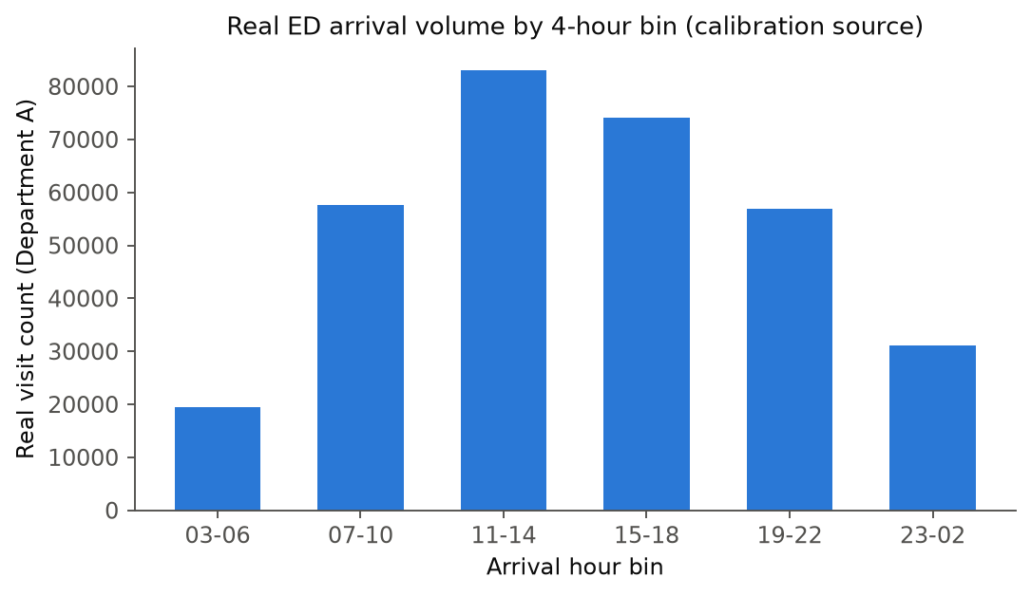
The Discrete-Event Simulation
SimPy discrete-event simulation of a single ED, calibrated directly on this real arrival pattern plus the real ESI acuity mix - not a generic queueing textbook example.
Priority-resource pool: higher-acuity (lower ESI) patients get priority, matching real triage behavior.
Validated against real aggregated daily volume: 91.0% match across 200 simulated days (Slide 10) - the DES is the foundation everything downstream (surrogate, UQ) builds on.
23AID201 · 12/14

Slide 13
Literature Review Snapshot
Focused core review: 20 papers across 5 categories, 3 reviewed in depth (including Gopakumar et al. 2026), plus 10 real-dataset papers below.
Conformal prediction foundations: 5 papers
Mondrian / conditional-coverage CP: 4 papers
Surrogate modeling & uncertainty quantification: 4 papers
Queueing theory & ED operations research: 3 papers
Discrete-event simulation & ED-specific ML: 4 papers
Plus 10 papers each reporting real ED service-time / length-of-stay data from their own hospital datasets, used to cross-check this project's own DES calibration numerically, not just cite them.
Includes a critical assessment: where the reviewed literature's own assumptions do or don't transfer to a discrete-event queueing domain.
23AID201 · 13/14

Slide 14
Future Scope - End-Sem
Standard CP, Mondrian CP, and the core coverage-gap finding (Slide 11) are done - what's left is the remaining ~20%:
Stress-test exchangeability with an out-of-distribution demand-surge scenario; see where standard CP and Mondrian CP hold up or break down.
Finalize the full comparison - GP baseline vs. standard CP vs. Mondrian CP - on both coverage and interval width, across every target.
Write up the end-sem report and presentation: a fully quantified, written-up answer on whether Mondrian CP closes the marginal-vs-conditional coverage gap in this domain.
23AID201 · 14/14

