Slide 1
AIML COURSE PROJECT · 23AID205 · END-SEMESTER REVIEW
Deepfake Detection on FaceForensics++:
Why Detectors Score Unseen Fakes Below Chance
XceptionNet vs. a CNN-ViT hybrid, and a follow-up study of a surprising failure: detectors that rank unseen fakes as more real than real faces.
Venugopalan Gangadharan · Vipin Sudhakar · Rithvik Arulprakash · Harshith Kv
AI & Data Science — Amrita Vishwa Vidyapeetham, Coimbatore

Slide 2
INTRODUCTION
Motivation, Problem & Objectives
▸ Deepfakes are a real misinformation and fraud risk, but detectors are usually judged on the same manipulation type they were trained on.
▸ Problem: a detector at 99% on its own manipulation can fail badly on a new one, and that failure is invisible until deployment.
▸ Objective 1: compare XceptionNet (CNN) and a CNN-ViT hybrid on identical data and protocol: does self-attention generalize better?
▸ Objective 2: measure same-method accuracy, the 4×4 cross-method matrix and compression robustness; show ROC curves; explain failures with Grad-CAM.
▸ Objective 3 (added after the results): explain why some cross-method scores fall below chance, and test a fix.
Deepfake Detection — End-Semester Review (23AID205)
2/23

Slide 3
LITERATURE REVIEW
Related Work
▸ Rössler et al. (ICCV 2019), FaceForensics++: the 4-method benchmark and the XceptionNet baseline (Chollet, CVPR 2017).
▸ Dosovitskiy et al. (ICLR 2021), Vision Transformer: motivates the hybrid's self-attention. Selvaraju et al. (ICCV 2017), Grad-CAM: our interpretability tool.
▸ Li et al. (CVPR 2020), Face X-ray: Xception trained on Deepfakes scores 0.49 on FaceSwap with official data, so FaceSwap is already the hardest target.
▸ Geirhos et al. (Nat. Mach. Intell. 2020), shortcut learning; Durall et al. and Frank et al. (2020), frequency artifacts in generated images.
▸ Gap: below-chance transfer is reported but not explained per manipulation; we give a measurable cue that predicts which cells invert.
Deepfake Detection — End-Semester Review (23AID205)
3/23

Slide 4
METHODOLOGY
End-to-End Pipeline
1
2
3
4
5
6
Raw video
Face crops
Official splits
Train
Evaluate
Analyze
FF++ c23: real + 4 manipulation methods, 5,000 videos
Original: MTCNN, JPEG. Reference: dlib + alignment, PNG
Video-level train / val / test, no identity leakage
One method + real; AMP, early stop; 2–3 seeds
Video AUC on all 4 methods, 95% bootstrap CIs
Image statistics, sign test, intervention, external data
Every reported number is produced by a script from saved per-video scores; nothing is typed by hand.
Deepfake Detection — End-Semester Review (23AID205)
4/23

Slide 5
DATASET & PREPROCESSING
Data: Source and Preparation
▸ FaceForensics++: 1,000 real YouTube videos and 4×1,000 manipulated (Deepfakes, Face2Face, FaceSwap, NeuralTextures), c23 compression, official splits.
▸ Source: a public Kaggle mirror (official access is still pending), so all results are labelled preliminary. An audit found no real-vs-fake differences in encoding.
▸ Original crops: MTCNN, 1.3× margin, 20 frames per video, JPEG (~100k crops). Reference crops: dlib + landmark alignment, 256 px PNG, 32 frames (~105k crops).
▸ External test set: DeepFakeFace (OpenRAIL licence): real IMDB-WIKI photos and fakes from Stable Diffusion and InsightFace, 1,000 sampled per class.
Deepfake Detection — End-Semester Review (23AID205)
5/23

Slide 6
RESULTS · EXPERIMENT 1
Baseline: Same-Distribution Performance
Both models trained and tested on all four manipulation methods (c23).
Model | Video accuracy | Video AUC | Frame AUC
XceptionNet | 97.29% | 0.996 | 0.986
CNN-ViT hybrid | 94.71% | 0.984 | 0.962
XceptionNet leads on every metric. The hybrid's expected advantage did not appear: a negative result, reported as such.
Deepfake Detection — End-Semester Review (23AID205)
8/23

Slide 7
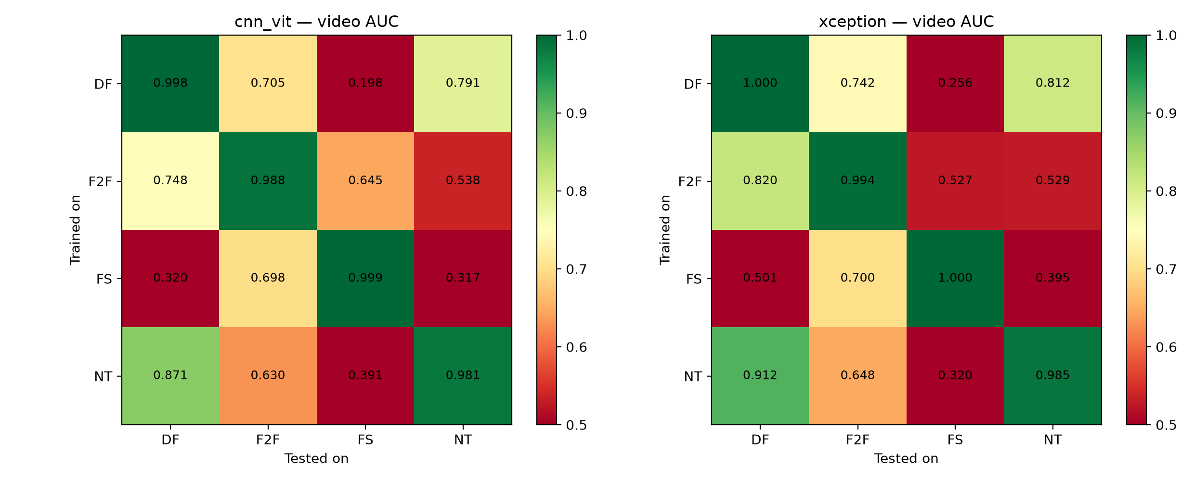
RESULTS · EXPERIMENT 2
Cross-Manipulation Generalization
Train on one method, test on all four. Values below 0.5 mean the detector ranks unseen fakes as more real than real faces.
OBSERVATIONS
0.26
Xception, Deepfakes → FaceSwap
0.20
CNN-ViT, Deepfakes → FaceSwap
0.40 / 0.42
generalization gap, Xception / hybrid
r = 0.94
the two models fail in the same pattern
Deepfake Detection — End-Semester Review (23AID205)
9/23

Slide 8
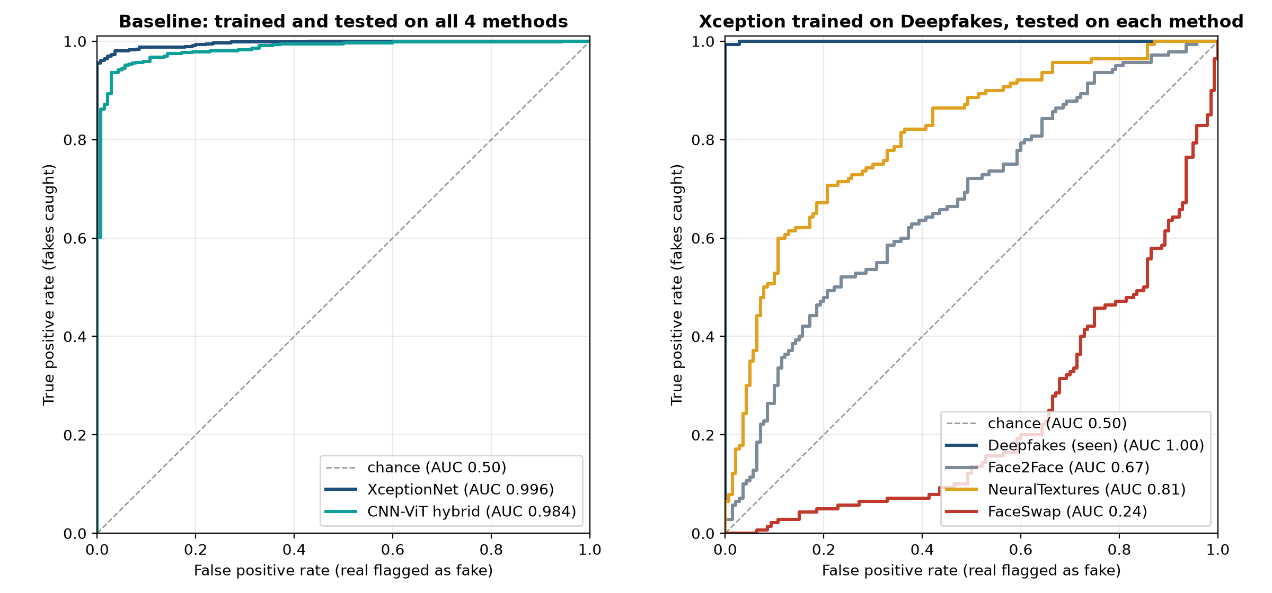
RESULTS · ROC & AUC
ROC Curves: Baseline and Cross-Manipulation
Left: both models, all four methods. Right: Xception trained on Deepfakes; a curve under the diagonal is worse than guessing.
AUC (AREA UNDER ROC)
0.996
XceptionNet, all methods
0.984
CNN-ViT hybrid, all methods
1.00
Deepfakes → Deepfakes (seen)
0.24
Deepfakes → FaceSwap: inverted
Deepfake Detection — End-Semester Review (23AID205)
10/23

Slide 9
RESULTS · EXPERIMENT 3
Compression Robustness
Tested on a c40 proxy (c23 test videos re-compressed); never trained on.
Model | c23 video AUC | c40-proxy video AUC | Drop
XceptionNet | 0.996 | 0.802 | -0.194
CNN-ViT hybrid | 0.984 | 0.817 | -0.166
Both degrade substantially. The hybrid drops slightly less, but on a proxy, not official c40, so this is not claimed as a general result.
Deepfake Detection — End-Semester Review (23AID205)
11/23

Slide 10
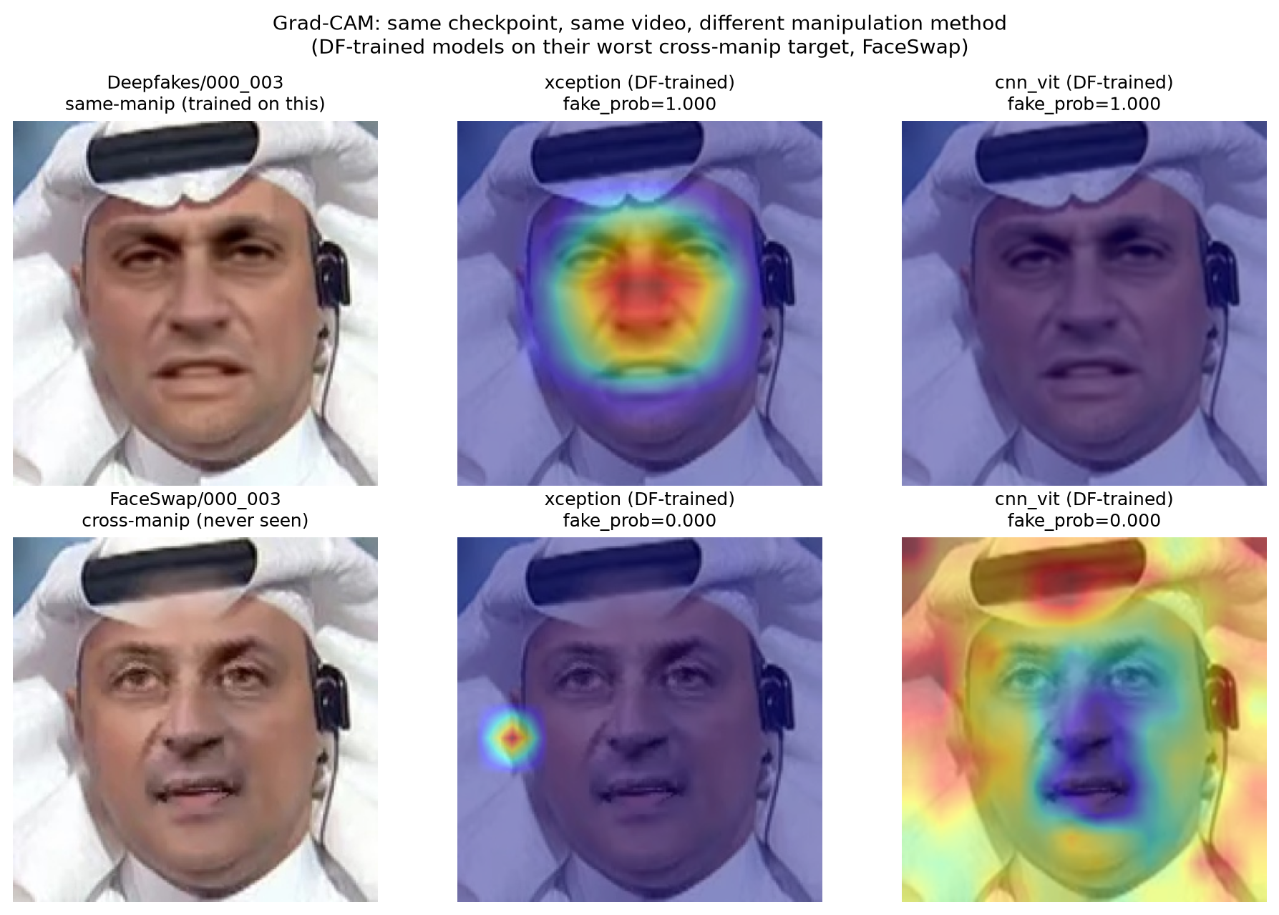
INTERPRETABILITY
Grad-CAM: What the Models Look At
Same Deepfakes-trained checkpoint, same video: its Deepfakes version vs. its FaceSwap version.
READING
Face
in-distribution: attention on the face
Off-face
FaceSwap: Xception attention collapses
Diffuse
FaceSwap: hybrid attention spreads out
0.00
fake probability on the FaceSwap video
Deepfake Detection — End-Semester Review (23AID205)
12/23

Slide 11
RESEARCH EXTENSION
From a Surprising Result to Four Testable Claims
Why do some cross-manipulation cells score below chance? We tested four claims:
C1 · PREPROCESSING
C2 · MECHANISM
▸ Does the inversion depend on how faces are cropped and stored?
▸ Is there a measurable image cue whose direction predicts which cells invert?
C3 · INTERVENTION
C4 · ARCHITECTURE
▸ Does removing that cue during training reduce the inversion?
▸ Do different network architectures fail the same way?
Deepfake Detection — End-Semester Review (23AID205)
13/23

Slide 12
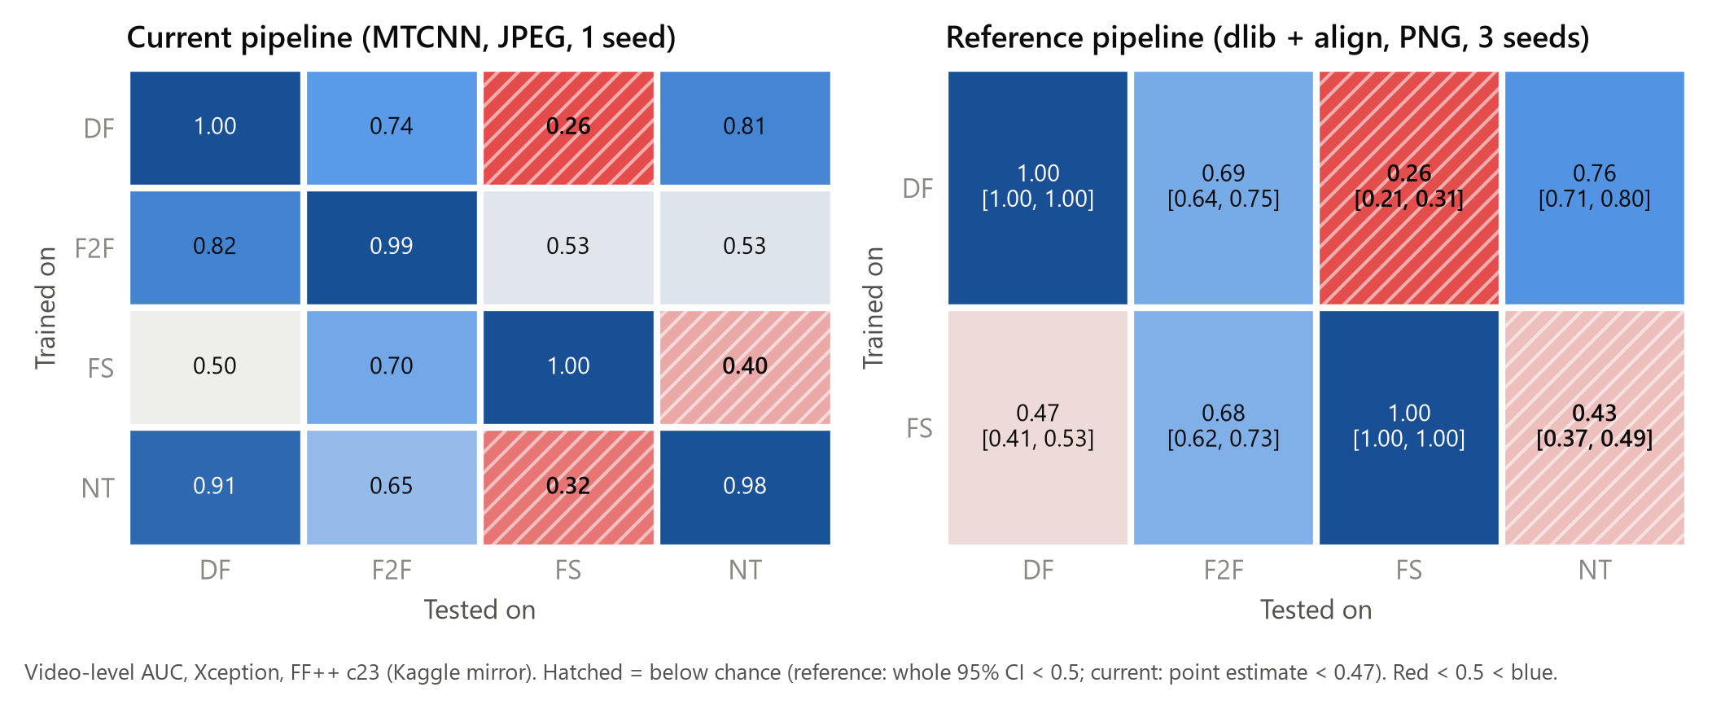
C1 · ROBUSTNESS
The Inversion Survives a Full Pipeline Rebuild
Original vs. reference preprocessing (different detector, alignment, format, size, frames). Hatched = below chance.
REFERENCE PIPELINE, 3 SEEDS
0.26
DF → FS [0.21, 0.31]
0.43
FS → NT [0.37, 0.49]
0.26
DF → FS, original pipeline
17 / 17
data and label audit checks passed
Deepfake Detection — End-Semester Review (23AID205)
14/23

Slide 13
C1 · ROBUSTNESS
No Single Preprocessing Change Moves DF → FS
One factor changed at a time, 2 seeds each; change = paired difference vs. the reference over the same test videos.
Variant | DF → FS | change | FS → NT | change
Reference (3 seeds) | 0.258 | — | 0.428 | —
JPEG quality 95 | 0.286 | +0.028 | 0.442 | +0.013
JPEG quality 75 | 0.290 | +0.032 | 0.472 | +0.044
10 frames per video | 0.271 | +0.013 | 0.422 | -0.006
Tight 1.0× crop | 0.259 | +0.001 | 0.470 | +0.042
Predictions were recorded before these results: they held for JPEG 95 and 10 frames, partly missed for JPEG 75, and failed for the tight crop.
Deepfake Detection — End-Semester Review (23AID205)
15/23

Slide 14
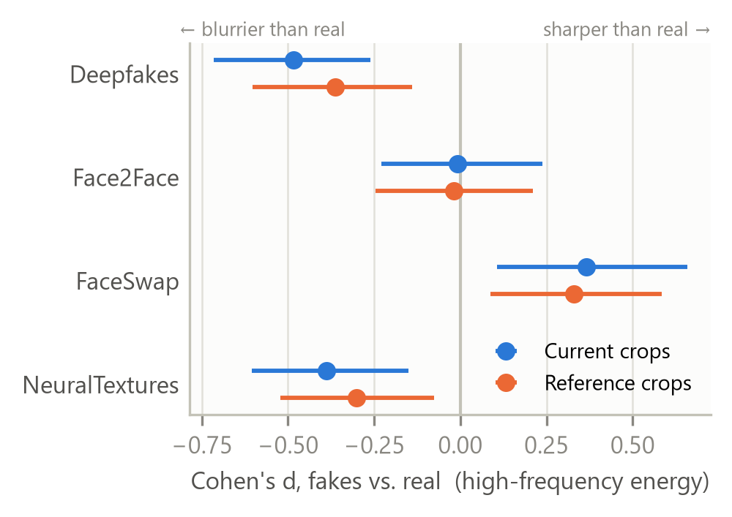
C2 · MECHANISM
Fakes Differ from Real Faces in Sharpness
High-frequency image energy, each manipulation vs. real faces (Cohen's d, 95% CI), in two independent crop sets.
EFFECT SIZE
-0.48
Deepfakes: blurrier than real
-0.39
NeuralTextures: blurrier than real
+0.37
FaceSwap: sharper than real
-0.01
Face2Face: no difference
Deepfake Detection — End-Semester Review (23AID205)
16/23

Slide 15
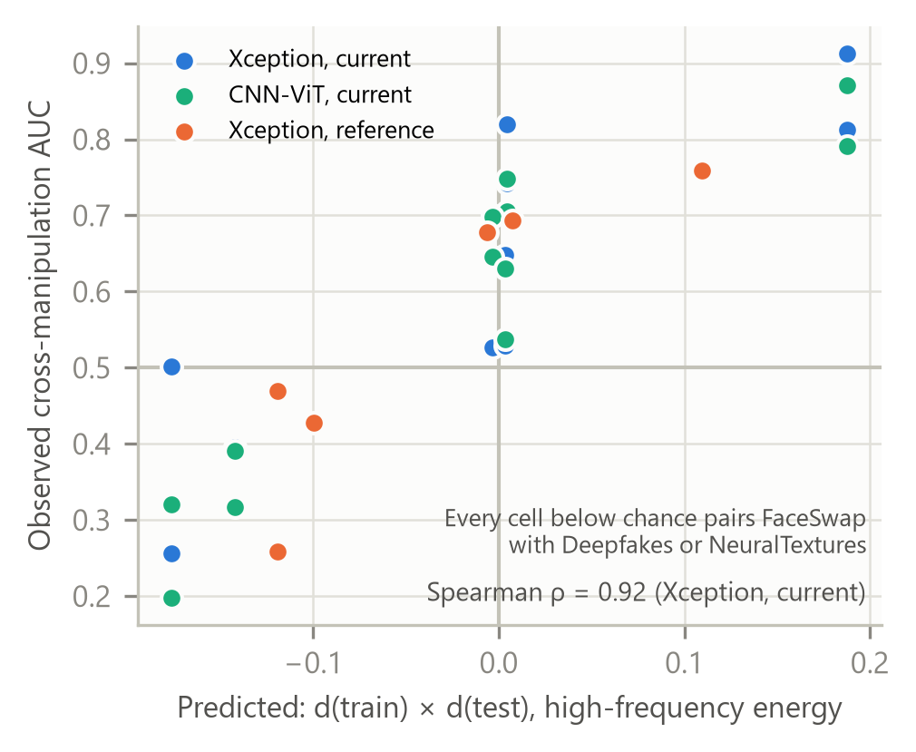
C2 · MECHANISM
The Sharpness Sign Predicts Which Cells Invert
A detector learns "blurrier = fake" from Deepfakes, so FaceSwap's sharper fakes look real to it.
PREDICTION VS. OBSERVED
ρ = 0.92
Xception (best of 24 relabelings)
ρ = 0.92
CNN-ViT hybrid
ρ = 0.73
published official-data matrix
ρ = -0.27
DF model: blurrier real faces look fake
Deepfake Detection — End-Semester Review (23AID205)
17/23

Slide 16
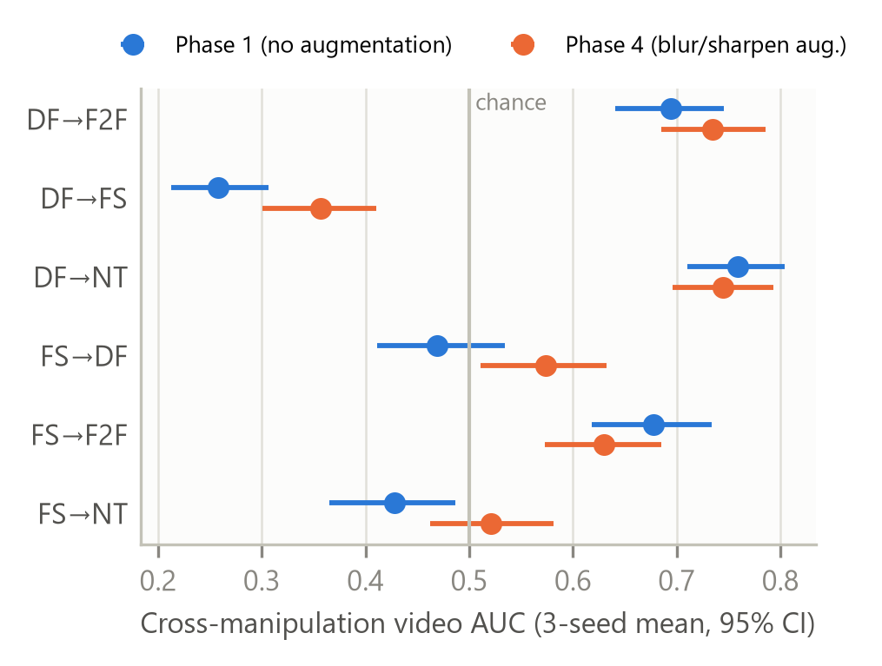
C3 · INTERVENTION
Randomizing Sharpness Partly Fixes It
Training with random blur/sharpen applied to real and fake alike. Paired change vs. the reference, 3 seeds.
CHANGE IN AUC
+0.098
DF → FS, now 0.36 (still below)
+0.093
FS → NT, now 0.52 (at chance)
-0.048
FS → F2F, a small cost
-0.000
in-domain accuracy unchanged
Deepfake Detection — End-Semester Review (23AID205)
18/23

Slide 17
C4 · ARCHITECTURE
Three Architectures Fail the Same Way
ImageNet-pretrained backbones, same 299 px input, reference pipeline.
Backbone | DF → FS | FS → NT | FS → DF | Same call as Xception
Xception (3 seeds) | 0.258 | 0.428 | 0.469 | —
ResNet-50 (2 seeds) | 0.291 | 0.416 | 0.450 | 8 / 8
EfficientNet-B4 (2 seeds) | 0.264 | 0.361 | 0.477 | 8 / 8
Same below / at / above-chance result in every cell. The inversion comes from the training data, not the network.
Deepfake Detection — End-Semester Review (23AID205)
19/23

Slide 18
EXTERNAL CHECK
The Rule Does Not Transfer to a New Dataset
DeepFakeFace, no retraining. Its fakes are all blurrier than its real faces, so DF-trained should transfer and FS-trained invert.
Generator | Sharpness d | DF-trained AUC | FS-trained AUC
SD inpainting | -0.26 | 0.463 [0.44, 0.49] | 0.514 [0.49, 0.54]
InsightFace swap | -0.52 | 0.654 [0.63, 0.68] | 0.491 [0.46, 0.52]
SD text-to-image | -0.40 | 0.323 [0.30, 0.34] | 0.399 [0.38, 0.42]
Prediction correct in 2 of 4 decided cells, no better than chance. The sharpness account explains FaceForensics++, not other datasets.
Deepfake Detection — End-Semester Review (23AID205)
20/23

Slide 19
CONCLUSION
Verdict on the Four Claims
C1 · PREPROCESSING — NOT SUPPORTED
C2 · MECHANISM — SUPPORTED IN FF++
▸ Survives every preprocessing change tested
▸ Detector, alignment, format, size, frames, JPEG, crop
▸ Sharpness sign predicts our and published matrices
▸ Fails on DeepFakeFace: within-benchmark only
C3 · INTERVENTION — PARTIAL
C4 · ARCHITECTURE — SUPPORTED
▸ Randomizing sharpness: +0.1 AUC on inverted cells
▸ DF → FS still below chance
▸ Xception, ResNet-50, EfficientNet-B4 agree 8 / 8
▸ Set by the training data, not the model
Deepfake Detection — End-Semester Review (23AID205)
21/23

Slide 20
LIMITATIONS & FUTURE WORK
What This Study Cannot Claim, and Next Steps
LIMITATIONS
FUTURE WORK
▸ Kaggle mirror, not official FF++ (access pending)
▸ Mechanism is a strong candidate, not proof
▸ Sharpness predicts direction, not effect size
▸ Course comparison confounded by pretraining
▸ One 6 GB laptop GPU limited the grid
▸ Re-run on official FaceForensics++
▸ Find the cue behind the remaining DF → FS gap
▸ Explain the DeepFakeFace behaviour
▸ Submit a short paper (draft in paper/main.pdf)
Deepfake Detection — End-Semester Review (23AID205)
22/23

Slide 21
REFERENCES & CONTRIBUTORS
Closing
▸ Rössler et al., FaceForensics++, ICCV 2019 · Chollet, Xception, CVPR 2017
▸ Dosovitskiy et al., Vision Transformer, ICLR 2021 · Selvaraju et al., Grad-CAM, ICCV 2017
▸ Li et al., Face X-ray, CVPR 2020 · Geirhos et al., Shortcut learning, Nat. Mach. Intell. 2020
▸ Durall et al., CVPR 2020 · Frank et al., ICML 2020 · Song et al., DeepFakeFace, arXiv 2023
CONTRIBUTORS
▸ Venugopalan Gangadharan — CB.AI.U4AID25115
▸ Vipin Sudhakar — CB.AI.U4AID25166
▸ Rithvik Arulprakash — CB.AI.U4AID25148
▸ Harshith Kv — CB.AI.U4AID25119
GITHUB REPOSITORY
github.com/DUNE-ODYSSEY/deepfake-detection
Deepfake Detection — End-Semester Review (23AID205)
23/23

