Slide 1
AIML COURSE PROJECT · 23AID205 · MID-REVIEW
Deepfake Detection:
XceptionNet vs. CNN-ViT Hybrid on FaceForensics++
Data pipeline complete, baseline results in. Cross-manipulation generalization, compression robustness, and final conclusions to follow at the final review.
Venugopalan Gangadharan · Vipin Sudhakar · Rithvik Arulprakash · Harshith Kv
AI & Data Science — Amrita Vishwa Vidyapeetham, Coimbatore

Slide 2
INTRODUCTION
Motivation, Problem & Objectives
▸ Deepfakes have moved from research curiosity to a real misinformation/fraud vector -- but published detectors usually report one headline accuracy number, on the same manipulation type and compression level they trained on.
▸ Problem: that number is misleading in practice -- a detector at 99% in a paper can collapse the moment the test distribution shifts, and that failure is invisible until deployment.
▸ Objective 1: fairly compare XceptionNet (CNN baseline) vs. a CNN-ViT hybrid (ResNet + Transformer) on identical data/protocol -- does global self-attention actually improve generalization?
▸ Objective 2: measure same-distribution accuracy, full 4×4 cross-manipulation generalization, and compression robustness -- not just one number.
▸ Objective 3: explain *why* generalization succeeds or fails (Grad-CAM), and ship a working, testable live demo -- not only offline metrics.
Deepfake Detection — XceptionNet vs. CNN-ViT (23AID205)
2/10

Slide 3
LITERATURE REVIEW
Directly Related Work
▸ Rössler, A. et al. (2019). FaceForensics++: Learning to Detect Manipulated Facial Images. ICCV. — source of the dataset and the standard 4-method/3-compression benchmark protocol this project follows; also the paper XceptionNet is drawn from as the baseline detector.
▸ Chollet, F. (2017). Xception: Deep Learning with Depthwise Separable Convolutions. CVPR. — the CNN baseline architecture, still a standard reference detector for this exact task in the FF++ literature.
▸ Dosovitskiy, A. et al. (2021). An Image is Worth 16x16 Words: Transformers for Image Recognition at Scale. ICLR. — motivates the Transformer-encoder half of this project's CNN-ViT hybrid and its global self-attention mechanism.
▸ Selvaraju, R. R. et al. (2017). Grad-CAM: Visual Explanations from Deep Networks via Gradient-based Localization. ICCV. — the interpretability method used to explain why cross-manipulation generalization fails.
▸ Gap identified: most FF++-benchmark work reports same-distribution accuracy only; head-to-head CNN vs. attention-based generalization comparisons, paired with an interpretability layer, are comparatively under-studied — the specific gap this project addresses.
Deepfake Detection — XceptionNet vs. CNN-ViT (23AID205)
3/10

Slide 4
METHODOLOGY
End-to-End Pipeline
1
2
3
4
5
6
Raw video
Face extraction
Official splits
Train
Evaluate
Analyze
FF++ c23, 5 folders: real + 4 manipulation methods
MTCNN crop, 20 frames/video, margin 1.3x
video-level train/val/test — no identity leakage
AMP, class-balanced sampler, cosine LR, early stop
frame + video-level Acc/F1/AUC on held-out test
cross-manip matrix, gap, Grad-CAM, live demo
Steps 1-3 (data) and step 4-5 for Experiment 1 are complete as of this review -- steps 4-6 continue for Experiments 2 & 3.
Deepfake Detection — XceptionNet vs. CNN-ViT (23AID205)
4/10

Slide 5
DATASET & PREPROCESSING
Data: Source & Preparation — Complete
▸ FaceForensics++ (FF++): 5,000 videos — 1,000 real (YouTube interviews) + 4×1,000 manipulated (Deepfakes, Face2Face, FaceSwap, NeuralTextures), all sharing the same real-video identities. c23 compression, official FF++ folder layout (Kaggle mirror).
▸ Official video-level train/val/test splits used throughout — critical, since random frame-level splits would leak identity between train/test and inflate accuracy.
▸ Preprocessing: MTCNN face detection on GPU, 20 frames/video, 1.3x crop margin (captures blending-boundary artifacts), resized to 299×299 (native for XceptionNet, downsampled to 224 for the hybrid).
▸ Result: ~99,987 face crops across all 5,000 videos — the full dataset is preprocessed and ready; this stage is complete.
▸ Official c0/c40 access still pending — being handled with a documented workaround, to be shown at the final review.
Deepfake Detection — XceptionNet vs. CNN-ViT (23AID205)
5/10

Slide 6
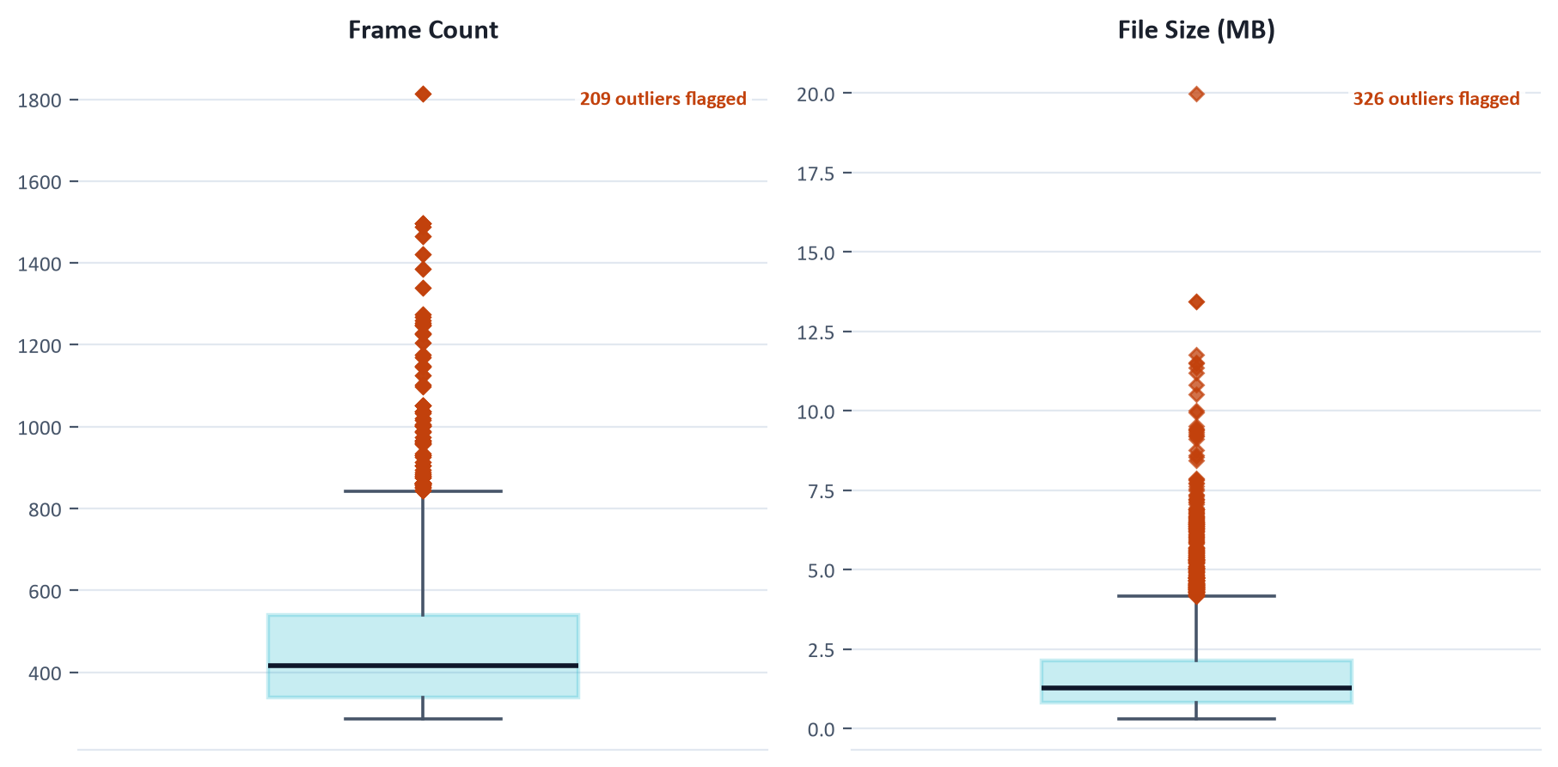
EDA
Data Quality: Outlier Check (IQR)
Per-video metadata (frame count, file size) checked via box-plot IQR across all 5,000 videos before committing to full preprocessing.
RESULT
5,000
videos analyzed (real + 4 methods)
209
flagged on frame count (4.2%)
326
flagged on file size (6.5%)
502
unique outliers overall (10.0%)
Deepfake Detection — XceptionNet vs. CNN-ViT (23AID205)
6/10

Slide 7
ALGORITHM SELECTION
Models: XceptionNet vs. CNN-ViT Hybrid
XCEPTIONNET (BASELINE)
CNN-VIT HYBRID
▸ Depthwise-separable CNN (Chollet 2017), ImageNet-pretrained
▸ 2048-d pooled features → dropout → linear → logit
▸ Purely convolutional — local receptive fields only
▸ The standard reference detector for this exact task
▸ ResNet-50 (stages 1-3) → 14×14×1024 map → 512-d tokens + CLS
▸ 6-layer, 8-head Transformer encoder over the tokens
▸ Tests: does global self-attention improve generalization?
▸ Same optimizer/schedule/data — architecture is the only variable
SHARED TRAINING & EVALUATION PROTOCOL (fair comparison — only the architecture differs)
AMP training, AdamW, cosine LR, batch size 32 (GPU-benchmarked — XceptionNet silently throttles above this), early stopping (patience 4 on val AUC). Metrics: Accuracy/F1/AUC at frame & video level (video = mean of frame probabilities).
Deepfake Detection — XceptionNet vs. CNN-ViT (23AID205)
7/10

Slide 8
RESULTS · EXPERIMENT 1 — COMPLETE
Baseline Comparison (same-distribution, c23)
Both models trained and tested on all 4 methods — the first of three planned experiments, complete as of this review.
Model | Video Acc | Video F1 | Video AUC | Frame Acc | Frame AUC
XceptionNet | 97.29% | 0.983 | 0.9958 | 95.49% | 0.986
CNN-ViT Hybrid | 94.71% | 0.967 | 0.9836 | 92.76% | 0.962
XceptionNet leads on every same-distribution metric here. Whether this holds under cross-manipulation and compression shift is what Experiments 2 & 3 will show at the final review.
Deepfake Detection — XceptionNet vs. CNN-ViT (23AID205)
8/10

Slide 9
STATUS
What's Done, What's Next
DONE
PLANNED FOR FINAL REVIEW
▸ Full pipeline built: preprocessing, training, evaluation, analysis scripts
▸ Dataset acquired, quality-checked (IQR outlier analysis), and fully preprocessed — 99,987 face crops
▸ Both model architectures implemented and verified end-to-end
▸ GPU capacity benchmarked — found & fixed a silent throughput cliff above batch size 32
▸ Experiment 1 (baseline comparison): both models trained, evaluated, and analyzed
▸ Experiment 2: cross-manipulation generalization — full 4×4 matrix, both models
▸ Experiment 3: compression robustness under heavier video compression
▸ Interpretability analysis (Grad-CAM) explaining *why* generalization succeeds or fails
▸ Live demo (upload a video, get a real/fake prediction) and final conclusions
Deepfake Detection — XceptionNet vs. CNN-ViT (23AID205)
9/10

Slide 10
REFERENCES & CONTRIBUTORS
Closing
▸ Rössler, A. et al. (2019). FaceForensics++: Learning to Detect Manipulated Facial Images. ICCV.
▸ Chollet, F. (2017). Xception: Deep Learning with Depthwise Separable Convolutions. CVPR.
▸ Dosovitskiy, A. et al. (2021). An Image is Worth 16x16 Words: Transformers for Image Recognition at Scale. ICLR.
▸ Selvaraju, R. R. et al. (2017). Grad-CAM: Visual Explanations from Deep Networks via Gradient-based Localization. ICCV.
CONTRIBUTORS
▸ Venugopalan Gangadharan — CB.AI.U4AID25115
▸ Vipin Sudhakar — CB.AI.U4AID25166
▸ Rithvik Arulprakash — CB.AI.U4AID25148
▸ Harshith Kv — CB.AI.U4AID25119
AI & Data Science — Amrita Vishwa Vidyapeetham, Coimbatore
GITHUB REPOSITORY
github.com/DUNE-ODYSSEY/deepfake-detection
Deepfake Detection — XceptionNet vs. CNN-ViT (23AID205)
10/10

