Slide 1
AIML COURSE PROJECT · 23AID205 · PROGRESS UPDATE
Deepfake Detection:
Why Detectors Invert on Unseen Manipulations
All three planned experiments are now complete. Cross-manipulation testing surfaced detectors scoring below random chance on FaceSwap cells -- not a pipeline bug (audited), and consistent across both architectures. This is now the project's central finding.
Venugopalan Gangadharan · Vipin Sudhakar · Rithvik Arulprakash · Harshith Kv
AI & Data Science — Amrita Vishwa Vidyapeetham, Coimbatore

Slide 2
STATUS
Since the Mid-Review: All Three Experiments Complete
▸ Experiment 1 (baseline, same-distribution) was complete at the mid-review. Experiments 2 (cross-manipulation) and 3 (compression robustness) are now also complete, along with Grad-CAM interpretability and a working live demo.
▸ The original hypothesis -- that the CNN-ViT hybrid would generalize better than the XceptionNet baseline -- did not hold. Reporting that as an honest negative result rather than reframing the comparison after the fact.
▸ What did turn up, unexpectedly: several cross-manipulation cells score below random chance (AUC < 0.5), which is a more interesting and more publishable finding than the architecture comparison itself.
▸ This update covers: the full results, why we're confident it isn't a pipeline artifact, and the research plan now built around it (RESEARCH_BRIEF.md, in the repo).
Deepfake Detection — XceptionNet vs. CNN-ViT (23AID205)
2/10

Slide 3
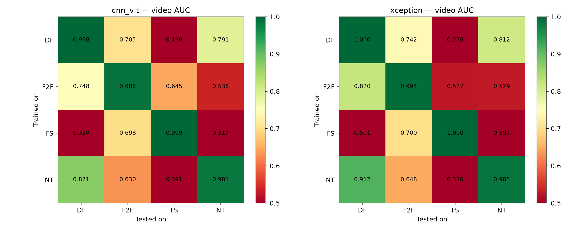
RESULTS · EXPERIMENT 2 — COMPLETE
Cross-Manipulation Generalization
Train on one manipulation method, test on another (and on the same method, diagonal). Color floor is clipped at 0.5 -- printed values below 0.5 are below random chance.
BELOW-CHANCE CELLS
0.256
Xception worst cell: Deepfakes → FaceSwap
0.198
CNN-ViT worst cell: Deepfakes → FaceSwap
0.398 / 0.421
Generalization gap -- Xception / CNN-ViT
7 of 24
off-diagonal cells ≤ chance -- all involve FaceSwap
Deepfake Detection — XceptionNet vs. CNN-ViT (23AID205)
3/10

Slide 4
RESULTS · EXPERIMENT 3 — COMPLETE
Compression Robustness (c23 → c40, proxy)
Official c0/c40 access is still pending -- c40 here is a documented proxy (c23 re-compressed), eval-only, caveated throughout the repo.
Model | c23 Video AUC | c40proxy Video AUC | AUC Drop
XceptionNet | 0.9958 | 0.8018 | -0.194
CNN-ViT Hybrid | 0.9836 | 0.8172 | -0.166
Both models degrade substantially under heavier re-compression; the hybrid's drop is somewhat smaller, but this is on the proxy set, not official c40 -- not being claimed as a general result.
Deepfake Detection — XceptionNet vs. CNN-ViT (23AID205)
4/10

Slide 5
THE FINDING
Transfer Failure Tracks the Training Method, Not the Model
▸ XceptionNet (ImageNet-pretrained, purely convolutional) and the CNN-ViT hybrid (trained from scratch, has global self-attention) are architecturally very different -- yet their cross-manipulation failure patterns are nearly identical cell-for-cell.
▸ That means the below-chance scores aren't an architecture quirk. Both models are picking up something from the training manipulation method itself that doesn't transfer -- and in the FaceSwap cells, actively points the wrong way.
▸ This reframes the project: not "which architecture generalizes better" but "why does detection invert on unseen manipulations, and can it be fixed." The second question is the one worth a paper.
ARCHITECTURE CORRELATION
r = 0.938
Pearson correlation, off-diagonal AUC cells
ρ = 0.951
Spearman correlation, same cells
12
off-diagonal cells compared per architecture
p < 0.001
both correlations, analysis/architecture_correlation.py
Deepfake Detection — XceptionNet vs. CNN-ViT (23AID205)
5/10

Slide 6
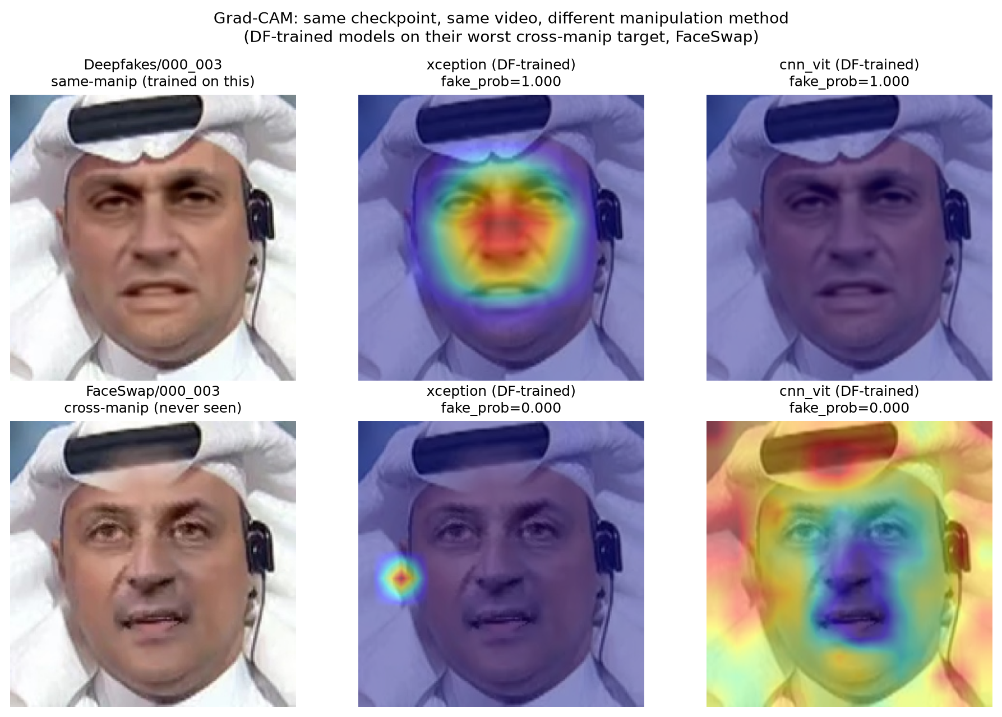
INTERPRETABILITY
Grad-CAM: What the Models Actually Attend To
Same checkpoint (Deepfakes-trained), same video, different manipulation. In-distribution: both models focus tightly on the face. Cross-manipulation (FaceSwap, never seen): attention collapses off-face or goes diffuse -- neither model falls back to anything sensible.
Deepfake Detection — XceptionNet vs. CNN-ViT (23AID205)
6/10

Slide 7
RULING OUT THE BORING EXPLANATION
Phase 0: Hygiene Fixes + Confound Audit
▸ Before treating the below-chance scores as a real finding, fixed two code issues (a training-resume bug that was silently discarding run history; checkpoint files that had been accidentally committed to version control) and audited the pipeline for anything that could trivially cause this.
▸ Label/split integrity -- 17/17 checks pass: AUC orientation is correct and not silently invertible; train/val/test are cleanly video-disjoint.
▸ Encoding audit (60 videos/class via ffprobe) -- codec, profile, pixel format, and compression setting (crf=23.0) are bit-exact identical across real and all 4 manipulation methods. No confound.
▸ Crop audit -- face-detection failure rate negligible (≤0.05%) everywhere; JPEG re-compression is bit-identical across classes. No confound.
▸ GATE 0 conclusion: no confirmed pipeline artifact explains the below-chance scores. This is very likely a real effect, not a bug -- worth explaining and fixing, not dismissing.
Deepfake Detection — XceptionNet vs. CNN-ViT (23AID205)
7/10

Slide 8
NEW DIRECTION
Research Plan: Why Transfer Inverts, and How to Fix It
▸ Working title: "Inverted Transfer" -- why deepfake detectors score unseen manipulations below chance, and how preprocessing toggles it.
▸ C1 -- Preprocessing sensitivity: does the below-chance pattern shift, possibly across the 0.5 line, under different face-detector/margin/format/alignment choices alone?
▸ C2 -- Mechanism: is there a measurable low-level image statistic (sharpness, boundary contrast, JPEG artifacts) whose sign predicts which transfer cells invert?
▸ C3 -- Intervention: can neutralizing that statistic during training raise the below-chance cells back toward/above 0.5 without a large in-domain accuracy drop?
▸ C4 -- Architecture independence: the r≈0.94 correlation above is the first evidence for this; testing it across more architectures next.
▸ Target: a 4-6 page paper, IEEE WIFS/ICASSP-style format.
Deepfake Detection — XceptionNet vs. CNN-ViT (23AID205)
8/10

Slide 9
STATUS
What's Done, What's Next
DONE
NEXT
▸ Experiments 1-3 complete: baseline, full 4×4 cross-manipulation matrix, compression robustness
▸ Grad-CAM interpretability analysis and live demo verified end-to-end
▸ Phase 0 (hygiene + audit) complete -- ruled out a pipeline artifact as the explanation for the below-chance scores
▸ Architecture-independence of the transfer-failure pattern confirmed (r≈0.94 across both models' off-diagonal cells)
▸ Phase 1: rebuild preprocessing with a different, standard face-alignment pipeline and retrain -- tests whether the below-chance pattern disappears (preprocessing-driven) or persists (a real inversion mechanism)
▸ Phase 2-3: systematic preprocessing sweep, then pin down the low-level statistic that predicts which cells invert
▸ Phase 4-5: test interventions that fix it, check generalization across more architectures
▸ ~4-week total budget for this phase of work, currently early -- paper write-up targeted by the end
Deepfake Detection — XceptionNet vs. CNN-ViT (23AID205)
9/10

Slide 10
CLOSING
Where to Follow Along
▸ Full research plan, phase-by-phase, with gates: RESEARCH_BRIEF.md in the repo.
▸ Progress log updated after every phase: docs/PROGRESS.md.
▸ Every number in this deck comes from a script-written file under analysis/ or results/ -- reproducible, not hand-typed.
CONTRIBUTORS
▸ Venugopalan Gangadharan — CB.AI.U4AID25115
▸ Vipin Sudhakar — CB.AI.U4AID25166
▸ Rithvik Arulprakash — CB.AI.U4AID25148
▸ Harshith Kv — CB.AI.U4AID25119
AI & Data Science — Amrita Vishwa Vidyapeetham, Coimbatore
GITHUB REPOSITORY
github.com/DUNE-ODYSSEY/deepfake-detection
Deepfake Detection — XceptionNet vs. CNN-ViT (23AID205)
10/10

