Slide 1
AIML COURSE PROJECT · 23AID205 · MID-REVIEW
Deepfake Detection:
XceptionNet vs. CNN-ViT Hybrid on FaceForensics++
Cross-manipulation generalization and compression robustness — full pipeline run, both models trained, results analyzed, and a working live demo.
Venugopalan Gangadharan · Vipin Sudhakar · Rithvik Arulprakash · Harshith Kv
AI & Data Science — Amrita Vishwa Vidyapeetham, Coimbatore

Slide 2
INTRODUCTION
Motivation, Problem & Objectives
▸ Deepfakes have moved from research curiosity to a real misinformation/fraud vector — but published detectors usually report one headline accuracy number, on the same manipulation type and compression level they trained on.
▸ Problem: that number is misleading in practice — a detector at 99% in a paper can be ~57% AUC (worse than random) the moment the test distribution shifts, and that failure is invisible until deployment.
▸ Objective 1: fairly compare XceptionNet (CNN baseline) vs. a CNN-ViT hybrid (ResNet + Transformer) on identical data/protocol — does global self-attention actually improve generalization?
▸ Objective 2: measure same-distribution accuracy, full 4×4 cross-manipulation generalization, and compression robustness — not just one number.
▸ Objective 3: explain *why* generalization succeeds or fails (Grad-CAM), and ship a working, testable live demo — not only offline metrics.
Deepfake Detection — XceptionNet vs. CNN-ViT (23AID205)
2/11

Slide 3
METHODOLOGY
End-to-End Pipeline
1
2
3
4
5
6
Raw video
Face extraction
Official splits
Train
Evaluate
Analyze
FF++ c23, 5 folders: real + 4 manipulation methods
MTCNN crop, 20 frames/video, margin 1.3x
video-level train/val/test — no identity leakage
AMP, class-balanced sampler, cosine LR, early stop
frame + video-level Acc/F1/AUC on held-out test
cross-manip matrix, gap, Grad-CAM, live demo
Deepfake Detection — XceptionNet vs. CNN-ViT (23AID205)
3/11

Slide 4
DATASET & PREPROCESSING
Data: Source, Prep & Quality Check
▸ FaceForensics++ (FF++): 5,000 videos — 1,000 real (YouTube interviews) + 4×1,000 manipulated (Deepfakes, Face2Face, FaceSwap, NeuralTextures), all sharing the same real-video identities. c23 compression, official FF++ folder layout (Kaggle mirror).
▸ Official video-level train/val/test splits used throughout — critical, since random frame-level splits would leak identity between train/test and inflate accuracy.
▸ Preprocessing: MTCNN face detection on GPU, 20 frames/video, 1.3x crop margin (captures blending-boundary artifacts), resized to 299×299 (native for XceptionNet, downsampled to 224 for the hybrid) → ~99,987 face crops total.
▸ EDA/data-quality check: IQR outlier analysis on frame count & file size flagged 502 of 5,000 videos (10%) before committing to full preprocessing.
▸ Real/fake class imbalance handled via a weighted random sampler at training time, not by discarding data. Official c0/c40 access still pending — see Compression slide.
Deepfake Detection — XceptionNet vs. CNN-ViT (23AID205)
4/11

Slide 5
ALGORITHM SELECTION
Models: XceptionNet vs. CNN-ViT Hybrid
XCEPTIONNET (BASELINE)
CNN-VIT HYBRID
▸ Depthwise-separable CNN (Chollet 2017), ImageNet-pretrained
▸ 2048-d pooled features → dropout → linear → logit
▸ Purely convolutional — local receptive fields only
▸ The standard reference detector for this exact task
▸ ResNet-50 (stages 1-3) → 14×14×1024 map → 512-d tokens + CLS
▸ 6-layer, 8-head Transformer encoder over the tokens
▸ Tests: does global self-attention improve generalization?
▸ Same optimizer/schedule/data — architecture is the only variable
SHARED TRAINING & EVALUATION PROTOCOL (fair comparison — only the architecture differs)
AMP training, AdamW, cosine LR, batch size 32 (GPU-benchmarked — XceptionNet silently throttles above this), early stopping (patience 4 on val AUC). Metrics: Accuracy/F1/AUC at frame & video level (video = mean of frame probabilities). 10 training runs, 36 evaluations total.
Deepfake Detection — XceptionNet vs. CNN-ViT (23AID205)
5/11

Slide 6
RESULTS · EXPERIMENT 1
Baseline Comparison (same-distribution, c23)
Both models trained and tested on all 4 methods — the headline accuracy number most papers stop at.
Model | Video Acc | Video F1 | Video AUC | Frame Acc | Frame AUC
XceptionNet | 97.29% | 0.983 | 0.9958 | 95.49% | 0.986
CNN-ViT Hybrid | 94.71% | 0.967 | 0.9836 | 92.76% | 0.962
XceptionNet leads on every same-distribution metric — the first sign the hybrid's extra complexity isn't paying off on this task.
Deepfake Detection — XceptionNet vs. CNN-ViT (23AID205)
6/11

Slide 7
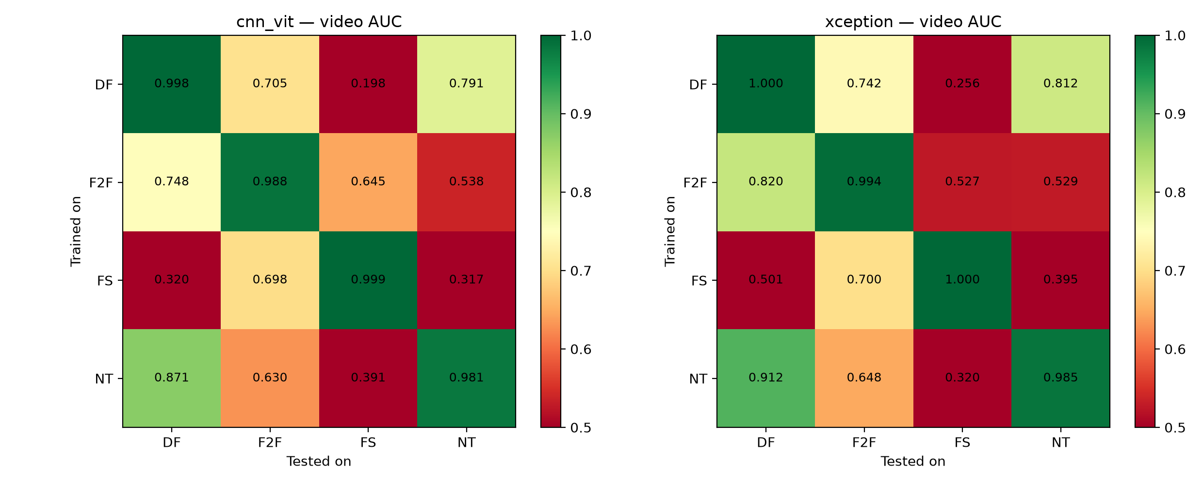
RESULTS · EXPERIMENT 2
Cross-Manipulation Generalization
Train on one manipulation method, test on all four (4×4 matrix per model). Diagonal = same-manip; off-diagonal = the actual generalization test.
HEADLINE FINDING
Hypothesis (“attention generalizes better”) did NOT hold: XceptionNet has both higher same-distribution AND cross-manip AUC (generalization gap 0.398 vs. 0.421) than the hybrid. Worst cell for both, DF→FS: 0.256 / 0.198 AUC — worse than random.
Deepfake Detection — XceptionNet vs. CNN-ViT (23AID205)
7/11

Slide 8
RESULTS · EXPERIMENT 3
Compression Robustness (Proxy-c40)
Official c0/c40 FaceForensics++ access was still pending, and no c40 mirror exists on Kaggle. Worked around it rather than skipping the experiment.
Model | c23 AUC | c40proxy AUC | Drop
XceptionNet | 0.9958 | 0.8018 | -0.194
CNN-ViT Hybrid | 0.9836 | 0.8172 | -0.166
METHOD (CAVEATED)
“c40proxy” = the held-out test videos re-transcoded locally, c23→crf40 (ffmpeg). This double-compresses rather than compressing once from raw like official c40, so degradation is harsher/different from the real thing — a documented approximation, used for evaluation only, never for training. Will re-run against official c0/c40 if FaceForensics++ approval arrives.
Deepfake Detection — XceptionNet vs. CNN-ViT (23AID205)
8/11

Slide 9
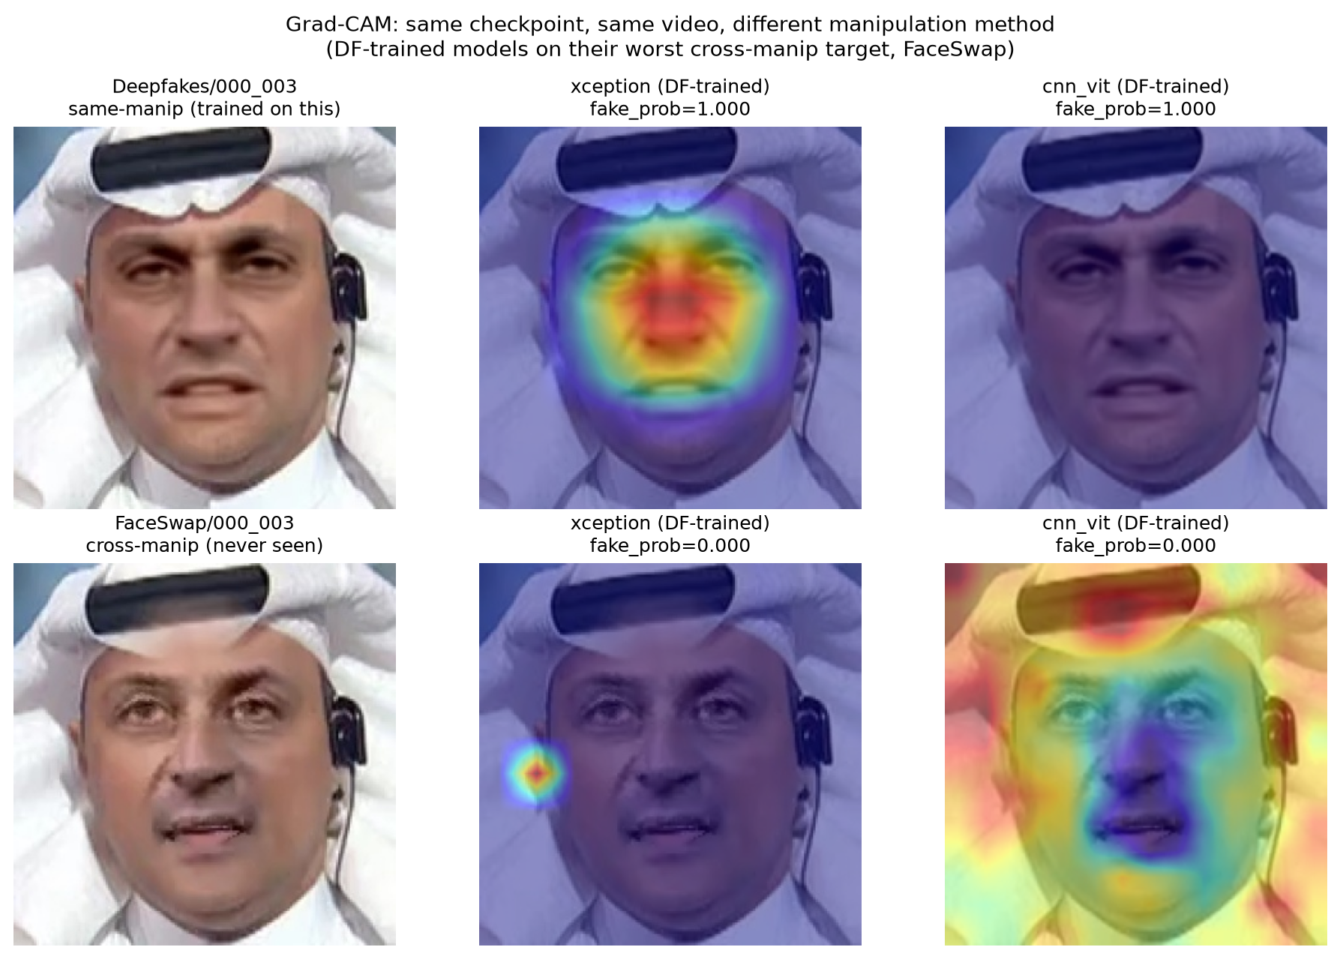
INTERPRETABILITY
Grad-CAM: Why Generalization Fails
Same video, same Deepfakes-only checkpoint. Same-manip: attention locks onto the central face (blending artifacts). Cross-manip to FaceSwap (worst cell): attention collapses off-face — neither model falls back to anything sensible.
DF → FS (worst cell)
0.256 / 0.198
cross-manip AUC (xception / cnn_vit) — worse than random
1.000 → 0.000
xception fake-prob: same-manip vs. cross-manip
face → background
where attention shifts when the signal is absent
Deepfake Detection — XceptionNet vs. CNN-ViT (23AID205)
9/11

Slide 10
SOFTWARE IMPLEMENTATION
Live Demo
▸ FastAPI backend + browser frontend: upload an image or short video, get a real/fake probability from either trained checkpoint. Pipeline mirrors training exactly (MTCNN crop → resize/normalize → per-frame probability → video-level average).
▸ Verified against a curated, held-out test-split set (never seen in training) — all correctly and confidently classified by XceptionNet; CNN-ViT correct but visibly less confident, consistent with its lower baseline accuracy.
▸ Sanity-checked against an out-of-distribution image circulating online (not FF++ data): both models confidently wrong — expected given the generalization-gap numbers, and a live demonstration of this project's own finding rather than a contradiction of it.
▸ Runs on CPU by design, so it never competes with GPU training/evaluation jobs.
Deepfake Detection — XceptionNet vs. CNN-ViT (23AID205)
10/11

Slide 11
CONCLUSION
Key Takeaways & Closing
▸ XceptionNet outperforms the CNN-ViT hybrid on every metric measured — same-distribution accuracy, generalization gap, and most compression conditions — contradicting the hypothesis that attention would help generalization.
▸ Both architectures share the same weakness: narrow, method-specific artifacts rather than a general "manipulated" signal — confirmed visually via Grad-CAM.
▸ Future work: official c0/c40 once approved (replacing the proxy), multi-seed runs for statistical confidence, Grad-CAM on a genuinely-uncertain cell.
▸ Practical takeaway: a deployed detector needs training coverage of its target manipulation types, or an explicit "unknown" fallback — confident-wrong is worse than honest uncertainty.
REFERENCES
▸ Rössler et al. (2019). FaceForensics++. ICCV.
▸ Chollet (2017). Xception. CVPR.
▸ Dosovitskiy et al. (2021). ViT. ICLR.
▸ Selvaraju et al. (2017). Grad-CAM. ICCV.
CONTRIBUTORS
▸ Venugopalan Gangadharan — CB.AI.U4AID25115
▸ Vipin Sudhakar — CB.AI.U4AID25166
▸ Rithvik Arulprakash — CB.AI.U4AID25148
▸ Harshith Kv — CB.AI.U4AID25119
AI & Data Science — Amrita Vishwa Vidyapeetham, Coimbatore
GITHUB REPOSITORY
github.com/DUNE-ODYSSEY/deepfake-detection
Deepfake Detection — XceptionNet vs. CNN-ViT (23AID205)
11/11

