Slide 1
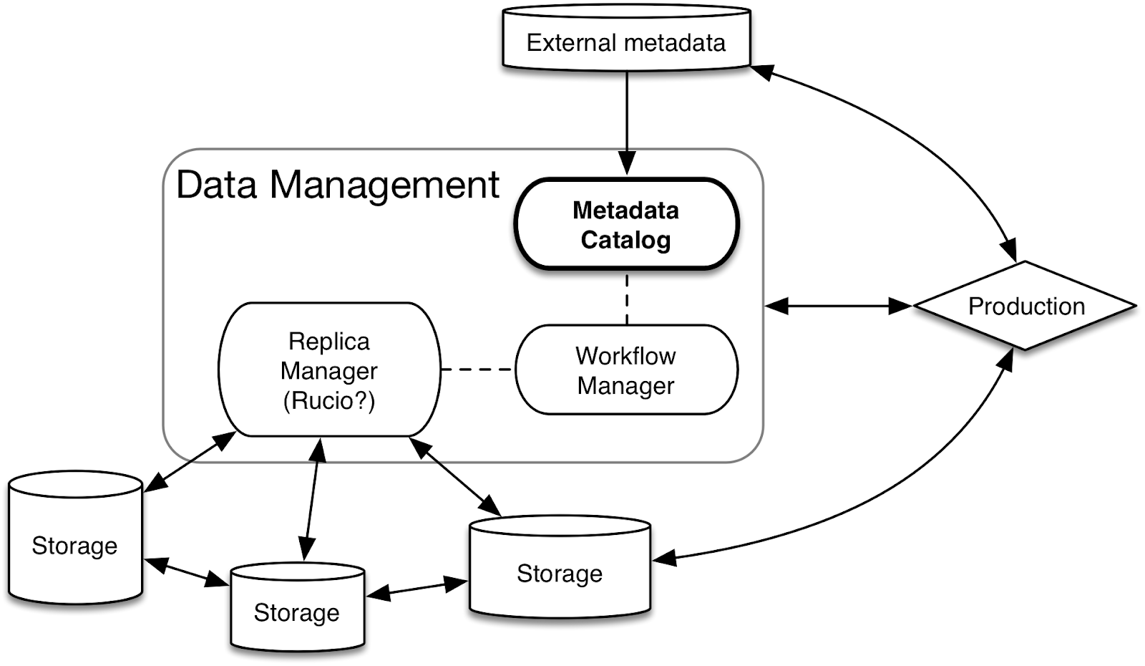
DAQ
MetaCat:
Metadata
Catalog
Data Ingest /
Declaration
Rucio:
Replica Manager
Data Dispatcher

Slide 2
DAQ
SAM
Fermi
File Transfer

