Slide 1

DUNE COMPUTING UPDATE Mike Kirby (FNAL) FOR THE COMPUTING CONSORTIUM

Slide 2
Upcoming Events
Recruiting event, Wednesday the 24th 9AM, WH2E
Tutorials Wednesday and Thursday the 24th/25th “Tollestrup Auditorium”
Frameworks workshop, Monday June 5-7 (FNAL and hybrid)
https://indico.fnal.gov/e/fermilab-frameworks-workshop
Review of US DUNE computing
Prereview June 23-23 – remote
Review. July 13-14 @FNAL in person
ProtoDUNE II
Lots to do to get ready

Slide 3
Review of where we are

Slide 4
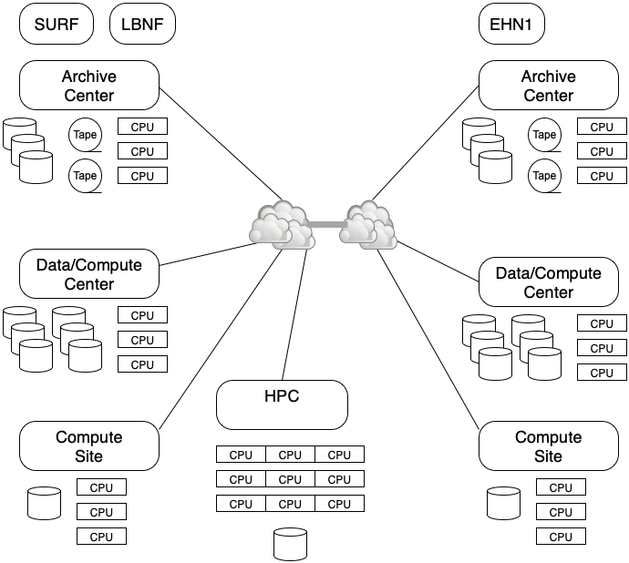
DUNE computing model
Less hierarchical than original WLCG model
Able to use opportunistic resources
Sites offer services
Archival (few)
Disk (Rucio Storage Element)
CPU
HPC

Slide 5
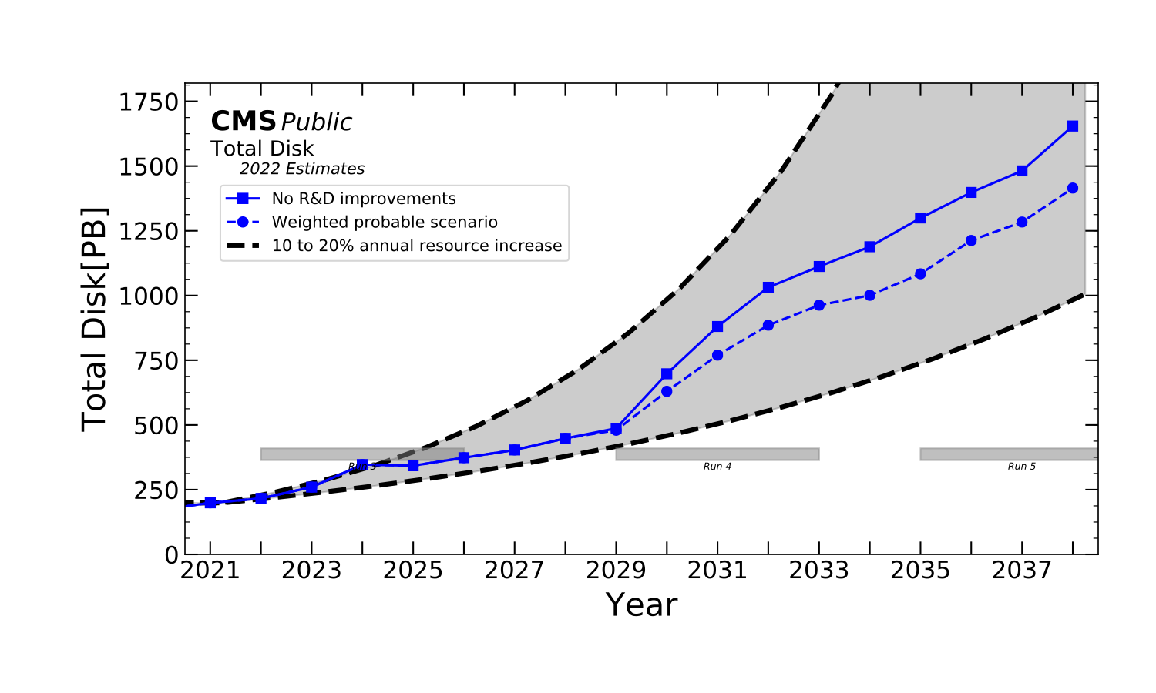
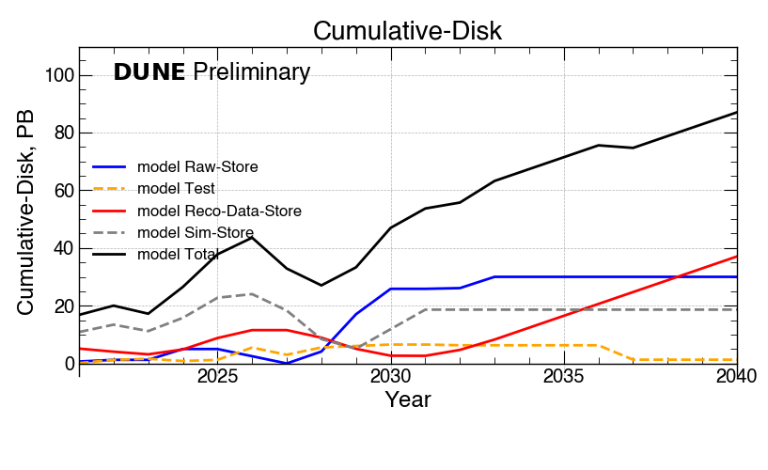
Disk compared to CMS
Disk ~ 5-10% of an LHC expt.

Slide 6
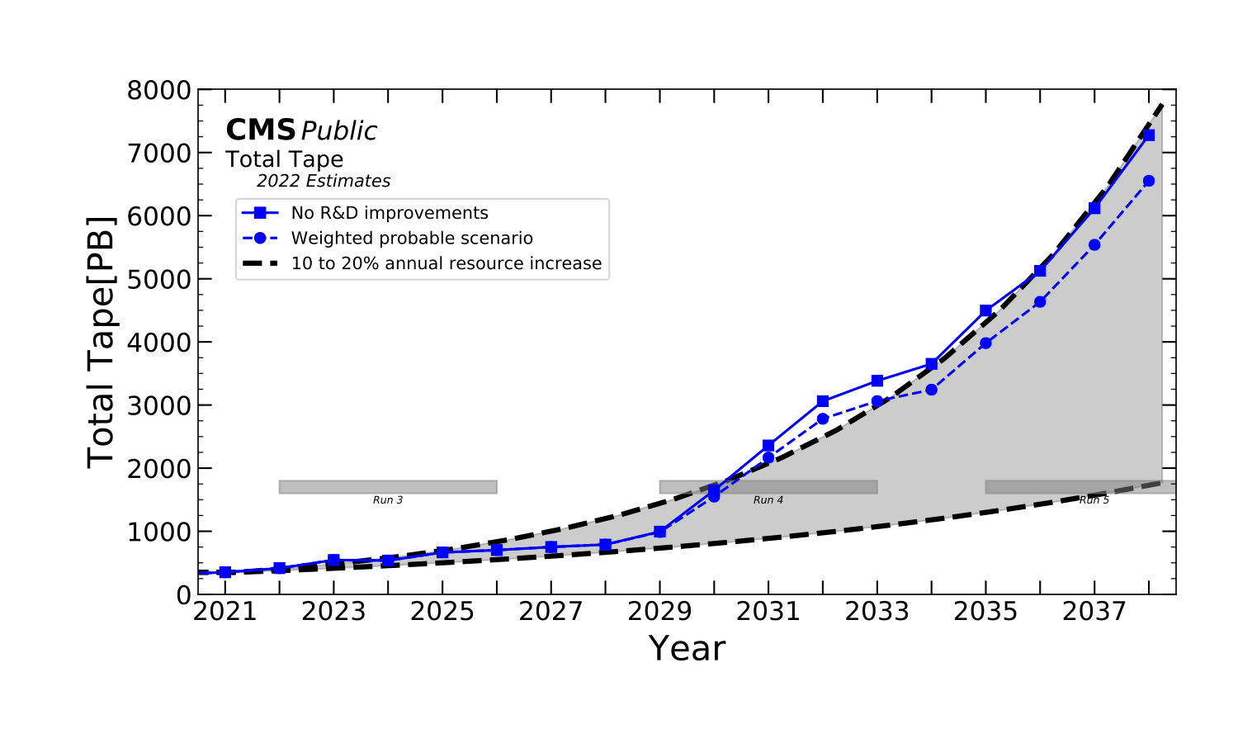
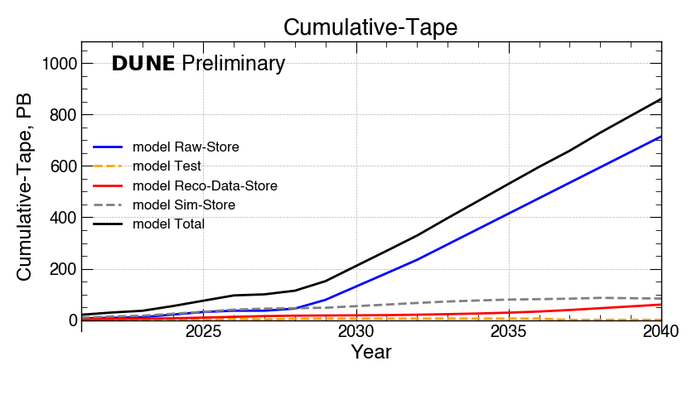
Tape prediction
Tape 10-15% of an LHC experiment

Slide 7
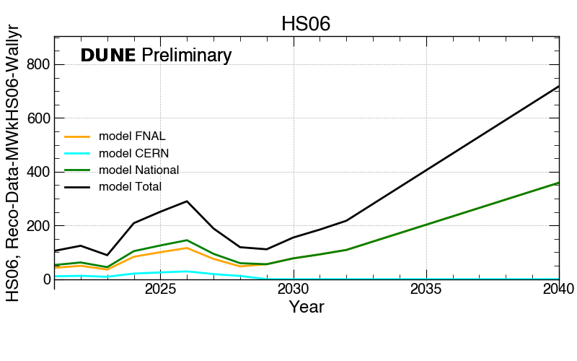
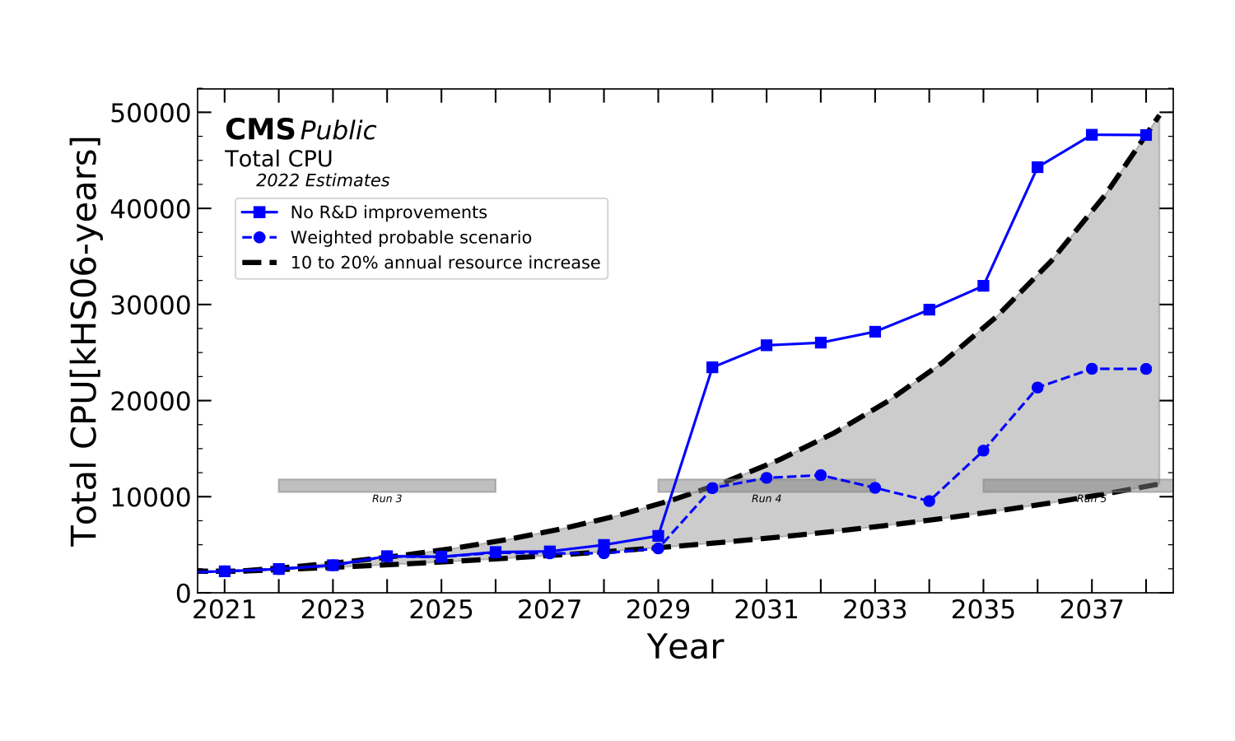
CPU
CPU ~ 2% ???
CPU is much harder to estimate as depends on human behavior

Slide 8
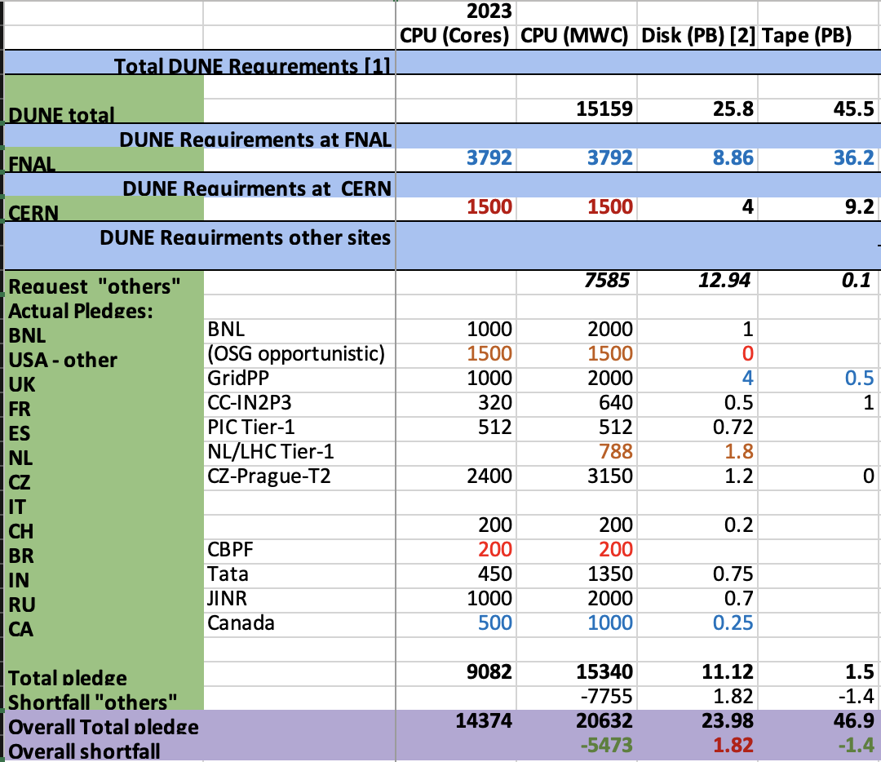
Global contributions
REQUEST
Computing Contributions Board
Chaired by Pete Clarke
Voluntary pledges of CPU and disk
CPU is now in Memory Weighted Cores normalized to 2 GB/core
MWC = Core * N GB/(2GB)
Many sites offer 4-6 GB/core
DUNE reco/sim are 4-6 GB/core
Disk allows 2 copies, one on either side of the Atlantic
Red text is tentative based on prior years

Slide 9
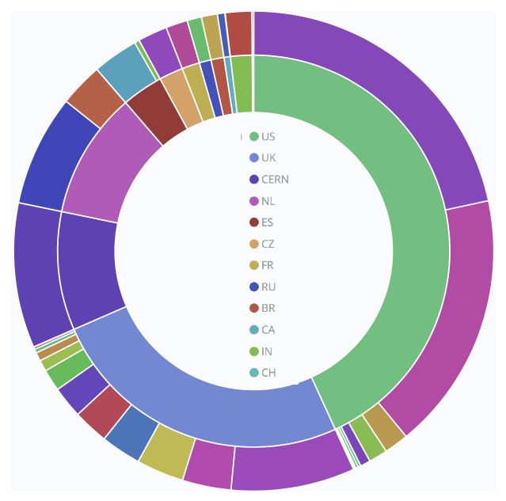
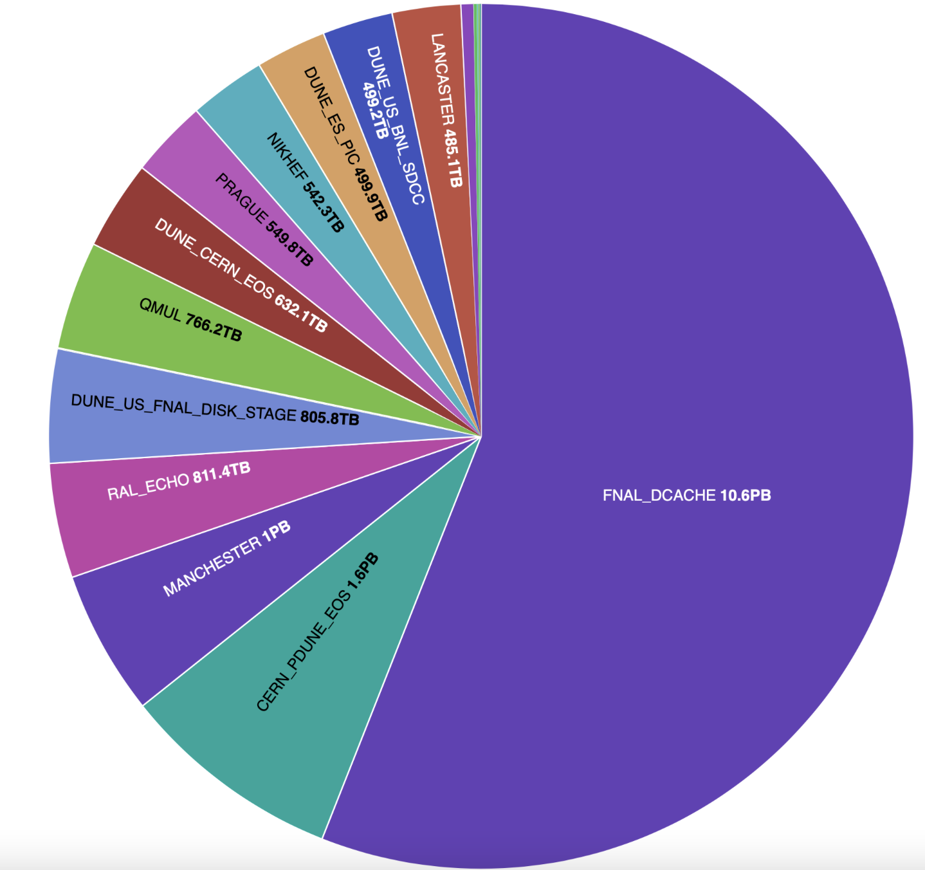
46.84%
DUNE CPU for the past year,
used 48.5M wall hours
Inner circle shows the national split
Disk currently in use/available
FNAL ~ 11/11 PB
Other ~ 7.6/12.5 PB

Slide 10
How can I help?
There are many computing roles that don’t require a PhD in CS
But very important for physics
We are looking for interested people to take on these roles.
Can be done remotely
A way to contribute
Recruiting Event
9AM in WH2E (Comitium)
Hear about public data and other upcoming projects

Slide 11
How can I help?
Data Placement Manager
Production Team
Database Interfaces to framework
Database Interfaces to Calibration/slow controls
Monitoring
Training group
Planning for public data releases
Build support/CE
Persistency Models/event data model
Job control improvements
HPC Integration
multithreading workflow/software development/update
Production Infrastructure
Accelerator Integration
database caching

Slide 12
Example: Data Manager
Data comes in collections defined by:
Experiment (PDHD/PDVD)
Run conditions
MC or Data
Processing stage (raw->full reco)
Version
Defining and documenting these samples depends on physics needs of the experiment
Finite disk space means samples need to be prioritized
This role interfaces with the physics groups, production groups and data management.
Requires basic abilities in unix/python
Experience with data analysis
Care and attention
Missing, poorly documented or duplicate data can profoundly affect results
Some eampleVe

Slide 13
Example: Production team
The production team validates and runs large scale data and MC processing
Vital for any physics study we do
Can do this remotely but requires checking on jobs several times/day when running a “campaign”
Need 6-10 people to allow rotations and spread the load
Team members learn how to run large jobs at scale
Need knowledge of unix/python commands
Learn how big compute systems work

Slide 14
Example: Training group
Help design and run the training programs
In person but with video/materials usable at any time
We use the carpentries format
Would like to include Jupyter notebooks
Must like teaching!
Right now our trainings are limited by time/personnel
Help us make more specialized courses!
Skills needed or gained
Github
Python/unix
DUNE computing
Video editing
documentation
How to start
Help us with a tutorial as a mentor!

Slide 15
And many more

