Slide 1
MongoDB Installation & Setup for Mac

Slide 2
Install Brew(Package Manager)
URL: https://brew.sh/
In terminal run:
/usr/bin/ruby -e "$(curl -fsSL https://raw.githubusercontent.com/Homebrew/install/master/install)"

Slide 3
Install Mongo
Install Mongo
Run in Terminal: brew Install mongo
Create Directory to put mongo DB data (Required before continuing)
Run in terminal: sudo mkdir -p /data/db
Give permission to the directory:
Run in terminal: whoami
You will get user name (say XXXX)
In terminal change ownership on the directory created:
Run in terminal: sudo chown -Rv XXXX /data/db
To start Local Mongo Instance
Run in terminal: mongod
If successful - You will see ‘waiting for connection on port 27017’

Slide 4
Install Node & npm
Hope you have Node and NPM installed from Previous seminar
installed Node.js and npm
In Terminal brew install node

Slide 5
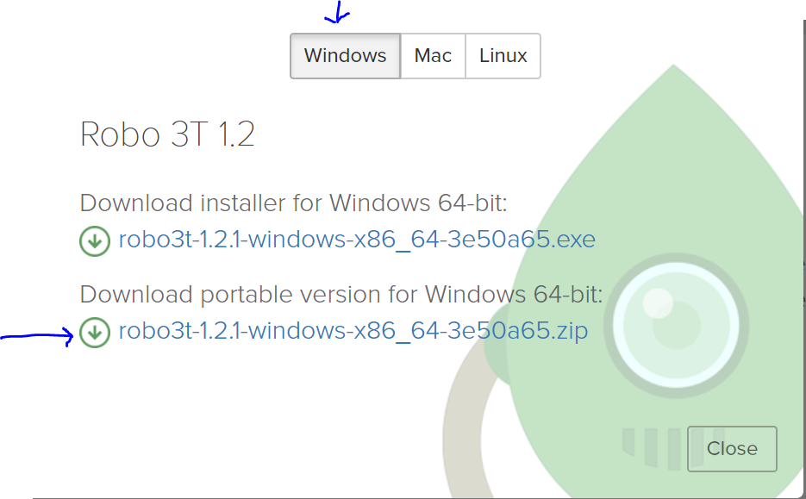
Install Robo 3T (GUI for MongoDB)
Access the link: https://robomongo.org/download
Download Portable version for Mac

Slide 6
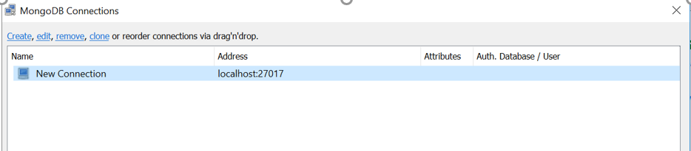
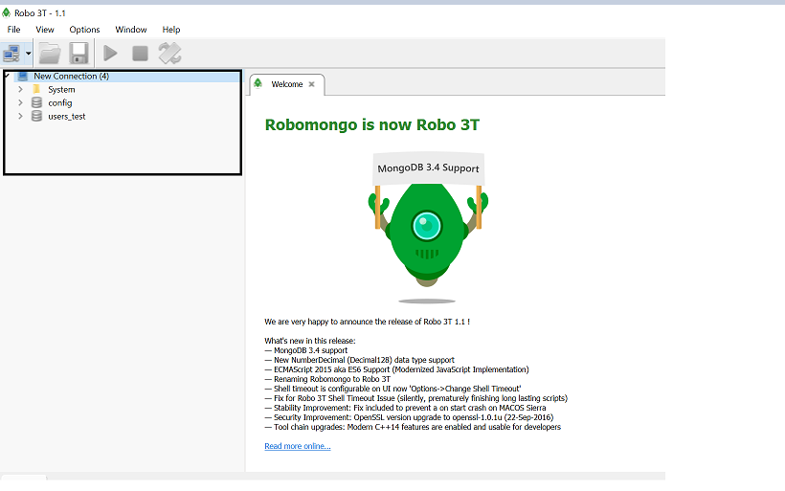
Running Robo 3T
Run ‘Robo3T.exe’ from Robo3T downloaded folder in previous step
You will see first screen short on left with ‘localhost connection’
Note: your MongoDB instance should be running (refer slide 2)
Click on Connect
It should be successfully connected (second screenshot on left)
Refer to next slides if you see errors

Slide 7
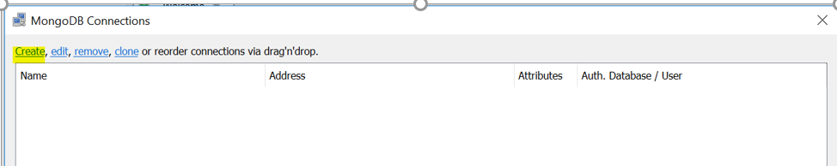
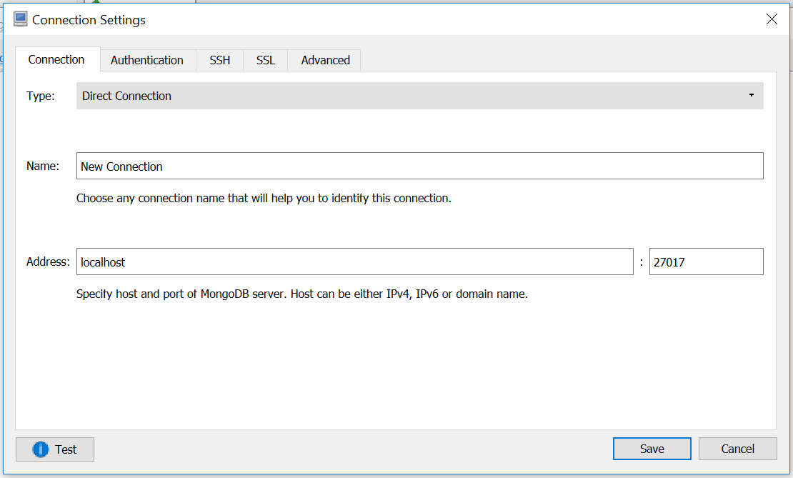
Running Robo 3T ( If you don’t see default instance)
Click on Create Button on left top
A window will open with default connection settings
Click on save ( second screenshot on left)
Click on Connect
It should be successfully connected

Slide 8
Running Robo 3T (If you get errors connecting to localhost instance)
If you see any errors connecting to Robo 3T:
Make sure your Mongo local instance is running
To start Local Mongo Instance
Run in terminal: mongod
Let us know if you are not able to connect.
THE END

