Slide 1
MongoDB Installation & Setup for Windows

Slide 2
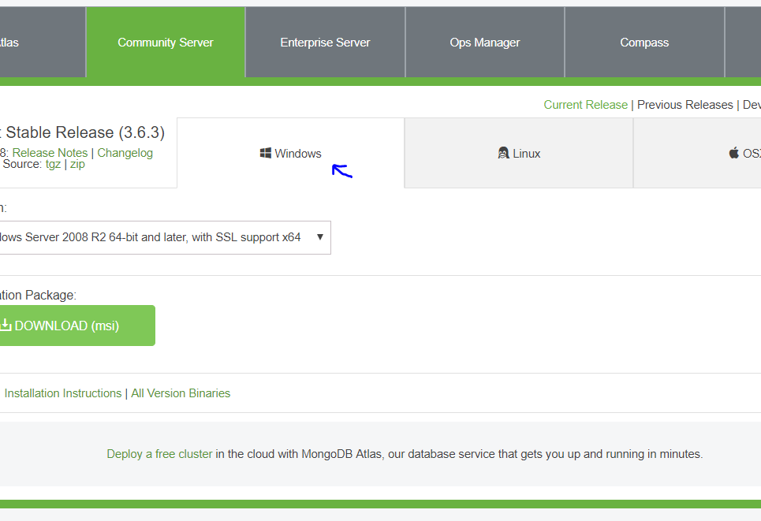
Install MongoDB:
https://www.mongodb.com/download-center?jmp=nav#community
Download MSI (Windows Version):

Slide 3
Install Mongo
Set up Data directory where mongoDB will stash all its data
In command Prompt: md \data\db
Start MongoDB
To start local copy of MongoDB instance ( you need to have it running during the Seminar)
In a Command Prompt: "C:\Program Files\MongoDB\Server\3.6\bin\mongod.exe"
You should see : Waiting for connection on port 27017 (If you don’t let us know)

Slide 4
Install Node & npm
Hope you have Node and NPM installed from Previous seminar
installed Node.js and npm

Slide 5
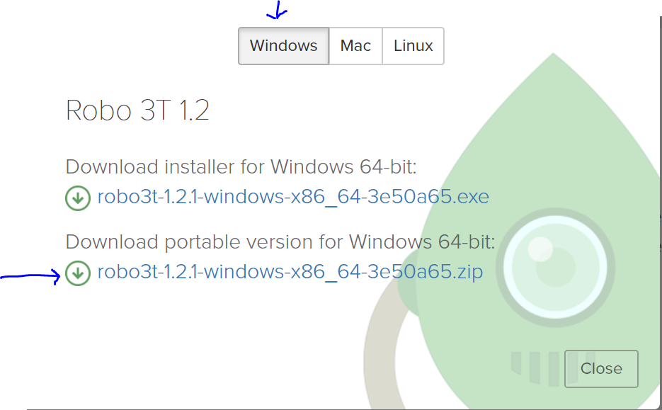
Install Robo 3T (GUI for MongoDB)
Access the link: https://robomongo.org/download
Download Portable version for Windows

Slide 6
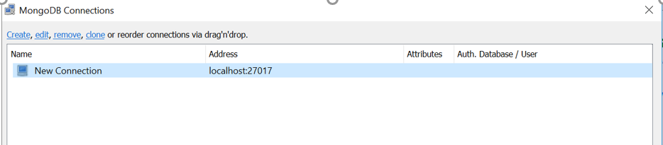
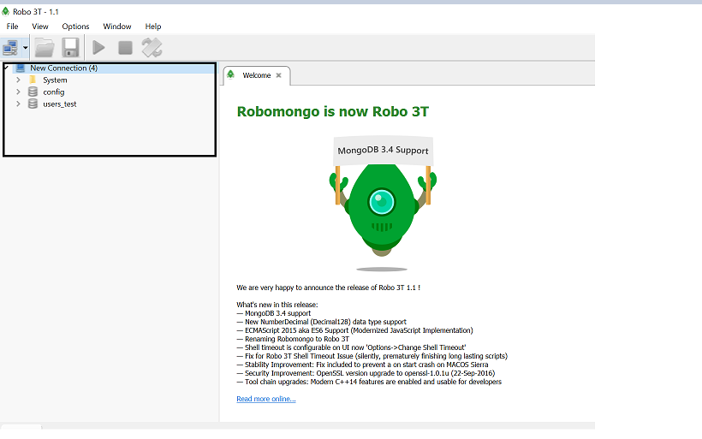
Running Robo 3T
Run ‘Robo3T.exe’ from Robo3T downloaded folder in previous step
You will see first screen short on left with ‘localhost connection’
Note: your MongoDB instance should be running (refer slide 2)
Click on Connect
It should be successfully connected (second screenshot on left)
Refer to next slides if you see errors

Slide 7
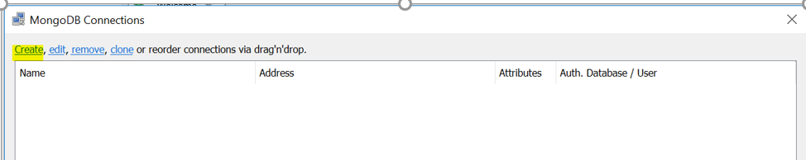
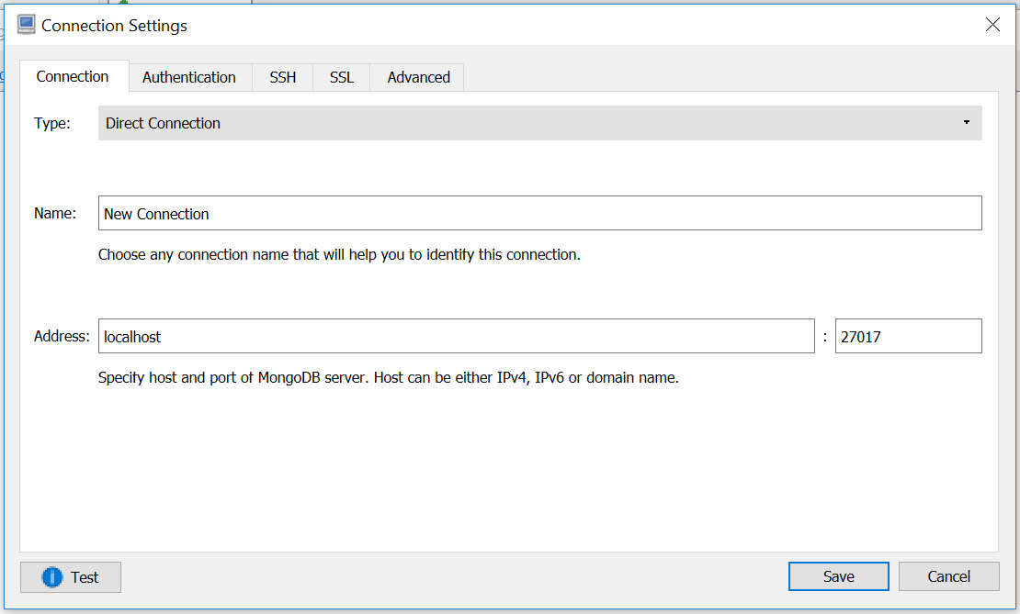
Running Robo 3T ( If you don’t see localhost by default)
Click on Create Button on left top
Window will open with connection settings, defaults as below, you can click on save ( second screenshot on left)
Click on Connect
It should be successfully connected

Slide 8
Running Robo 3T (If you see errors connecting to localhost instance)
If you see any errors connecting to Robo 3T:
Kill the mongo server that is running in the command prompt (cntrl + C) and restart it
In command Prompt: "C:\Program Files\MongoDB\Server\3.6\bin\mongod.exe"
Let us know if you are not able to connect.
THE END

