Slide 1

Open-Vocabulary Segmentation
常世杰
2023.3.31

Slide 2
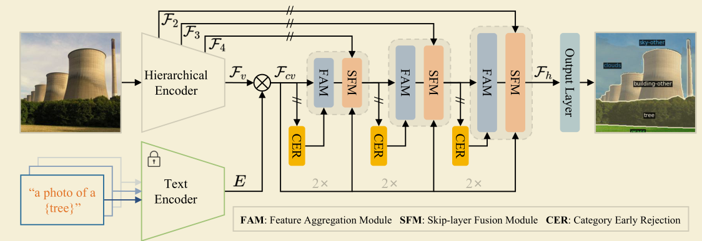
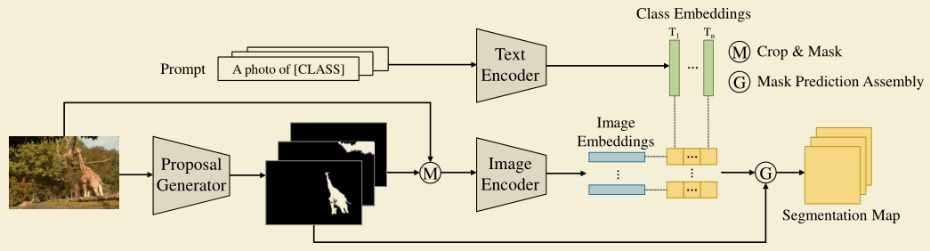
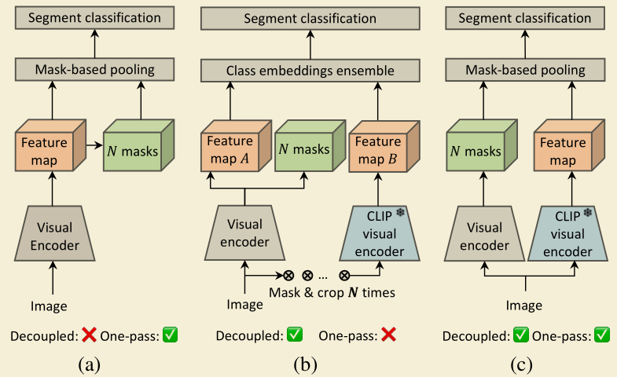
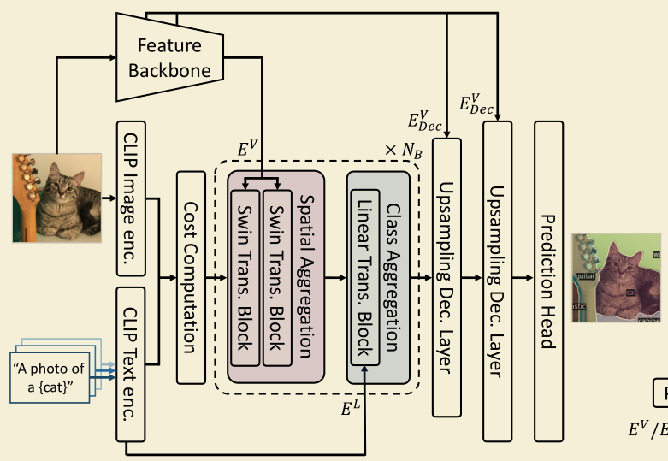
Fully-Supervised OV SS
ECCV 2022
CVPR 2024
Two-stage OVSeg
One-stage OVSeg
CVPR 2024
ICCV 2023

Slide 3
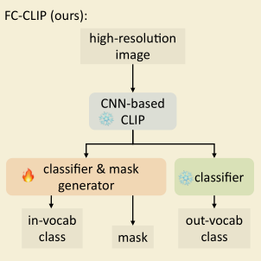
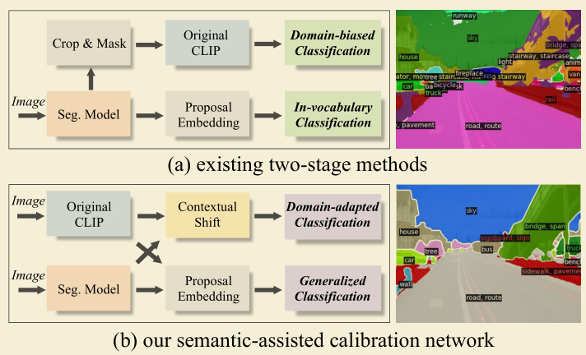
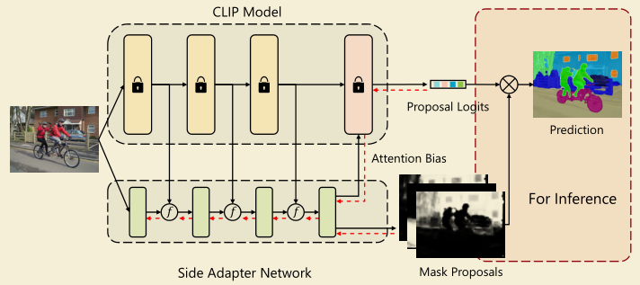
Two-stage OVSeg
ECCV 2022 SimBaseline
NIPS 2023 FC-CLIP
CVPR 2024 SCAN
Mask proposal (mask2former) + CLIP Classification
CVPR 2023 SAN

Slide 4
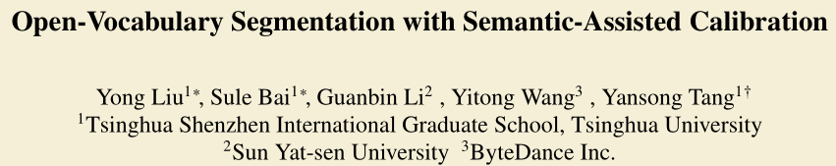
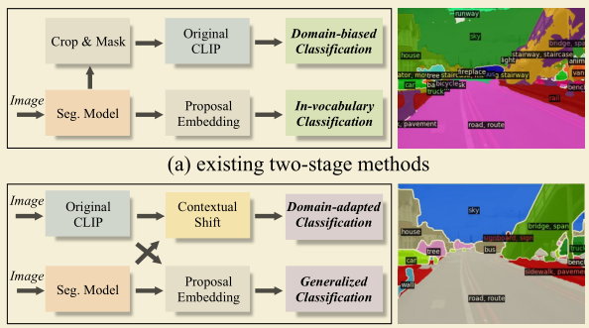
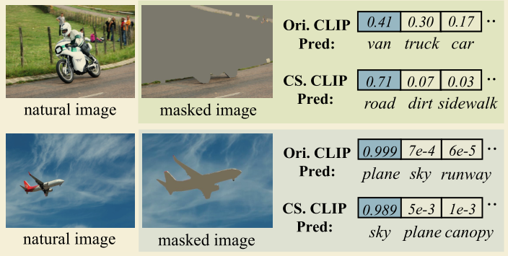
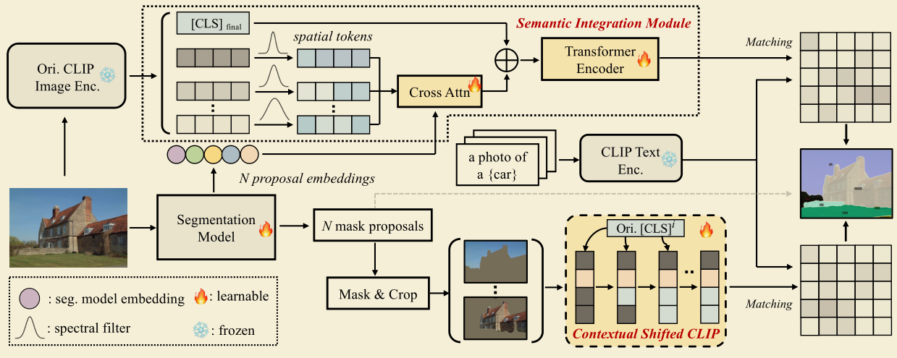
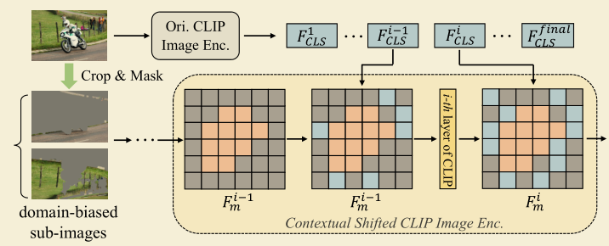
CVPR 2024

Slide 5
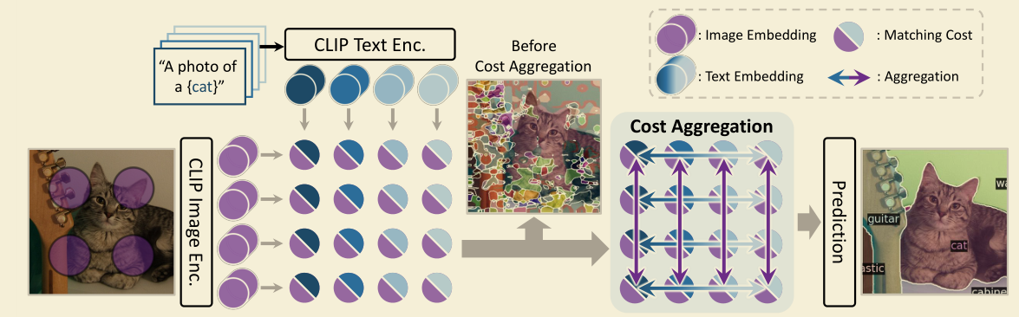
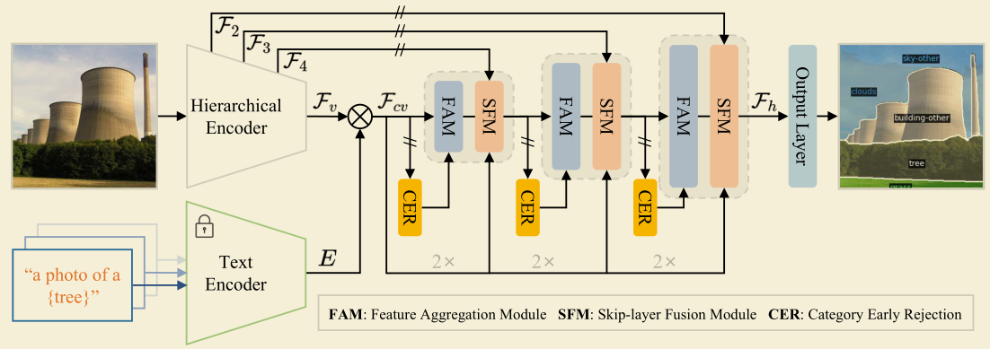
One-stage OVSeg
CVPR 2024
CAT-Seg
CVPR 2024 SED

Slide 6
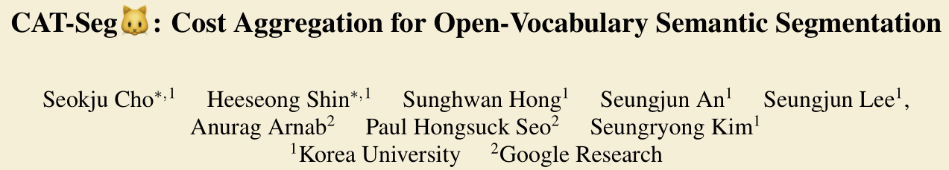
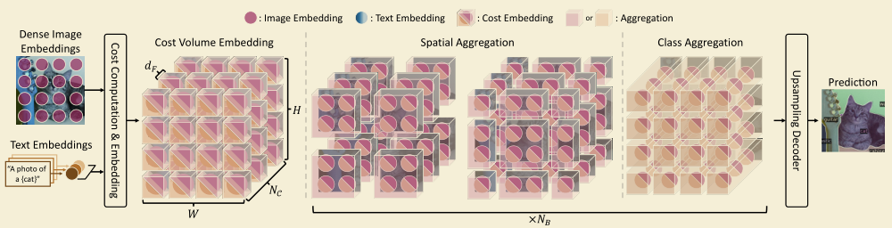
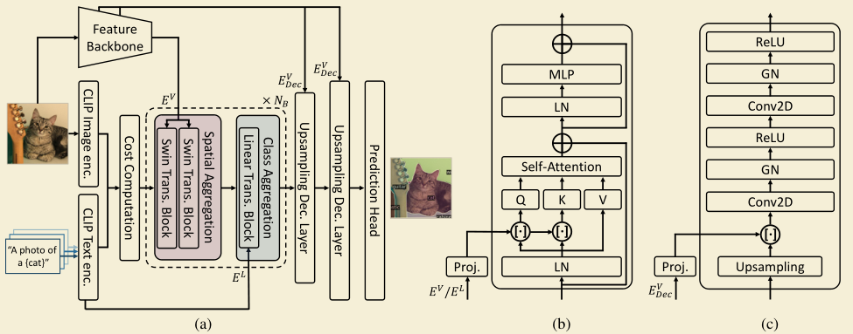
CVPR 2024
N，H，W

Slide 7
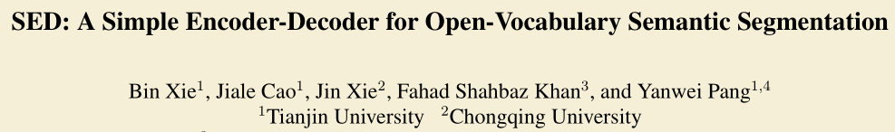
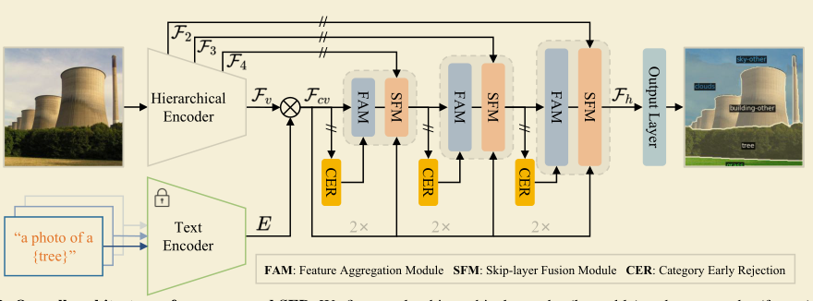
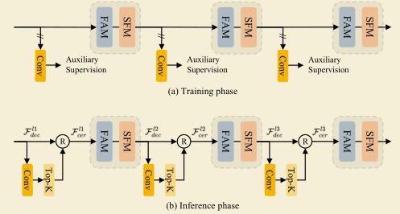
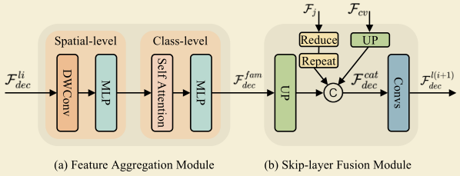
CVPR 2024
双阶段法用两个独立的网络预测mask和类别—速度慢
现有单阶段法用ViT作为视觉backbone—局部表示差
NPC
CHW
NDHW N1HW
利用层次化结构带来更多局部信息
提出CER，提前过滤图片中不存在的类别，提高推理速度

Slide 8
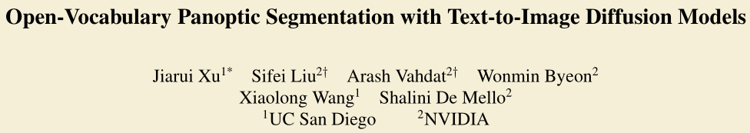
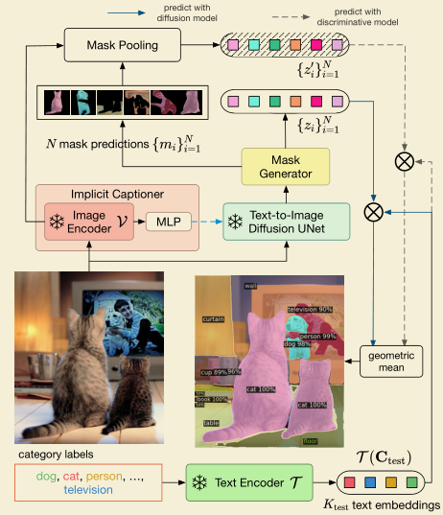
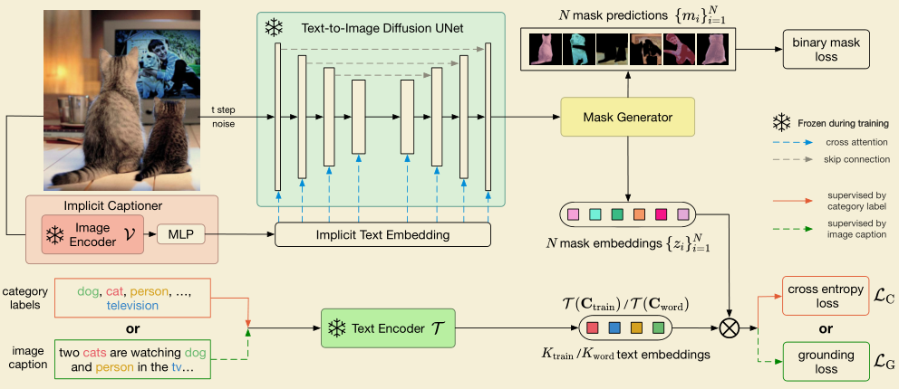
CVPR 2023

Slide 9
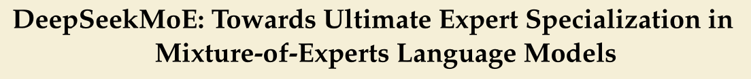
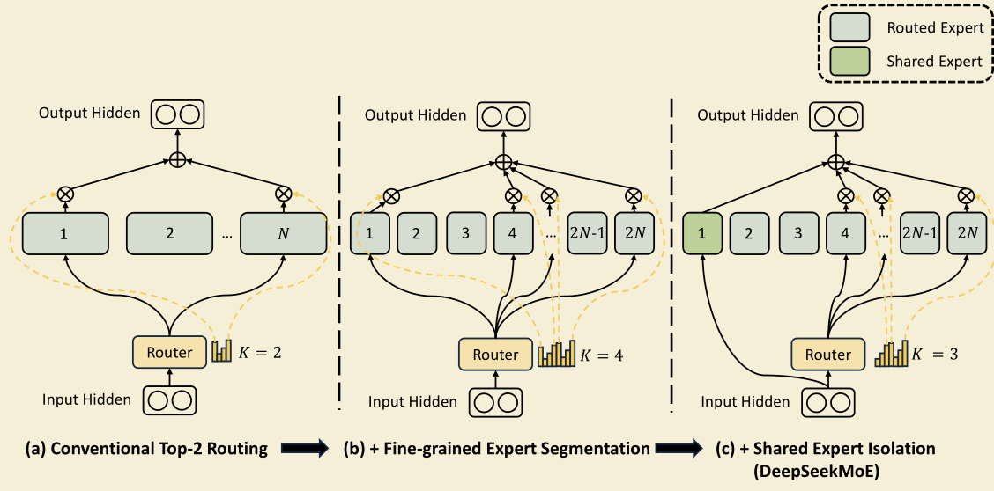
DeepSeek-MoE
 | A-847 | PC-459 | A-150 | PC-59 | PAC-20
SED-B | 11.4 | 18.6 | 31.6 | 57.3 | 94.4
moe | 10.9 | 17.7 | 31.5 | 57.5 | 94.1
deepseek | 10.8 | 18.1 | 31.5 | 57.1 | 93.6

Slide 10
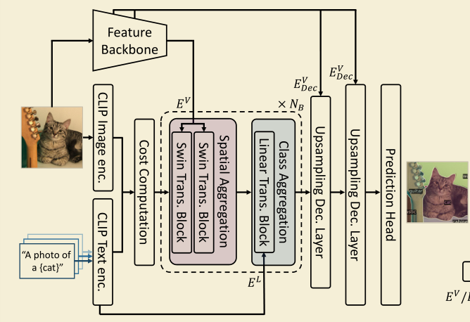
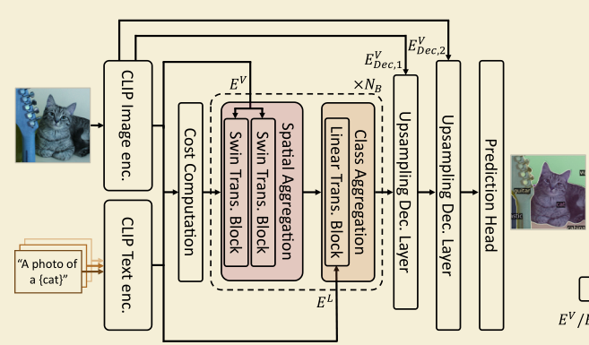
 | A-847 | PC-459 | A-150 | PC-59 | PAC-20
CAT-v1-B | 8.4 | 16.6 | 27.2 | 57.5 | 93.7
SED-B | 11.4 | 18.6 | 31.6 | 57.3 | 94.4
CAT-v2-B | 12.0 | 19.0 | 31.8 | 57.5 | 94.6
SED-L | 13.9 | 22.6 | 35.2 | 60.6 | 96.1
CAT-v2-L | 16.0 | 23.8 | 37.9 | 63.3 | 97.0
特征图基于cost volume，导致特征图大小受类别数影响(B, C, H, W) -> (B, T, C, H, W) solov2
预测逻辑：为每个类别T预测一个二值mask
训练集和测试集类别域偏移太大，测试集很多类别IoU=0

Slide 11
CAT-Seg-v1 v.s. SED v.s. CAT-Seg-v2
CAT-Seg-v1
CLIP-ViT + feature backbone
Fine-tune visual encoder attention
Train 384
Test sliding inference 384/640
Imagenet templates
SED
CLIP-ConvNext
Fine-tune full visual encoder
Train 768
Test 640
Imagenet templates
CAT-Seg-v2
CLIP-ViT
Fine-tune q/v visual&textual encoder
Train 384
Test sliding inference 384/640
Single template
ViT-Base 2d8h

Slide 12
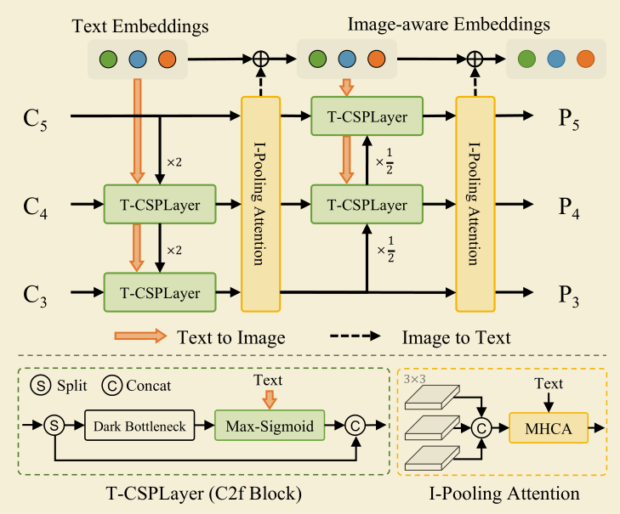
(B,T,C)
(B,T,C)
FPN
重复前过程
余弦相似度
(B,T,H,W)
(B,C,H,W)
Spatial
Aggregation
Text-image
Attention
Text
Update
(B,C,H,W)
 | A-847 | PC-459 | A-150 | PC-59 | PAC-20
SED-B | 11.4 | 18.6 | 31.6 | 57.3 | 94.4
 | 3.1 | 9.0 | 17.3 | 49.3 | 89.1

Slide 13
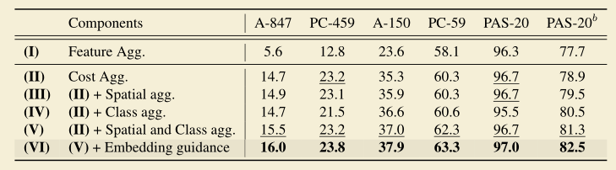
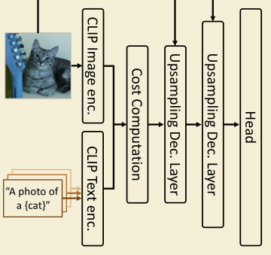
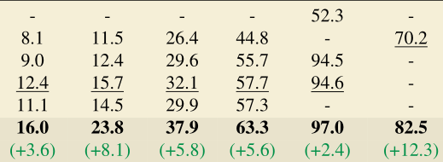
 | A-847 8.00 | PC-459 20 | A-150 5.31 | PC-59 9.01 | PAC-20 2.0
CAT-B | 12.1 | 19.1 | 31.6 | 57.4 | 94.7
baseline | 10.0 | 16.6 | 27.0 | 52.6 | 93.8
baseline2 | 10.8 | 17.5 | 28.6 | 54.0 | 94.2
 | 11.1 | 17.8 | 30.7 | 56.0 | 94.4
 | 11.6 | 18.6 | 31.1 | 56.8 | 94.8
dino | 10.1 | 16.5 | 27.1 | 52.5 | 93.9
deformcl | 11.6 | 18.9 | 31.5 | 57.2 | 94.8
 | A-847 8.00 | PC-459 20 | A-150 5.31 | PC-59 9.01 | PAC-20 2.0
baseline2 | 10.8 | 17.5 | 28.6 | 54.0 | 94.2
+aug | 10.9 | 17.7 | 28.6 | 54.4 | 94.6
+ms | 10.8 | 17.5 | 28.4 | 53.9 | 94.5
dcn | 11.4 | 18.3 | 31.1 | 55.7 | 94.8
+cls | 12.0 | 19.5 | 31.9 | 58.2 | 94.4
Oracle | 28.7 | 43.2 | 51.1 | 75.3 | 97.7

Slide 14
Text
Encoder
Inter-class
Aggregation
Image
Encoder
Cos Sim
Cat
UP
Prediction
(B T C H W)
Intra-class
Aggregation
(B N H W H W)
CAT-Seg Baseline
Cos Sim
4D Conv Mean
(B C H W)
(BHW T C)

Slide 15
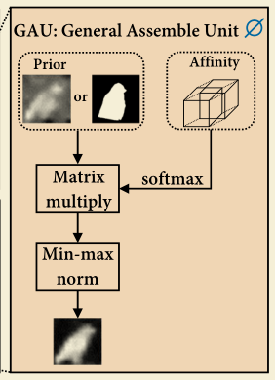
 | A-847 8.00 | PC-459 20 | A-150 5.31 | PC-59 9.01 | PAC-20 2.0
CAT-B | 12.1 | 19.1 | 31.6 | 57.4 | 94.7
baseline | 10.0 | 16.6 | 27.0 | 52.6 | 93.8
baseline2 | 10.8 | 17.5 | 28.6 | 54.0 | 94.2
i-i corr | 11.1 | 17.8 | 30.7 | 56.0 | 94.4
i-i corr2 | 11.6 | 18.6 | 31.1 | 56.8 | 94.8
dino | 10.1 | 16.5 | 27.1 | 52.5 | 93.9
maskMHA | 11.6 | 18.9 | 31.5 | 57.2 | 94.8
dcn | 11.4 | 18.3 | 31.1 | 55.7 | 94.8
去掉spatial和class aggregation和decoder中的浅层特征
去掉spatial和class aggregation
加入i-i correlation
在baseline2的基础上将浅层特征替换为dino对应层特征
Class aggregation时使用mask MHA，仅和相近的K个类别做MHA
K初步设置为16，感觉应该增大K试一下
降点原因可能是原spatial agg都使用了大核 CAT-Seg 12，SED 9
初始DCNv3核设置为3
获取更好的初始化cost volume
更好的cost aggregation方式
对spatial和class都使用deformable操作：
Spatial，改一下DCNv3中生成offset和mask的过程
Class，使用mask MHA仅和相近的K个类别做MHA

Slide 16
 | A-847 8.00 | PC-459 20 | A-150 5.31 | PC-59 9.01 | PAC-20 2.0
CAT-B | 12.1 | 19.1 | 31.6 | 57.4 | 94.7
oracle | 28.7 | 43.2 | 51.1 | 75.3 | 97.9
Cls_head | 12.2 | 19.2 | 31.9 | 58.1 | 94.7
APL | 12.1 | 19.1 | 32.0 | 58.2 | 94.9
MLDecoder | 12.1 | 19.5 | 31.5 | 58.0 | 95.0
+RAM | 11.3 | 19.1 | 31.6 | 57.4 | 94.8
给定图片中存在的类别
Transformer cross-attention + BCE Loss
Transformer cross-attention + AP Loss
MLDecoder+ AP Loss
使用RAM进行分类直接测试性能
与分类联合训练后，性能会有一点提升，但过用分类头推理类别则效果不好。分类头不能做到囊括所有存在的类别

Slide 17
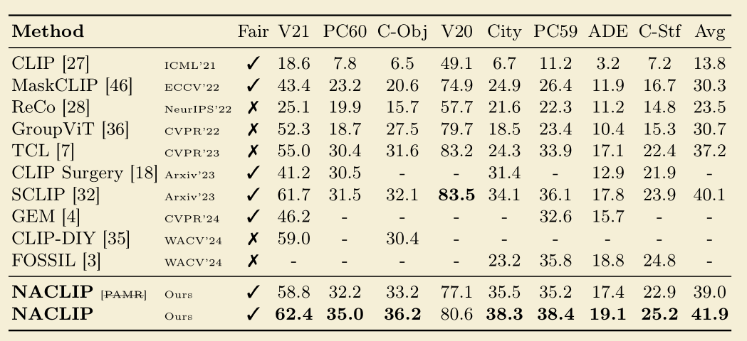
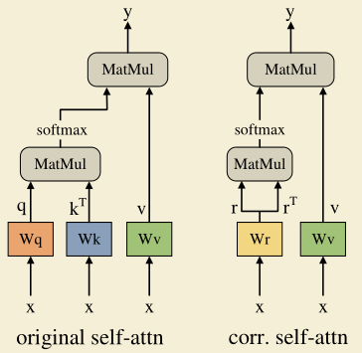
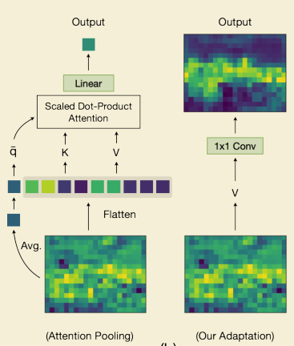

调整CLIP以生成更好的cost volume
NACLIP
ECCV 2022 MaskCLIP
SCLIP

Slide 18
