Slide 1
Joint Entity-Relation Extraction
Zhiheng Li
2020/07/22

Slide 2
Content
Introduction
1
2
Related Work
3
RSAN @ IJCAI2020
4
Conclusion

Slide 3
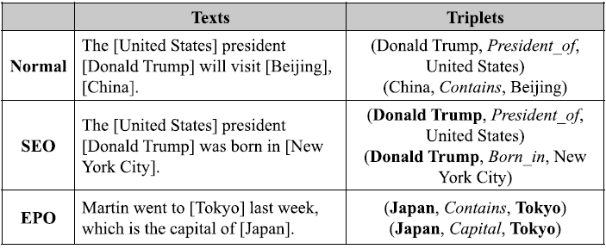
Introduction
Joint Entity-Relation Extraction
Sentence -> Relations (head, relation, tail)

Slide 4
Introduction
Joint Entity-Relation Extraction
Redundant operations
Method | Description | Challenge
Pipeline | Entity -> Relation | Error propagation
Parameter sharing | Jointly training [Miwa and Bansal, 2016] | Predict separately Redundant operations
Table-filling | [Miwa and Sasaki, 2014] | Redundant operations
 | GraphRel [Fu et al., 2019]
Novel tagging | NovelTagging [Zheng et al., 2017] | Overlapping

Slide 5
Introduction
Joint Entity-Relation Extraction
Extract overlapping relations
Redundant operations
Method | Description | Challenge
Head-tail (Seq2seq) | PA-LSTM [Dai et al. 2019] | O(n²)
 | ETL-Span [Yu et al., 2020] | Q(1+m)
Relation-guided (Seq2seq) | CopyRE (CopyMTL, OrderRL) [Zeng et al., 2018] | Fine-grained semantic connections between relations and words
 | HRL [Takanobu et al., 2019]

Slide 6
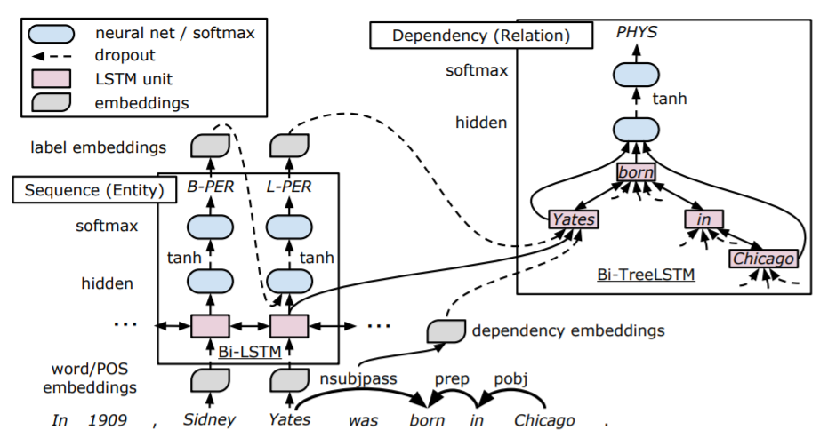
Related work
Miwa and Bansal, 2016
End-to-End Relation Extraction using LSTMs on Sequences and Tree Structures
Recognize entities
Get SDP for each entity pair
Relation classification

Slide 7
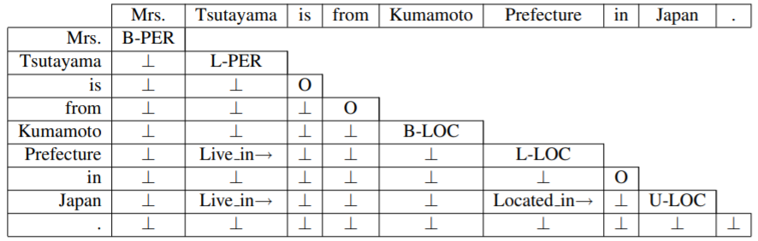
Related work
Miwa and Sasaki, 2014 -- Table-filling
Modeling Joint Entity and Relation Extraction with Table Representation (EMNLP2014)
Build a table for each sentence
Fill in the table with different tags

Slide 8
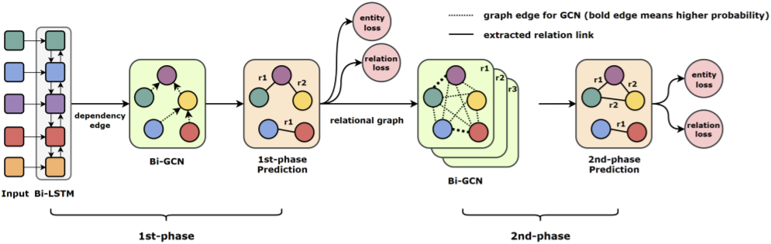
Related work
Fu et al., 2019 -- GraphRel
GraphRel: Modeling Text as Relational Graphs for Joint Entity and Relation Extraction (ACL 2019)
Recognize all entities & extract relations between each word pair
2nd-phase relation-weighted GCN

Slide 9
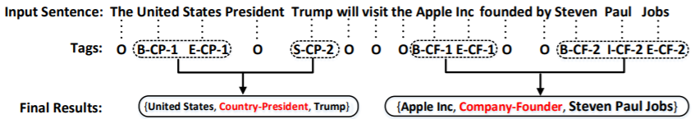
Related work
Zheng et al., 2017 -- NovelTagging
Joint Extraction of Entities and Relations Based on a Novel Tagging Scheme
Sequence labeling approach
Tag scheme: entity and relation information

Slide 10
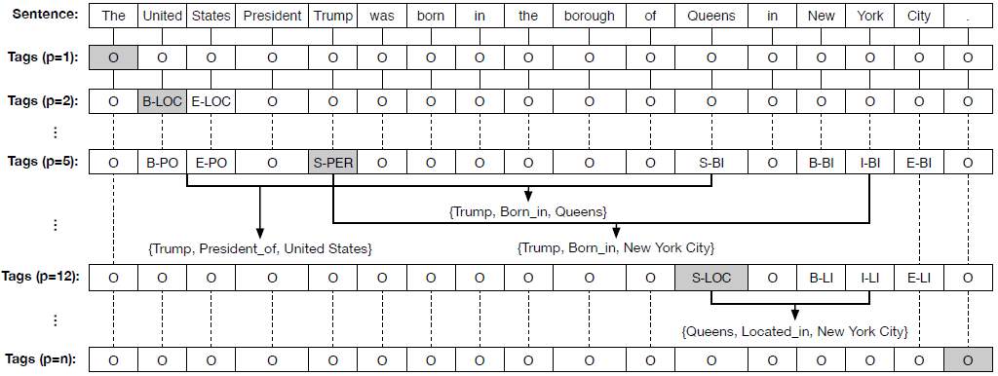
Related work
Dai et al., 2019 -- PA-LSTM
Joint extraction of entities and overlapping relations using position-attentive sequence labeling (AAAI2019)

Slide 11
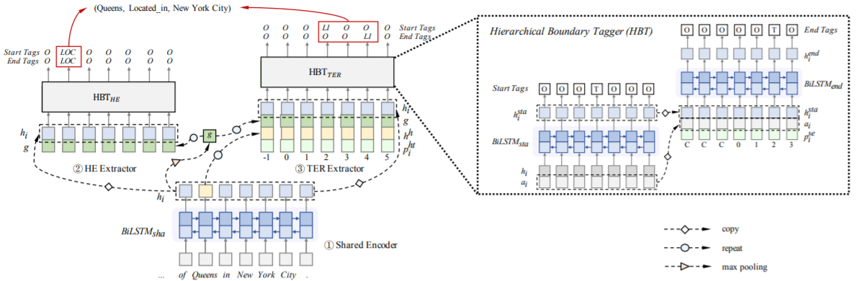
Related work
Yu et al., 2020 -- ETL-Span
Joint Extraction of Entities and Relations Based on a Novel Decomposition Strategy (ECAI2020)

Slide 12
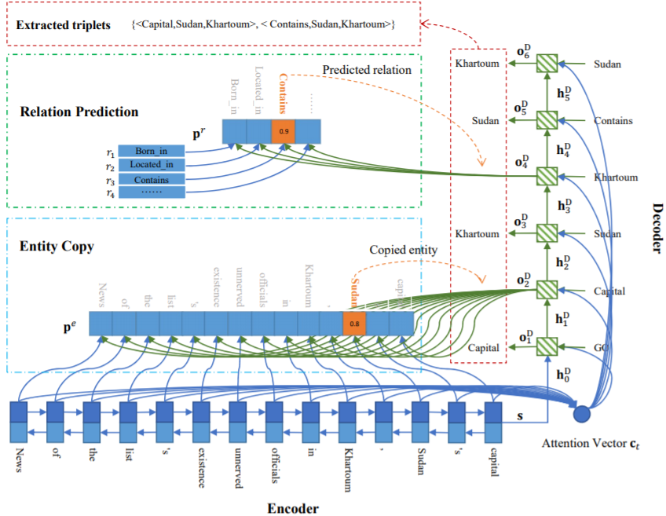
Related work
Zeng et al., 2018 -- CopyRE
Extracting Relational Facts by an End-to-End Neural Model with Copy Mechanism (ACL2018)
Seq2seq model
Encoder: BiRNN
Decoder: attn-based
Copy the word in ori-sen
Relation -> entity

Slide 13
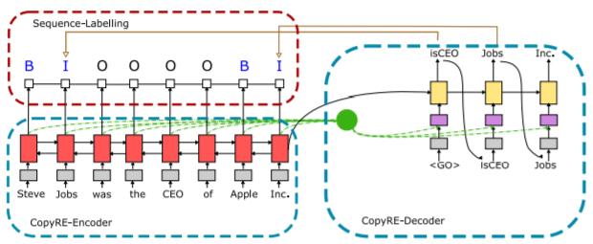
Related work
Zeng et al., 2019a -- CopyMTL
CopyMTL: Copy Mechanism for Joint Extraction of Entities and Relations with Multi-Task Learning (AAAI2020)
CopyRE + sequence labeling task -> NER
Entity coping
Multiple token entity

Slide 14
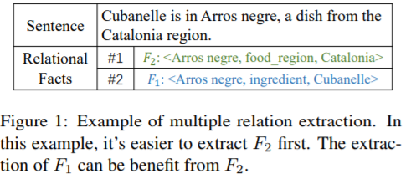
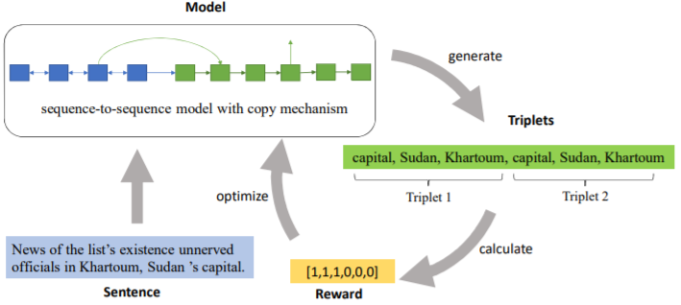
Related work
Zeng et al., 2019b -- OrderRL
Learning the Extraction Order of Multiple Relational Facts in a Sentence with Reinforcement Learning (EMNLP2019)
Extraction order matters -> RL

Slide 15
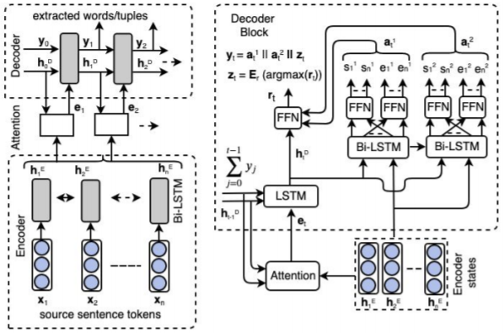
Related work
Nayak and Ng, 2020 -- WDec
Effective Modeling of Encoder-Decoder Architecture for Joint Entity and Relation Extraction (AAAI2020)
Multiple token entity
Copy start & end word

Slide 16
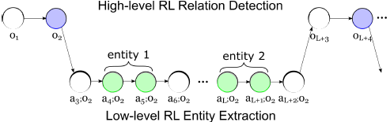
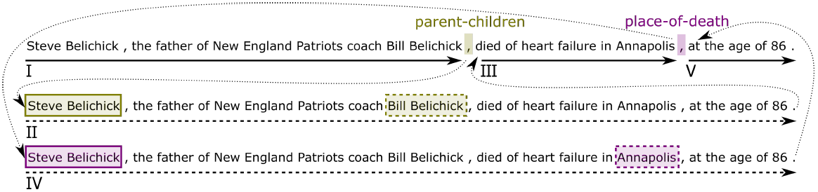
Related work
Takanobu et al., 2019 -- HRL
A Hierarchical Framework for Relation Extraction with Reinforcement Learning (AAAI2019)
Reinforcement learning
Multiple turns

Slide 17
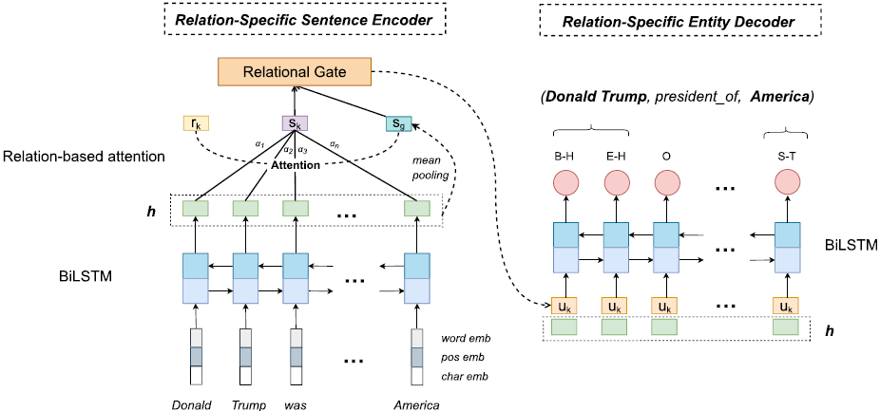
RSAN
A Relation-Specific Attention Network for Entity and Relation Extraction (IJCAI2020)

Slide 18

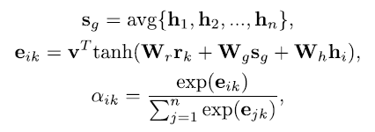
RSAN
A Relation-Specific Attention Network for Entity and Relation Extraction (IJCAI2020)

Slide 19

RSAN
A Relation-Specific Attention Network for Entity and Relation Extraction (IJCAI2020)

Slide 20

RSAN
A Relation-Specific Attention Network for Entity and Relation Extraction (IJCAI2020)

Slide 21
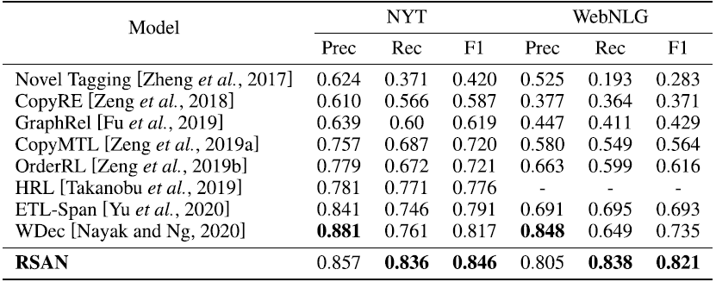
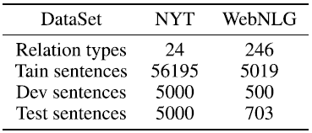
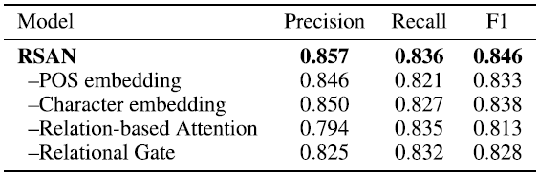
RSAN
Experiments

Slide 22
RSAN
Analysis
Ablation Study

Slide 23
RSAN
Analysis
Ablation Study

Slide 24
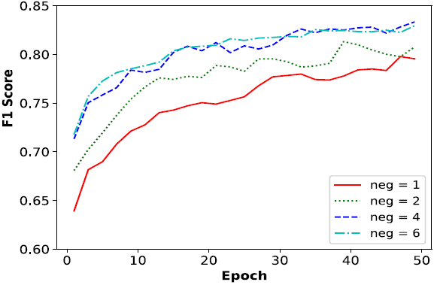
RSAN
Analysis

Slide 25
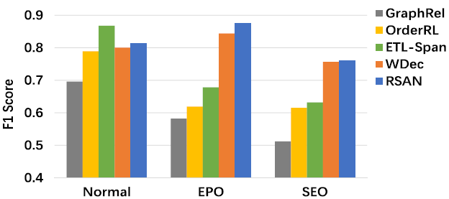
RSAN
Analysis

Slide 26
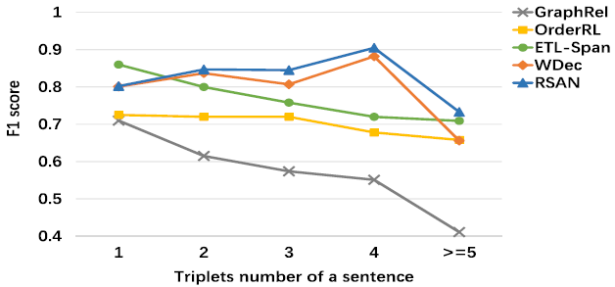
RSAN
Analysis

Slide 27
Conclusion
Approach | Model | Reference
Pipeline | NER + Relation classification | -
Entity->Relation | Jointly training (share parameters) | [Miwa and Bansal, 2016]
 | GraphRel | [Fu et al., 2019 ]
 | WDec | [Nayak and Ng, 2020]
Relation->Entity | CopyRE; CopyMTL; OrderRL | [Zeng et al., 2018] …
 | HRL | [Takanobu et al., 2019]
Entity & Relation | Table-filling | [Miwa and Sasaki, 2014]
 | NovelTagging | [Zheng et al., 2017]
 | PA-LSTM; ETL-Span | [Dai et al. 2019]; [Yu et al., 2020]
Relation-based Entity | RSAN | [Yuan et al. 2020] (IJCAI2020)

Slide 28
Conclusion
Method | Model
NER + Relation Classification | Pipeline
 | Joint (parameter sharing)
 | GraphRel
Sequence labeling | Table-filling
 | NovelTagging
 | PA-LSTM; ETL-Span
 | RSAN
Generation | CopyRE; CopyMTL; OrderRL
 | HRL
 | WDec

Slide 29
Thanks For Your Attention!

