Slide 1

Garbage Collection & optimization in Unity
Giovanni Campo
Game Client Engineer – DIGIT Game Studios
codingadventures.me

Slide 2
About me
1 year as Game Client Engineer @ DIGIT Game Studios
10 years in finance/military industry as a software engineer
Blog writer @ codingadventures.me
Open source contributor @ github.com/nbasakuragi
Nerd @ home

Slide 3
Today’s talk
Memory allocation
Garbage Collection
Pros and cons
Pitfalls
Optimization tips and tricks in Unity

Slide 4
Memory allocation
Languages provide 3 types of memory allocation
Static allocation
Memory reserved at compile time, No OutOfMemoryException
Stack allocation (or Automatic memory allocation)
Memory frames, recursion available, Reduced robustness, StackOverflowException!
Heap allocation (or dynamic memory allocation)
Extreme flexibility, Memory management but bye bye robustness !
Welcome undefined behaviours!
Notes:
Static Allocation:
- Simplest allocation option and was supported by initial languages like Fortran (early 50’s). All memory was allocated (reserved) during compile time and variable names were bound to the target memory and frozen.
- Size of all Data Structures were known at runtime. Recursion was not possible as the variables for a method were statically allocated and cannot be saved.
- Advantage is predictability and robustness.
Stack Allocation:
- worked past some limitations of static allocation by supporting memory frames that got pushed onto the system stack as procedures were called.
- Reduced robustness because based on control flow the program could get out of stack and the additional stack management overhead reduced speed
Static members live as gc roots forever (as they are part of the app domain) and are not collected unless the assembly is unloaded. For VM languages static allocation means that the memory is allocated by the CLR when the program is first executed and it lives for the whole duration of the process.

Slide 5
Automatic dynamic Memory allocation
Invented by John McCarthy around 1959 to abstract away manual memory management in Lisp
Garbage Collector
There exists several algorithms
Reference counting
Stop and Copy
Mark and Sweep – (used by the mono runtime)
Generational GC
Notes:
John McCarthy was a computer scientist, he coined the term AI and he LISP and was very influential in the early development of AI.
LISP was the second oldest high-level programming language (after fortran) invented. Was used mainly for AI research.

Slide 6
Garbage collector CASE SCENARIOs
Two inter-related scenarios
removes garbage
avoids dangling pointers
Notes:
The garbage collector usually takes care of two different scenarions which are very inter-related. Removes garbage, and avoid dangling pointers.

Slide 7
Case 1: Garbage collect
ROOT
Object 1
Object 2
Object 3
ROOT
Object 1
Object 2
Object 3

Slide 8
Case 2: Dangling reference
ROOT
Object 1
Object 2
Object 3
ROOT’
Object 4

Slide 9
Case 2: Dangling reference
ROOT
Object 1
Object 2
Object 3
ROOT’
Object 4

Slide 10
GC pros and cons
Pros
Frees devs from manually dealing with memory deallocation
Avoid dangling pointer bugs
Avoid memory leaks
Increases Robustness, Reduces code overhead
Cons
uneven performance in real-time environments
Non deterministic

Slide 11
Reference vs value type
Classes are reference types
Passed by reference
allocated on the heap ⬅ GC
Struct and primitive are value types
Passed by value
Allocated on the stack

Slide 12
Reclaiming heap storage
Reference Counting
based on counting the number of references to a memory block
continuously tracks memory
frees objects when they go out of scope
Notes:
Each time memory is created or a reference to the object is assigned it’s refcount is bumped up. Each time a pointer is assigned away from it the refcount is reduced. When refcount of the block goes to 0, it means that no pointer references it and hence it is un-reachable and is garbage and can be reclaimed.

Slide 13
Reclaiming heap storage
Cons
Doesn’t support circular references
Poor performance
Continuous calls to update refCount
Not thread safe
Pros
collection distributed over the whole period of execution
In interactive system doesn’t result in system freezes
Notes:
Each time memory is created or a reference to the object is assigned it’s refcount is bumped up. Each time a pointer is assigned away from it the refcount is reduced. When refcount of the block goes to 0, it means that no pointer references it and hence it is un-reachable and is garbage and can be reclaimed.

Slide 14
Reclaiming heap storage
Stop and copy
breaks the memory into two regions (A, B)
Memory is allocated in the region a in a stack fashion
When first region is full, GC is run and alive objects are copied over region b
Region a is freed

Slide 15
Reclaiming heap storage
Mark and Sweep
No memory track, it is fired under certain conditions
Mark
Enumerates all the roots
Traverse the memory graph recursively
Objects are marked if reachable
Sweep
gets rid of unreachable objects

Slide 16
Mark and sweep
Root 1
Object 1
Object 2
Object 3
Root 2
Object 4
Object 5
NULL
Object 6

Slide 17
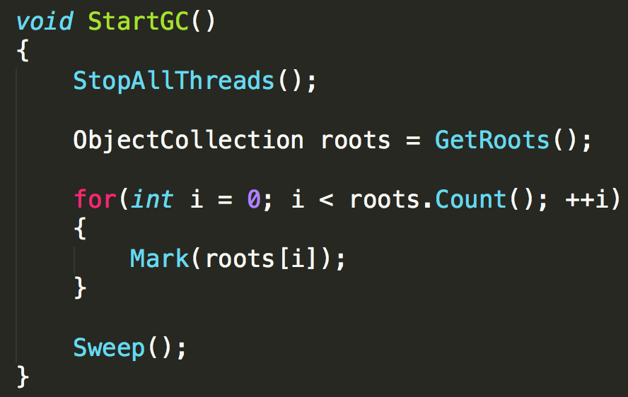
Mark and sweep
The algorithm

Slide 18
Mark and sweep
ROOT ENUMERATION
all references held in
global or static fields
local variables on the stack
function arguments on stack
Etc…
Notes:
The GC accesses the roots through an API provided by the CLR or the mono runtime.

Slide 19
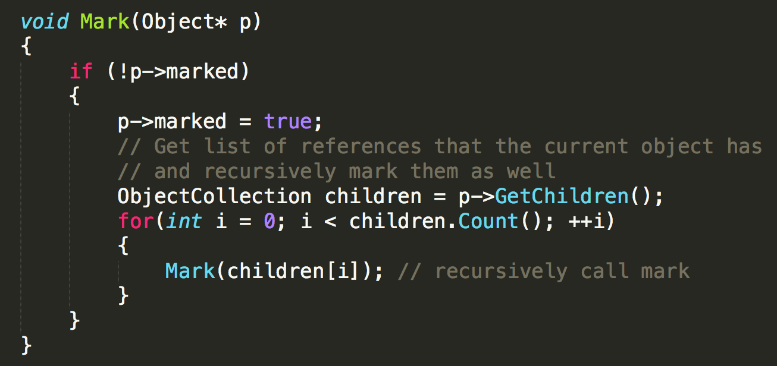
Mark and sweep
Notes:
This is a very simplified version of the algorithm. The purpose of this phase is to mark all of the objects that are referenced and can be traced from the root.
The recursion termination criteria is:
Either a node doesn’t have any children (leaf node)
If it is already marked which ensures that we do not land in infinite recursion for circular references

Slide 20
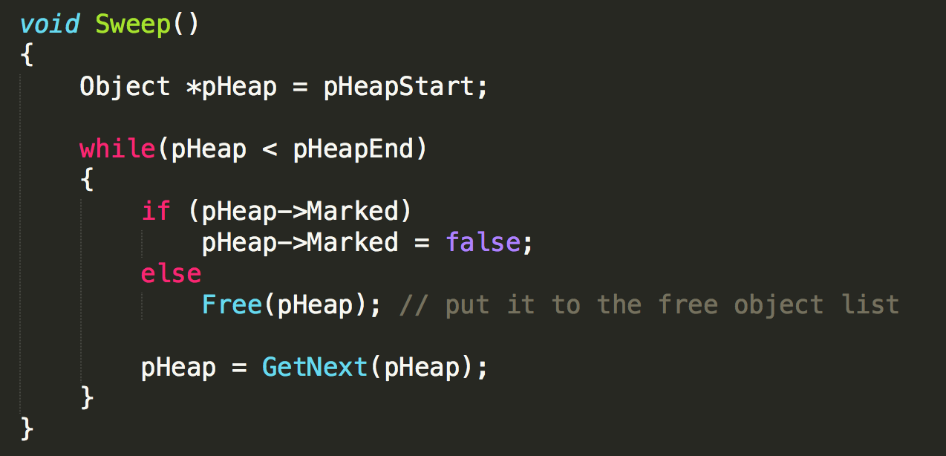
Mark and sweep
Notes:
Sweep starts by iterating through the entire memory and frees memory blocks that are not marked. It also clears the Mark bit so that subsequent GC passes can correctly mark/unmark them (resets the memory to pre-mark state).

Slide 21
MARK and sweep
Fragmentation
Repeated allocation can fragment memory
Slows allocation speed significantly
Compaction is run to reduce fragmentation and ensure faster allocations
when memory is compacted objects move, hence all references to them has to be updated

Slide 22
Pros and cons
Pros
Handles cyclic references naturally
Combined with compaction it ensures good locality
Cons
pauses execution
walks entire memory to mark objects
gets triggered again and again when memory approaches exhaustion

Slide 23
Reclaiming heap storage
Generational GC
Optimization over Mark and Sweep based on these assumptions:
Most objects die young
Over 90% garbage collected in a GC is newly created post the previous GC cycle
If an object survives a GC cycle the chances of it becoming garbage in the short term is low and hence the GC wastes time marking it again and again in each cycle
Notes:
The optimization based on the above observations is to segregate objects by age into multiple generations and collect each with different frequencies.

Slide 24
Generational garbage collection
objects can be segregated into age based generations in different ways
Time of creation
there exists 3 generations
Generation 0, 1 and 2

Slide 25
Generational garbage collection
A new created object goes into generation 0
If it survives a collection cycle it is promoted to the next higher generation
Lower generations are collected more often
ensures lower system pauses
Generations 1 and 2 collection is triggered a fewer times

Slide 26
Generational garbage collection
The heap can be considered as the accumulation of two heaps
Small object heap (SOH)
Objects smaller than 85 kb
All SOH objects go into generation 0
Large object heap (LOH)
Usually arrays but in general objects bigger than 85 kb
All LOH objects go directly into generation 2
No compaction

Slide 27
Generational garbage collection
Root 1
Object 1
Object 2
NULL
Object 4
Object 3
Generation 0
Generation 1

Slide 28
Generational garbage collection
Root 1
Object 1
Object 2
NULL
Object 4
Object 3
Generation 0
Generation 1

Slide 29
Generational garbage collection
Root 1
Object 1
NULL
Object 4
Generation 0
Generation 1

Slide 30
Generational garbage collection
Root 1
Object 1
Root 2
Object 2
Object 3
Object 4
NULL
Generation 0
Generation 1

Slide 31
Condition for garbage collection
The system has low physical memory
The memory used by allocated objects on the managed heap is over an acceptable threshold
The GC.Collect method is called
In unity is good practice to trigger GC during game pauses or level loading

Slide 32
Unity’s garbage collector
Mono Runtime 2.6.5 uses Boehm Garbage collector
Uses mark-and-sweep only
No heap compaction
No Generations
Heap fragmentation is hard to recover from
Prefer allocating small buffers over large buffer

Slide 33
Optimization tricks
Rule of Thumb
Don’t optimize too early
“Premature optimization is the root of all evil” D. Knuth
Which doesn’t mean optimize your code when your project if finished!
Keep profiling your project to avoid surprises

Slide 34
Optimization tricks
class vs struct
object pooling
virtual methods
Casting
finalizers
Function pointers
Boxing vs Unboxing

Slide 35
Class vs struct
Instance of classes are allocated on the heap
Accessed through a pointer dereference ( 4 bytes )
Fixed overhead ( 8 bytes )
pointer to the method table
Sync block field
Total size for an empty class: 12 bytes

Slide 36
Class vs struct
Struct has no overhead
Size as the sum of the size of all its fields
But…
A struct declared as a local variable in a method is allocated on the stack
A struct declared as part of a class will live on the heap
If allocated on the stack the struct is copied if passed to a method

Slide 37
Array of objects vs array of struct
Consider an array of a million items
Array of objects:
object with 16 bytes of data
Total space usage is:
8 bytes array overhead + ( 4 byte pointer size × 1,000,000 ) + [ ( 8 bytes overhead + 16 bytes data) × 1,000,000) = 28 MB

Slide 38
Array of objects vs array of struct
Consider an array of a million items
Array of struct:
8 bytes array overhead + (16 bytes data × 1,000,000) = 16 MB

Slide 39
object pooling
Object pool is a tool to reuse objects
Goal is to instantiate once
As opposed to creating and destroying objects
Notes:
Object pooling can be applied also to lists. Instead of creating a new list every frame for instance you could just simply instantiate once in the awake/start and then cleaning it (emptying it). This approach saves a lot of memory.

Slide 40
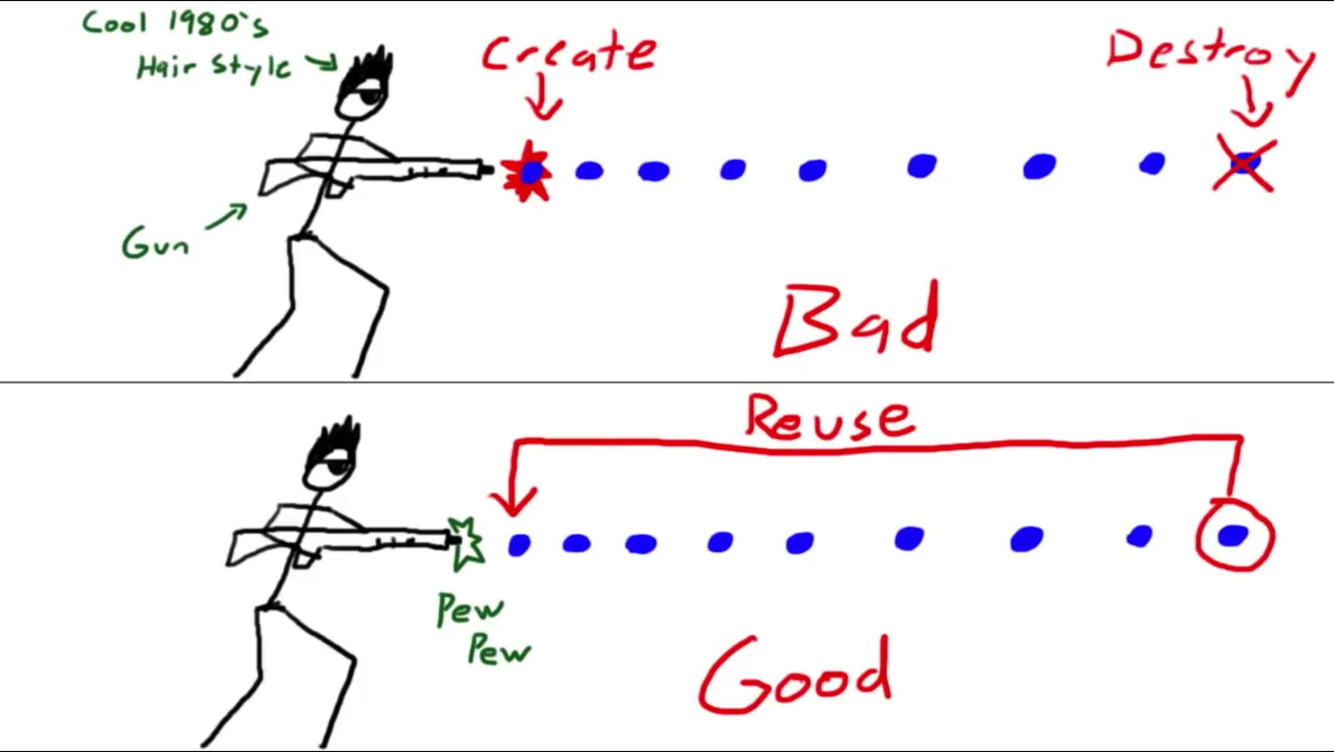
object pooling

Slide 41
Virtual Methods
Do not mark methods virtual “just in case”
Making methods virtual prevents the JIT to perform optimizations
i.e. the ability to inline them
Notes:
virtual methods are necessary for a coherent design in your program don’t remove them of course

Slide 42
Casting
avoid casting wherever possible
Casting is never free:
Up cast is cheap
Down cast is expensive
An invalid cast is extremely expensive

Slide 43
casting
Up cast (1 gen): 1.00x
Up cast (2 gens): 1.00x
Down cast (1 gen): 1.25x
Down cast (2 gens): 1.37x
Interface: 2.73x
Invalid Cast: 14934.51x
as (success): 1.01x
as (failure): 2.60x

Slide 44
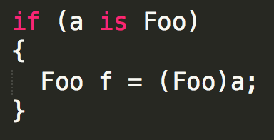
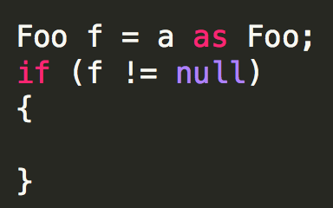
Casting
Don’ts
Do’s

Slide 45
delegates
There are two costs associated with use of delegates:
construction
invocation
Invocation is comparable to a normal method call
Construction can be quite expensive

Slide 46
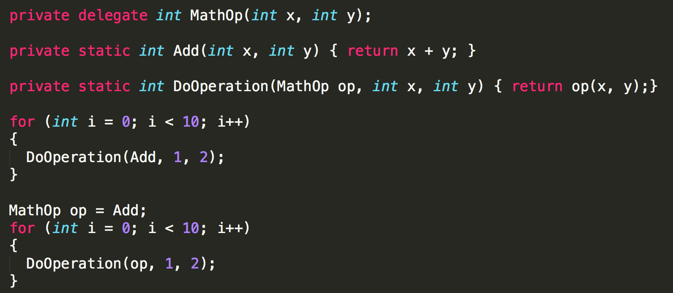
Delegates

Slide 47
Finalizers
Finalizers are code, triggered by the GC to cleanup unmanaged resources
Never implement a finalizer unless it is required
And if it’s required…use the Dispose method by implementing IDisposable interface instead
if your class implements a finalizer
you are guaranteeing that it will stay in memory after the collection that should have collected it

Slide 48
Boxing vs unboxing
Boxing is the process of wrapping a value type inside an object (a reference type) that lives on the heap
Unboxing is getting the original value back out again

Slide 49
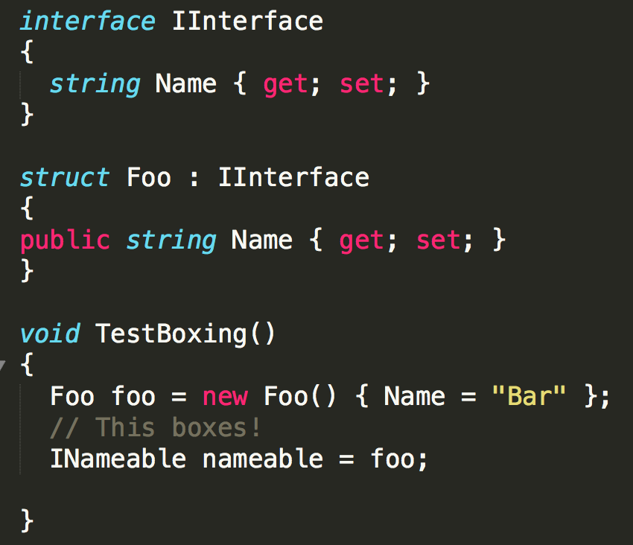
Boxing vs unboxing

Slide 50
Q&A
Any questions ?

