Slide 1
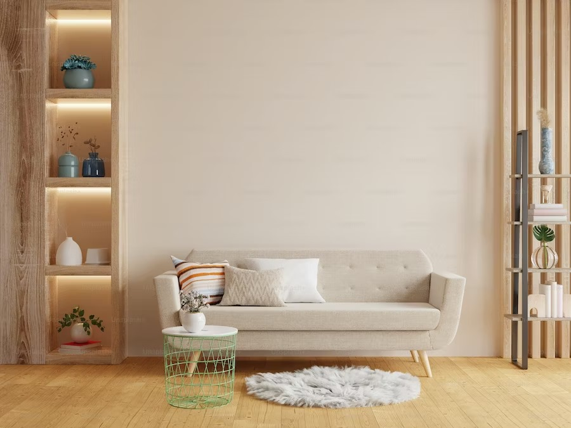


Find your next house!
Register here!
View Listings

Slide 2





REGISTER NOW
Search

Slide 3
REGISTER NOW
FILTER BY
Search
Property Type
Rental Frequency
Villa
Townhouse
Weekly
Monthly
Apartment
Colony
Yearly
Any
Bedrooms
Bathrooms
1
Any
1
Any
Area
Price
800 sqft.
5700 sqft.
₹20k
₹3L
Amenities
Pool
Ventilation
Vaastu Compliant
Clubhouse
Parking
Air Conditioned
Large Windows
Park
Gym
Spa
DONE

Slide 4
FILTER BY
Property Type
Rental Frequency
Villa
Townhouse
Weekly
Monthly
Apartment
Colony
Yearly
Any
Bedrooms
Bathrooms
1
Any
1
Any
Area
Price
800 sqft.
5700 sqft.
₹20k
₹3L
Amenities
Pool
Ventilation
Vaastu Compliant
Clubhouse
Parking
Air Conditioned
Large Windows
Park
Gym
Spa
DONE

Slide 5
REGISTER NOW
Search

