Slide 1
Applied Data Science Capstone: Predicting car accident severity
Buhai DIANA-VICTORIA
COURSERA 2020 PROJECT

Slide 2
Introduction
The demand for vehicles rises consistently. Consequently, so does the number of vehicles on the road and the probability of involvement in traffic jams or car accidents.
By collecting and analysing relevant data on car accidents, we aim to establish to what extent can:
1) weather conditions
2) the total number of people involved in the collision or the number pedestrians
3) road conditions or light conditions
4) driving under the influence of drugs or alcohol (DUI)
help us predict car accident severity.
Stakeholders: traffic participants, traffic police (authorities).

Slide 3
DATA SOURCES
In order to answer the proposed questions, we shall use data from the SDOT Traffic Management Division, Traffic Records Group.
Here is the provided link to database: https://s3.us.cloud-object-storage.appdomain.cloud/cf-courses-data/CognitiveClass/DP0701EN/version-2/Data-Collisions.csv
The metadata is to be found here: https://s3.us.cloud-object-storage.appdomain.cloud/cf-courses-data/CognitiveClass/DP0701EN/version-2/Metadata.pdf
The database contains 37 attributes, including the severity code, the number of persons involved in the car accident, the number of pedestrians, road and light conditions, information on driving under the influence of drugs or alcohol. The database contains 194673 records.

Slide 4
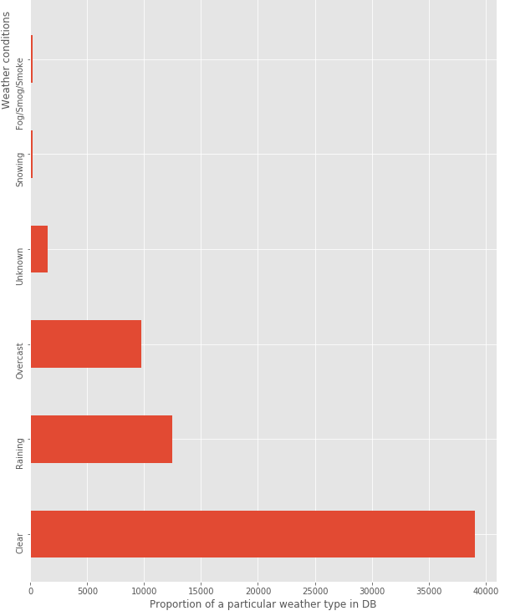
Weather conditions among car accidents data Clear, raining, and overcast weather types are the most common among the available data. *Bar plot was cropped for the purpose of this presentation. Please refer to the full report for the figure.

Slide 5
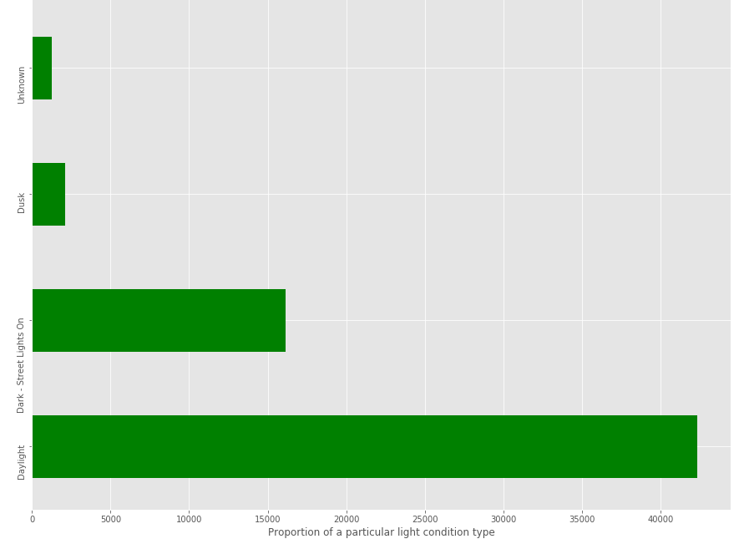
Light conditions among car accident data. The most common light conditions are: daylight, dark with street lights on, and dusk. *Bar plot was cropped for the purpose of this presentation. Please refer to the full report for the figure.

Slide 6
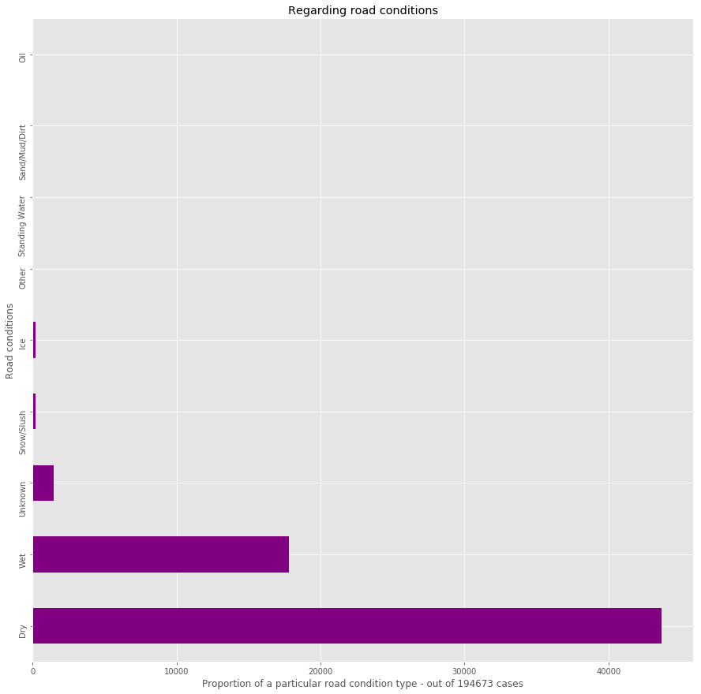
Road conditions among car accident data Dry, wet, and unknown road conditions are the most common.

Slide 7
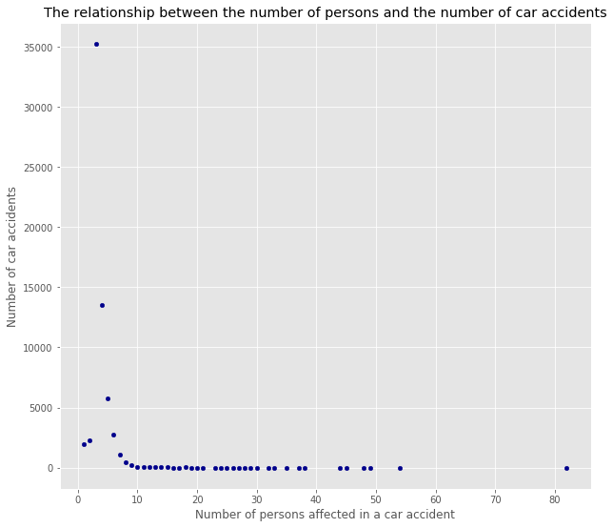
The majority of cases involve under 10 persons.

Slide 8
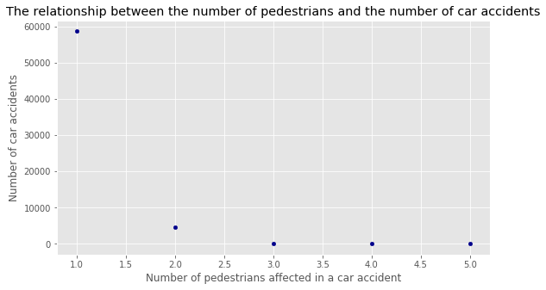
One can tell the most the accidents involve one pedestrian.

Slide 9
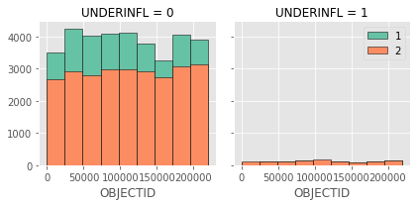
Representation of DUI CASES With green are represented the property damage cases (1) and with orange the injury cases (2). Additionally, one notices that most cases do not involve DUI. In fact, 3.15% are dui-caused car accidents (2231 cases).

Slide 10
INFERENTIAL STATISTICAL TESTING
Attribute (in correlation with severity code) | Spearman coefficient | p value | Interpretation
DUI | 0.030 | 1.468 | not correlated; not statistically significant
No. of persons | 0.079 | 6.383 | not correlated; not statistically significant
No. of pedestrians | 0.270 | 0.0 | slightly correlated; probably statistically significant
Raining (weather condition) | 0.006 | 0.103 | not correlated; not statistically significant
Dark - Street Lights Off (light conditions) | -0.0002 | 0.952 | not correlated; not statistically significant
Standing water (road conditions) | -0.004 | 0.235 | not correlated; not statistically significant
Daylight (weather condition) | 0.017 | 1.332 | not correlated; not statistically significant
Sand/Mud/Dirt (road conditions) | -0.001 | 0.733 | not correlated; not statistically significant
The set level of statistical significance was p<0.05. A Spearman coefficient of 1 or -1 (or close to those values) denote a correlation.

Slide 11
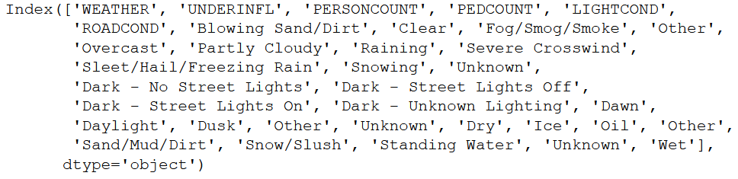
FINAL FUTURE SET FOR MACHINE LEARNING MODELS
The following attributes were one-hot coded:
Weather conditions
Road conditions
Light conditions

Slide 12
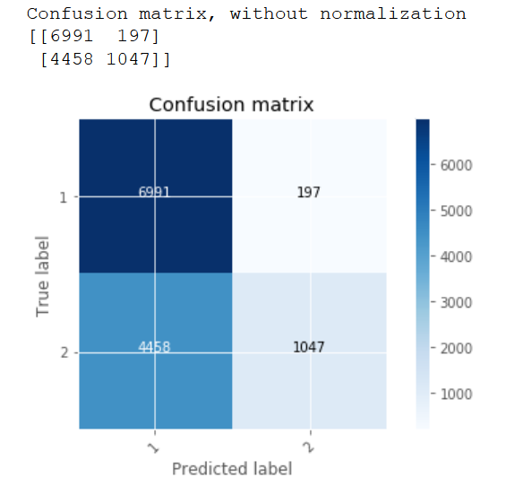
SUPPORT VECTOR MACHINE – CONFUSION MATRIX

Slide 13
ACCURACY OF SVM AND LOGISTIC REGRESSION MODELS
 | Jaccard’s index | F1-score | Log Loss
Support Vector Machine | 0.633 | 0.559 | -
Logistic Regression | 0.633 | 0.565 | 0.632
The values for F1-score and Jaccard’s index are comparable with those obtained through support vector machine. Log Loss of 0.632 in a case of binary classification (severity code of 1 or 2) showcases a considerable level of uncertainty or entropy of the model.

Slide 14
Discussion: RECOMMENDATIONS
Choose / provide balanced set of data
Increase the number of attributes for feature sets (overfitting!)

Slide 15
CONCLUSION
Our project highlighted the fact…
that the number of involved pedestrians is slightly correlated with car accidents’ severity code;
that in the large majority of cases the drivers were not driving under the influence of drugs or alcohol;
that most car accidents seem to occur having clear weather and daylight.

