Slide 1
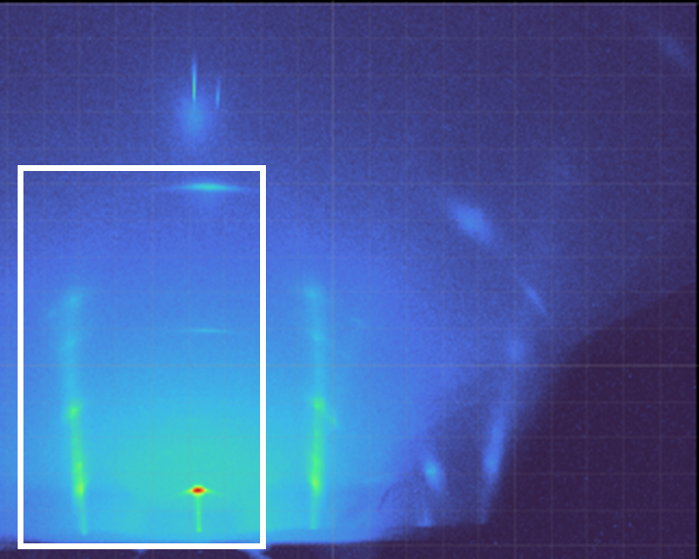
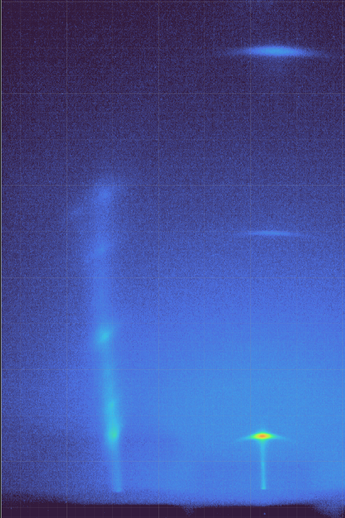


Detector Image of $PbI_{2}$
r=0
r=1
$$2θ=0$$
Region of Interest

