Slide 1
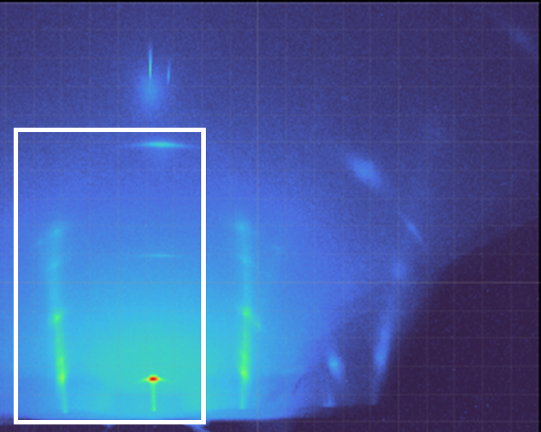
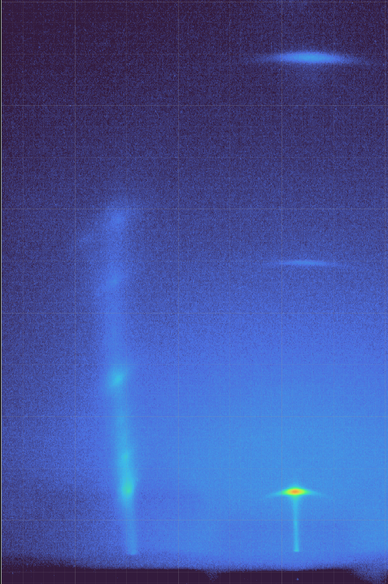


Detector Image of $PbI_{2}$
m=0
m=1
$$2θ=0$$
Region of Interest

