Slide 1
General vs Category-Specific: Kickstarter Campaign Success Prediction
CMSE802 | Alex Chen

Slide 2
Table of contents
01
02
03
04
05
06
Background
Dataset
Preprocessing
Exploratory Analysis
Modeling
Interpretations and Results

Slide 3

01
Background

Slide 4



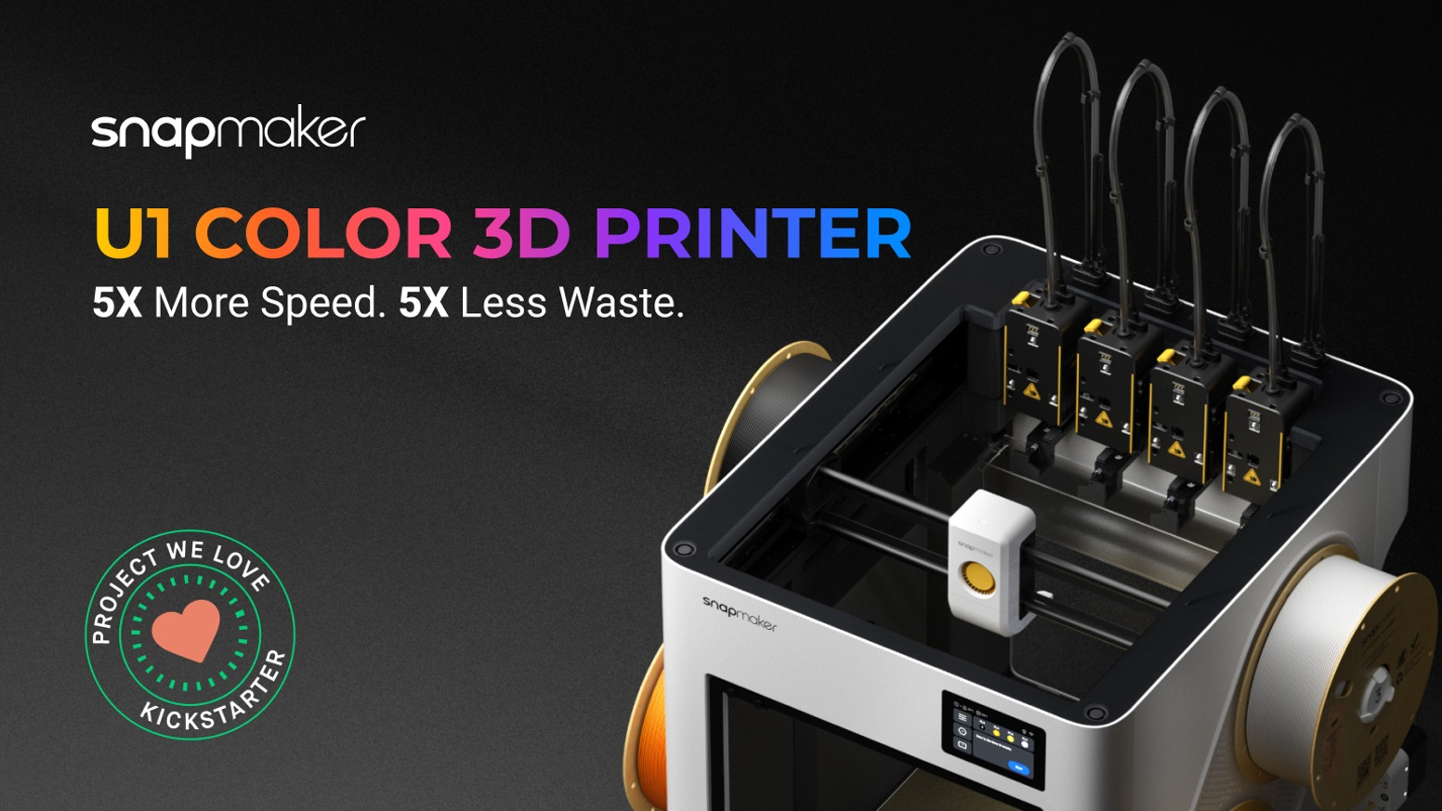
Background
$13 million
What is Kickstarter?
$8.8 million
Founded in 2009, crowdfunding platform for all types of different creative projects.
As of April 2025, more than US$8.7 billion has been pledged by about 24 million backers to over 275,000 successfully funded projects [1].
All-or-nothing funding: backers are only charged if the campaign reaches its funding goal
Campaigns are organized into broad categories (Games, Film & Video, Technology, etc.) that differ in audience and typical norms / scale.
$20.6 million

Slide 5
Research Question
⭐ Do different categories of Kickstarter campaigns have different predictive patterns for success?
⭐ Are models trained within specific categories more predictive within their category than models that are trained generally?
Motivation
Existing Work
Hosting a crowdfunding campaign is hard! Not everyone succeeds. There is no one-size-fits-all model.
Studying whether predictive relationships vary by category may allow for better focusing of strength and structure for implications in campaign design.
Common approaches emphasize overall predictive accuracy.
Campaign category is often just included as a control variable, models are usually estimated on all campaigns together.

Slide 6
02
Dataset

Slide 7

Origin
Webscraped Repository
Monthly snapshots of Kickstarter automatically taken by "Webrobots.io", a webscraping service provider.
Each snapshot contains all available campaigns that are reachable through regular pagination.
  This includes campaigns dating back to the beginning, so long as they have not been ripped from the site
We utilize a single snapshot, taken on Sept. 11th 2025

Slide 8
Shape and Target
Features
Monetary Info – goal, currency, exchange rates, ...
Timestamp Info – created_at, launched_at, deadline, ...
Geographic Info – country, location, state, ...
Project Profile Info – parent category, sub category, name, blurb, ...
⚠️ Lots of nested JSON object features
1 Snapshot | 83 Files
(262892, 42) RAW
`status`
"successful"
"failed"
"submitted"
For this project, we only care about projects with determined outcome, successful or failed
"live"​
"canceled"​
"suspended"
Target: status

Slide 9
03
Preprocessing

Slide 10
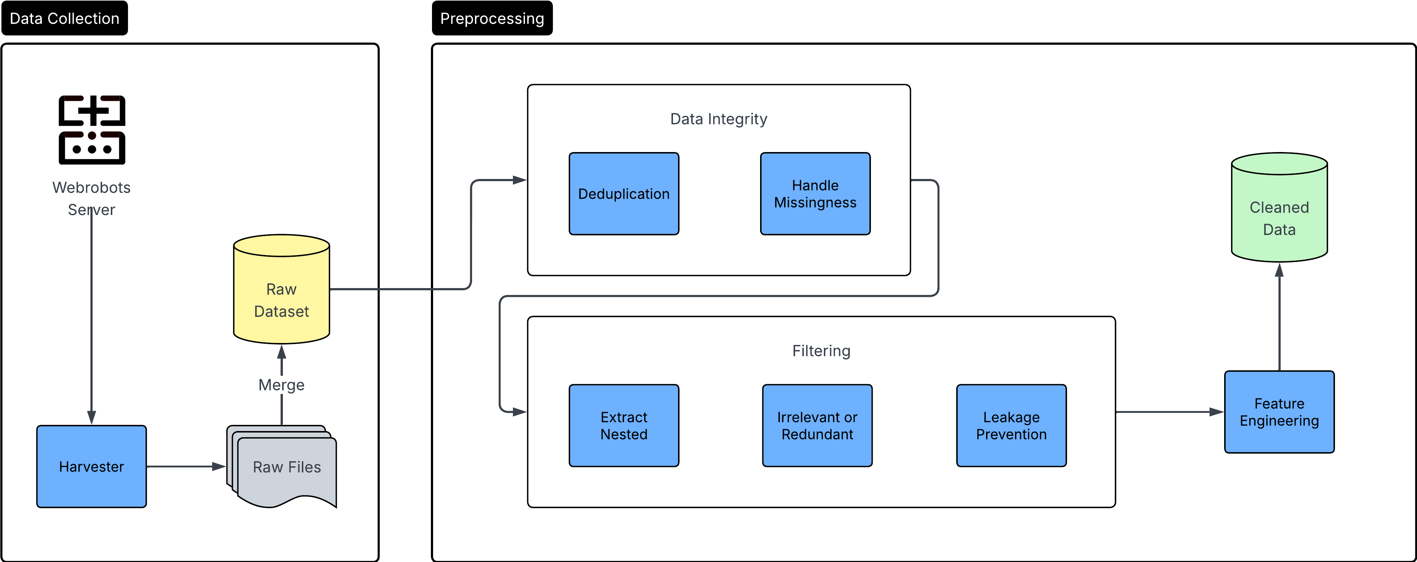
Preprocessing
Pipeline

Slide 11
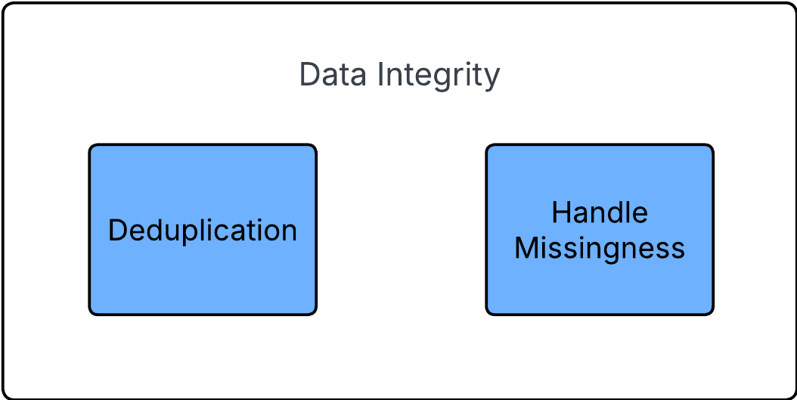
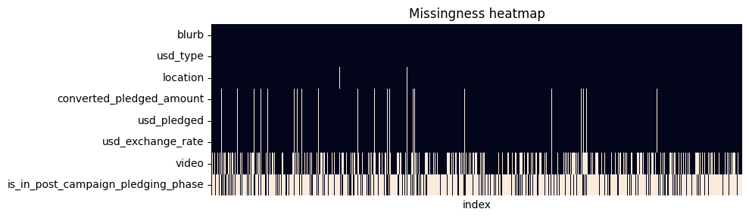
Integrity Analysis
Deduplication
Duplication analysis: duplicate ids, decide which one to keep
True duplication removal
Handle Missingness
Examining features closer to inform handling, either imputation, engineering, or dropping.
The main challenges:
Messy nested JSON features
Many types of missingness to solve:
  Some can be directly imputed using equation
  Some directly use missingness as signal
  Goal: Keep as much info as possible, robustly impute as much as possible.

Slide 12
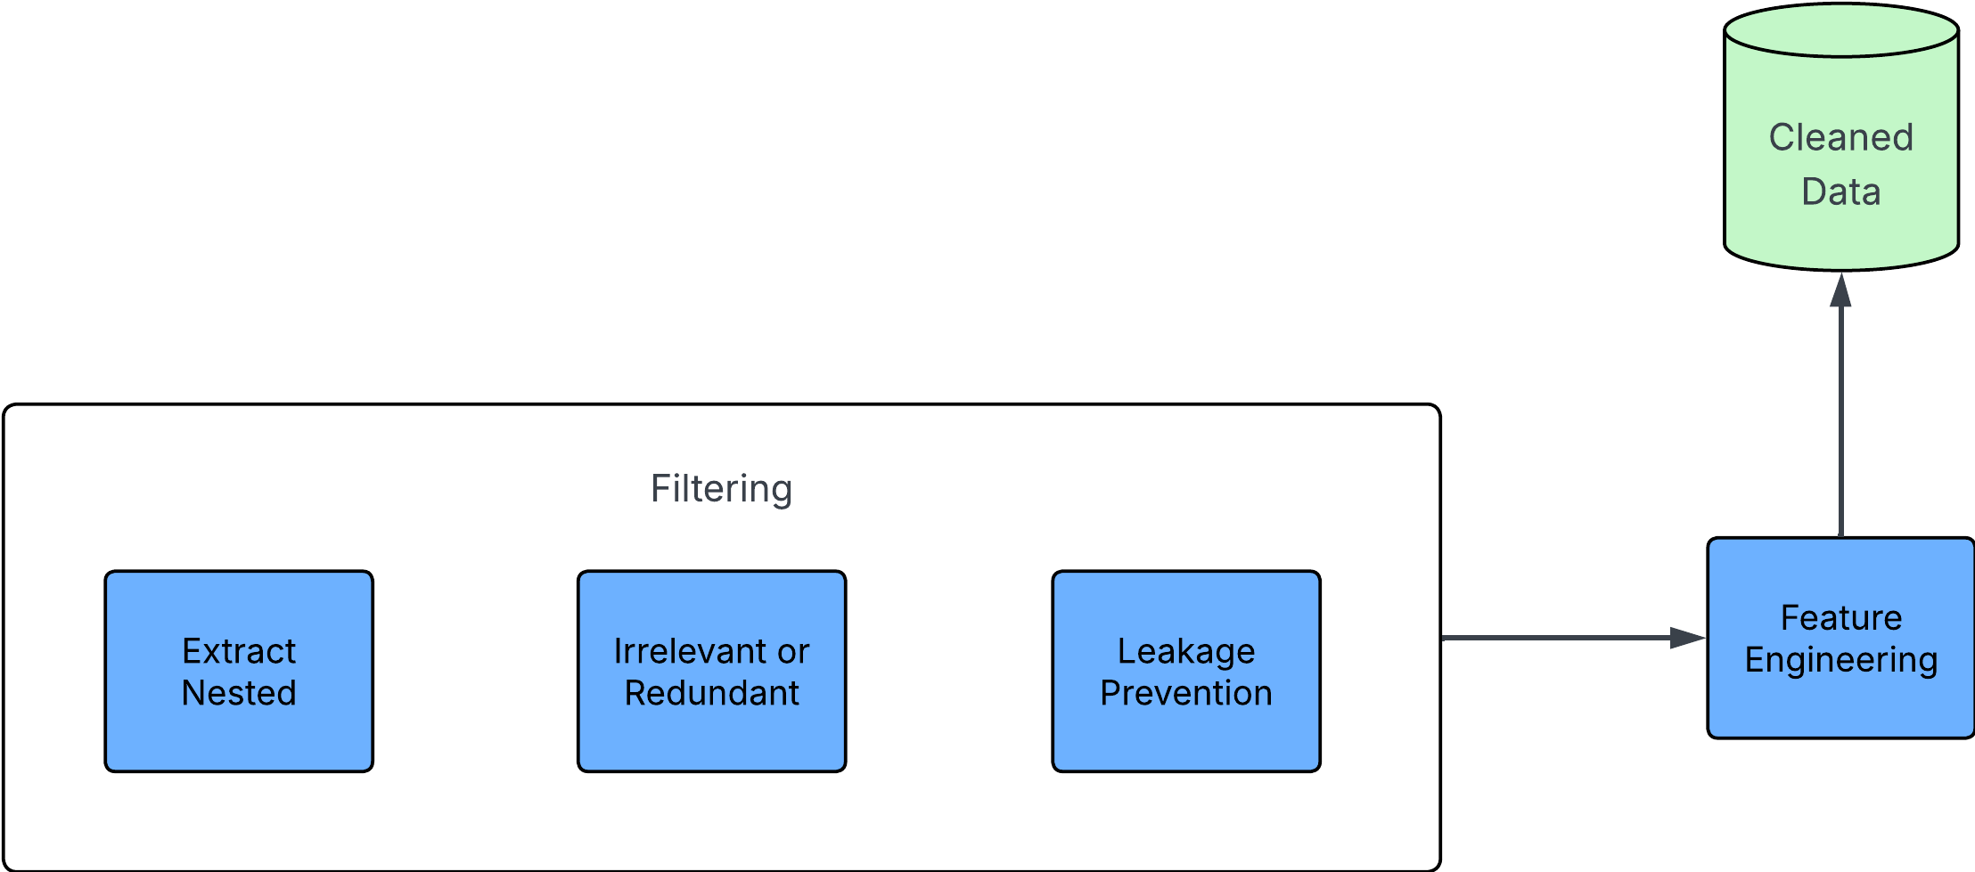
Filtering and Engineering
Extract Nested
Irrelevant / Redundant
Parse, and fix JSON errors
Load as JSON
Extract
Example:
{
'id': 284,
'name': 'Musical',
'analytics_name': 'Musical',
'slug': 'theater/musical',
'position': 5,
'parent_id',
'parent_name': 'Theater',
'color': 16743775,
'urls': {...}
}
Removal of repeated information, later correlation analysis for help.
Removal of irrelevant features, like urls, and UI attributes
Feature Engineering
Take irrelevant or relevant feature and turn it into something that can be used:
Example:
'video' -> 'has_video'
'blurb' -> 'blurb_len'
'deadline' - 'launched_at' ->
duration
Leakage Prevention
Overlap with `state`="successful"
'backers_count', 'pledged', 'percent_funded', 'spotlight', ...

Slide 13
04
Exploratory Analysis

Slide 14
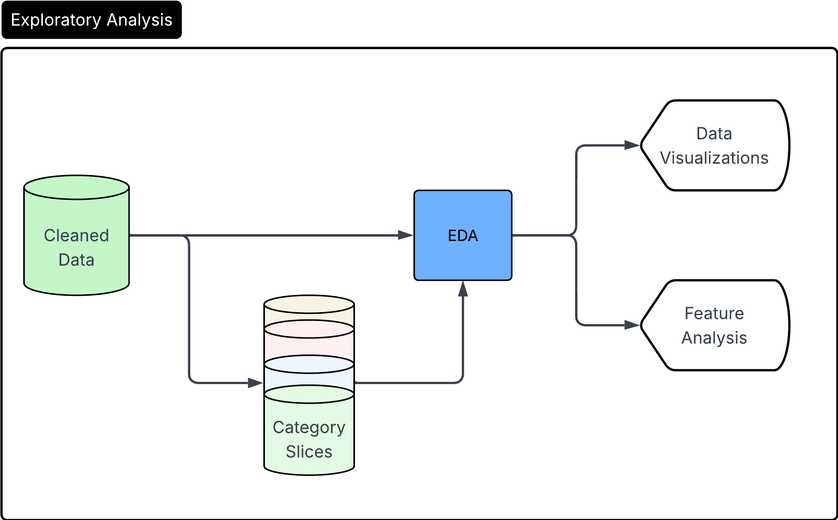
EDA
Pipeline

Slide 15
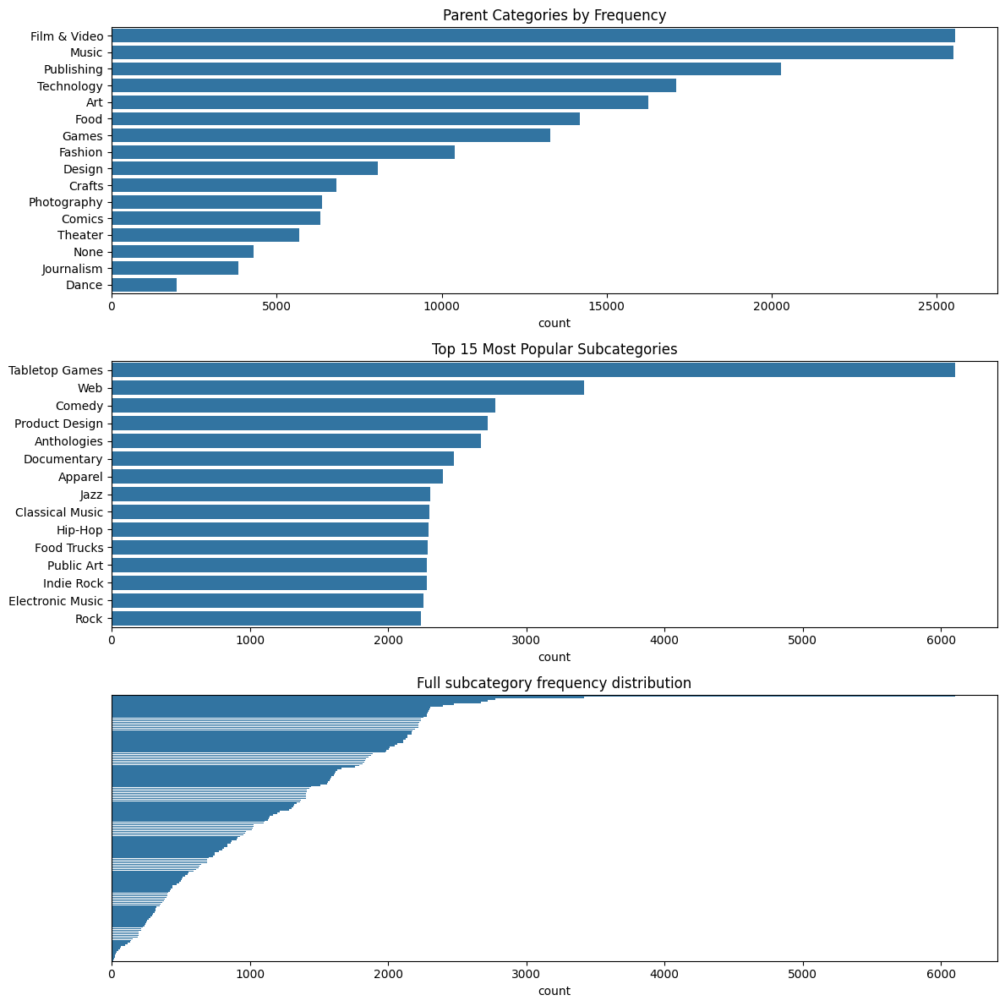
Heavy parent category imbalance
Film & Video and Music have over 25000 observations
Dance is only a 10th of this
What can this imply?
Model learning could be dominated by common categories
Niche signals could be obscured
Category Frequency
Distributions

Slide 16
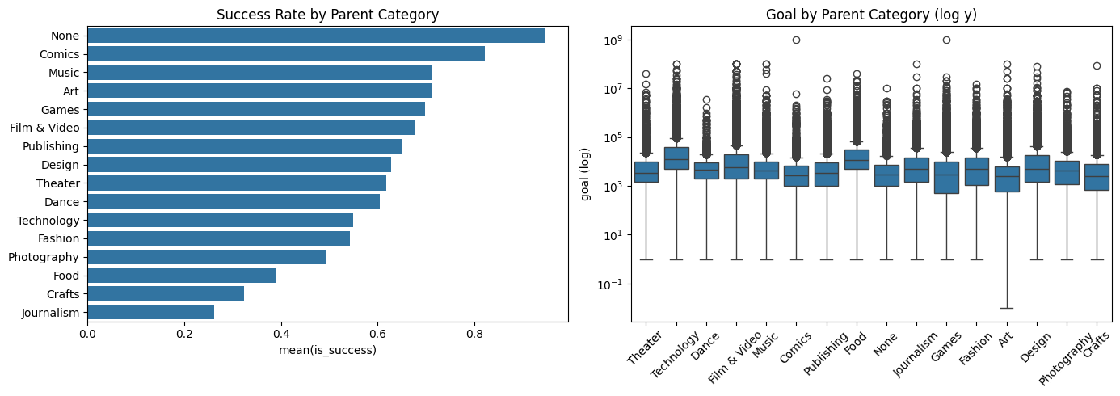
Feature variation across categories
Categories have heavy category success rate variation
Categories have large goal amount variation
Further justifies category specific modeling to capture nuances
Category vs Success
Goal vs Category

Slide 17
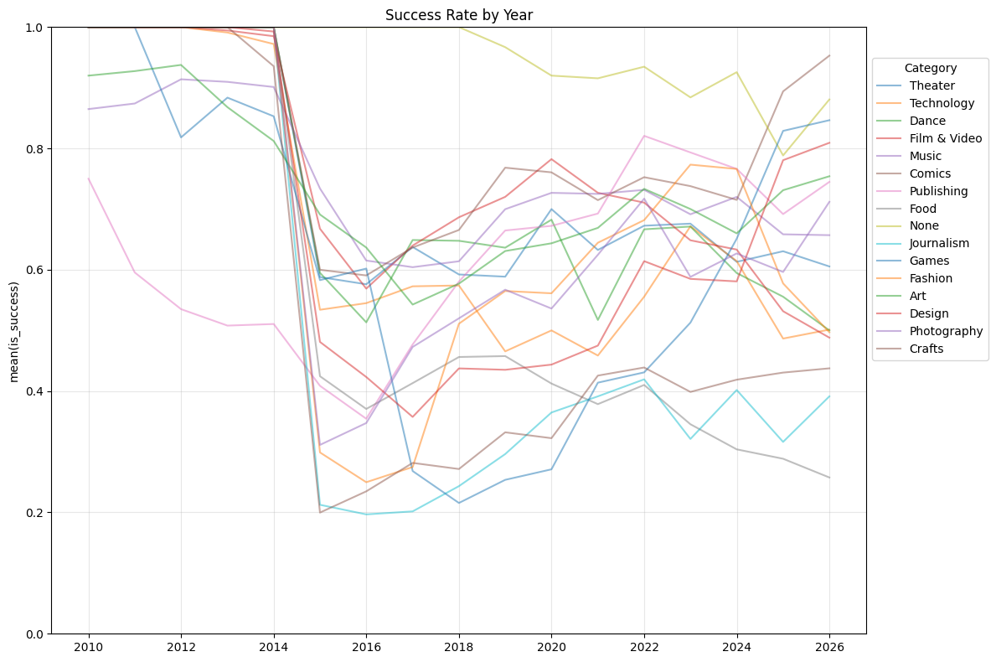
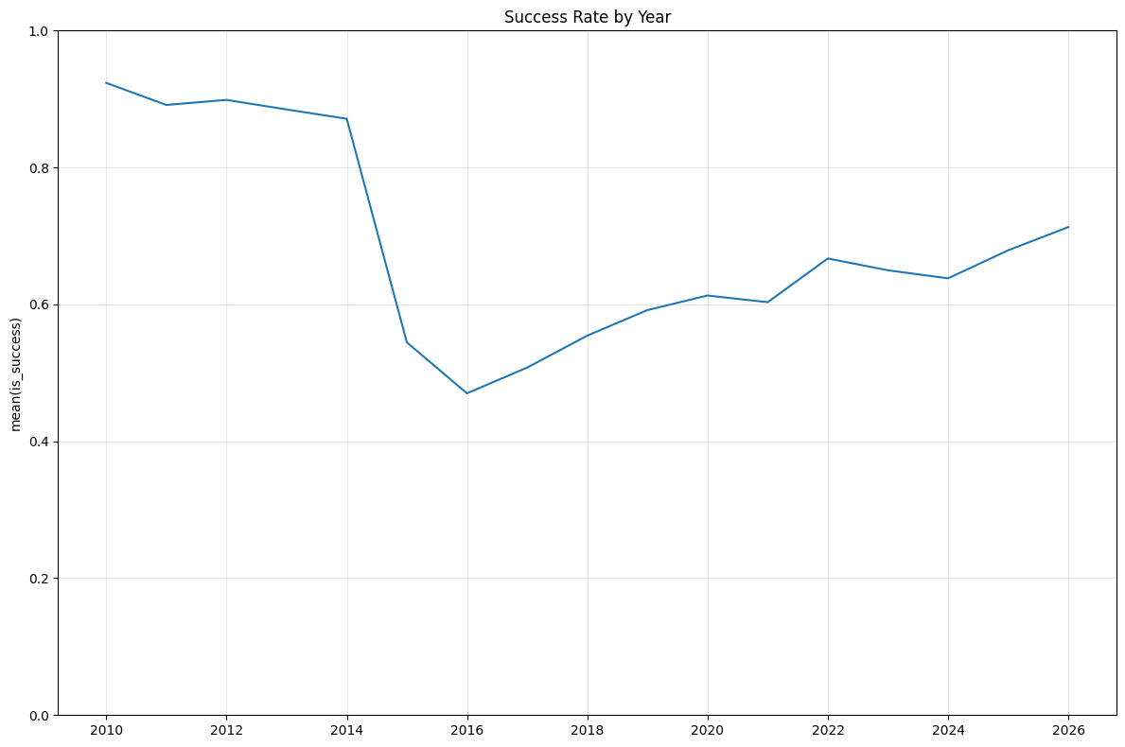
Categories seem to have generally matched the general trend of success rate over time.
Sharp decline in 2014, gradual increase from there on
Timeline Success Trends

Slide 18
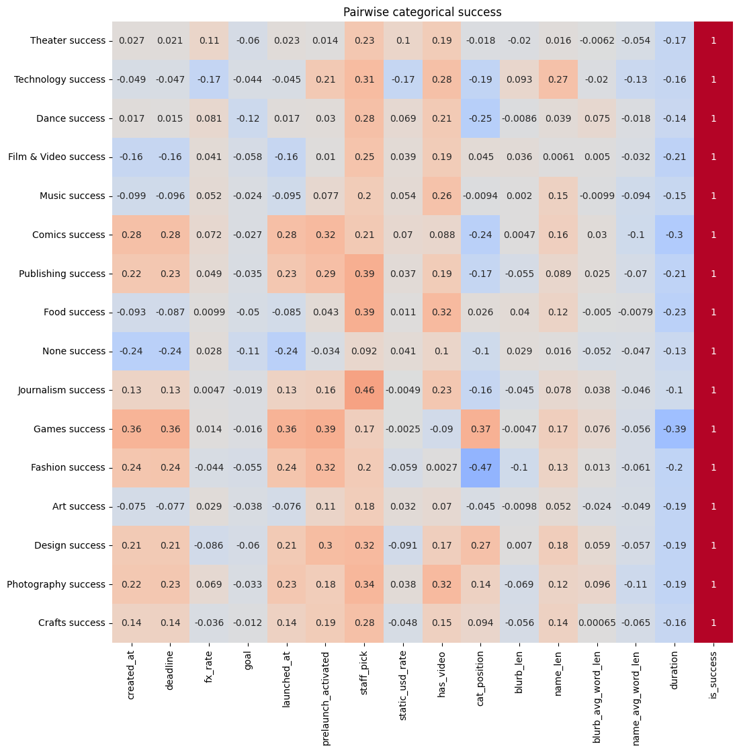
Categorical success rate correlations
Clear differences in linear affect of each feature depending on category
Goal does not appear to be a great linear predictor (but later, we see it have heavy nonlinear importance)
⭐General lack of consistent predictors across categories suggests category specific models may capture different feature importance than a general model.
Categorical Slice
Correlation

Slide 19
05
Modeling

Slide 20
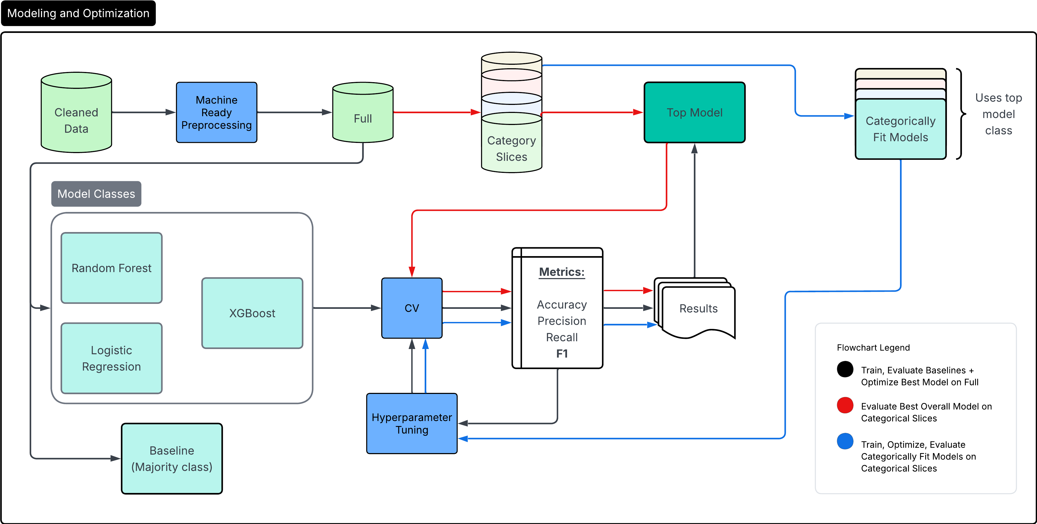
Modeling and Optimization Pipeline

Slide 21
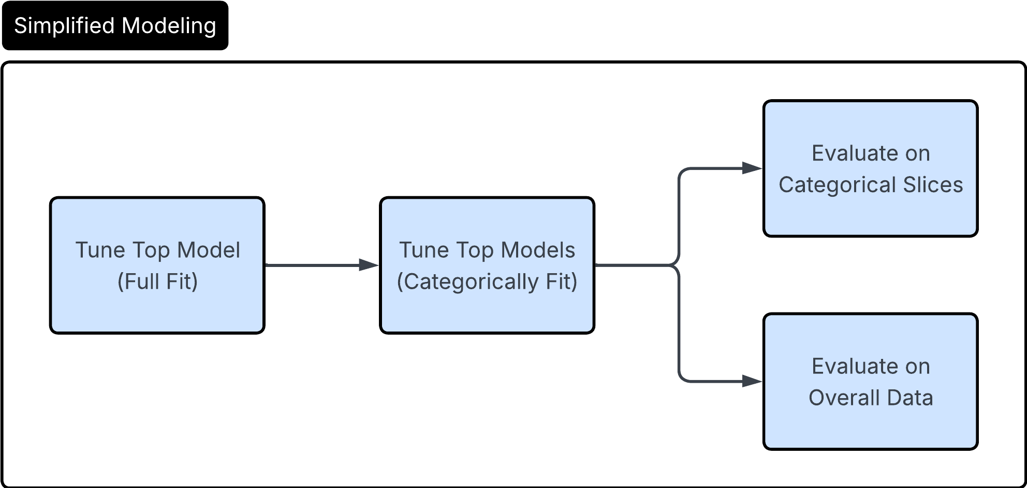
Notes:
StandardScalar for numerical
One-hot for categorical
Frequency encoding for high cardinality categorical
Single test holdout (20%), 5-fold stratified CV for optimization
Simplified Modeling Pipeline

Slide 22
06
Interpretation and Results

Slide 23
Overall Results
(Untuned)
Naïve Majority and Baseline Models
Majority class model shows 62.2% accuracy. If a model does not beat this baseline, we deem it as unpredictive and not useful for our investigation
Best model: XGBoost (but not by much)

Slide 24
Overall Results
(Tuned + Ensemble)
Virtually identical performance:
Both our tuned XGBoost and ensemble of tuned XGBoost models (on categorical slices) performed virtually equally.

Slide 25
General XGB Model
Category XGB Ensemble Model
Again, virtually identical, even across categories!
Category Specific Results (Tuned XGB vs Ensemble)

Slide 26
Interpretations
What does this say about our research questions?
Are models trained within specific categories more predictive within their category than models trained generally?
Answer:
No, at both aggregate and the category level, results show no clear advantage in terms of predictive power from either side.
Do different categories of Kickstarter campaigns have different predictive patterns for success?
Let’s do further investigation, EDA suggests yes

Slide 27
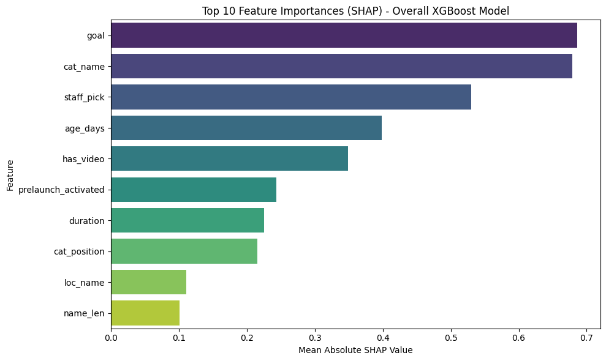
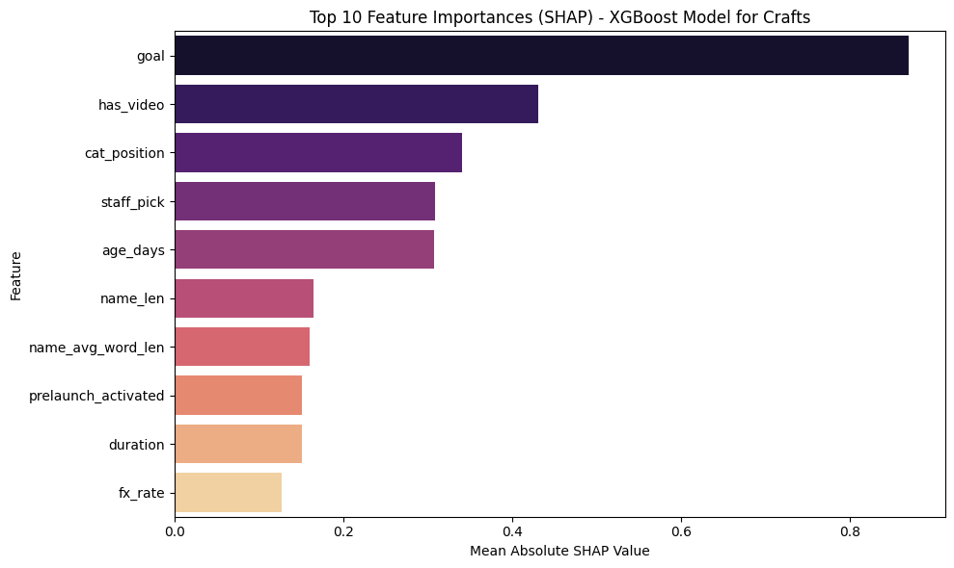
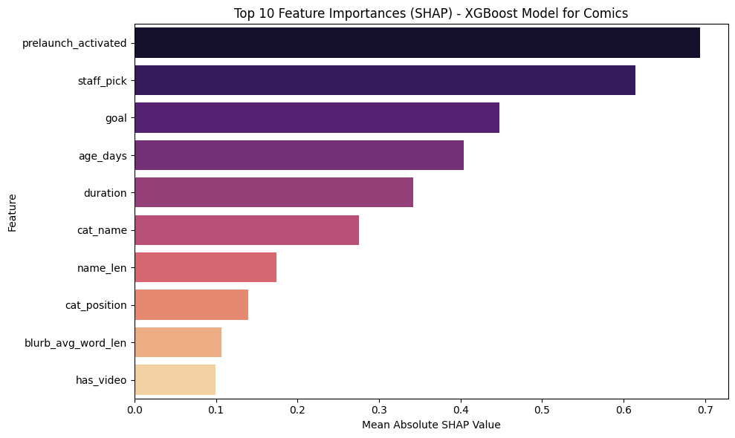
Top 10 SHAP values
(overall vs category specific)
Sample of 10,000 for overall model SHAP values
Full categorical slice for category specific model model SHAP values
Different feature importances and relationships with success, even if overall predictive performance is similar!

Slide 28
Interpretations Pt.2
What does this say about our research questions?
Are models trained within specific categories more predictive within their category than models trained generally?
Answer:
No, at both aggregate and the category level, results show no clear advantage in terms of predictive power from either side.
Do different categories of Kickstarter campaigns have different predictive patterns for success?
Answer:
Yes, different categories exhibit different predictive patterns for success, as evidenced by SHAP analysis as well as bivariate and correlation analysis from EDA.

Slide 29
Conclusion
Taking these findings together, we can see a nuanced picture:
If the goal is purely predictive power (forecasting campaign outcomes), both general and category-specific models perform similarly, with no clear advantage to specialization.
However, if the goal includes interpretability and understanding category-specific dynamics, then category-specific models may still be valuable for providing domain specific insights without loss of predictive accuracy.

Slide 30
Thanks!
Please keep this slide for attribution

Slide 31
References
Kickstarter Stats — Kickstarter
Frosthaven by Isaac Childres — Kickstarter
Exploding Kittens by Exploding Kittens — Kickstarter
Snapmaker U1 Color 3D Printer: 5X More Speed. 5X Less Waste. by Snapmaker — Kickstarter
Dataset: Kickstarter Datasets – Web Scraping Service

