Slide 1





MotionGlow

Slide 2
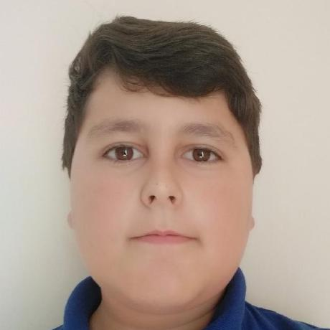
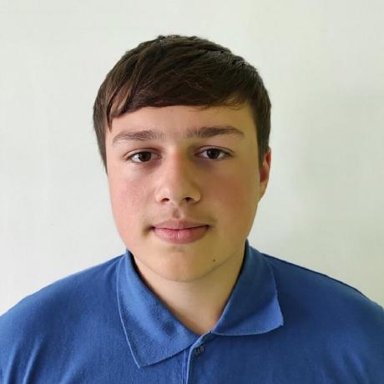
THE TEAM
Kaloyan Lambov
Daniil Furnika

Slide 3

THE IDEA

Slide 4


Slide 5















USED TECHNOLOGIES

Slide 6
PROJECT

