Slide 1
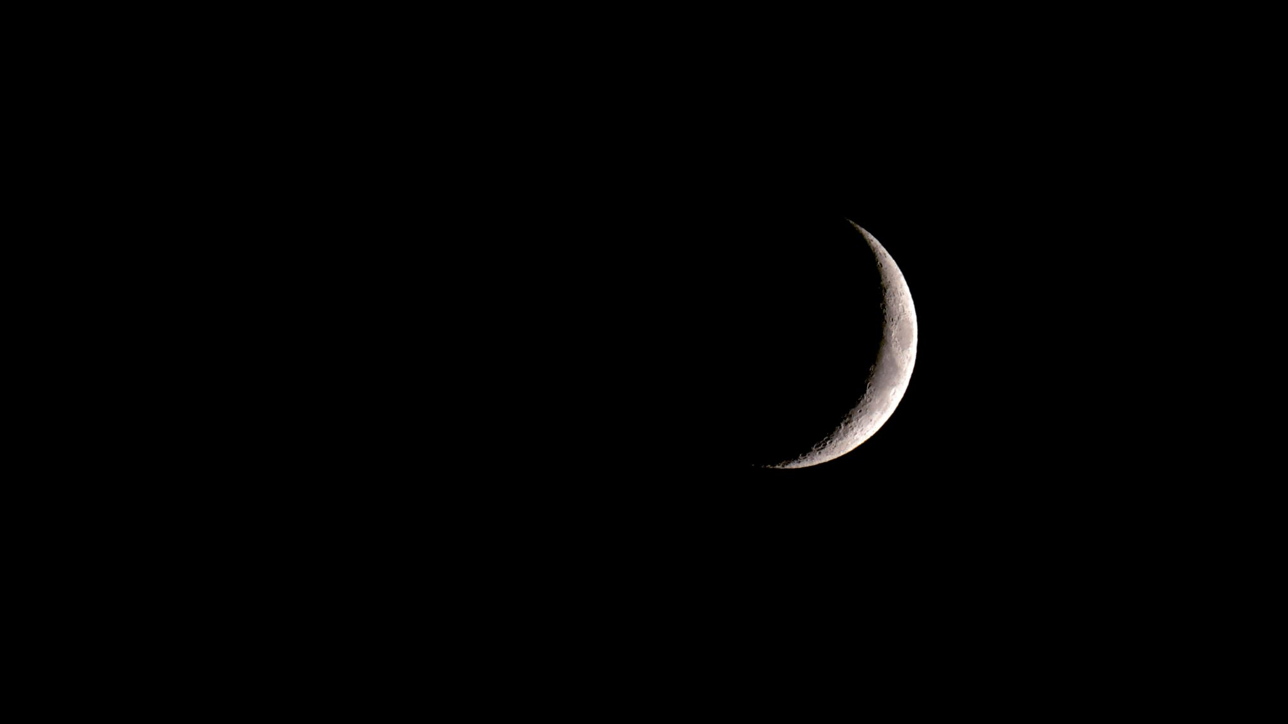
Megalodon
(Big Tooth)

Slide 2
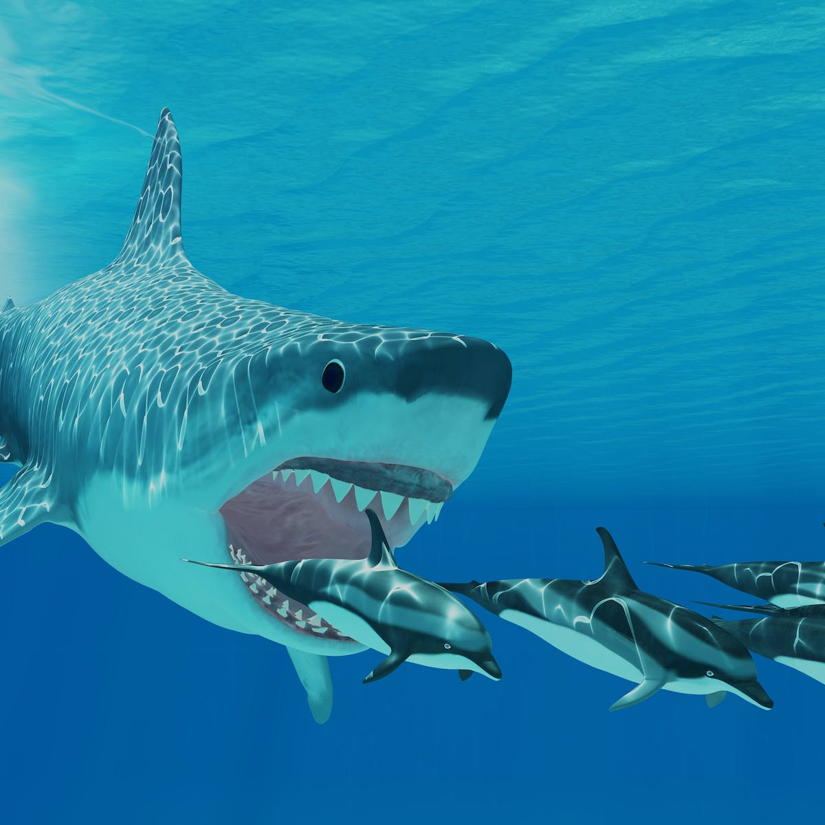
Megalodon was a kind of shark that lived millions of years ago. It is now extinct. It is thought to be the largest shark, as well as the largest fish, that ever lived. The word megalodon means “giant tooth.” it is thought that megalodons, on average, were about 33.5 feet (10.2 meters) long. The largest could have been up to 58.7 feet (17.9 meters) long. Some scientists argue that the largest megalodons may have been up to 82 feet (25 meters) long. Megalodons may have weighed from 30 to more than 65 metric tons.

Slide 3
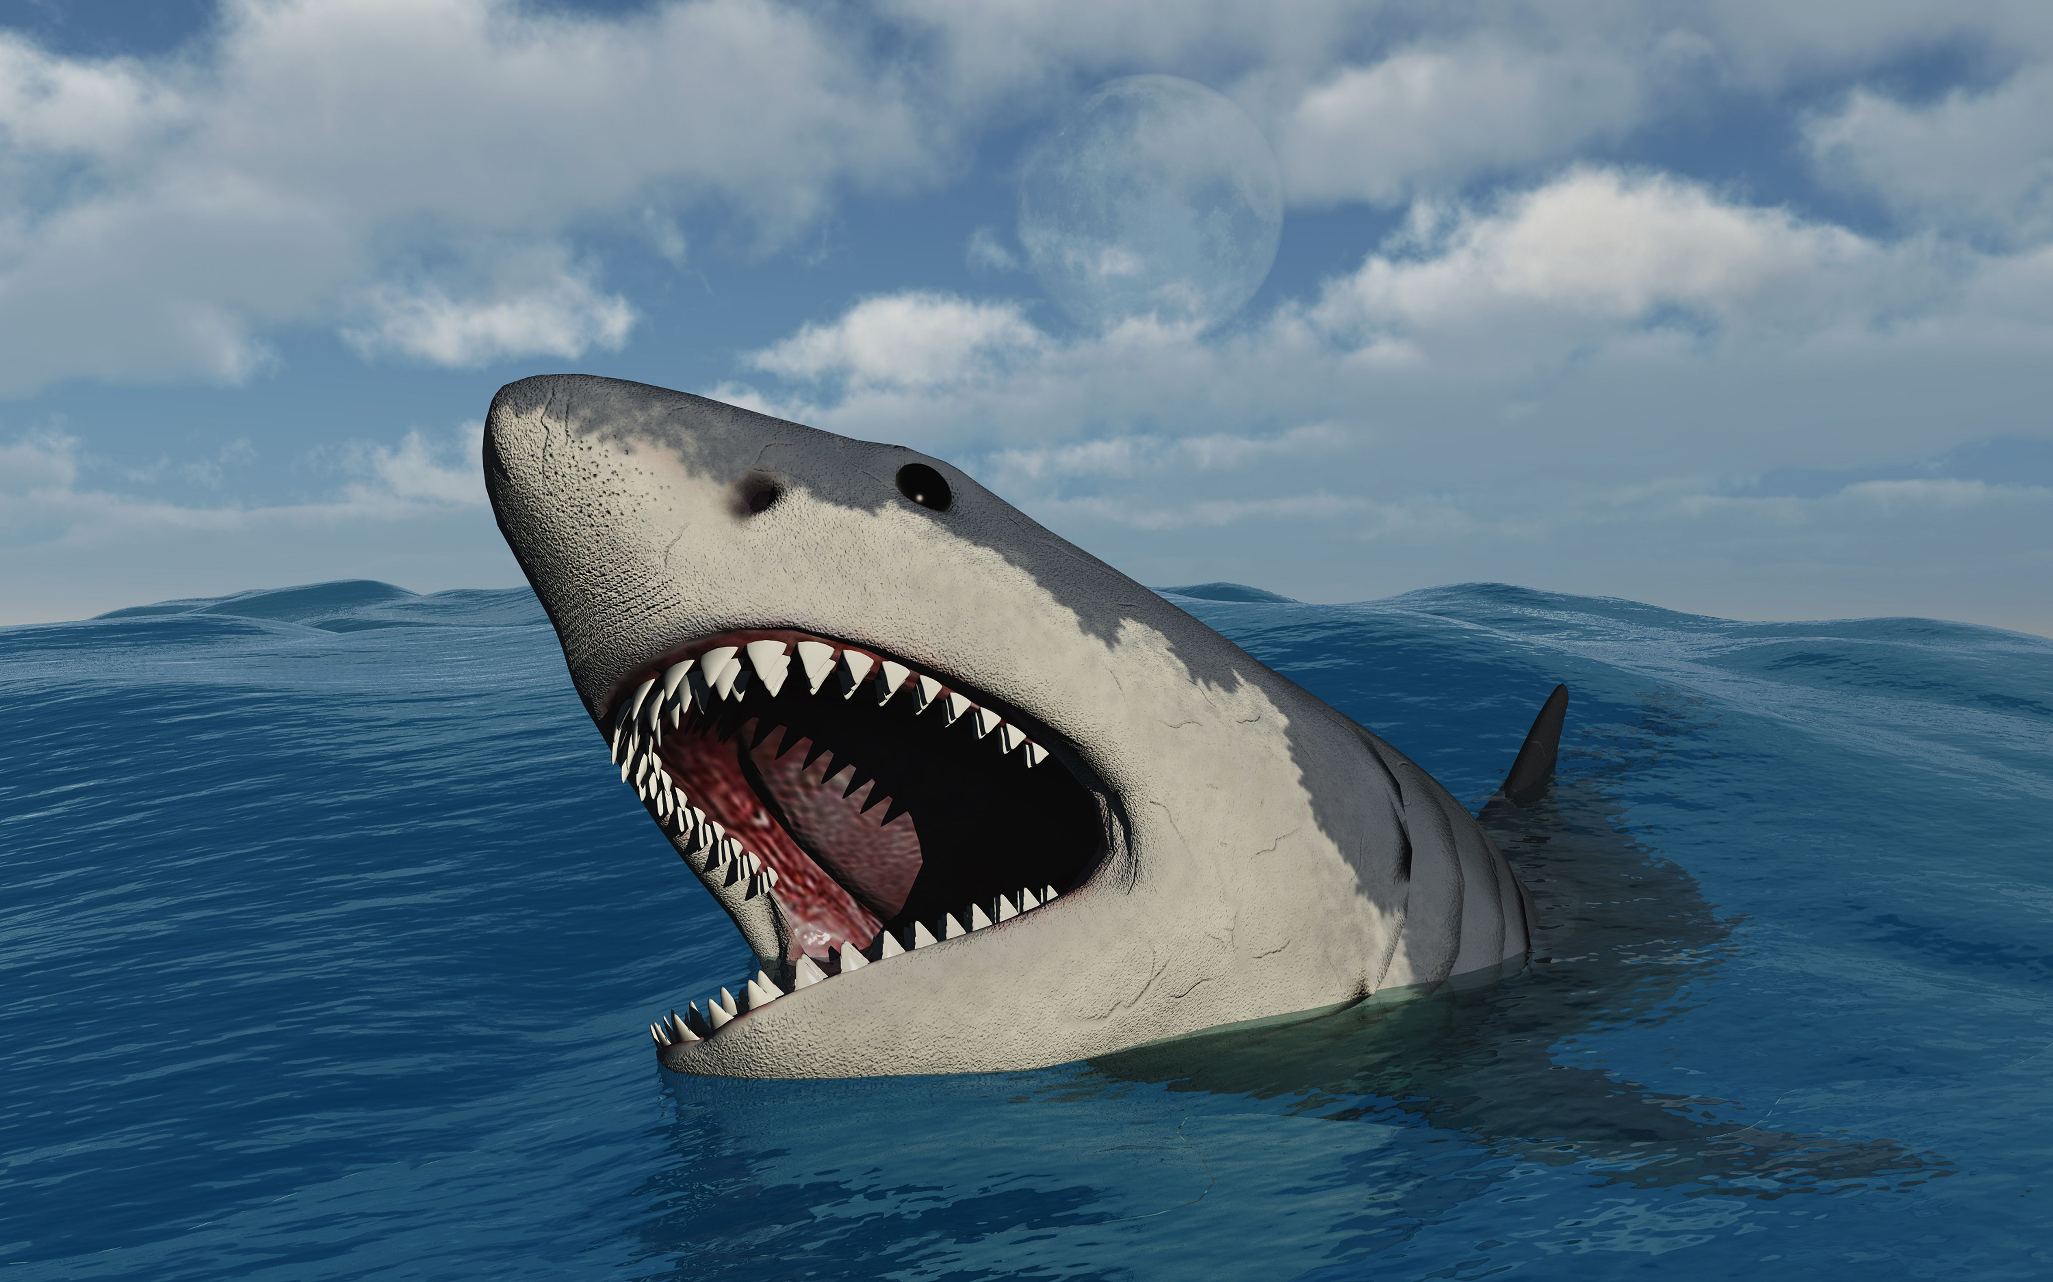
Megalodon lived in oceans around the world and was adapted to warm tropical and subtropical locations around the globe.
Megalodon primarily fed on large marine mammals including whales, dolphins, sea lions, dugongs (sea cows), as well as sea turtles and large fish.
The Megalodon, like other sharks, was an incredibly skilled swimmer. It had a streamlined body shape and a powerful tail that allowed it to move through the water with great speed of over three miles an hour.

