Slide 1
How to Use Generate?
Example: hasHazard_generate.py

Slide 2
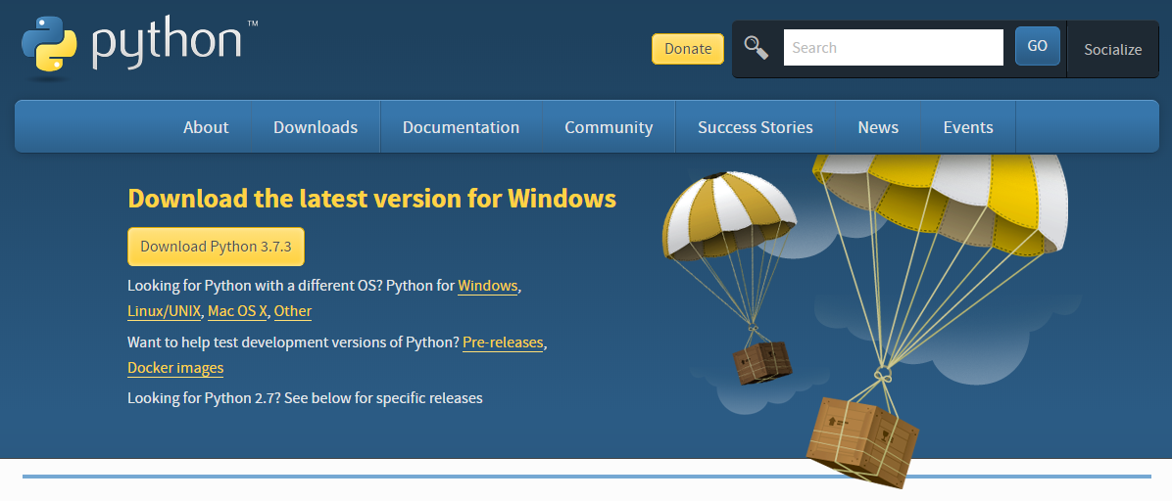
The Simplest Way: Python IDLE
Download Python first (latest preferred)
https://www.python.org/downloads/

Slide 3
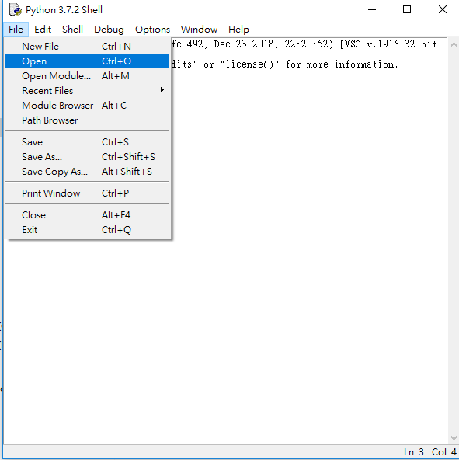
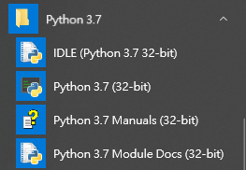
Open File: Method 1
Choose IDLE
File → Open…

Slide 4
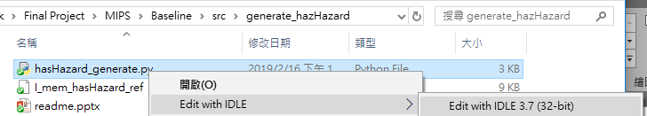
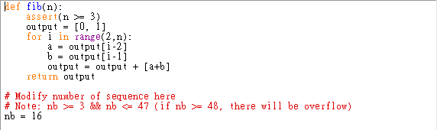
Open File: Method 2
Right click the file
Ex: hasHazard_generate.py
And you will see the code:

Slide 5
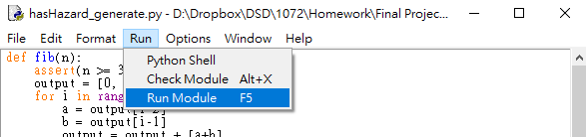
Modify and Run
Change parameters (This case: nb = 16)
Run Module

Slide 6
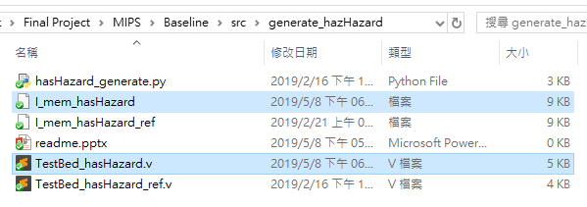
Simulation
New files (testbench and pattern) are constructed
Run your Verilog simulation
Have fun!

