Slide 1






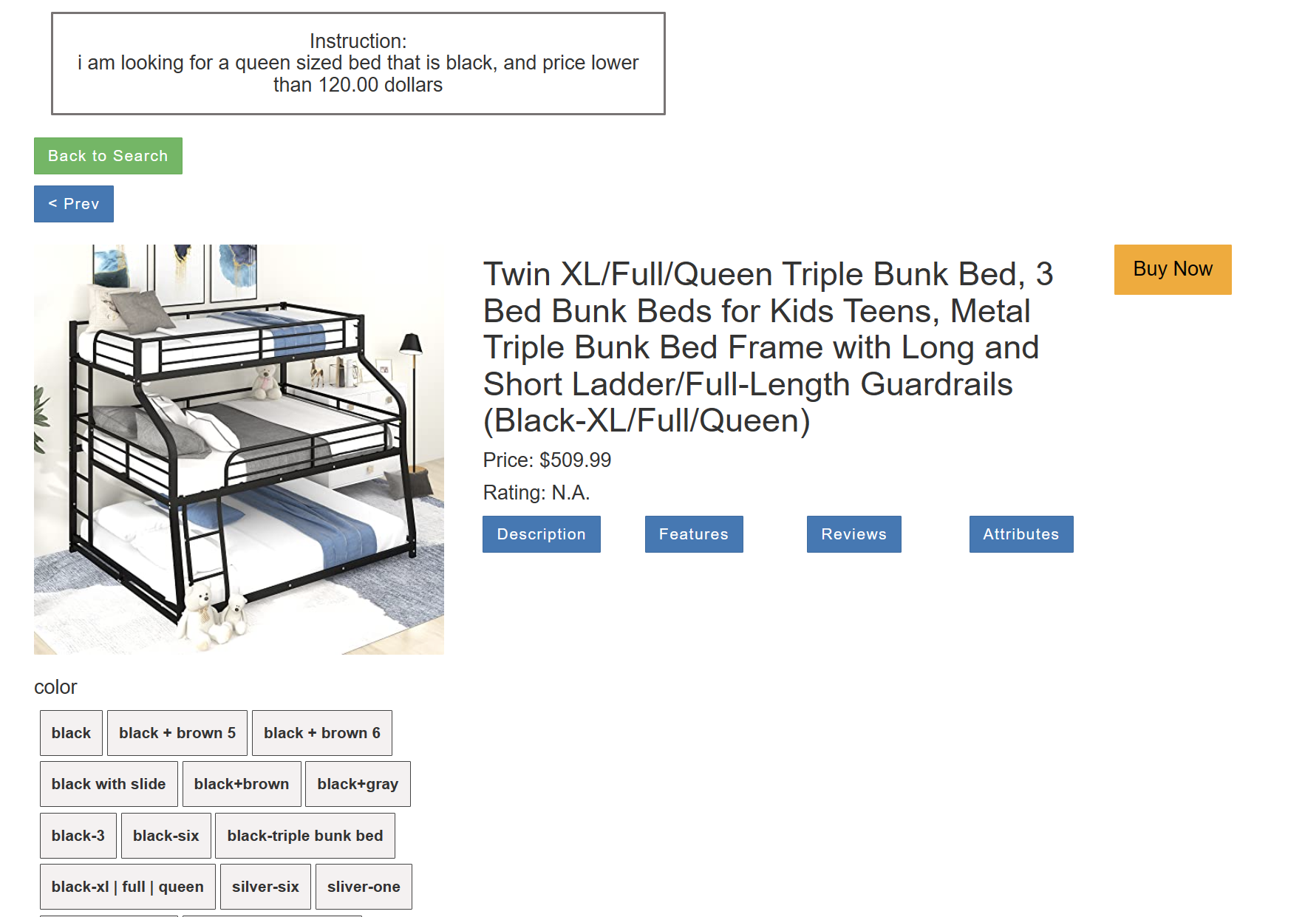
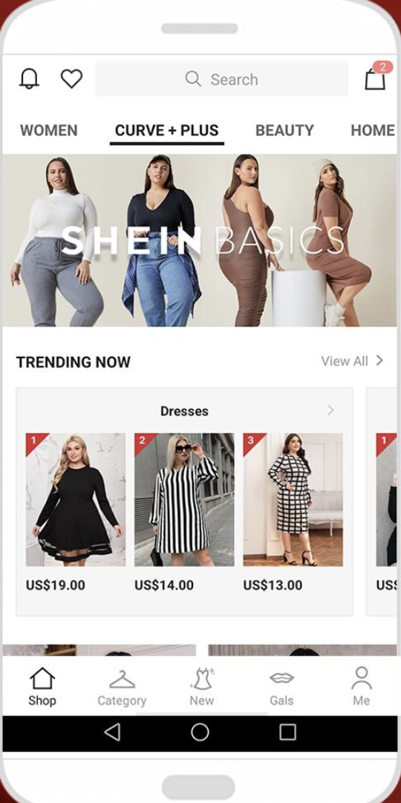




User
Instruction
I am looking for a queen-sized bed that is black, and price lower than 120.0 dollars.
DVM
LLM Agent
DVM
Agent Instructions
LLMs
Action Primitive Concepts
Planning
Reflecting
…
red
…
…
blue
Reasoning
……
Planned
Action
Generated Oracles
LLAMA
Oracles
Oracle 1
Oracle 2
…
Action
red
Vetted Observation
Oracle Violation
Controller
Observation
Observation
Avoiding Actions
Vision
Module
Environment

Slide 2
User
Instruction
I am looking for a queen-sized bed that is black, and price lower than 120.0 dollars.
DVM
LLM Agent
DVM
Agent Instructions
LLM Agent
Internal Reasoning:
I need to find a bed whose size is queen-sized, color is black, and price is less then $120.
LLMs
Action Primitive Concepts
Planning
Reflecting
…
red
…
…
blue
Reasoning
……
Planned
Action
Generated Oracles
LLAMA
Oracles
Oracle 1
Oracle 2
…
Action
red
Vetted Observation
Oracle Violation
Controller
Observation
Observation
Avoiding Actions
Vision
Module
Environment

Slide 3
User
Instruction
I am looking for a queen-sized bed that is black, and price lower than 120.0 dollars.
DVM
LLM Agent
DVM
Agent Instructions
LLM Agent
Internal Reasoning:
I need to find a bed whose size is queen-sized, color is black, and price is less then $120.
LLMs
Action Primitive Concepts
Planning
Reflecting
…
red
…
…
blue
Planned
Action
DVM
Extracting concept:
{object: bed, size: queen,
color: black, price: [0-120)}
Generating Oracle:
Reasoning
……
Generated Oracles
LLAMA
Oracles
Oracle 1
Oracle 2
…
Input
price : [0-120)
def price_lower(price:float):
return price < 120
Action
red
Output
Vetted Observation
…
Oracle Violation
Controller
Observation
Observation
Avoiding Actions
Vision
Module
Environment

Slide 4
User
Instruction
I am looking for a queen-sized bed that is black, and price lower than 120.0 dollars.
DVM
LLM Agent
DVM
Agent Instructions
LLM Agent
Internal Reasoning:
I need to find a bed whose size is queen-sized, color is black, and price is less then $120.
LLMs
Action Primitive Concepts
Planning
Reflecting
…
red
…
…
blue
Planned
Action
DVM
Extracting concept:
{object: bed, size: queen,
color: black, price: [0-120)}
Generating Oracle:
…
Reasoning
……
Generated Oracles
LLAMA
Oracles
Oracle 1
Oracle 2
…
Input
price : [0-120)
def price_lower(price:float):
return price < 120
Action
red
Output
Vetted Observation
Oracle Violation
Controller
Observation
Vision Module
Observations:
Queen-sized $100 white
…
Queen-sized bed $80 black
Observation
Avoiding Actions
Vision
Module
Environment

Slide 5
Vision Module
Observations:
User
Instruction
Queen-sized $100 white
…
Queen-sized bed $80 black
I am looking for a queen-sized bed that is black, and price lower than 120.0 dollars.
DVM
LLM Agent
DVM
Agent Instructions
LLMs
Action Primitive Concepts
Planning
Reflecting
…
red
…
…
blue
Reasoning
……
Planned
Action
Generated Oracles
LLAMA
Oracles
Oracle 1
Oracle 2
…
Action
red
Vetted Observation
Oracle Violation
Controller
Observation
Observation
Avoiding Actions
Vision
Module
Environment

Slide 6
Vision Module
Observations:
User
Instruction
Queen-sized $100 white
…
Queen-sized bed $80 black
I am looking for a queen-sized bed that is black, and price lower than 120.0 dollars.
DVM
LLM Agent
DVM
Agent Instructions
LLM Agent
Planning:
The first item is a queen-sized bed and is lower than $120, which satisfy my need. I should click the item to purchase it.
Planned Action:
Click [First item]
LLMs
Action Primitive Concepts
Planning
Reflecting
…
red
…
…
blue
Reasoning
……
Planned
Action
Generated Oracles
LLAMA
Oracles
Oracle 1
Oracle 2
…
Action
red
Vetted Observation
Oracle Violation
Controller
Observation
Observation
Avoiding Actions
Vision
Module
Environment

Slide 7
Vision Module
Observations:
User
Instruction
Queen-sized $100 white
…
Queen-sized bed $80 black
I am looking for a queen-sized bed that is black, and price lower than 120.0 dollars.
DVM
LLM Agent
DVM
Agent Instructions
LLM Agent
Planning:
The first item is a queen-sized bed and is lower than $120, which satisfy my need. I should click the item to purchase it.
Planned Action:
Click [First item]
LLMs
Action Primitive Concepts
Planning
Reflecting
…
red
…
…
blue
Reasoning
……
Planned
Action
Generated Oracles
LLAMA
Oracles
DVM
Oracle Checking:
Queen-sized $100 white
Oracle Violation:
color != black
Avoiding actions:
Remove [First item]
New Observation:
Oracle 1
Oracle 2
…
Action
red
Vetted Observation
Oracle Violation
Controller
Observation
…
Queen-sized bed $80 black
…
Observation
Avoiding Actions
Vision
Module
Environment

Slide 8
User
Instruction
Vision Module
Observations:
I am looking for a queen-sized bed that is black, and price lower than 120.0 dollars.
…
Queen-sized bed $80 black
…
DVM
LLM Agent
DVM
Agent Instructions
LLMs
Action Primitive Concepts
Planning
Reflecting
…
red
…
…
blue
Reasoning
……
Planned
Action
Generated Oracles
LLAMA
Oracles
Oracle 1
Oracle 2
…
Action
red
Vetted Observation
Oracle Violation
Controller
Observation
Observation
Avoiding Actions
Vision
Module
Environment

Slide 9
User
Instruction
Vision Module
Observations:
I am looking for a queen-sized bed that is black, and price lower than 120.0 dollars.
…
Queen-sized bed $80 black
…
DVM
LLM Agent
DVM
Agent Instructions
LLMs
Action Primitive Concepts
LLM Agent
Planning:
The second item is a queen-sized bed and is lower than$120, which satisfy my need. I should click the item to purchase it.
Planned Action:
Click [Second item]
Planning
Reflecting
…
red
…
…
blue
Reasoning
……
Planned
Action
Generated Oracles
LLAMA
Oracles
Oracle 1
Oracle 2
…
Action
red
Vetted Observation
Oracle Violation
Controller
Observation
Observation
Avoiding Actions
Vision
Module
Environment

Slide 10
User
Instruction
Vision Module
Observations:
I am looking for a queen-sized bed that is black, and price lower than 120.0 dollars.
…
Queen-sized bed $80 black
…
DVM
LLM Agent
DVM
Agent Instructions
LLMs
Action Primitive Concepts
LLM Agent
Planning:
The second item is a queen-sized bed and is lower than$120, which satisfy my need. I should click the item to purchase it.
Planned Action:
Click [Second item]
Planning
Reflecting
…
red
…
…
blue
Reasoning
……
Planned
Action
Generated Oracles
LLAMA
Oracles
Oracle 1
Oracle 2
…
DVM
Oracle Checking:
Queen-sized bed $80 black
Oracle Violation:
pass
Action
red
Vetted Observation
Oracle Violation
Controller
Observation
Observation
Avoiding Actions
Vision
Module
Environment

Slide 11
User
Instruction
Vision Module
Observations:
I am looking for a queen-sized bed that is black, and price lower than 120.0 dollars.
…
Queen-sized bed $80 black
…
DVM
LLM Agent
DVM
Agent Instructions
LLMs
Action Primitive Concepts
LLM Agent
Planning:
The second item is a queen-sized bed and is lower than$120, which satisfy my need. I should click the item to purchase it.
Planned Action:
Click [Second item]
Planning
Reflecting
…
red
…
…
blue
Reasoning
……
Planned
Action
Generated Oracles
LLAMA
Oracles
Oracle 1
Oracle 2
…
DVM
Oracle Checking:
Queen-sized bed $80 black
Oracle Violation:
pass
Action
red
Vetted Observation
Oracle Violation
Controller
Observation
Controller
Applying Action:
Click [Second item]
Observation
Avoiding Actions
Vision
Module
Environment

Slide 12
User
Instruction
Vision Module
Observations:
I am looking for a queen-sized bed that is black, and price lower than 120.0 dollars.
…
Queen-sized bed $80 black
…
DVM
LLM Agent
DVM
Agent Instructions
LLMs
Action Primitive Concepts
LLM Agent
Planning:
The second item is a queen-sized bed and is lower than$120, which satisfy my need. I should click the item to purchase it.
Planned Action:
Click [Second item]
Planning
Reflecting
…
red
…
…
blue
Reasoning
……
Planned
Action
Generated Oracles
LLAMA
Oracles
Oracle 1
Oracle 2
…
DVM
Oracle Checking:
Queen-sized bed $80 black
Oracle Violation:
pass
Action
red
Vetted Observation
Oracle Violation
Controller
Observation
Controller
Applying Action:
Click [Second item]
Observation
Avoiding Actions
Vision
Module
Task Continue…
Environment

