Slide 1



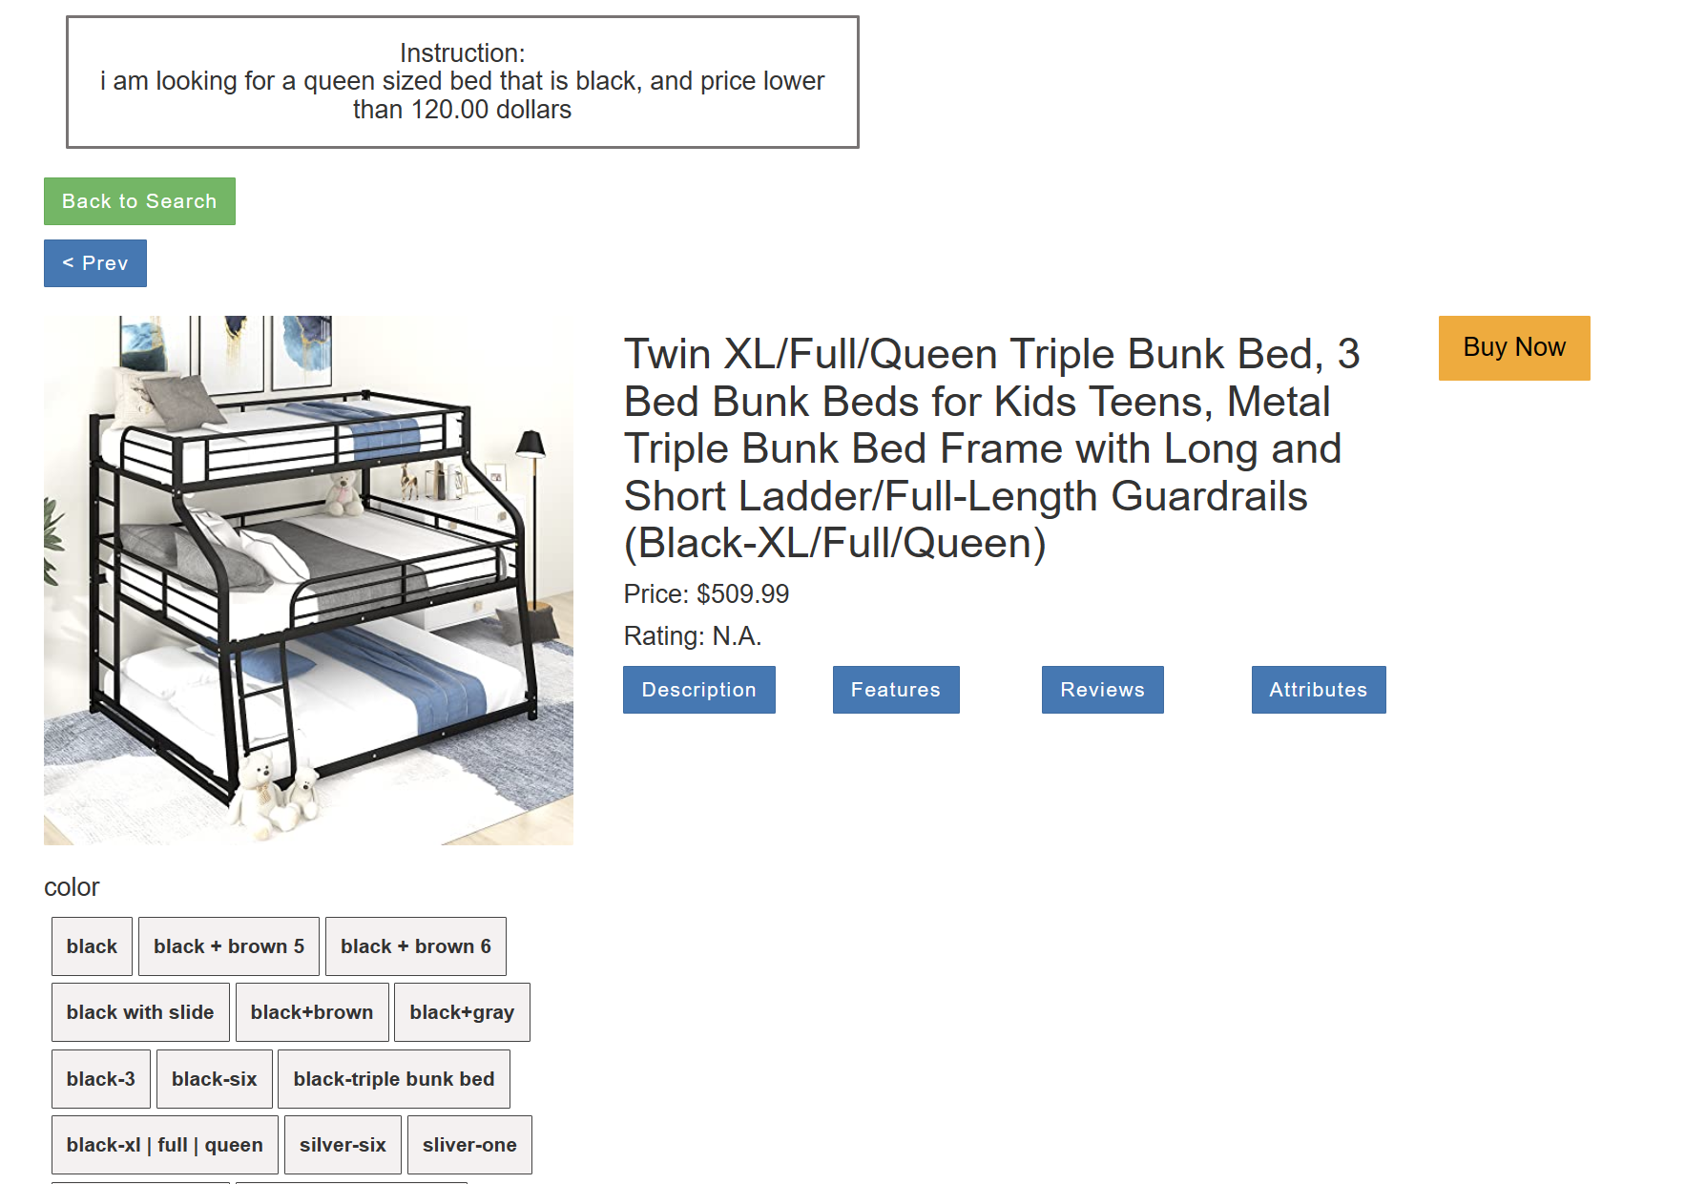
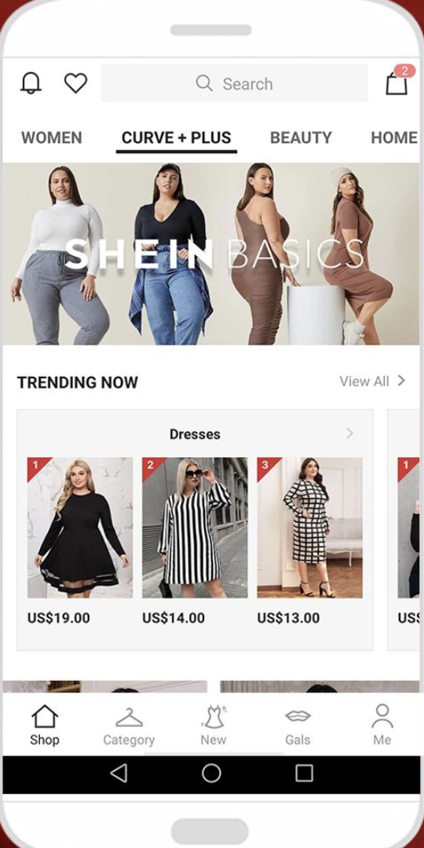


I am looking for a queen-sized bed that is black, and price lower than 120.0 dollars.
User Instruction
LLM Agent
LLMs
Planning
Reflecting
Reasoning
……
LLAMA
Action
Observation
Controller
Vision
Module
Environment

Slide 2
I am looking for a queen-sized bed that is black, and price lower than 120.0 dollars.
User Instruction
LLM Agent
Internal Reasoning:
I need to find a bed whose size is queen-sized, color is black, and price is less then $120.
LLM Agent
LLMs
Planning
Reflecting
Reasoning
……
LLAMA
Action
Observation
Controller
Vision
Module
Environment

Slide 3
I am looking for a queen-sized bed that is black, and price lower than 120.0 dollars.
User Instruction
LLM Agent
Internal Reasoning:
I need to find a bed whose size is queen-sized, color is black, and price is less then $120.
LLM Agent
LLMs
Planning
Reflecting
Vision Module
Observations:
Reasoning
……
Queen-sized $100 white
…
Queen-sized bed $80 black
LLAMA
Action
Observation
Controller
Vision
Module
Environment

Slide 4
I am looking for a queen-sized bed that is black, and price lower than 120.0 dollars.
User Instruction
LLM Agent
Internal Reasoning:
I need to find a bed whose size is queen-sized, color is black, and price is less then $120.
LLM Agent
LLMs
Planning
Reflecting
Vision Module
Observations:
Reasoning
……
Queen-sized $100 white
…
Queen-sized bed $80 black
LLAMA
Action
LLM Agent
Planning:
The first item is a queen-sized bed and is lower than $120, which satisfy my need. I should click the item to purchase it.
Observation
Controller
Vision
Module
Environment

Slide 5
I am looking for a queen-sized bed that is black, and price lower than 120.0 dollars.
User Instruction
LLM Agent
Internal Reasoning:
I need to find a bed whose size is queen-sized, color is black, and price is less then $120.
LLM Agent
LLMs
Planning
Reflecting
Vision Module
Observations:
Reasoning
……
Queen-sized $100 white
…
Queen-sized bed $80 black
LLAMA
Action
LLM Agent
Planning:
The first item is a queen-sized bed and is lower than $120, which satisfy my need. I should click the item to purchase it.
Observation
Controller
Controller
Applying Action:
Click [First item]
Vision
Module
Environment

Slide 6
I am looking for a queen-sized bed that is black, and price lower than 120.0 dollars.
User Instruction
LLM Agent
Internal Reasoning:
I need to find a bed whose size is queen-sized, color is black, and price is less then $120.
LLM Agent
LLMs
Planning
Reflecting
Vision Module
Observations:
Reasoning
……
Queen-sized $100 white
…
Queen-sized bed $80 black
LLAMA
Action
LLM Agent
Planning:
The first item is a queen-sized bed and is lower than $120, which satisfy my need. I should click the item to purchase it.
Observation
Controller
Controller
Applying Action:
Click [First item]
Vision
Module
Environment
Violation: Wrong color; Task failed.

