Slide 1
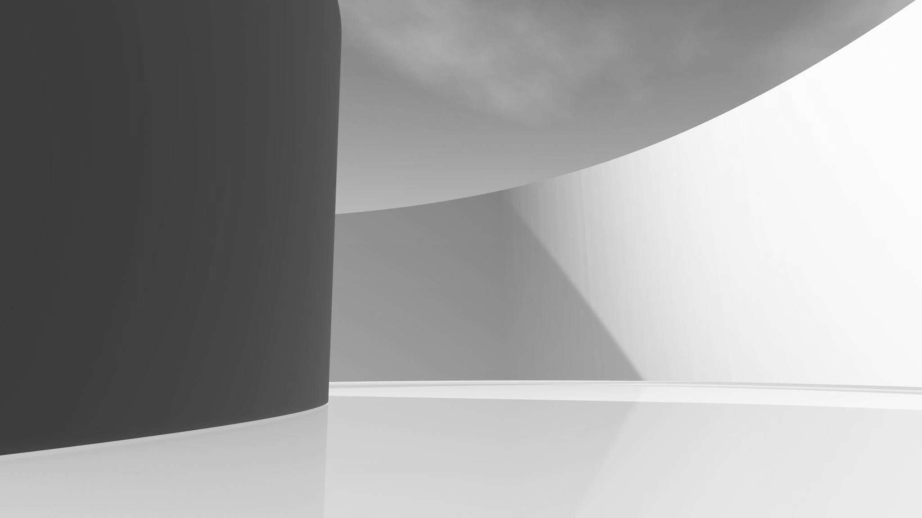
GRELARN
Walking hand in hand into the future.

Slide 2
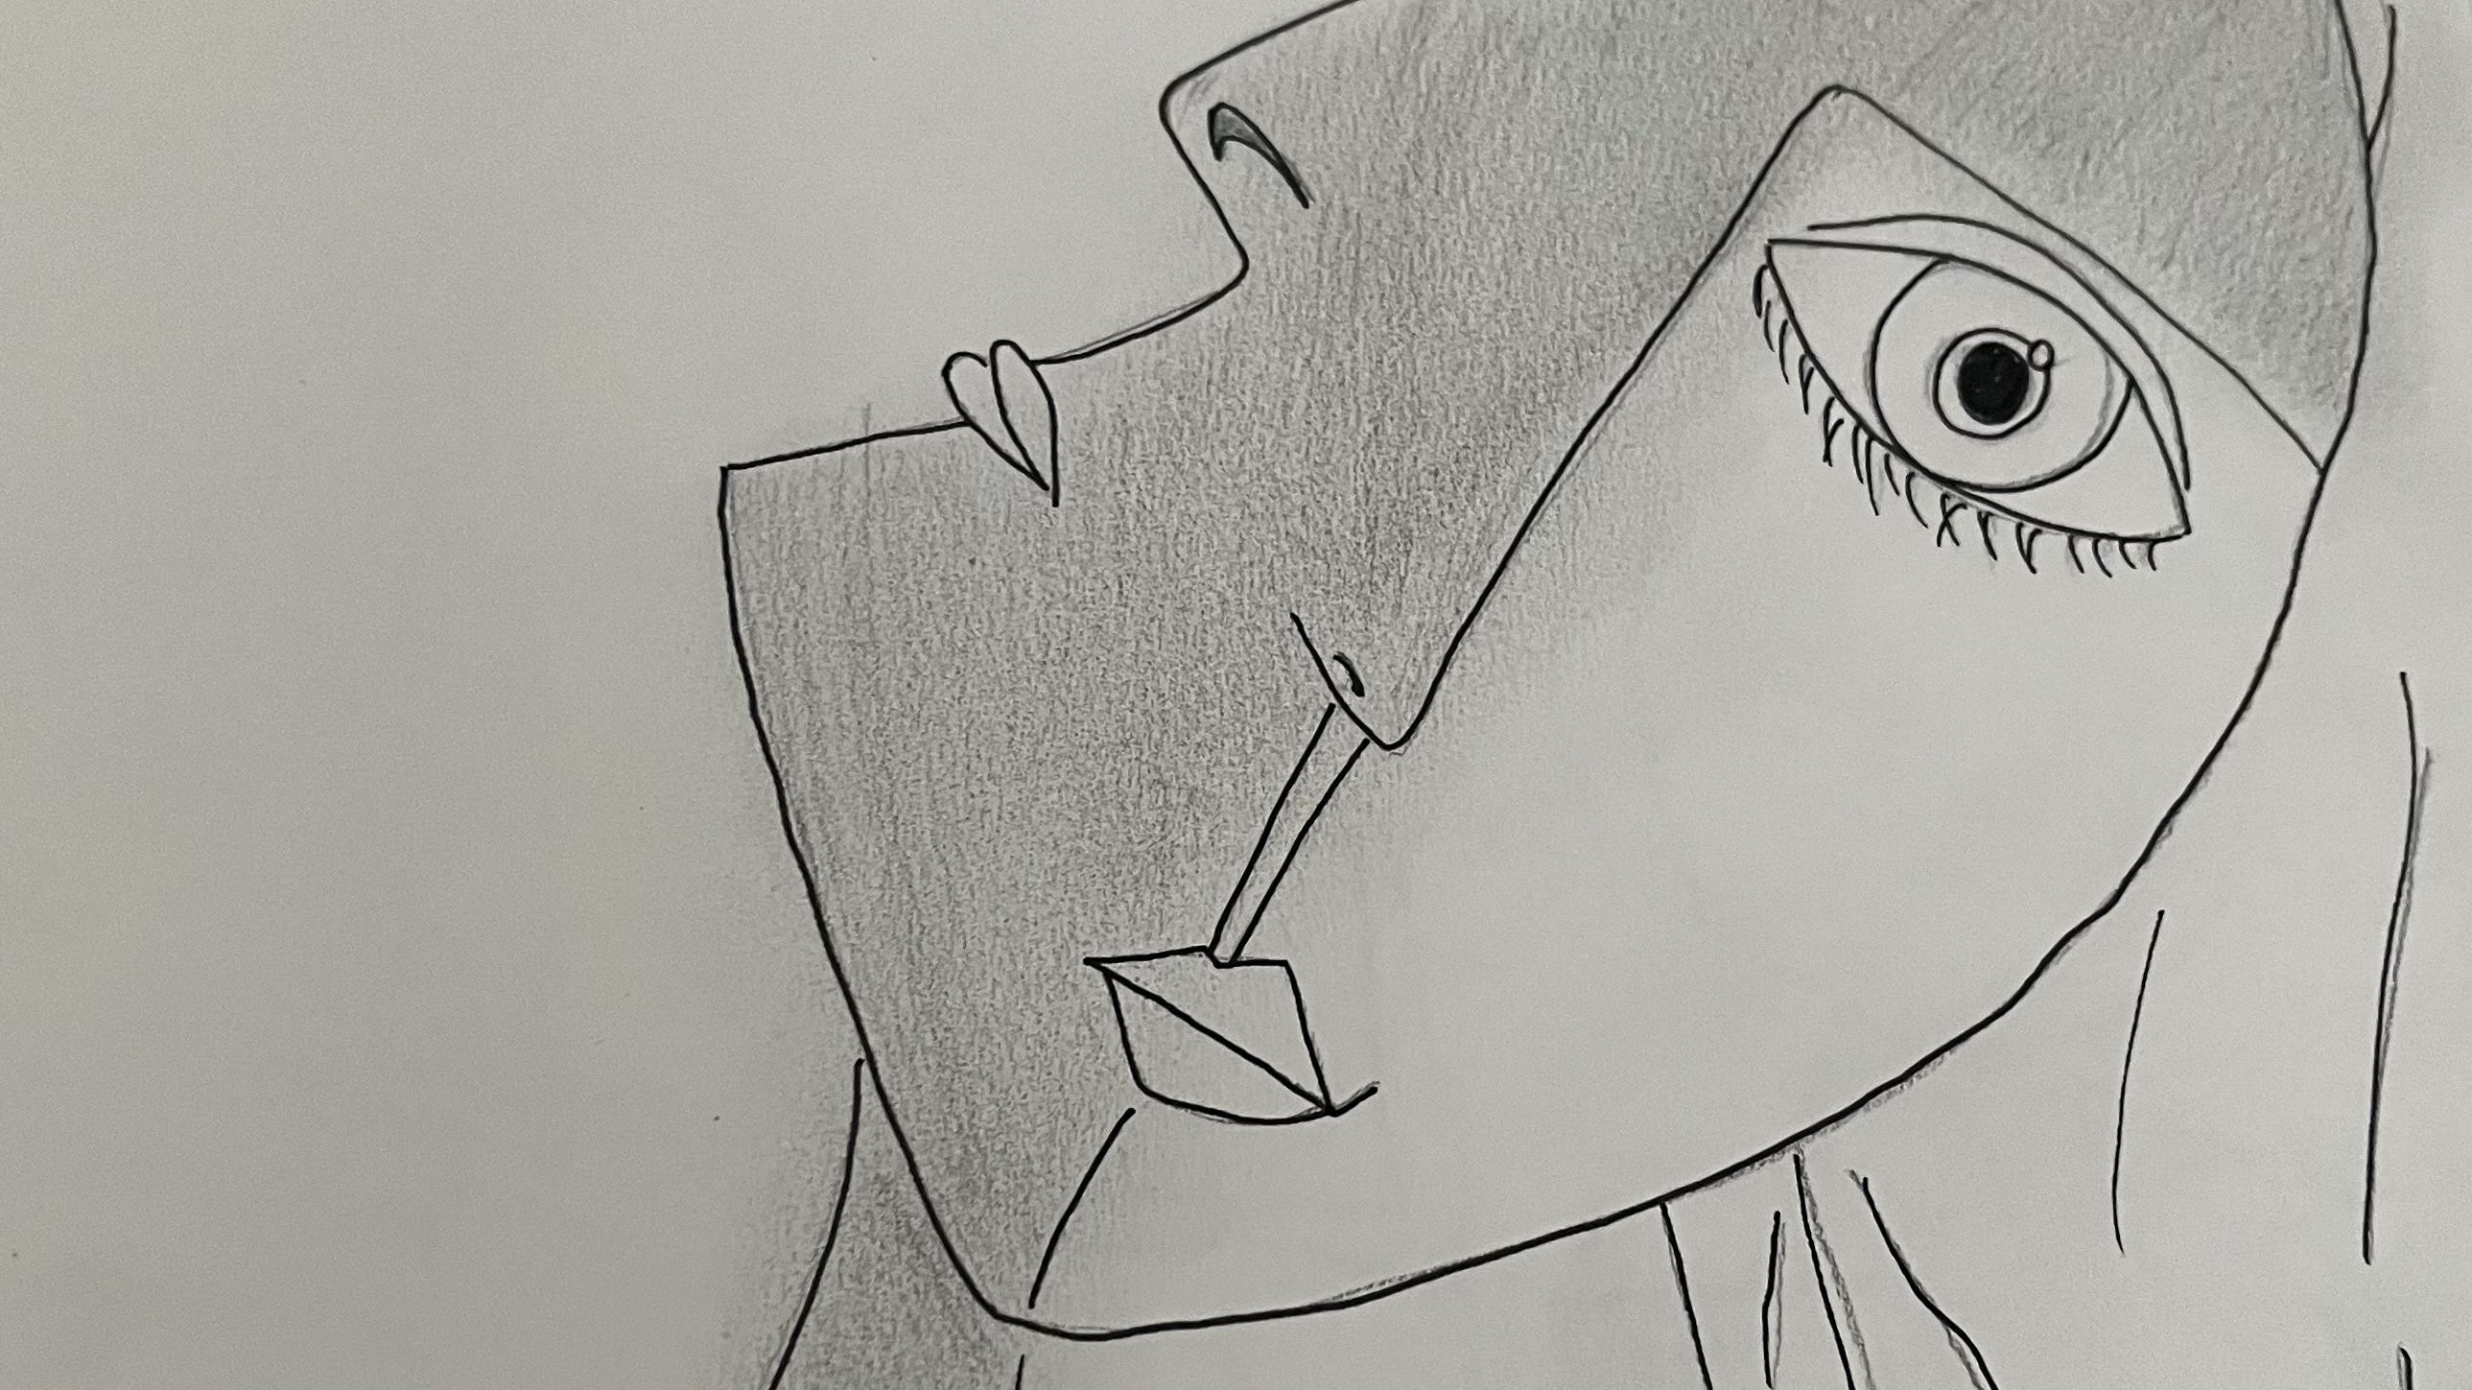
CONTENT

Slide 3
01.GRELARN
02. ECO PROGRAMMING
03. BUSINESS OVERVIEW / MARCKET ANALYSIS
04. OPERATING PLAN
05. FINANCIAL PLAN
06. THE FUTURE

Slide 4
GRELARN
Grelarn is a Software start up providing services in Artificial intelligence, Data management, web design, Programming and Security.
We use Ecoprogramming, a technology redesigned to

