Slide 1
Welcome to the Card Guessing Game!

Slide 2
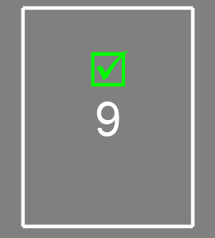
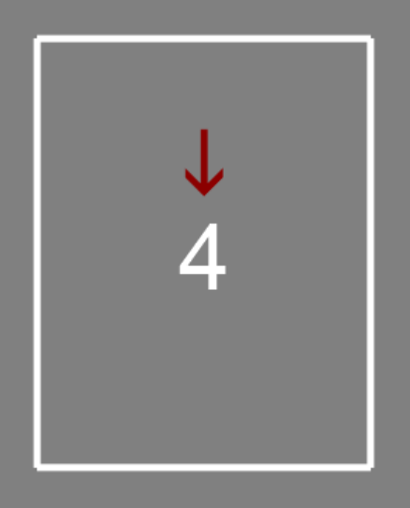
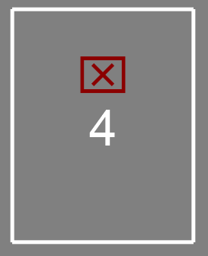
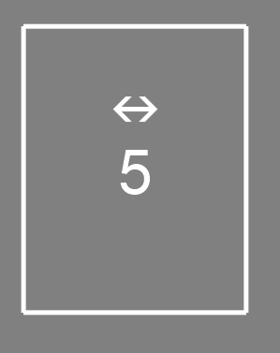
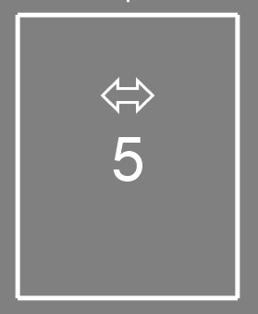
Instructions
In this game, all you have to do is guess whether the value of a card is higher or lower than the number 5.
The number on the card can be between 1 and 9.
If you guess correctly, you will earn $20 for that trial.
If you guess incorrectly, you will lose $10 for that trial.
If the card number is exactly 5, you won’t gain or lose any money for that trial.

Slide 3




Importantly, the outcome (money won or lost) will be split evenly with one of 3 possible partners:
Computer - money goes back to the lab’s equipment fund
Stranger – a past participant in this study
Friend – the person you put us contact with
Correct Guess: win $20 -> $10 for you, $10 for your partner
Incorrect Guess: lose $10 -> $5 from you, $5 from your partner

Slide 4




You’ll know which partner you’re sharing the outcome with based on the name and image above the card.
You’ll have 2.5 seconds to make your guess while the question mark is on the screen. If you guess in time, the question mark will turn orange. If you don't guess in time, you'll see a # symbol and won't get money for that guess
Use your right pointer finger to guess lower than 5
Use your right middle finger to guess higher than 5

Slide 5
During the task practice, you will see a silhouette rather than an actual image. In the real task you will see images of your friend and the stranger.
At the end of the game, we will randomly pick 1 guess to pay you and your partner from that round. This money will be added to your total bonus payment. (Money lost will never affect the payment for your time)
After your scan we’ll discuss the possibility of you being a study partner for future participants! Do you have any questions before we begin our practice round?

