Slide 1
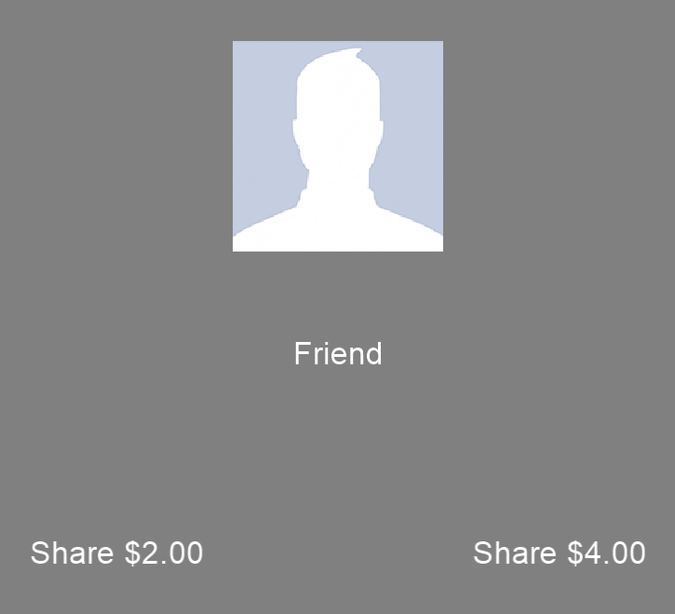

You’ve been assigned the role of investor! To start each decision out, you’ll be given $8. You can share some of that with your partner for that round.
To send the amount on the left, click with your pointer finger.
To send the amount on the right, click with your middle finger. If you don’t respond in time, that decision won't count.

Slide 2

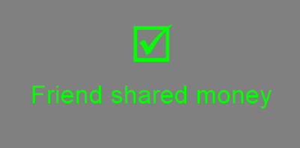
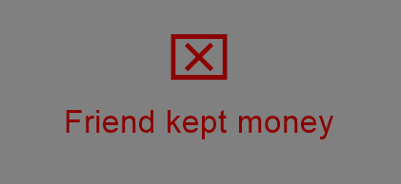
You will have 3 seconds to decide which amount to invest in your partner. You keep the rest of the money.
If you do invest, whatever amount you send is tripled, then given to them
Ex: $2.00 x 3 = $6.00
After you decide, your choice will turn orange. You will then see the choice your partner made before this study. They can either share the tripled amount evenly with you, or keep it for themselves.

Slide 3
During the task practice, you will see a silhouette rather than an actual image. In the real task you will see images of your friend and the stranger.
We have partnered you with one randomly selected past participant from a list of volunteers. You will be partnered with a different stranger in each task.
At the end of the game, we will randomly pick 1 guess to pay you and your partner from that round. This money will be added to your total bonus payment.

Slide 4
Money won with the computer will be returned to the lab’s equipment fund. Money earned with your friend or the past participant will be sent to them after the visit.
After your scan we’ll discuss the possibility of you being a study partner for future participants! Do you have any questions before we begin our practice round?

