Slide 1
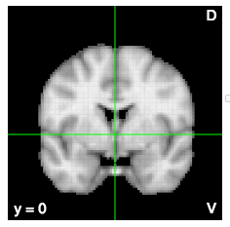

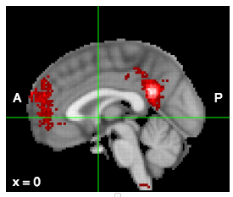


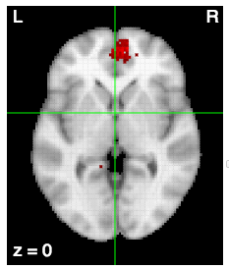
Here we applied a meta-analytic data-driven approach to nearly 10,000 fMRI studies to identify putatively separable regions of MFC and determine which
psychological states preferentially recruit their activation.
Here we defined
Multivariate classification analyses aimed at identifying the psychological functions most strongly predictive of activity in each region revealed a tripartite division within MFC,
with each zone displaying a relatively distinct functional signature. The posterior zone was associated
preferentially with motor function, the middle zone with cognitive control, pain, and affect, and the anterior with reward, social processing,
and episodic memory. Within each zone, the more fine-grained subregions showed distinct, but subtler, variations in psychological
function. These results provide hypotheses about the functional organization of medial prefrontal cortex that can be tested explicitly in
future studies.
Neurosynth
As a whole, these accompanied by fine-grained differences between subregions.

