Slide 1



Decision
Feedback
(Win)
Monetary
+
or
+
(Loss)
Social
11000-11600 ms
3000 ms
1000 ms

Slide 2
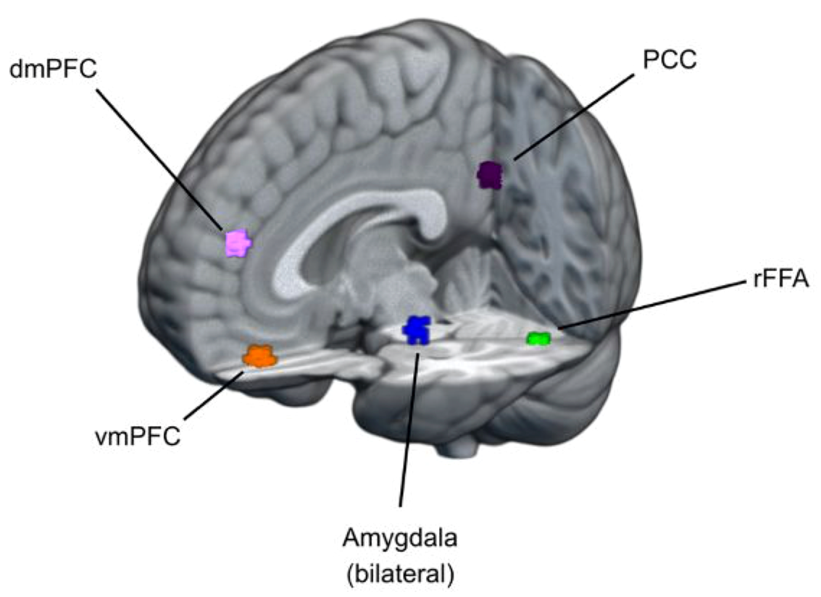

A
SEED REGION
B
HYPOTHESIZED TARGET REGIONS
dmPFC
PCC
rFFA
vmPFC
vmPFC
VS
y=12
Amygdala
(bilateral)

Slide 3
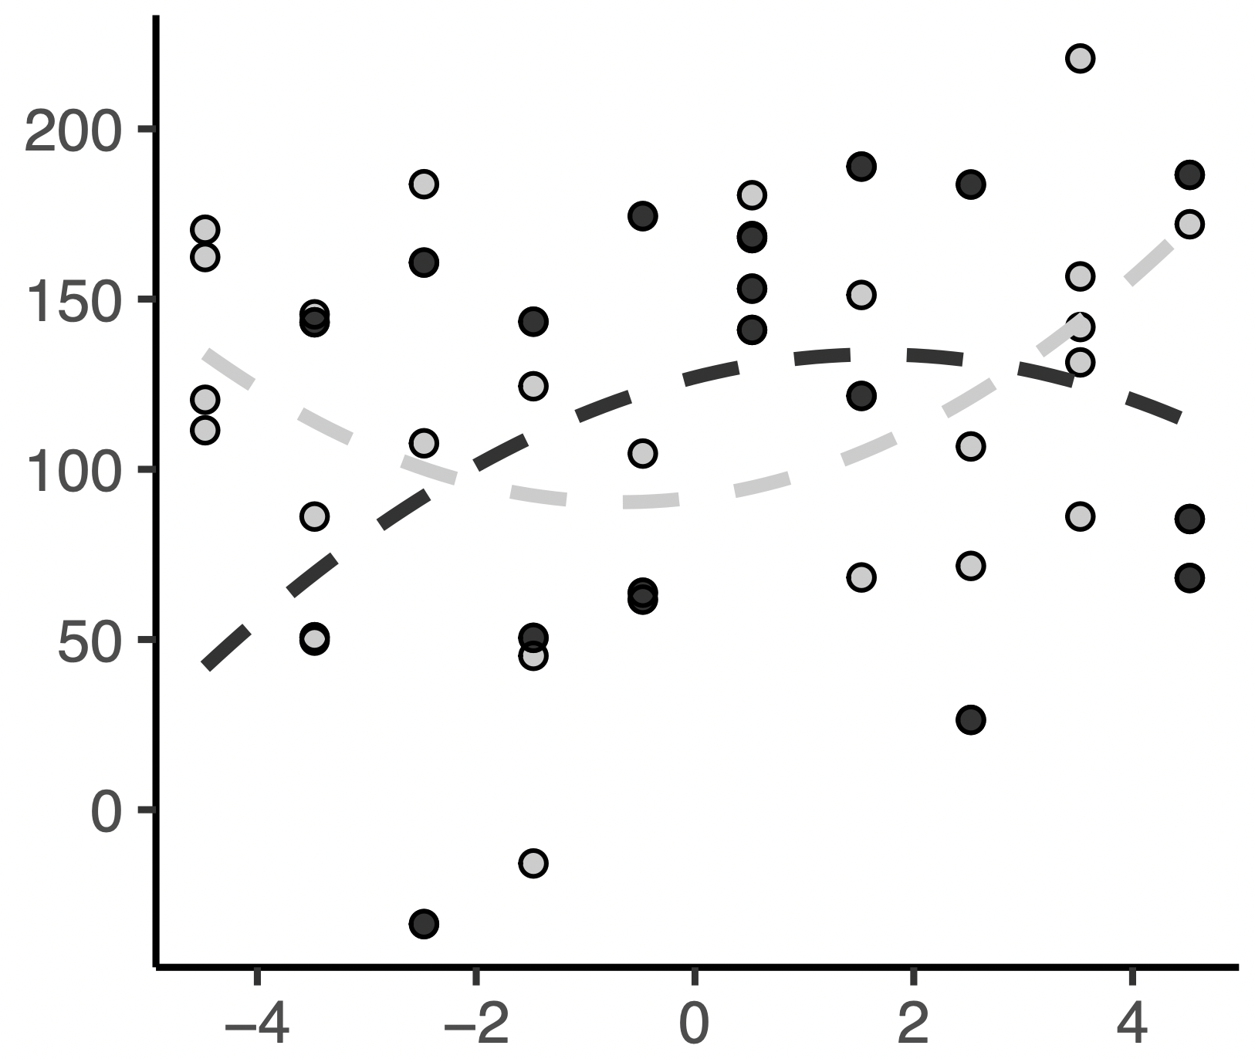
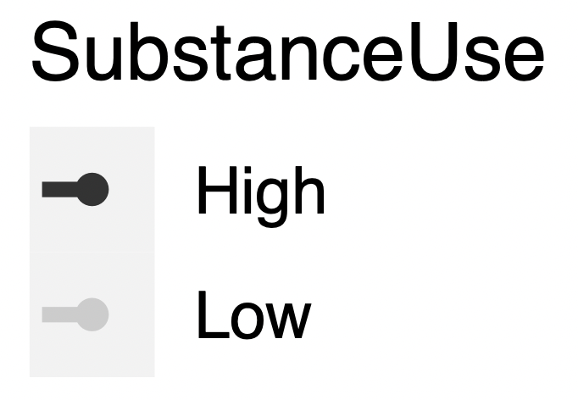
A
B
VS Activation (β)
Reward > Loss
VS
y=12
Reward Sensitivity
(BAS + SR)

Slide 4
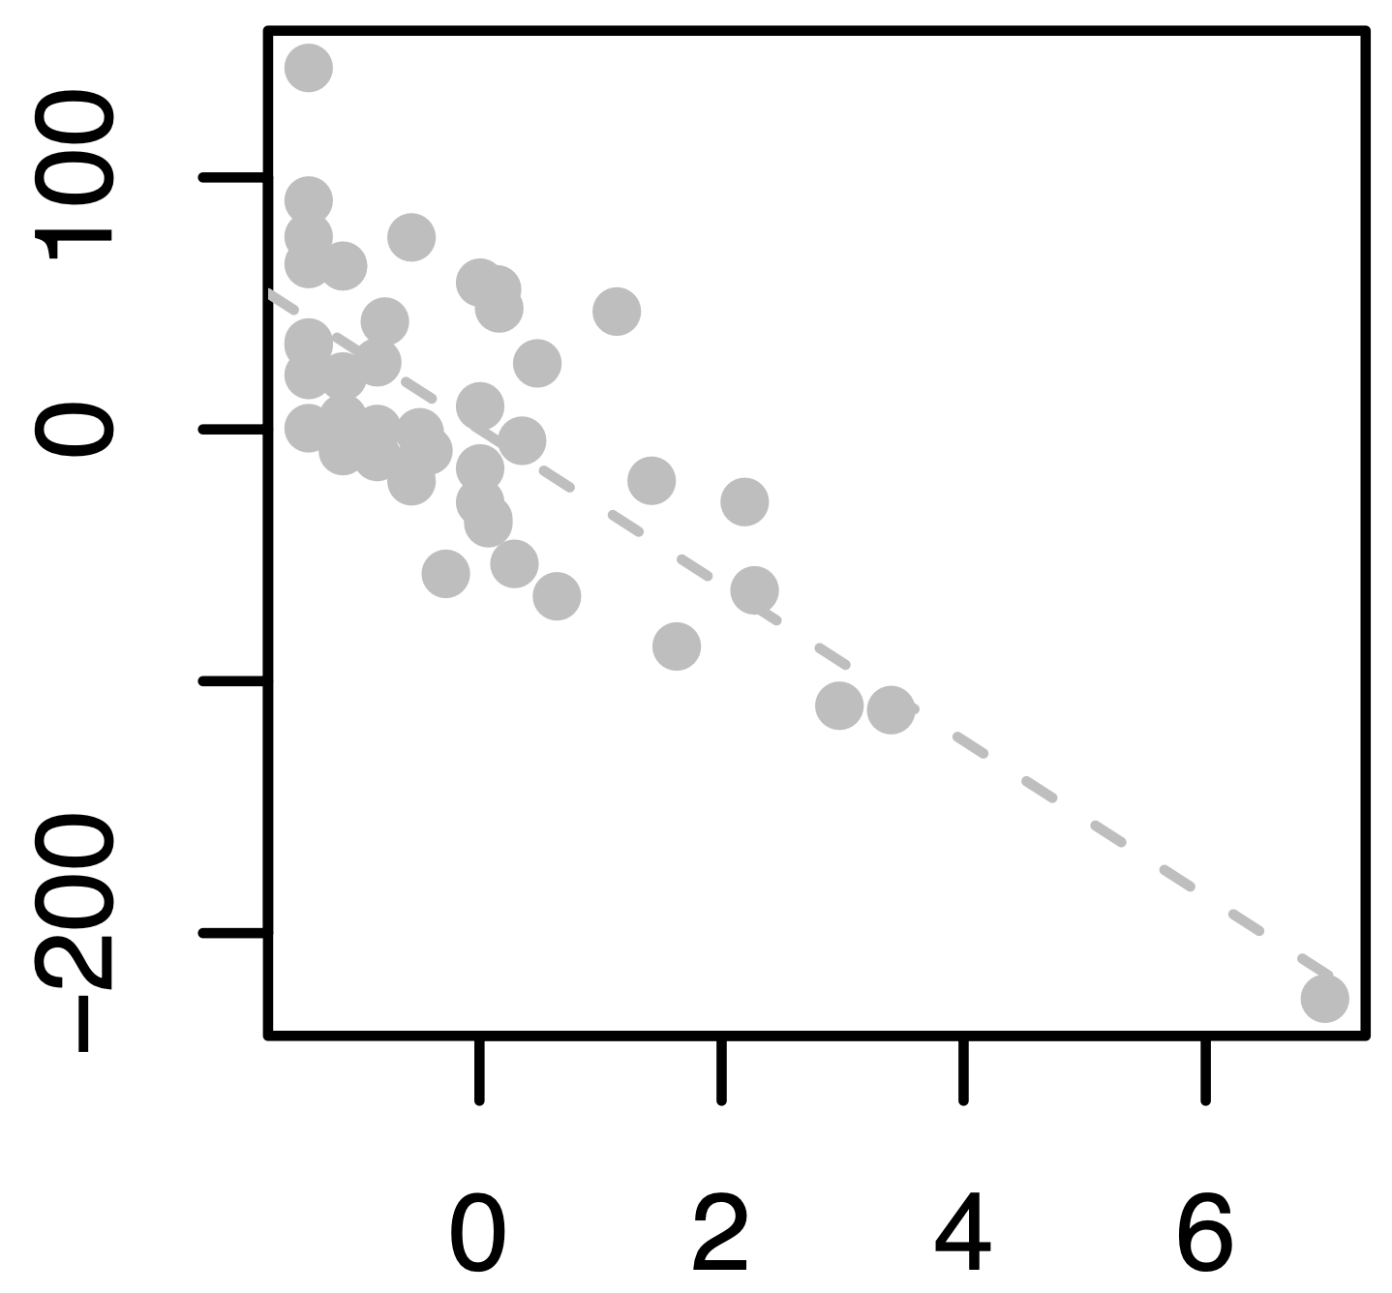
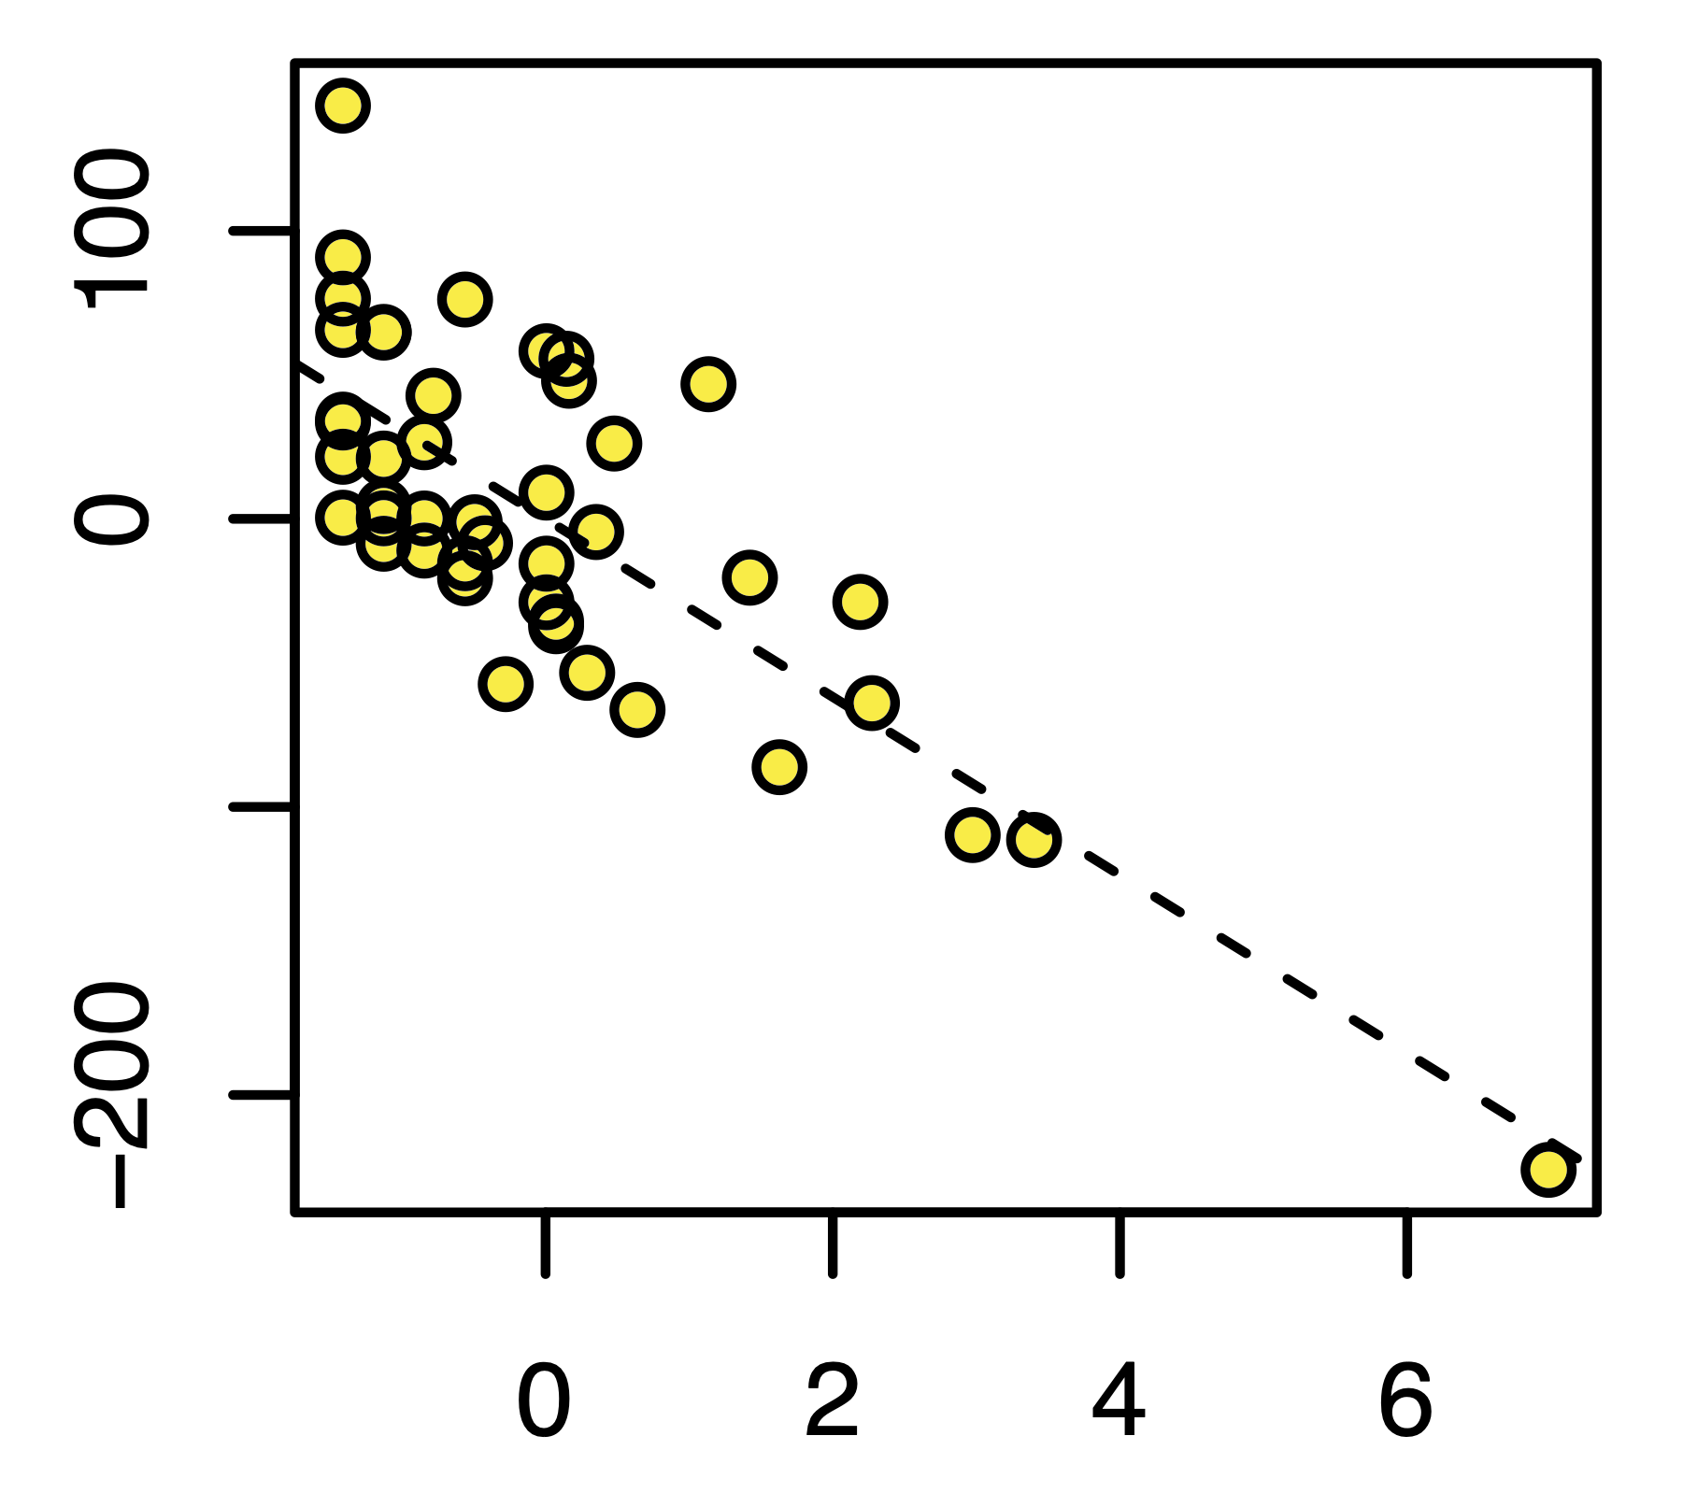
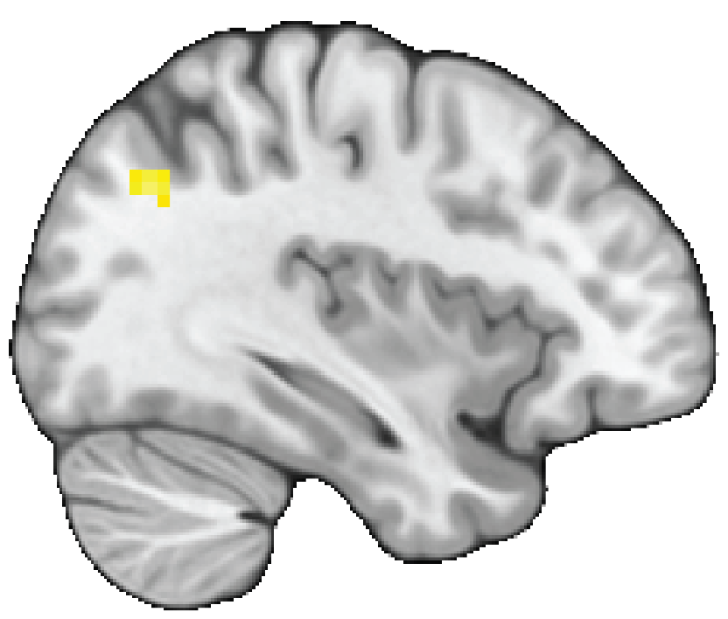
A
B
100
0
TPJ Activation (β)
Social (Reward>Loss) >
Monetary (Reward> Loss)
-100
-200
TPJ
x=20
0
2
4
6
Substance Use
(AUDIT + DUDIT)

Slide 5
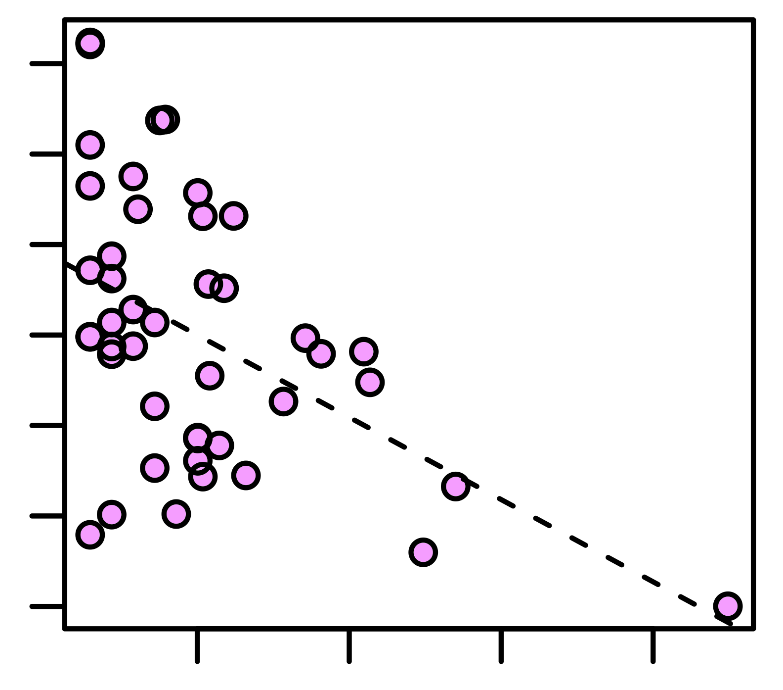

A
B
SEED REGION
TARGET REGION
150
100
50
VS-dmPFC Connectivity (β)
Social (Reward > Loss) >
Monetary (Reward > Loss)
0
-50
-100
-150
VS
y=12
dmPFC
x=3
0
2
4
6
Substance Use
(AUDIT + DUDIT)

Slide 6
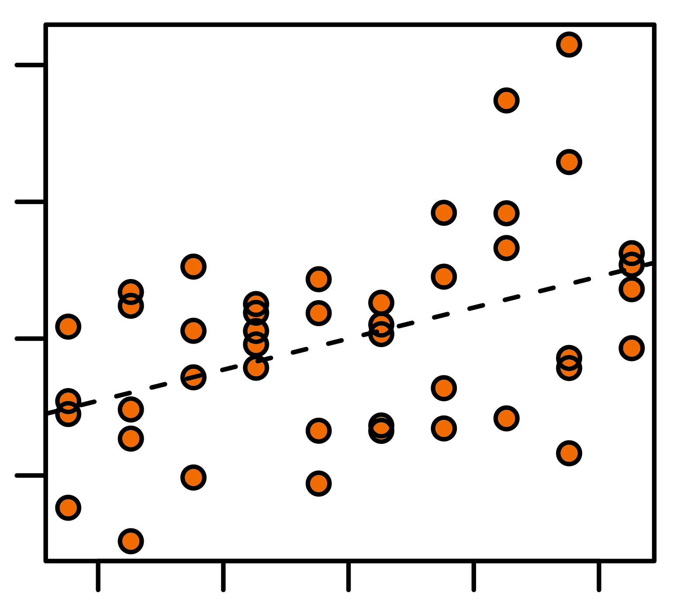
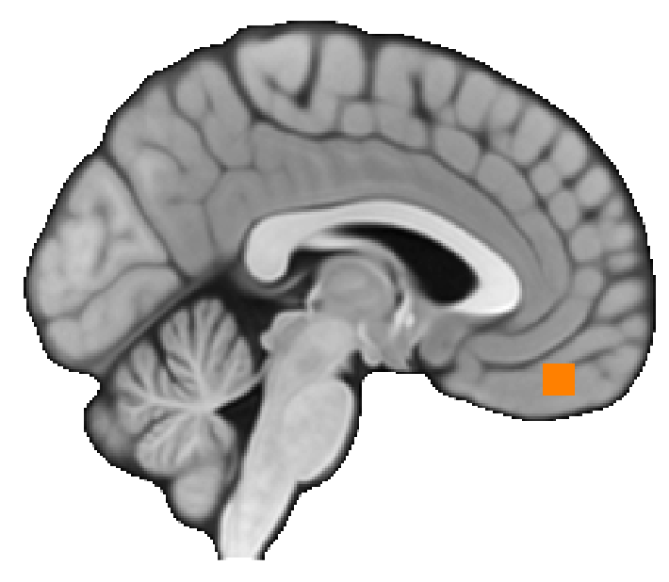
A
B
SEED REGION
TARGET REGION
200
100
VS-vmPFC Connectivity (β)
Social (Reward > Loss) >
Monetary (Reward > Loss)
0
-100
VS
y=12
vmPFC
x=-3
-4
-2
0
2
4
Reward Sensitivity
(BAS + SR)

