Slide 1
Welcome to the Card Guessing Game!

Slide 2
Thanks for coming in to participate in our study!
Welcome to the mock scanner. Here we are going to practice the task that you will soon complete 6 repetitions of in the MRI machine.
Today you’ll be playing a game called the Card Guessing Game.

Slide 3
In this game, all you have to do on each trial of the task is guess whether the value of a card that appears on the screen is higher or lower than the number 5.
The number on the card can be between 1 and 10.
If you guess correctly, you will earn $10 for that trial.
If you guess incorrectly, you will lose $5 for that trial.
If the card number is exactly 5, nothing happens.

Slide 4
Importantly, you will be playing with 2 partners today and you will be sharing the monetary outcomes of the task with them.
Sometimes you will be playing with a computer, and other times you will be playing with a stranger.
This person is a real individual who has participated in our study recently, and who will receive payment based on your performance in the task, but whom you won’t get to meet.

Slide 5
You will know which partner you are playing with on a given set of trials by the image that appears at the top of the screen above the card.
The card will appear in the middle of the screen on each trial with a question mark inside.
The question mark will remain on the screen for approximately 2.5 seconds, and during this time you have to enter your guess regarding the card value.
Press with your left index finger if you think the card will be lower than 5, and press with your right index finger if you think the card will be higher than 5.

Slide 6
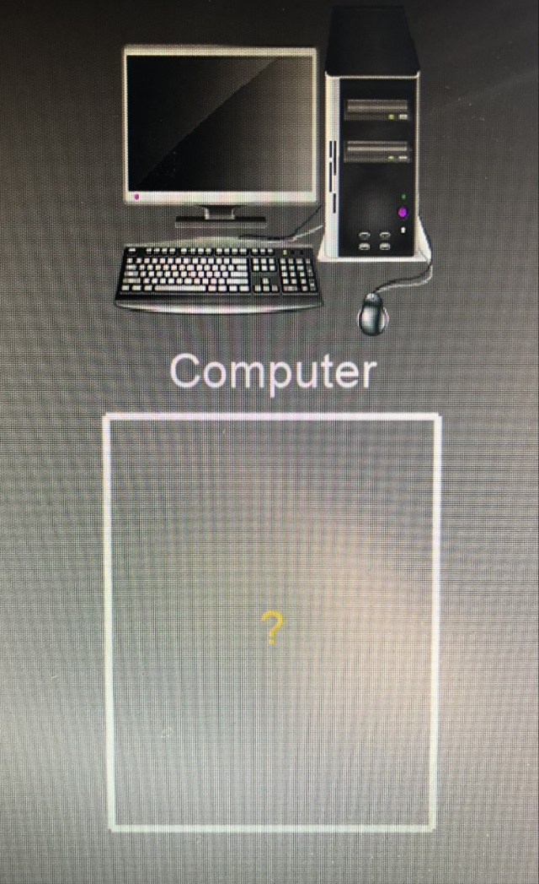
The image above the card will either be of a computer, or the recent participant whose reward depends on your performance. When you make a guess, the question mark on the screen will turn orange, as pictured.

Slide 7
Every monetary outcome on each trial of the task will be shared equally between you and your partner on the screen.
Earning $10 for guessing correctly means that you earn $5 for yourself and $5 for your partner.
Losing $5 for an incorrect guess means that both you and your partner will each lose $2.50.
After you indicate your choice, you will see the actual value of the card.
If your guess was correct, you'll see a green arrow pointing up, indicating monetary gain.
If it was incorrect, you'll see a red arrow pointing down indicating a loss.
If you happen to not respond within the 2.5 seconds, you won't see anything but the value of the card, and a # sign will show on the screen.

Slide 8
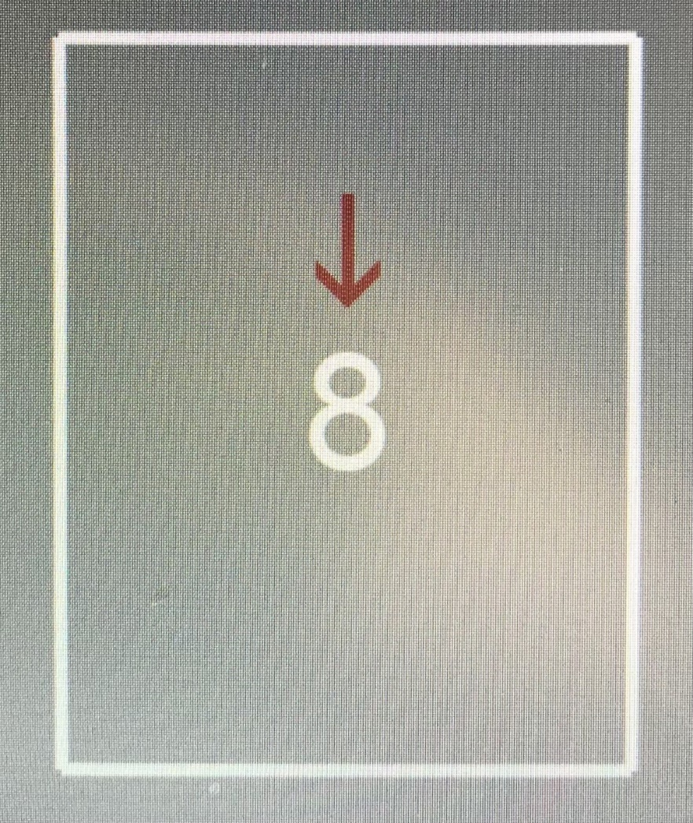
For example, imagine you guessed ‘lower than 5’ and the card was an ‘8.’ In this case, a red down arrow would appear, meaning an incorrect guess and monetary loss of $2.50 each for you and whichever partner was on the screen.

Slide 9
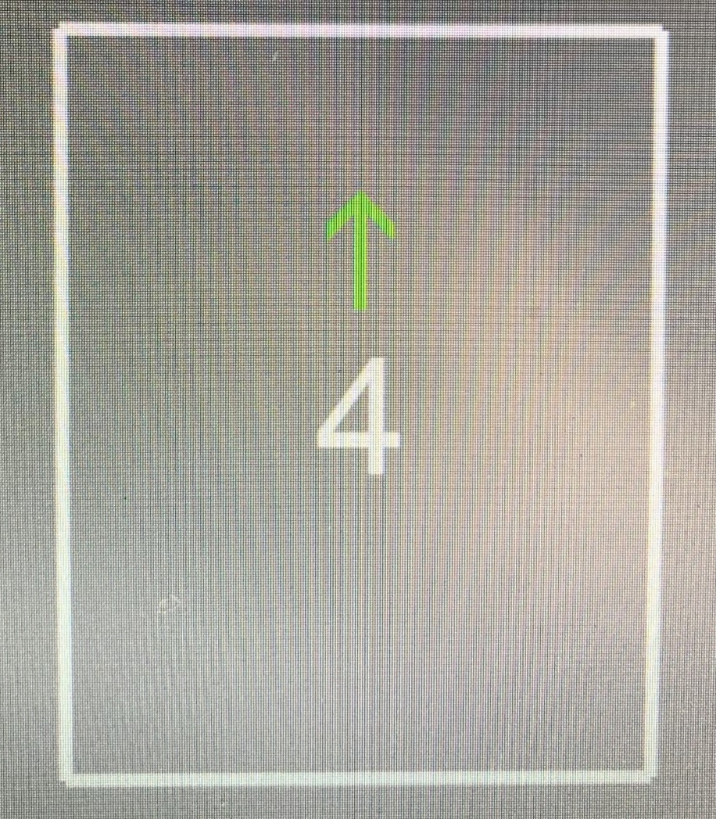
If the card had been a ‘4,’ then a guess of ‘lower than 5’ would have been correct. In this case you would see a green arrow pointing up, meaning a monetary gain of $5 each for both you and the partner on the screen

Slide 10
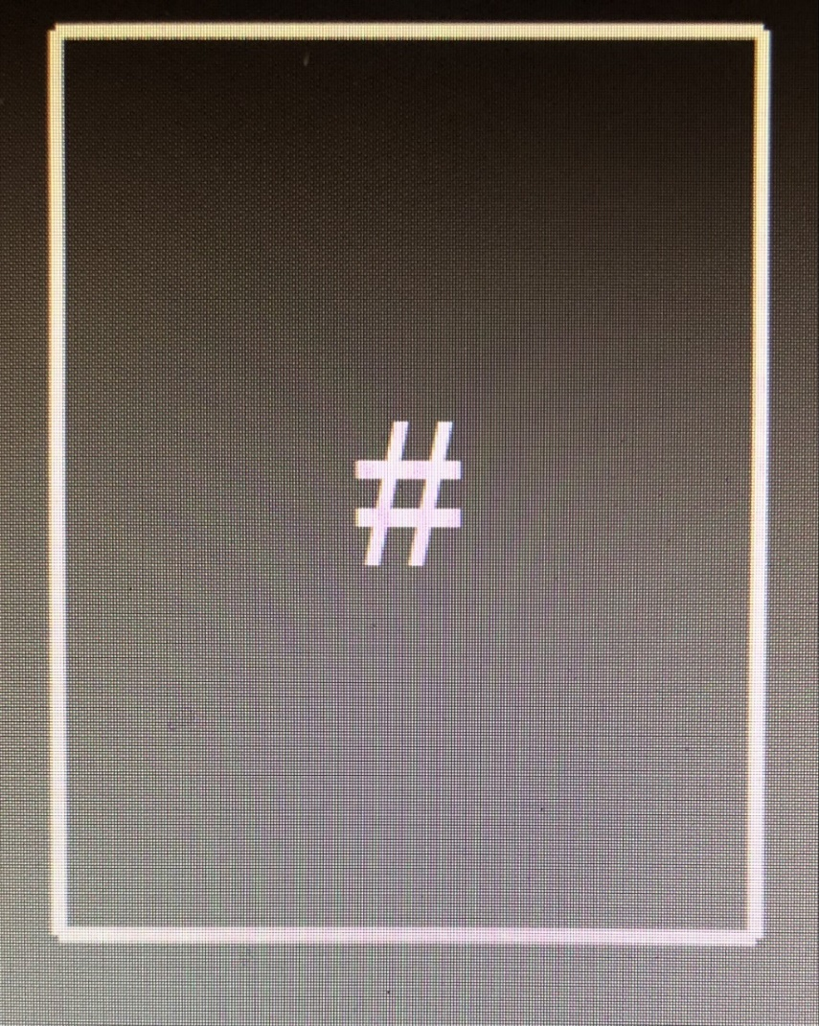
If you don’t respond in time, you will see the above symbol

Slide 11
At the end of the task, we will randomly choose ten trials and will pay both you and your partner your total earnings for those trials.
Any money earned with the computer will go back into a pool of general lab funds.
There's no penalty for missing a trial, but if we happen to choose a missed trial as one of the random ten, you and your partner can't earn anything for that trial.
After your scan we’ll discuss the possibility of you being a study partner for future participants!
Do you have any questions? We will go through some practice trials before you complete the actual experiment in the scanner so you can get used to the timing of the task. Please let us know if anything about the game is unclear.

