Slide 1


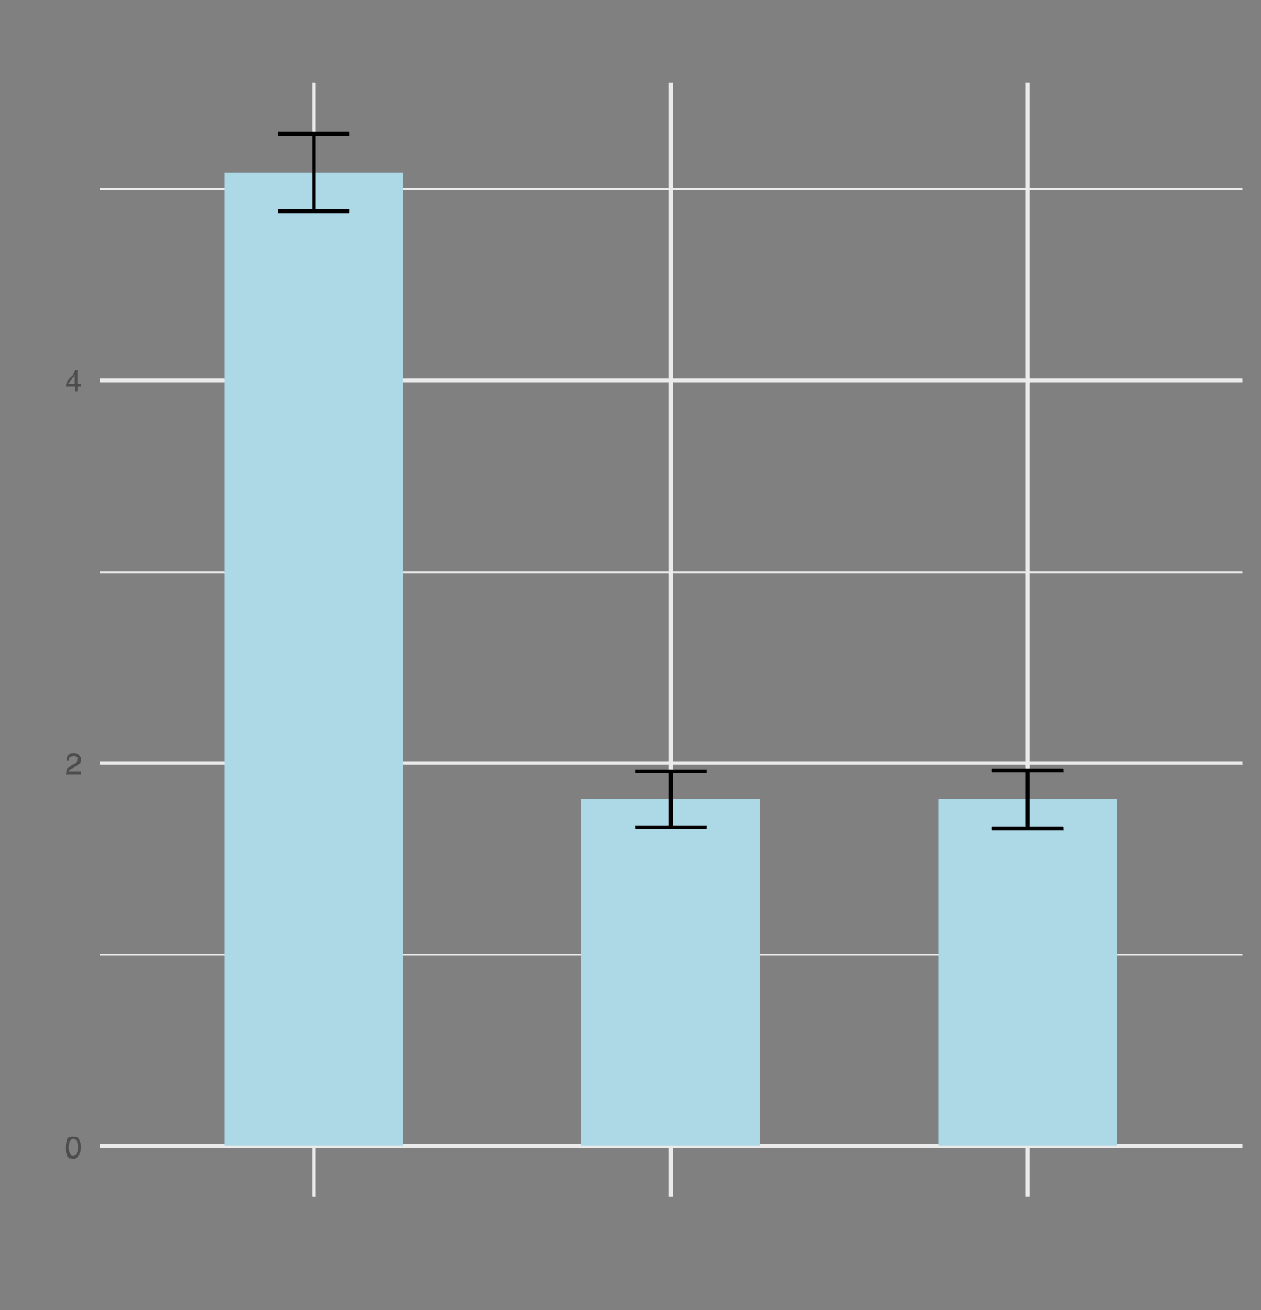
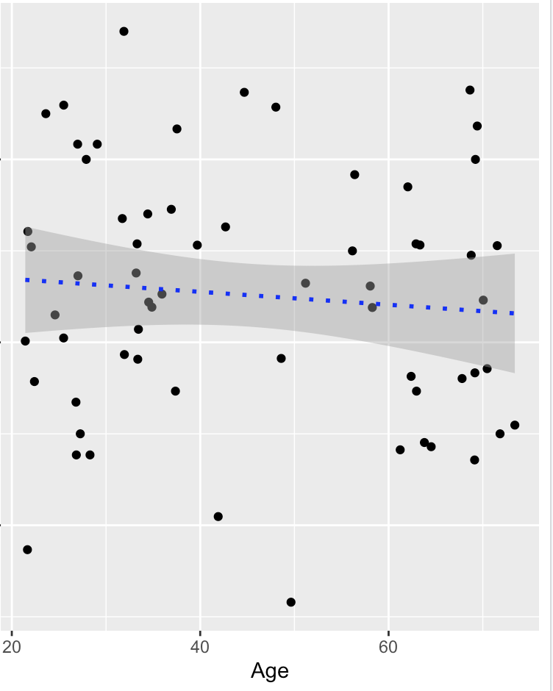
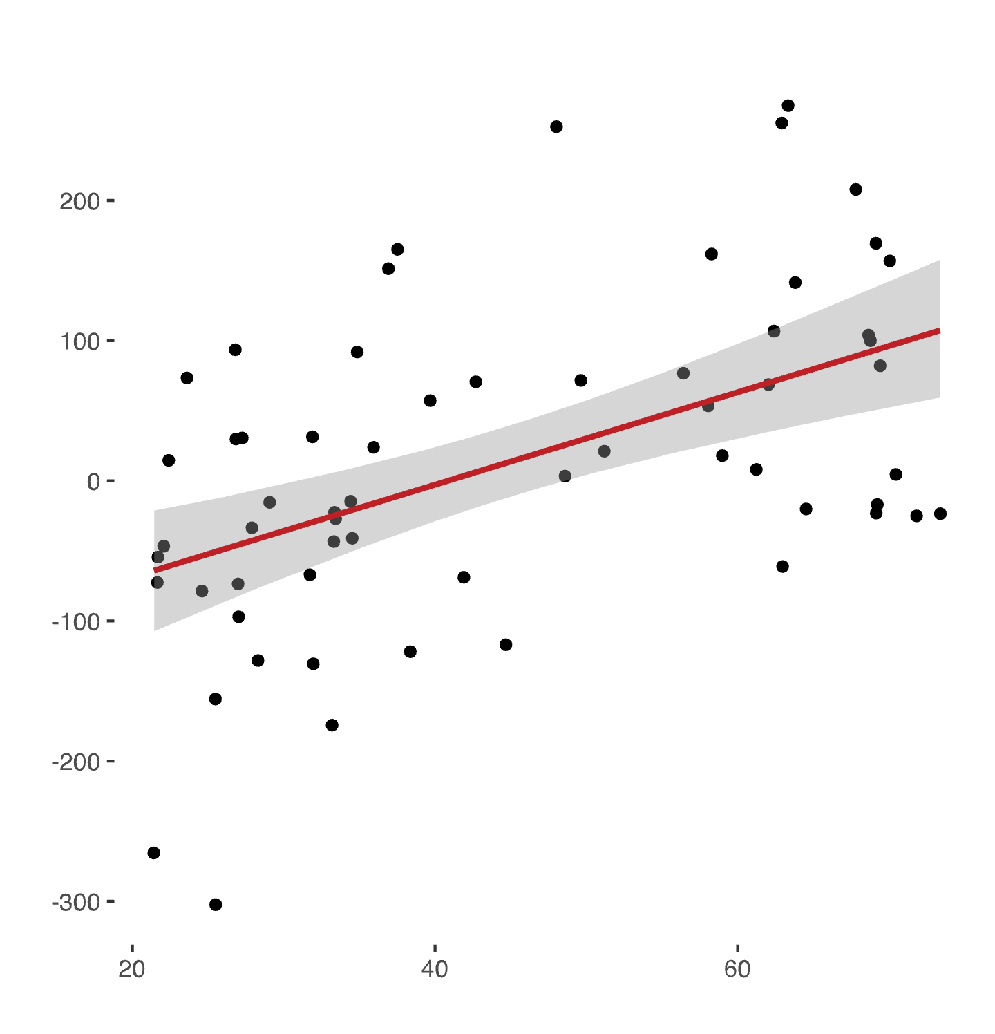
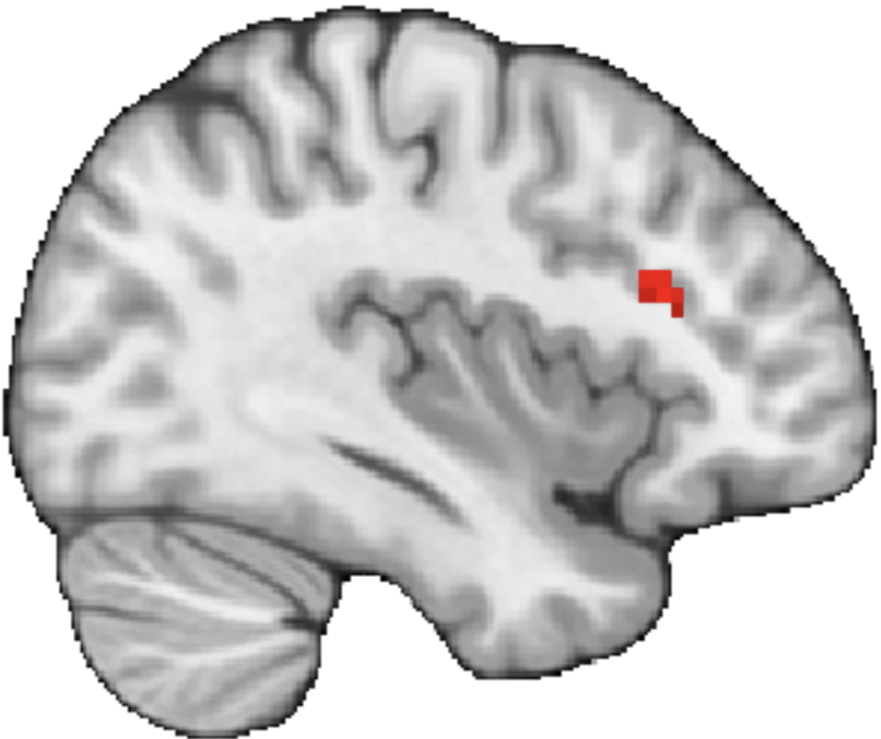
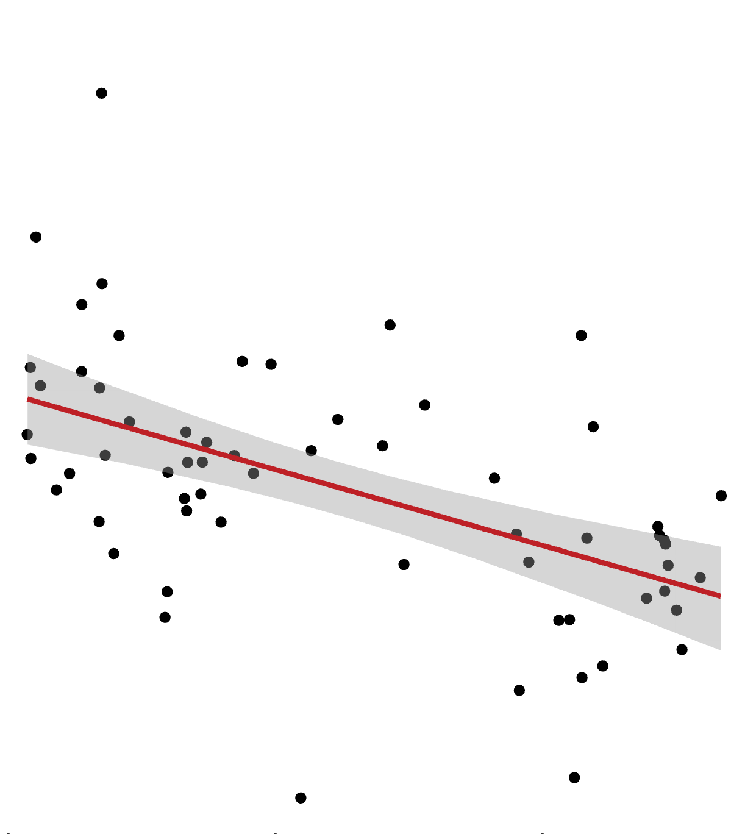
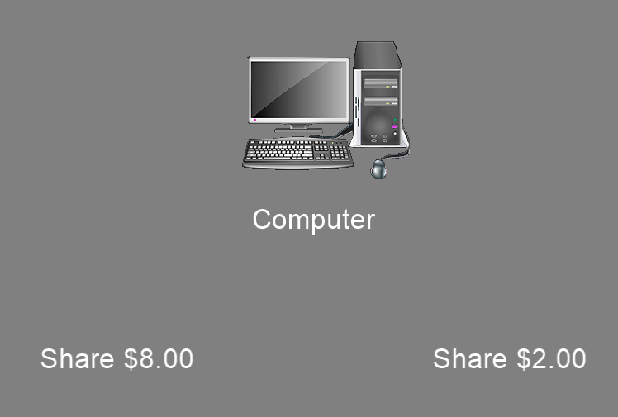
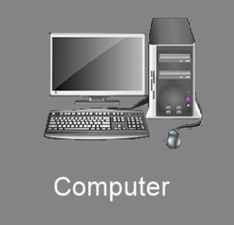



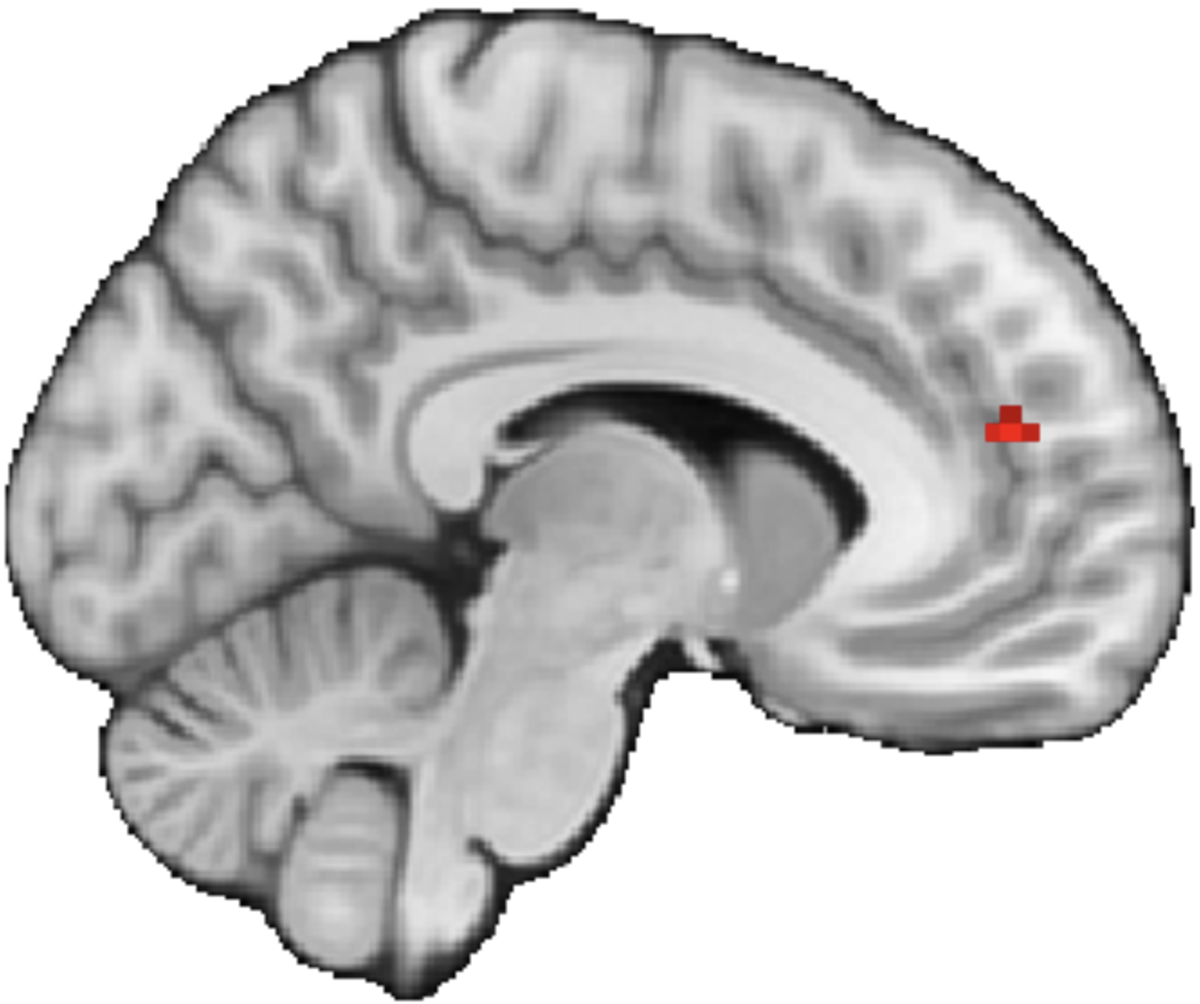



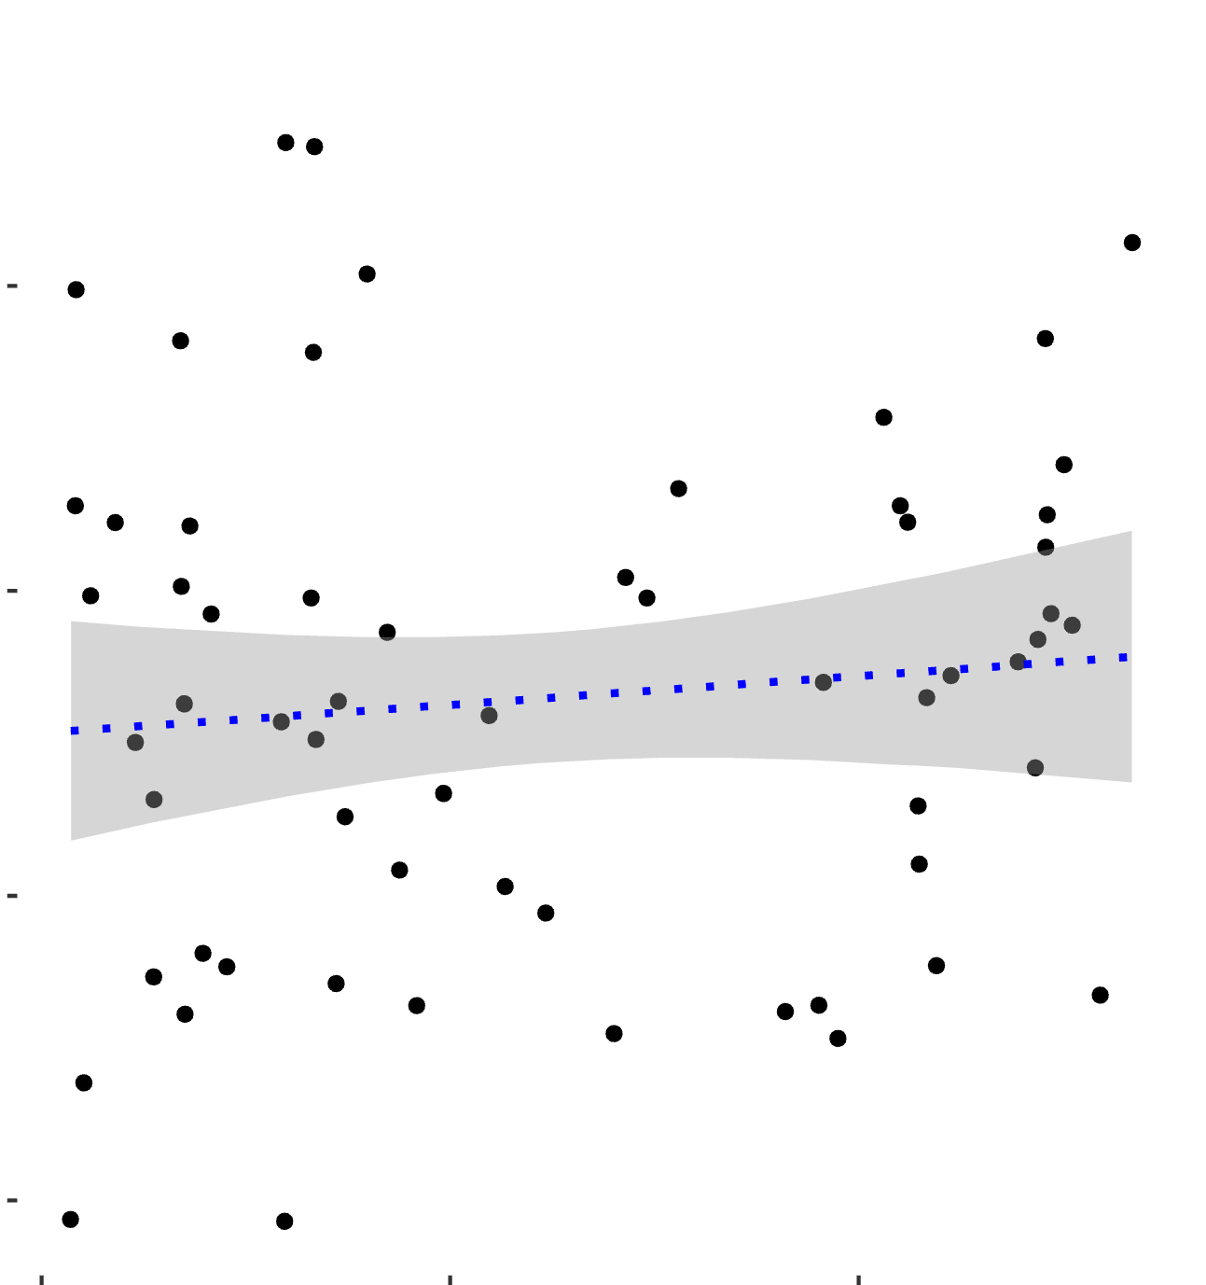
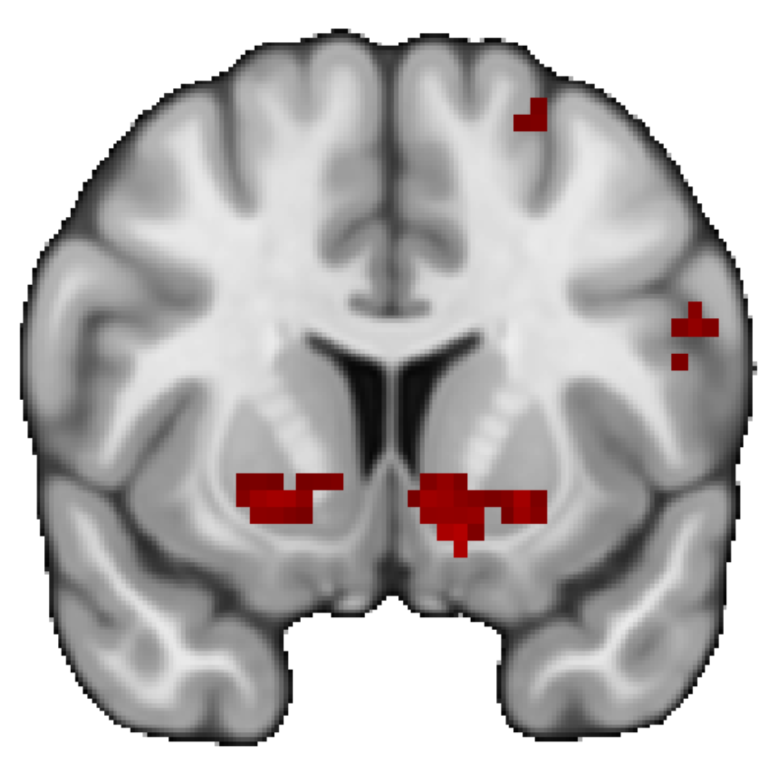
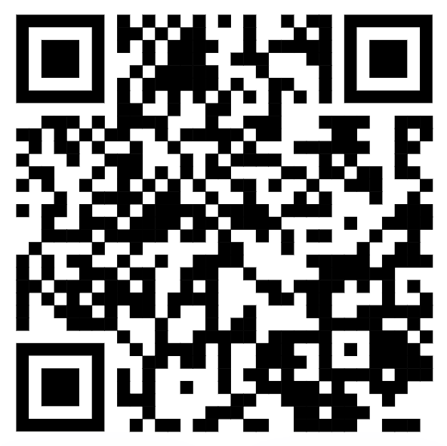
Examining Age-Related Differences in Neural Responses to Trust
Abraham Dachs¹, Cooper J. Sharp¹, Enes Yanilmaz¹, James B. Wyngaarden III¹, Ori Zaff², Tia Tropea¹, Daniel Sazhin¹, Rita Ludwig², Tania Giovannetti¹, Dominic S. Fareri³, David V. Smith¹
1. Temple University, Philadelphia, PA; 2. University of Pennsylvania, Philadelphia, PA; 3. Adelphi University, Garden City, NY
1. Introduction
3. Subjects Are Closer With Friends than With Strangers
5. Age Related Differences in Partner Response
Social relationships influence our behaviors and may modulate our neural responses to reward. (Fareri et al., 2015)
The effect of relationships on behavior and reward activation may change as we age. (Fareri et al., 2022)
It remains unclear whether age-related differences in responses to trust are associated with maladaptive outcomes such as financial exploitation.
4
2
Friend Defecting > Computer Defecting
200
Sharing with Friend – Sharing with Stranger
X= 52
2
0
dlPFC activation
We investigated whether social trust decisions change as we age, and how those changes could be related to financial exploitation.
-2
0
Friend
Stranger
Computer
20
40
60
dlPFC
-300
We found greater MFG activation in older adults than in younger adults when experiencing friend defecting.
Age
20
60
2. Methods
mPFC activation was negatively correlated with age during friend reciprocation
You are given $8 for the trial.
400
Friend Reciprocate > Computer Reciprocate
You are assigned a partner.
Computer
X= -8
Share $8
Share $2
mPFC activation
You choose a higher or lower amount to share with your partner.
Loading…
mPFC
-200
The money you sent is tripled
x3
+
20
Age
60
Outcome Phase
We found that friend defecting resulted in increased dlPFC activation in older adults compared to younger adults.
We also found that friend reciprocating resulted in reduced mPFC activation in older adults compared to younger adults.
4. Age-Related Differences in Striatal Response?
End of trial
400
6. Conclusions and Future Directions
Scan the QR code to see the
Pre-registration!
N = 62 Completed the Inclusion of Other in Self Scale and the Older Adults Financial Exploitation and Vulnerability Scale.
Whole brain results were thresholded at Z > 3.1 and Family Wise Error corrected at p > .05
Y=9
Our preliminary results indicate that reciprocation elicited activation in the ventral striatum. Additionally, we find that during the
Reciprocate > Defect
VS
-200
20
Age
60
This study was supported by National Institutes of Health grant RF1-AG67011 (David V. Smith). Contact information: Avi.Dachs@temple.edu, Cooper.Sharp@temple.edu
We found activation in the VS when participants were presented with a reciprocate outcome as opposed to a defect outcome, however, there was no significant interaction with age.

Slide 2
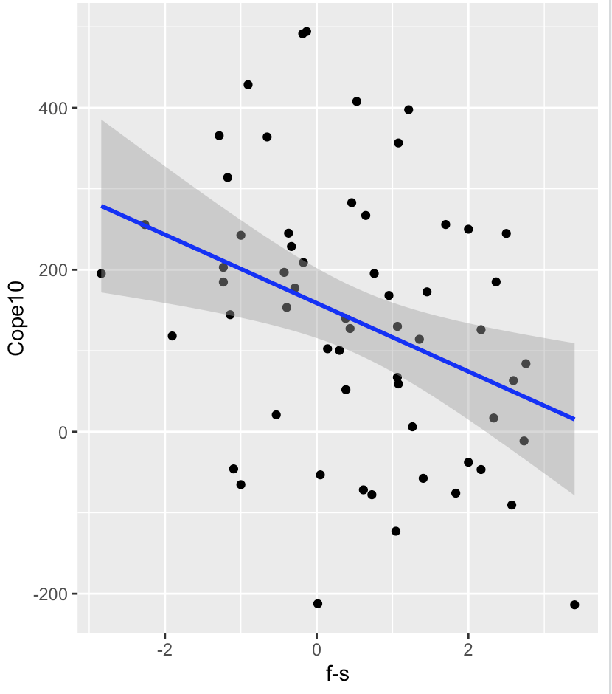
Other
Self
Kyle M. Woosnam,
The inclusion of other in the self (ios) scale
Friend
Stranger
Computer
VS mask Cope 10, f-s behavior

Slide 3
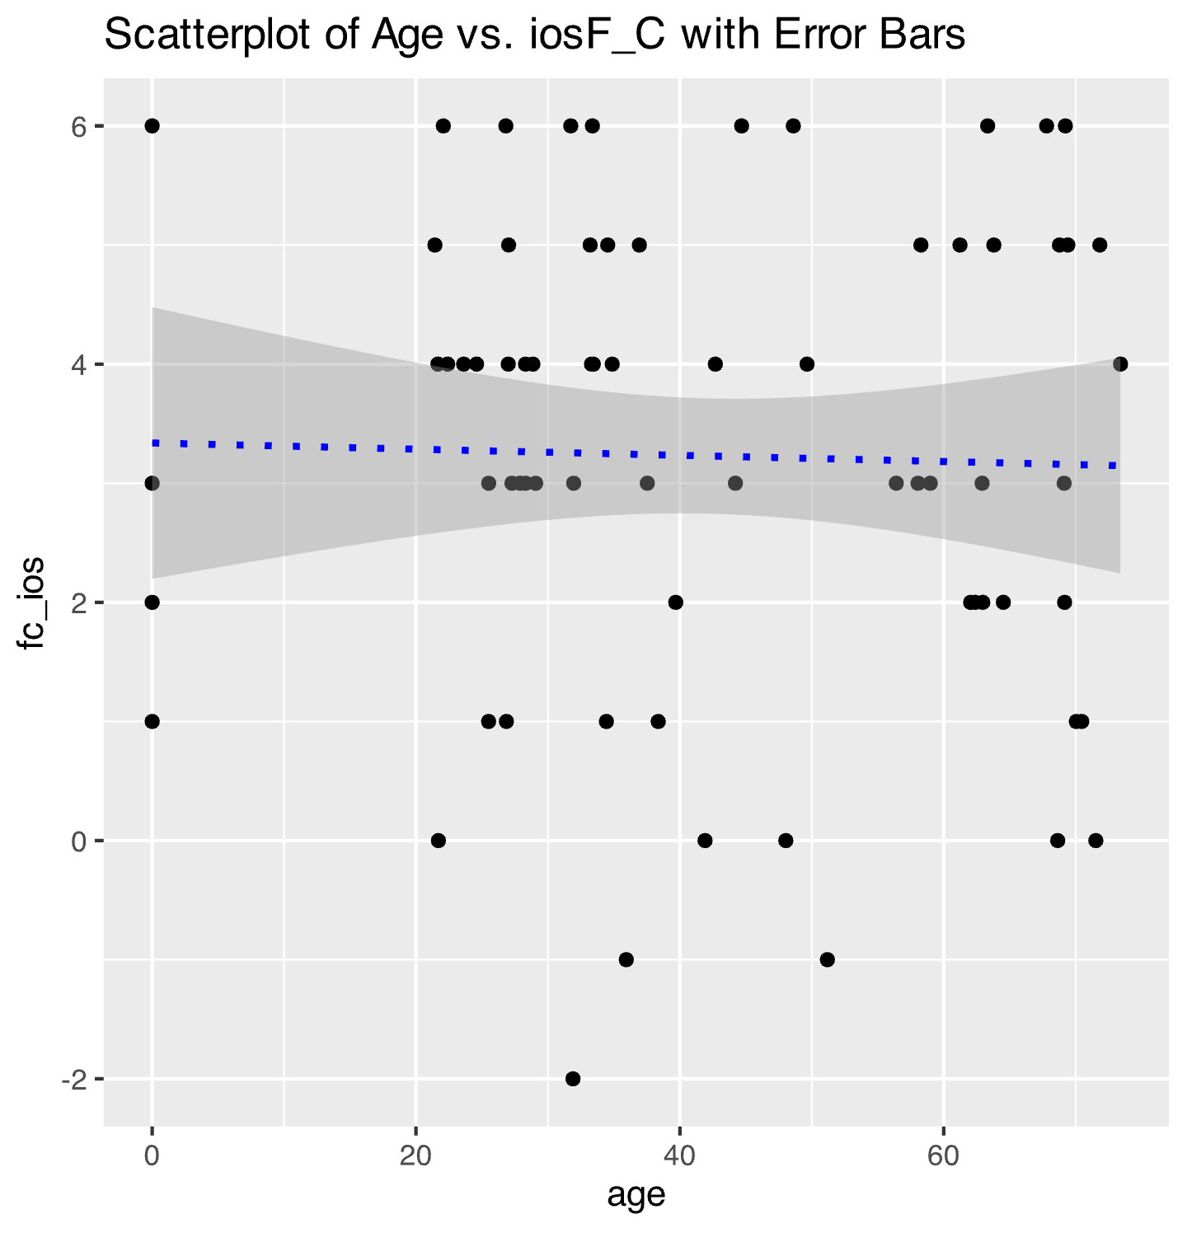
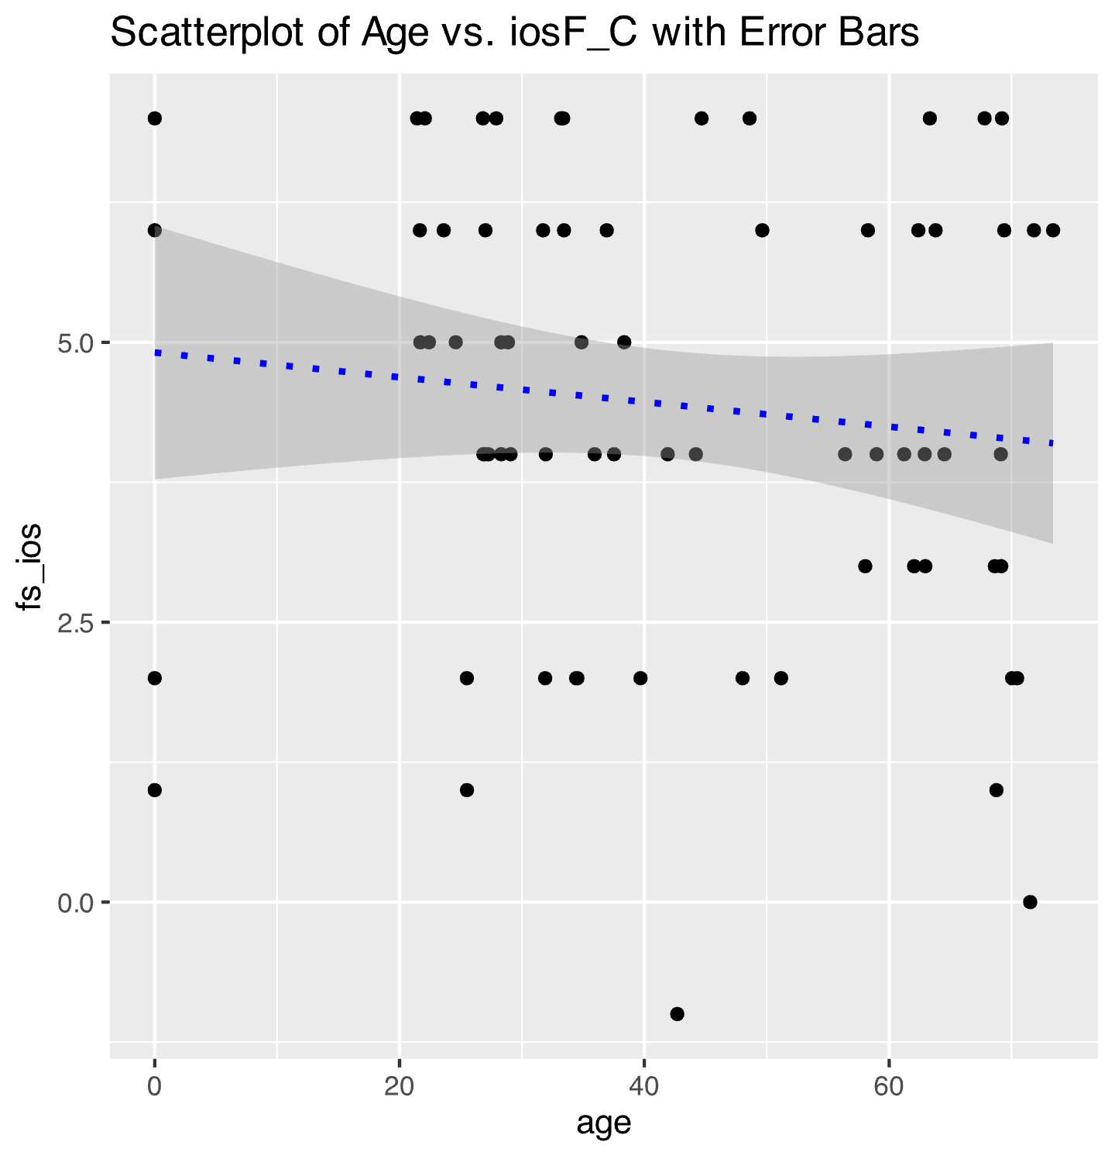
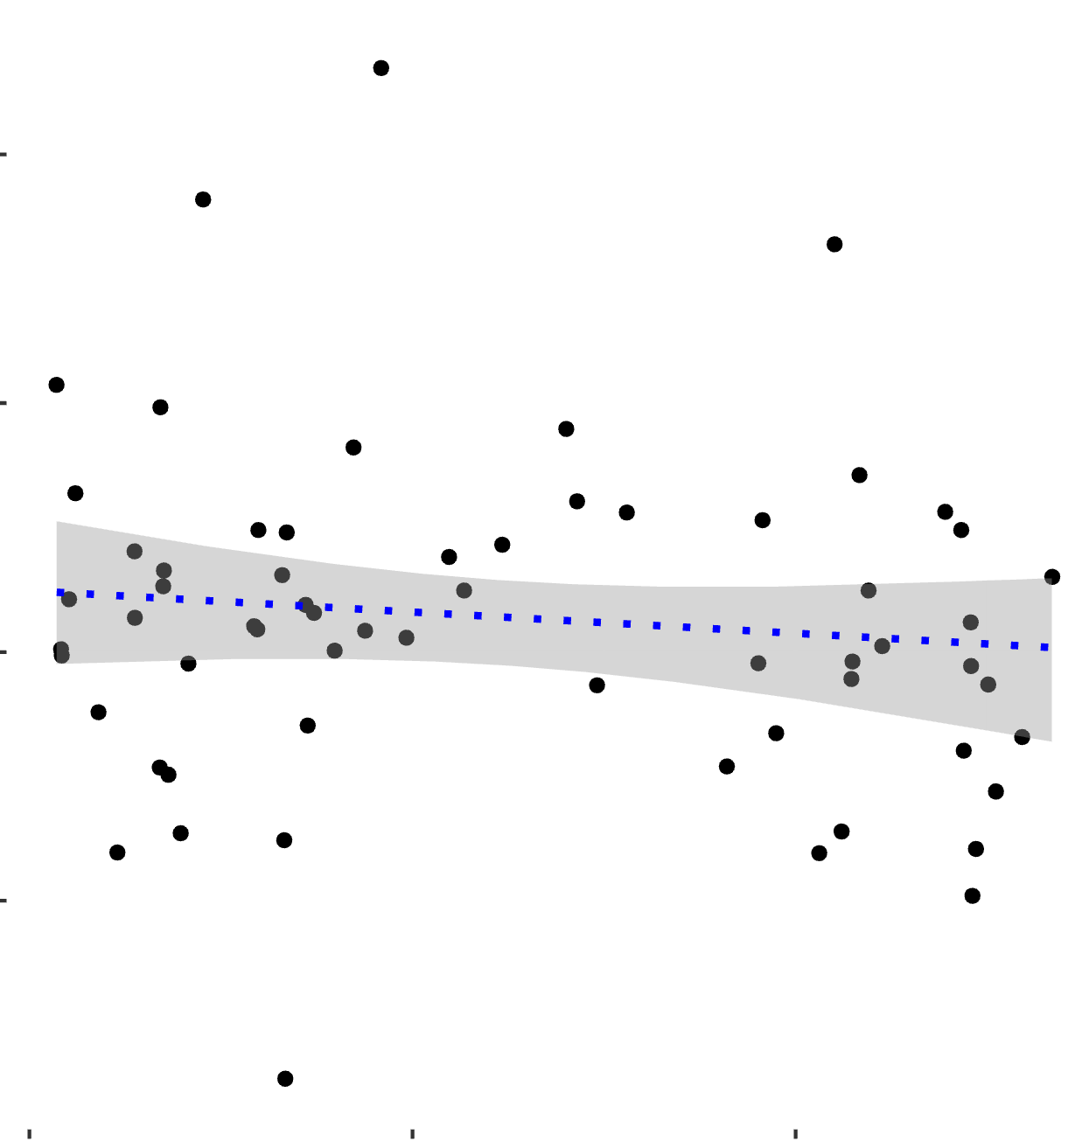
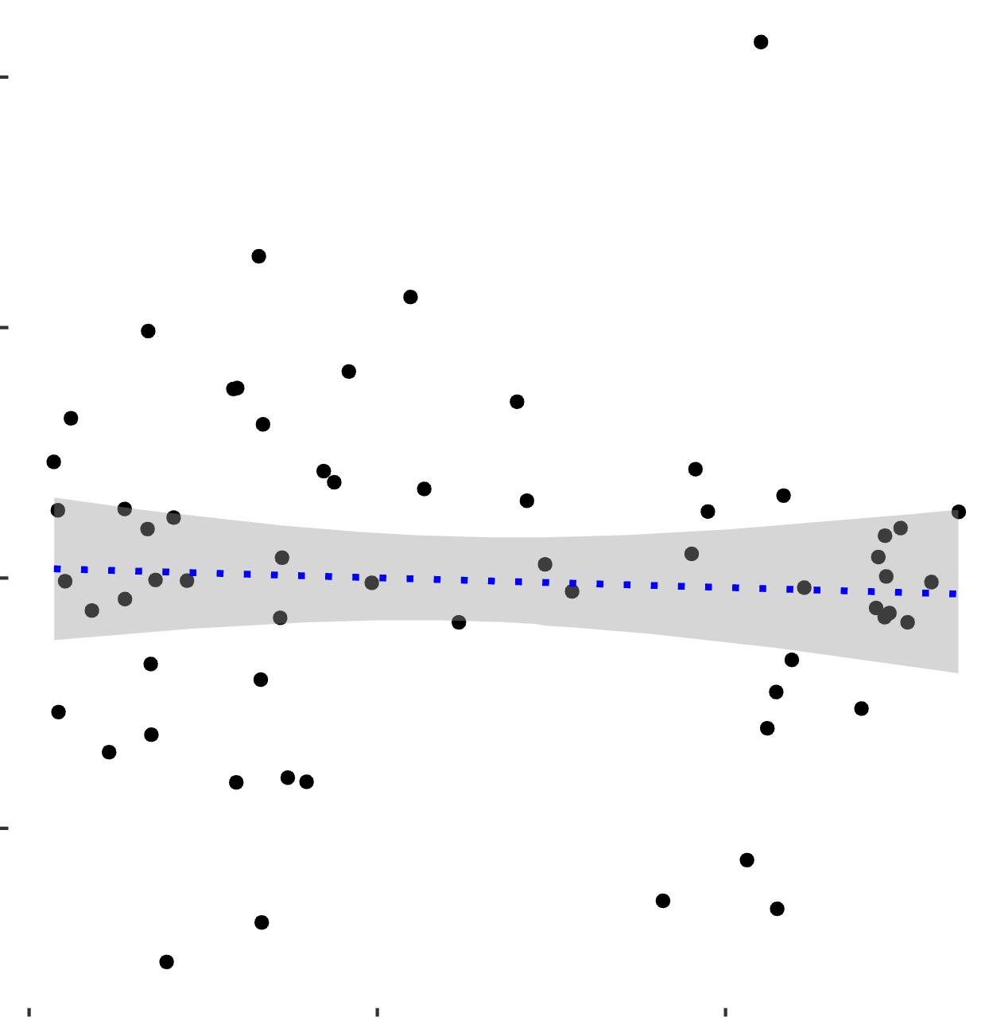
400
Friend (Reciprocate > Defect) > Computer (Reciprocate > Defect)
-200
20
Age
60
400
Friend (Reciprocate > Defect) > Stranger (Reciprocate > Defect)
-200
20
Age
60
Participants were asked to rate their closeness with the three partners before the task on a 7-point Likert Scale

Slide 4
4. Ventral Striatal Activation Is not Associated with Age
We found Ventral Striatum (VS) activation for Reciprocate > Defect outcomes
Y=9
VS
We found activation in the VS when participants were presented with a reciprocate outcome as opposed to a defect outcome.
400
400
400
Friend (Reciprocate > Defect) > Stranger (Reciprocate > Defect)
Friend (Reciprocate > Defect) > Computer (Reciprocate > Defect)
Reciprocate > Defect
-200
-200
20
60
-200
20
Age
60
Age
20
Age
60
We found that activation in the VS was not related to age

