Slide 1


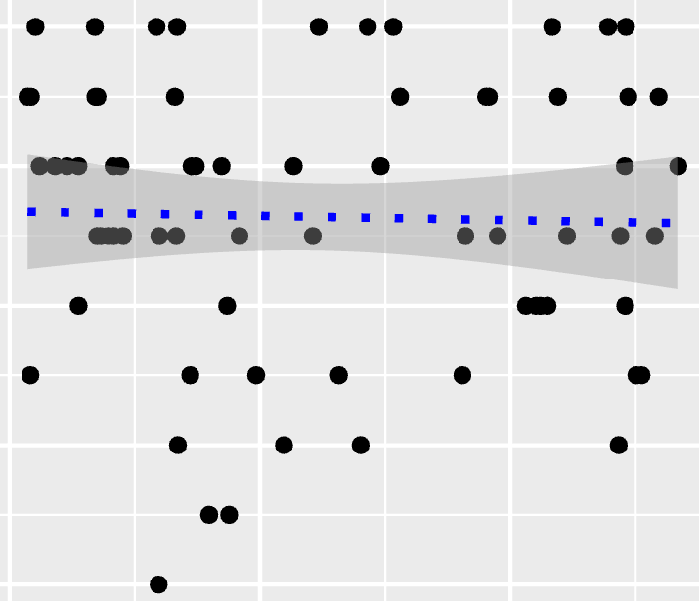
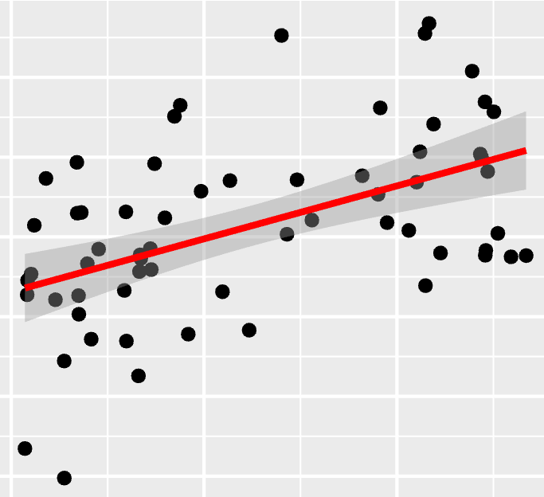
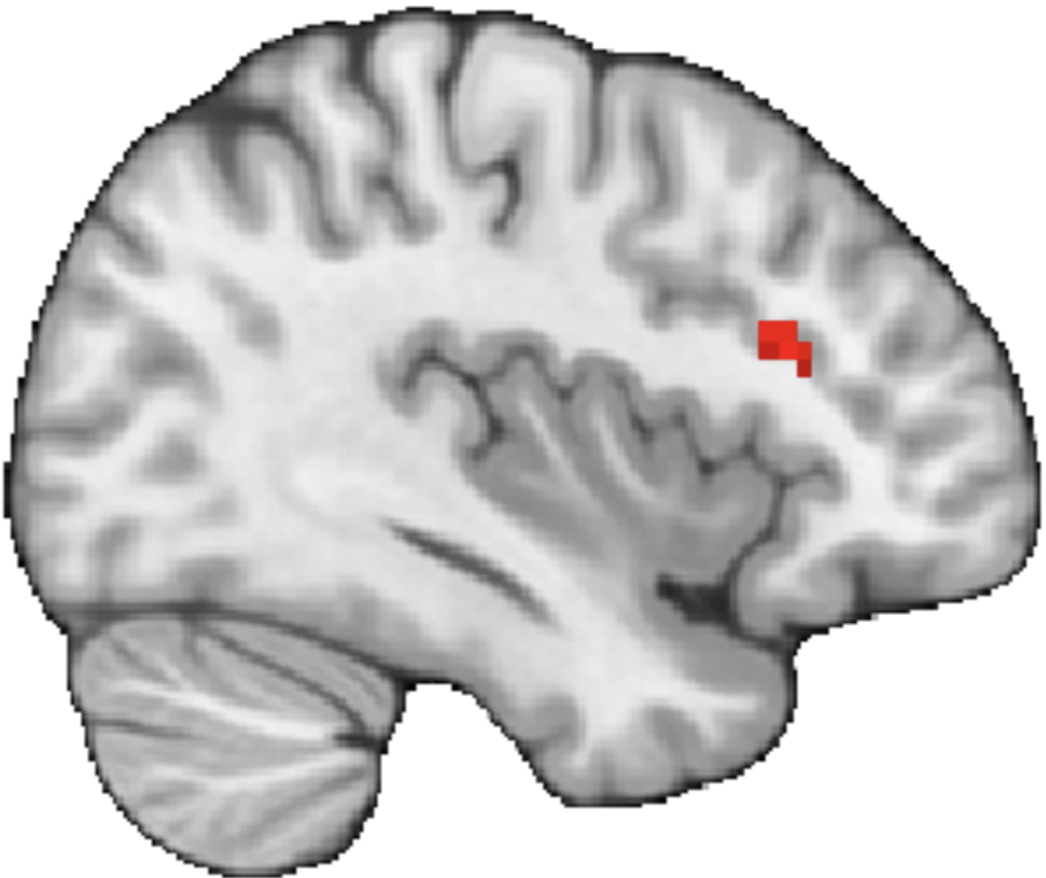
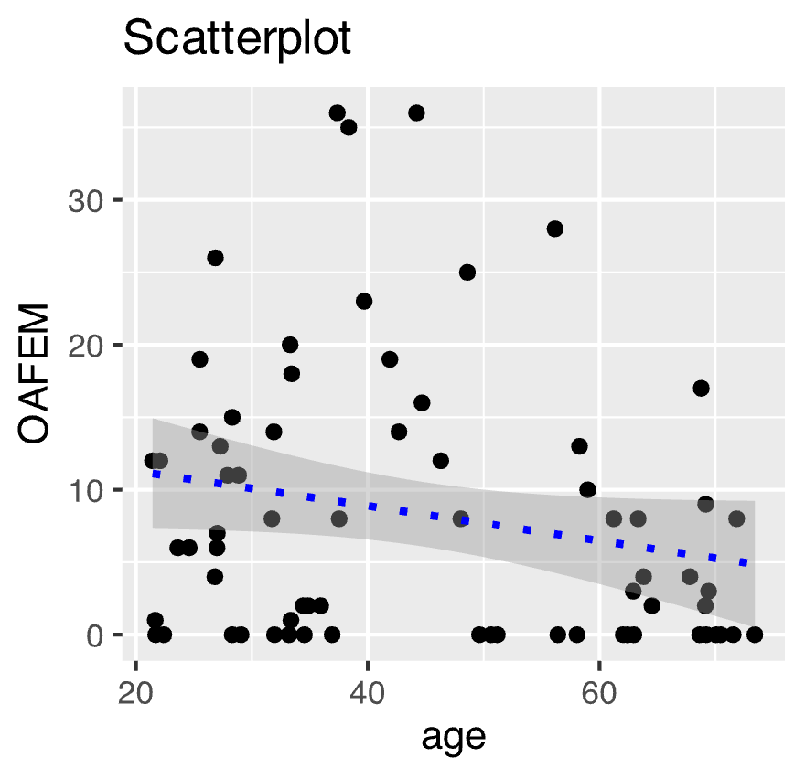
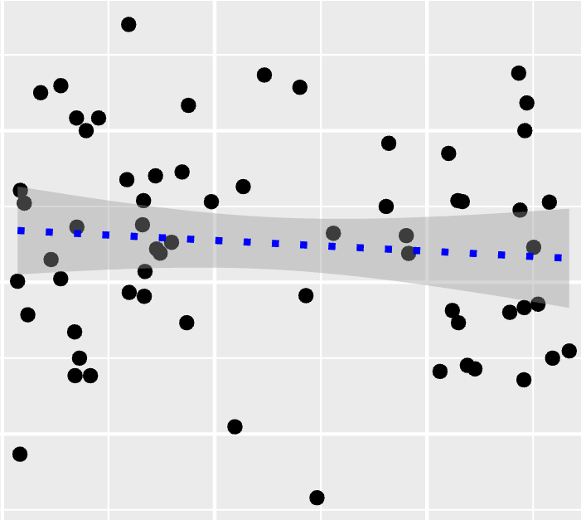
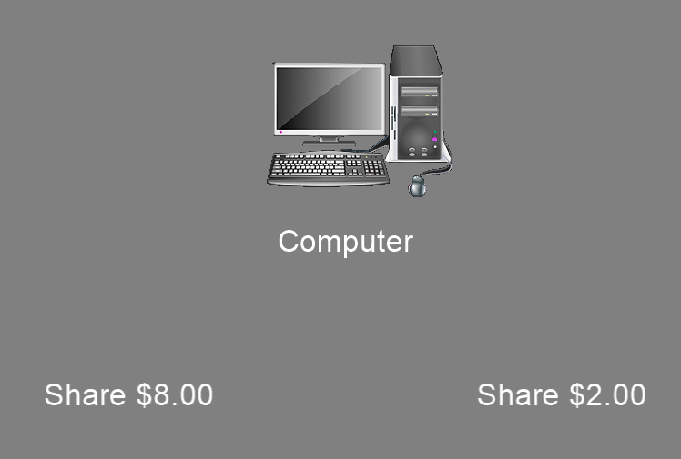
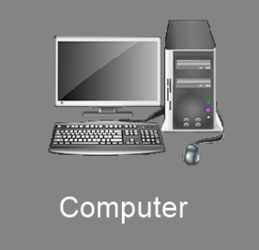


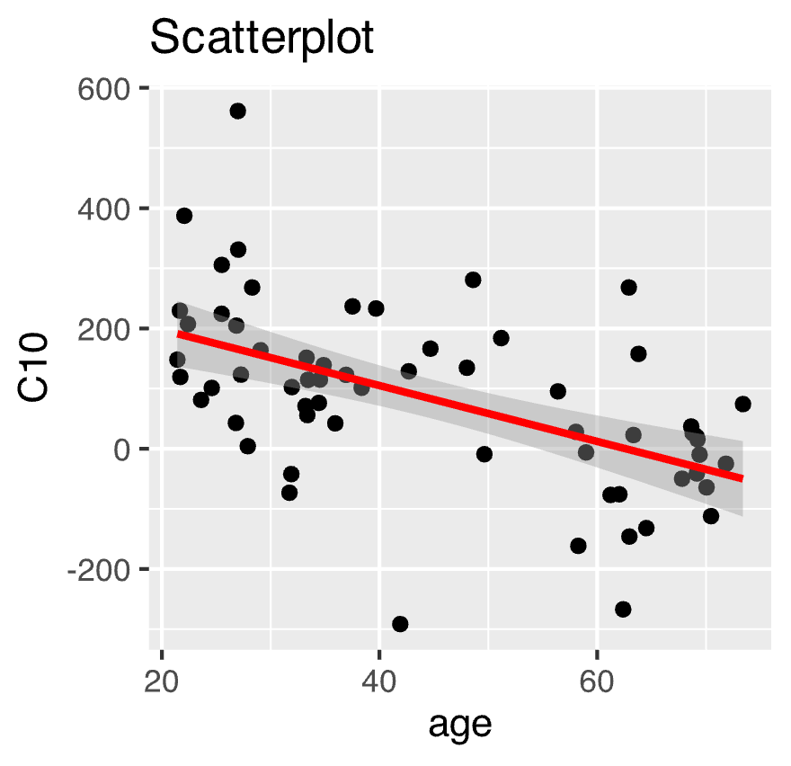

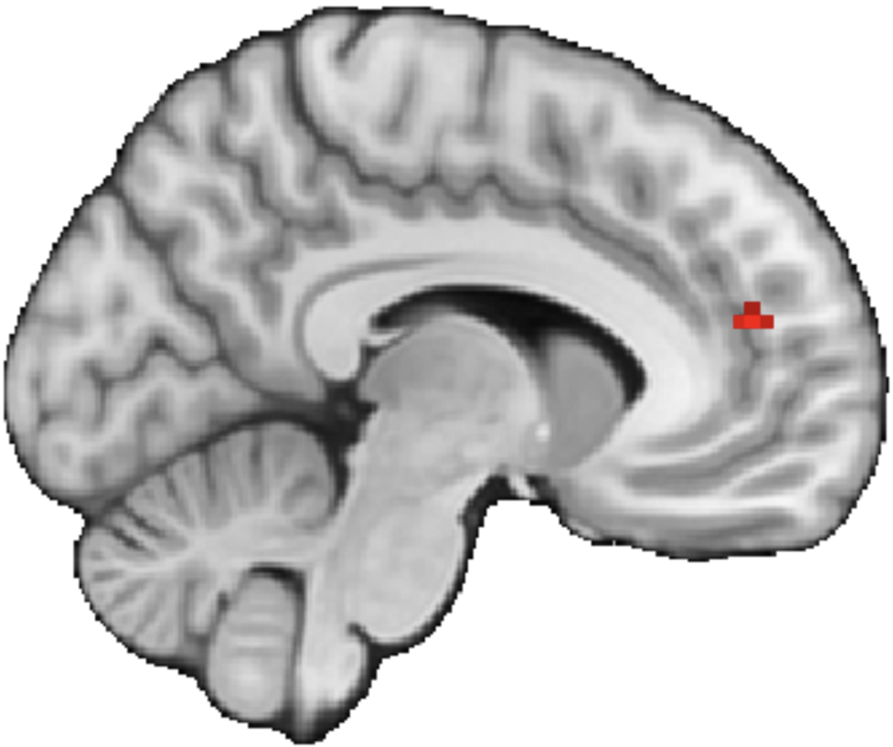



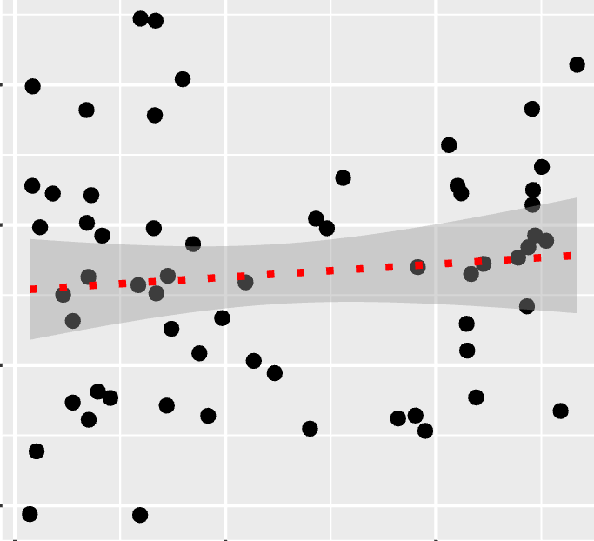
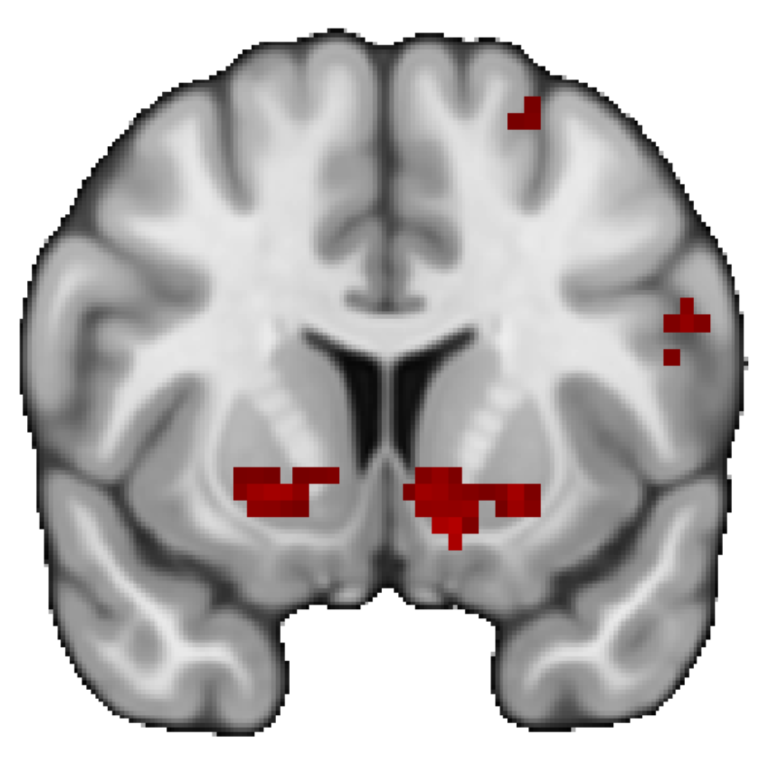
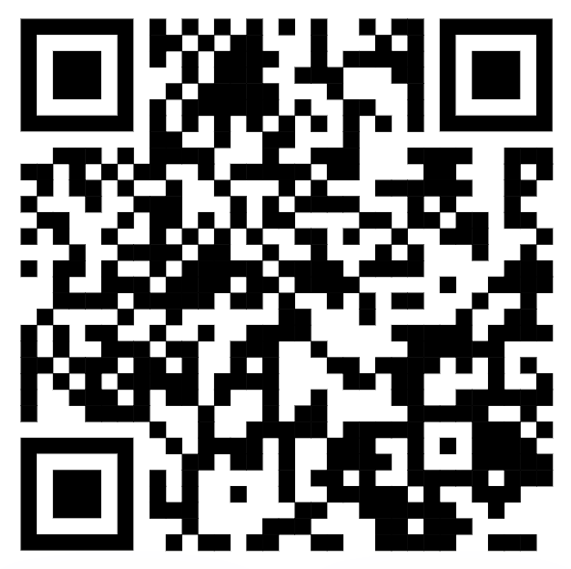
Examining Age-Related Differences in Neural Responses to Trust
Abraham Dachs¹, Cooper J. Sharp¹, Enes Yanilmaz¹, James B. Wyngaarden III¹, Ori Zaff², Tia Tropea¹, Daniel Sazhin¹, Rita Ludwig², Tania Giovannetti¹, Dominic S. Fareri³, David V. Smith¹
1. Temple University, Philadelphia, PA; 2. University of Pennsylvania, Philadelphia, PA; 3. Adelphi University, Garden City, NY
1. Introduction
3. Age-Related Behavioral Effects?
5. Whole Brain Analyses of Neural Responses to Social Outcomes
Social relationships influence our behaviors and modulate our neural responses to reward (Fareri et al., 2015).
The effect of relationships on behavior and reward activation change as we age (Fareri et al., 2022; Cassidy et al., 2020).
It remains unclear whether age-related differences in responses to trust are associated with maladaptive outcomes such as financial exploitation.
R = -.03
6
To investigate if age-related effects were present elsewhere, we conducted a set of whole brain analyses.
4
200
IOS Friend - Computer
Friend Defecting > Computer Defecting
Closeness
X= 52
dlPFC activation
We investigated whether social trust decisions change as we age, and if those changes could be related to financial exploitation.
0
Friend
Stranger
Computer
-2
20
Age
70
Participants are closer with their friend than with the stranger and computer partners, however, there is no relationship between age and closeness ratings.
dlPFC
-300
2. Methods
20
Age
70
Participants (N = 62) completed a trust task with three partners: a computer, a stranger, and their chosen friend.
35
R = -.21
R = -0.09
We found that friend defecting resulted in increased dorsolateral prefrontal cortex (dlPFC) activation in older adults compared to younger adults.
2
400
You are assigned a partner.
Computer
OAFEM
Sharing with Friend –With Stranger
Friend Reciprocate > Computer Reciprocate
0
X= -8
Share $8
Share $2
-2
mPFC activation
You choose a higher or lower amount to share with your partner.
Loading…
0
20
Age
70
20
Age
70
x3
+
We found no age-related effects across financial exploitation measures or investment behavior
mPFC
-200
The money you sent is tripled
20
Age
70
4. Age-Related Differences in Striatal Response?
We also found that friend reciprocating resulted in reduced medial prefrontal cortex (mPFC) activation in older adults compared to younger adults.
Outcome Phase
400
End of trial
Y= 9
6. Conclusions and Future Directions
We used the Inclusion of Other in Self Scale (IOS) and the Older Adults Financial Exploitation Measure (OAFEM) to measure closeness ratings and risk for financial exploitation.
Whole brain results were thresholded at Z > 3.1 and Family Wise Error corrected at p > .05
fMRI data were preprocessed with fMRIprep and statistical analyses were performed using FSL
Reciprocate > Defect
Our preliminary results indicate that reciprocation elicited activation in the ventral striatum.
Additionally, we find that activation of the dlPFC increased, and mPFC decreased, during the processing of social outcomes as a function of age.
Future analyses will examine how neural and behavioral responses to trust are associated with risk for financial exploitation.
Scan the QR code to see the
Pre-registration!
VS
-200
20
Age
70
We found activation in the ventral striatum (VS) when participants were presented with a reciprocate outcome as opposed to a defect outcome, however, there was no significant association with age for any condition (Friend > Stranger and Friend > Computer).
This study was supported by NIH grant RF1-AG67011 (David V. Smith). Contact information: Avi.Dachs@temple.edu, Cooper.Sharp@temple.edu

Slide 2
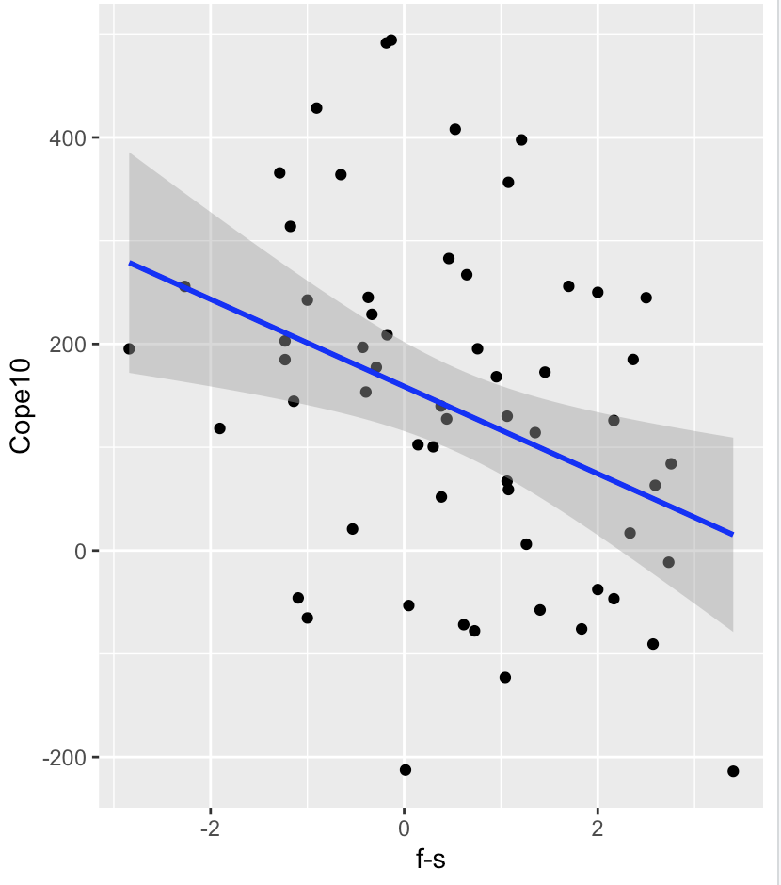
Other
Self
Kyle M. Woosnam,
The inclusion of other in the self (ios) scale
Friend
Stranger
Computer
VS mask Cope 10, f-s behavior

Slide 4
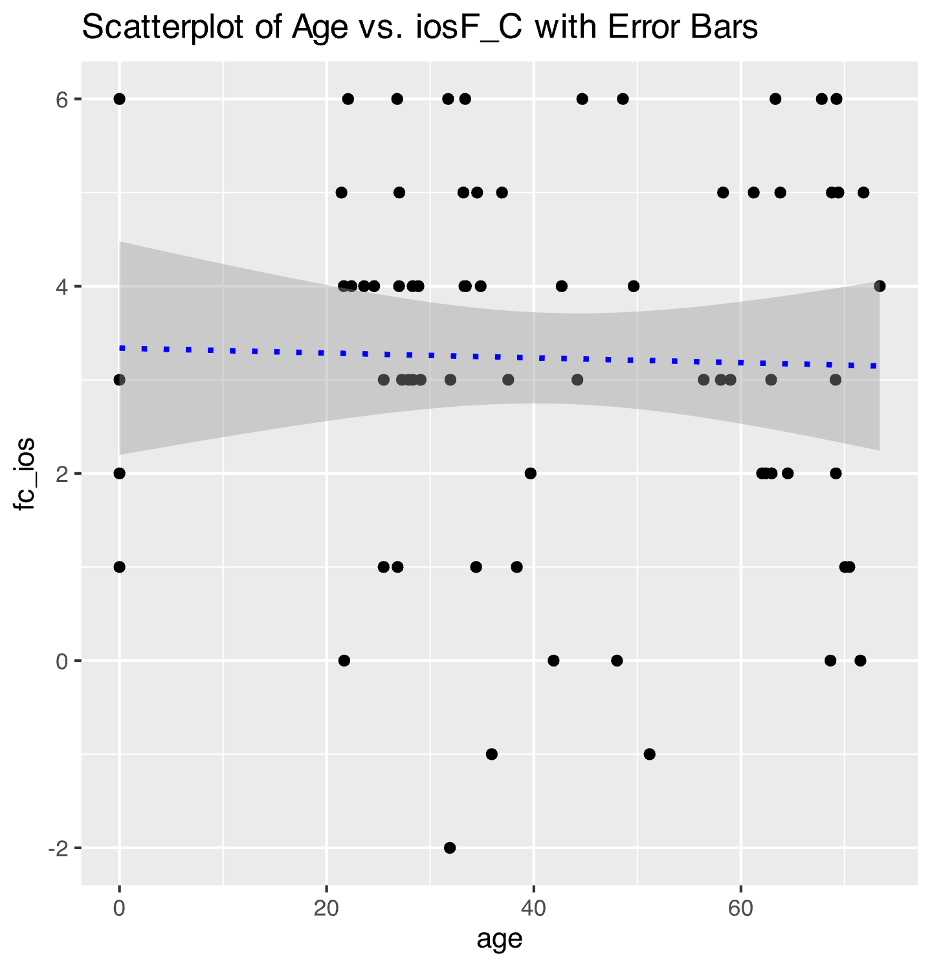
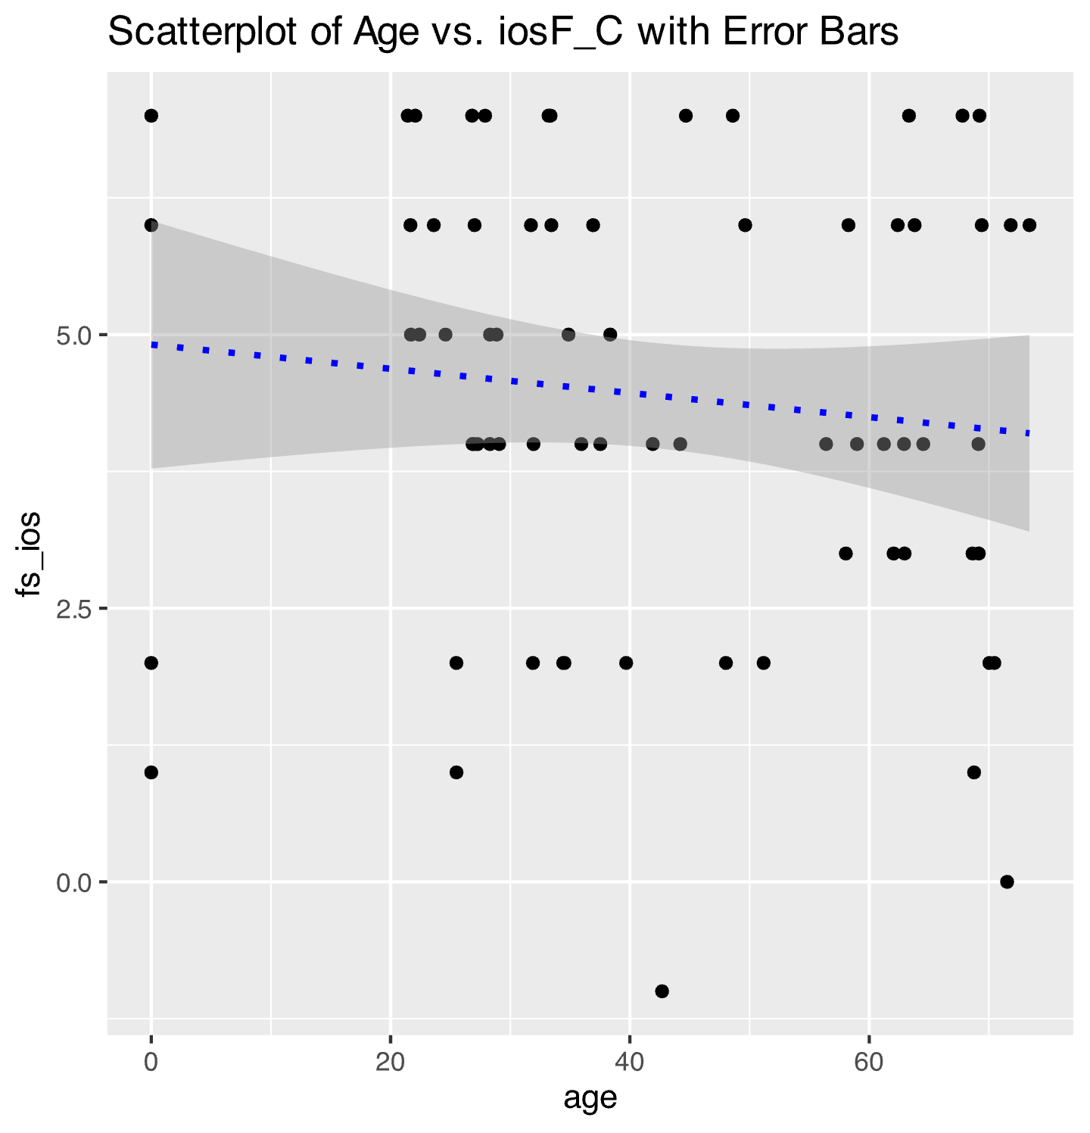
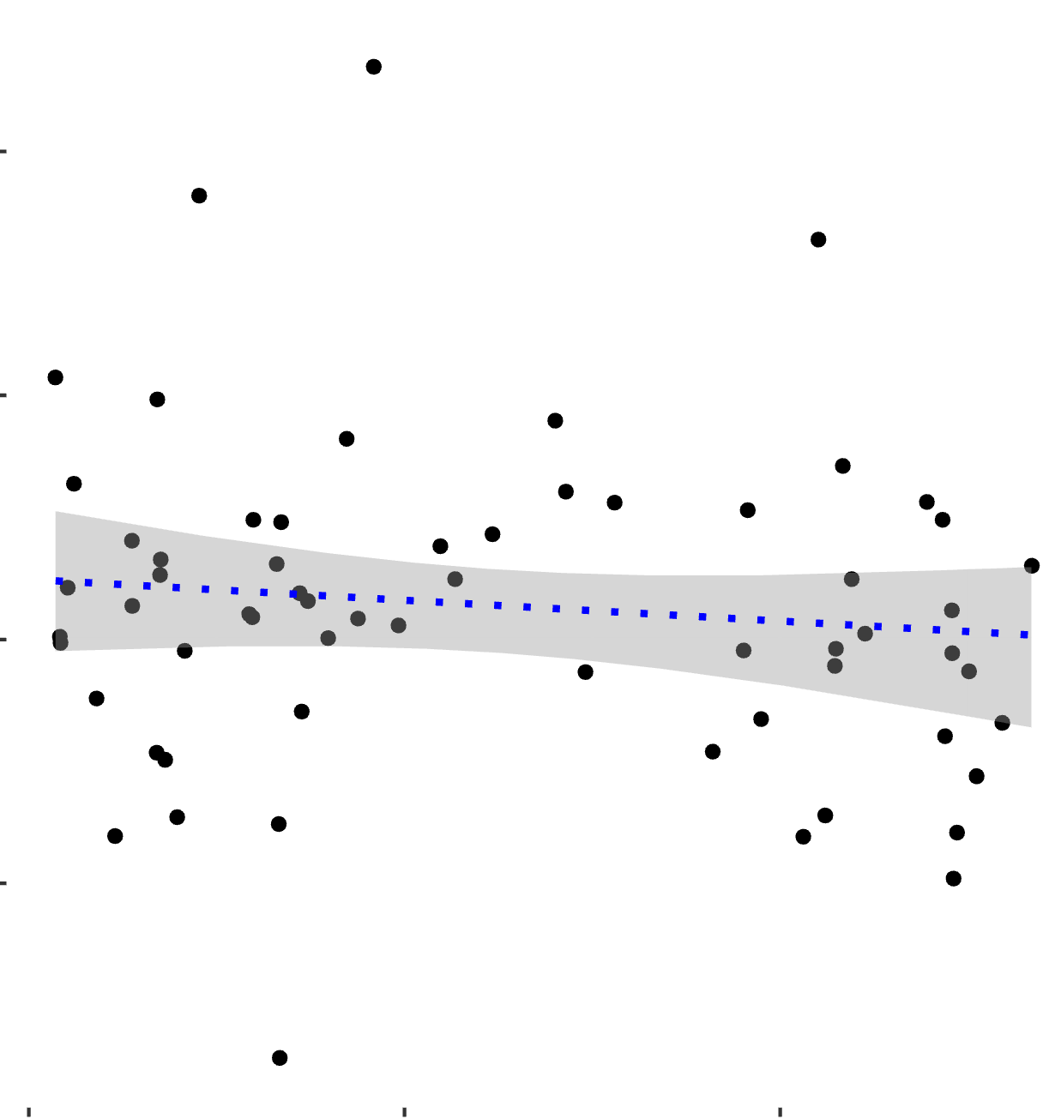
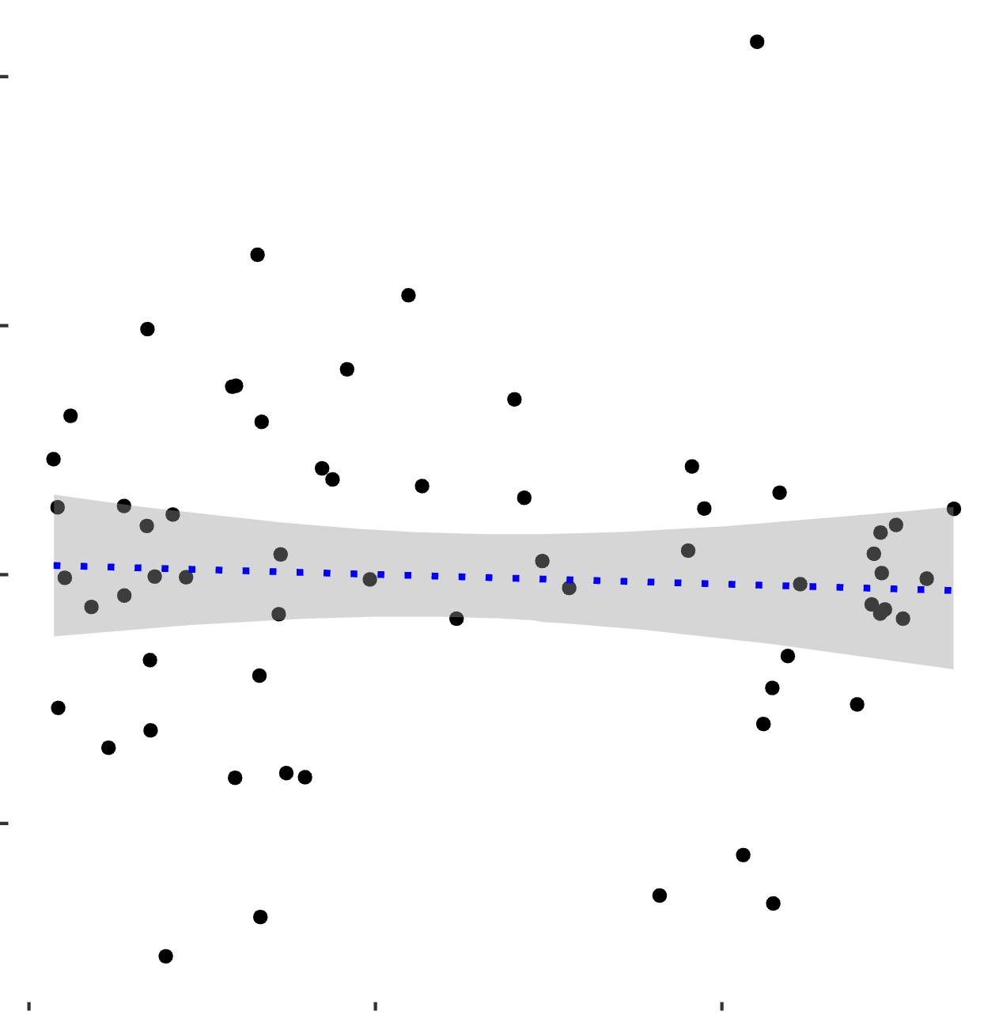
400
Friend (Reciprocate > Defect) > Computer (Reciprocate > Defect)
-200
20
Age
60
400
Friend (Reciprocate > Defect) > Stranger (Reciprocate > Defect)
-200
20
Age
60
Participants were asked to rate their closeness with the three partners before the task on a 7-point Likert Scale

Slide 5
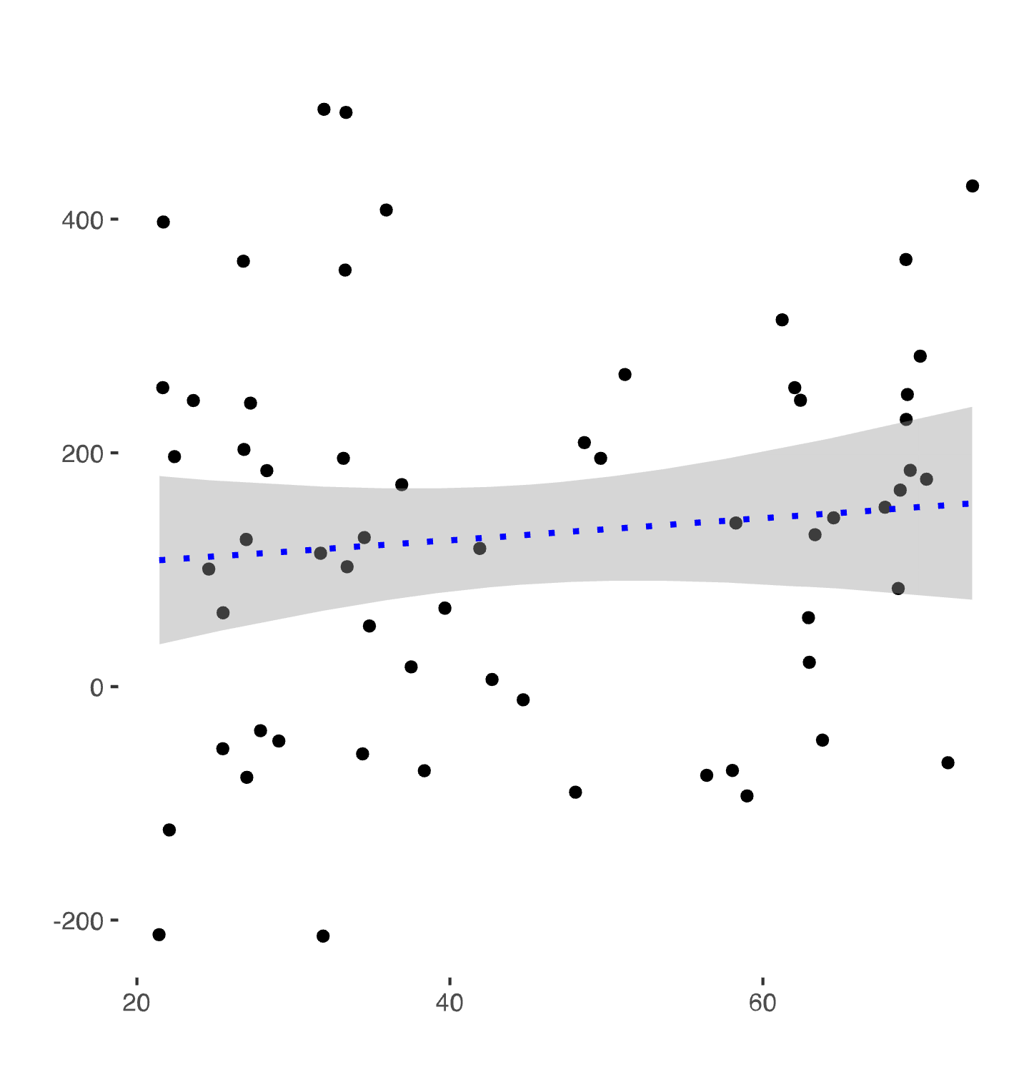
4. Ventral Striatal Activation Is not Associated with Age
We found Ventral Striatum (VS) activation for Reciprocate > Defect outcomes
Y=9
VS
We found activation in the VS when participants were presented with a reciprocate outcome as opposed to a defect outcome.
400
400
400
Friend (Reciprocate > Defect) > Stranger (Reciprocate > Defect)
Friend (Reciprocate > Defect) > Computer (Reciprocate > Defect)
Reciprocate > Defect
-200
-200
20
60
-200
20
Age
60
Age
20
Age
60
We found that activation in the VS was not related to age

