Slide 1



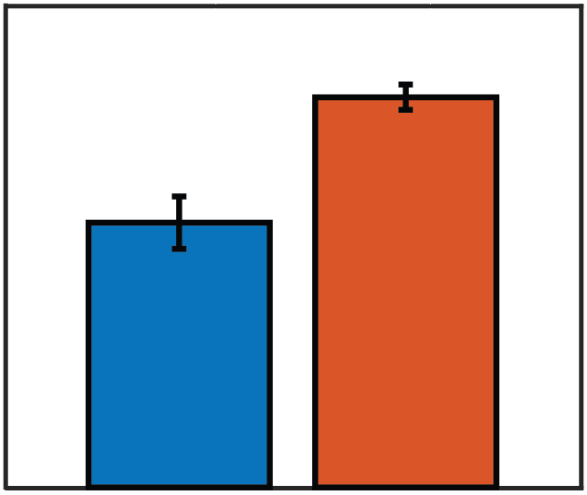
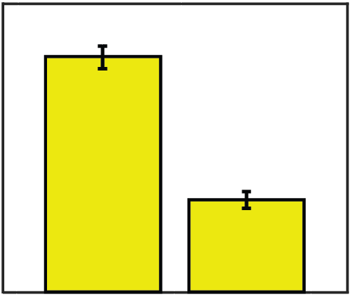
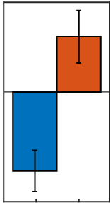
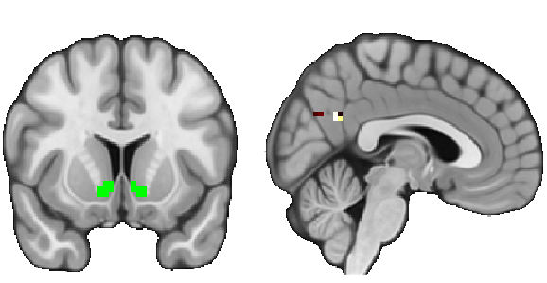
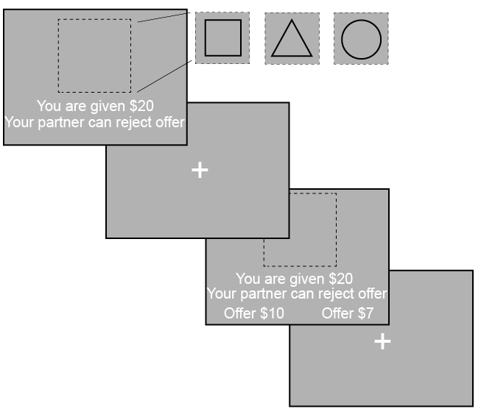
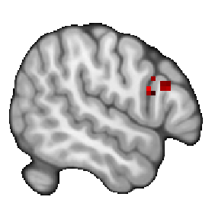
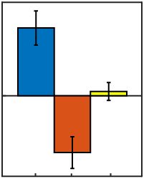

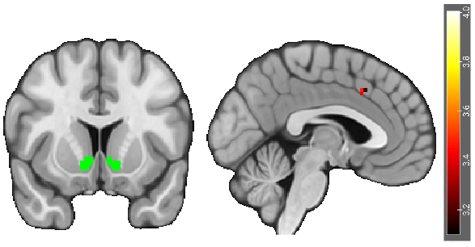
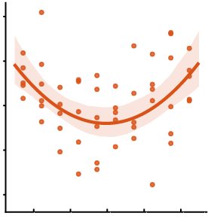
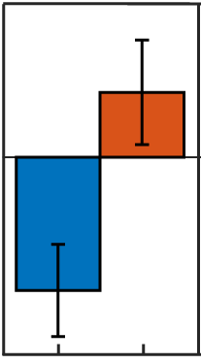
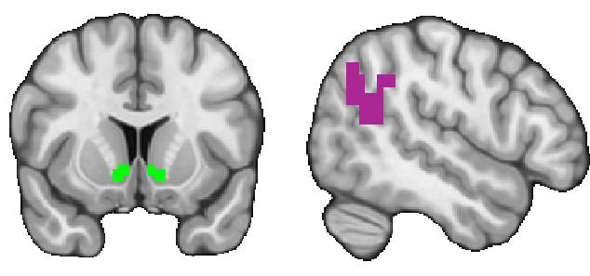
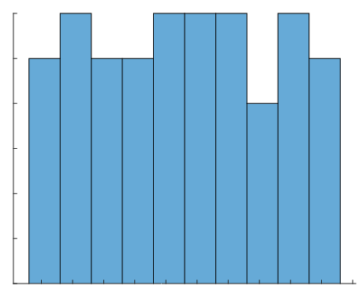
Examining Age-Related Differences in Neural Responses to Trust
Abraham Dachs¹, Cooper J. Sharp¹, Enes Yanilmaz¹, James B. Wyngaarden III¹, Ori Zaff², Tia Tropea¹, Daniel Sazhin¹, Rita Ludwig², Tania Giovannetti¹, Dominic S. Fareri³, David V. Smith¹
1. Temple University, Philadelphia, PA; 2. University of Pennsylvania, Philadelphia, PA; 3. Adelphi University, Garden City, NY
1. Introduction
3. Behavioral Results Indicate Subjects Act Strategically
6. Corticostriatal Connectivity Underlying Strategic Behavior
To assess if people behaved strategically as proposers, we used a mixed effects model.
Social relationships influence our behaviors and may modulate our neural responses to reward.
The effect of relationships on behavior and reward may change as we age.
It remains unclear whether age-related differences in responses to trust are associated with maladaptive outcomes such as financial exploitation.
Proportion of Endowment Offered (0-1)
Proposer Conditions
0.4
Recipient Conditions
We investigated connectivity between a VS seed and other possible target regions during strategic behavior.
0.3
0.3
Seed Region: Ventral Striatum
Target Region: PCC
VS-PCC Connectivity (β)
Parametric Effect of Fairness
2.0
0.2
0.2
1.0
0.1
0.1
0
We investigated whether social trust decisions change as we age, and how those changes could be related to financial exploitation.
-1.0
0
0
-2.0
Dictator Game
Ultimatum Game
Accept
Reject
X=4
DG-P
UG-P
2. Methods
Using a mixed effects model, we found that task as a proposer predicts decisions. A binary logistic regression showed that participants reject more with lower offers.
Y=12
As participants made fairer offers while making strategic decisions (UG > DG), we found enhanced effective connectivity between a VS seed and Posterior Cingulate Cortex (PCC) target.
The Ultimatum (UG) and Dictator (DG) Games were used to assess neural and behavioral responses to perceived fairness. We defined strategic behavior as the difference in offers (high vs. low) in the proposer conditions.
4. Activation during Strategic Decisions
We replicated previous findings (Spitzer et al., 2007) during strategic decisions.
7. Aberrant Reward Sensitivity Modulates Corticostriatal Connectivity Underlying Fairness
IFG
IFG Activation (β)
Parametric Effect of Fairness
150
We investigated associations between reward sensitivity, fairness, and connectivity between a VS seed and possible target regions.
100
VS-ACC Connectivity (β)
Parametric Effect of Fairness
UG Proposer
DG Proposer
UG Recipient
50
Seed Region: Ventral Striatum
Target Region: ACC
10
Scan the QR code to see the
Pre-registration!
0
5
-50
0
Endowment
Phase (1s)
-100
-5
X=54
DG-P
UG-P
UG-R
-10
-4
-2
0
2
4
ISI
(jittered 1-8s)
As participants proposed fairer offers during strategic decisions (DG-P > UG-P), we found increasing activation in the Inferior Frontal Gyrus (IFG).
Y=12
X=-3
Composite Reward
As participants with aberrant reward sensitivity made fairer offers, they expressed stronger effective connectivity between a VS seed and an Anterior Cingulate Cortex (ACC) target.
Proposers offer a high/low split
Recipients accept or reject offers
In UG, offers could be rejected and both partners earn $0
5. Strategic Decisions Enhance VS-pTPJ Connectivity
Decision
Phase 3s
During strategic decisions (DG-P > UG-P), we expected that elevated ventral striatal (VS) responses will be associated with enhanced effective connectivity in the posterior temporoparietal junction (pTPJ).
8. Conclusions and Future Directions
VS-pTPJ Connectivity (β)
Parametric Effect of Fairness
We found that the VS has stronger connectivity with the pTPJ and PCC while making strategic decisions.
Effective connectivity between the VS and ACC tracks fairness, modulated by reward sensitivity.
Future investigations could assess corticostriatal connectivity and substance use in a clinical population.
N = 54 completed the Behavioral Activation System (Carver & White, 1994) and Sensitivity to Reward (Torrubia & Tobeña, 1984) questionnaires.
Seed Region: Ventral Striatum
A Priori ROI
Target: pTPJ
0.8
ITI
(jittered 1.5-4.5s)
0.4
0
Frequency
6
-0.4
Whole brain results were thresholded at Z > 3.1 and Family Wise Error corrected at p > .05
Masks were extracted from Harvard–Oxford and Mars atlases.
-0.8
Our findings help to characterize the role of corticostriatal connectivity in
social decision making.
3
-1.2
UG-P
Y=12
X=50
DG-P
0
5
As participants made fairer offers while making strategic decisions (UG > DG), we found enhanced VS effective connectivity with the pTPJ.
-5
0
This study was supported by a grant from the National Institutes of Health (R03-DA046733 (DVS). Contact information for Daniel Sazhin: daniel.sazhin@temple.edu.
Composite Reward Sensitivity

