Slide 1
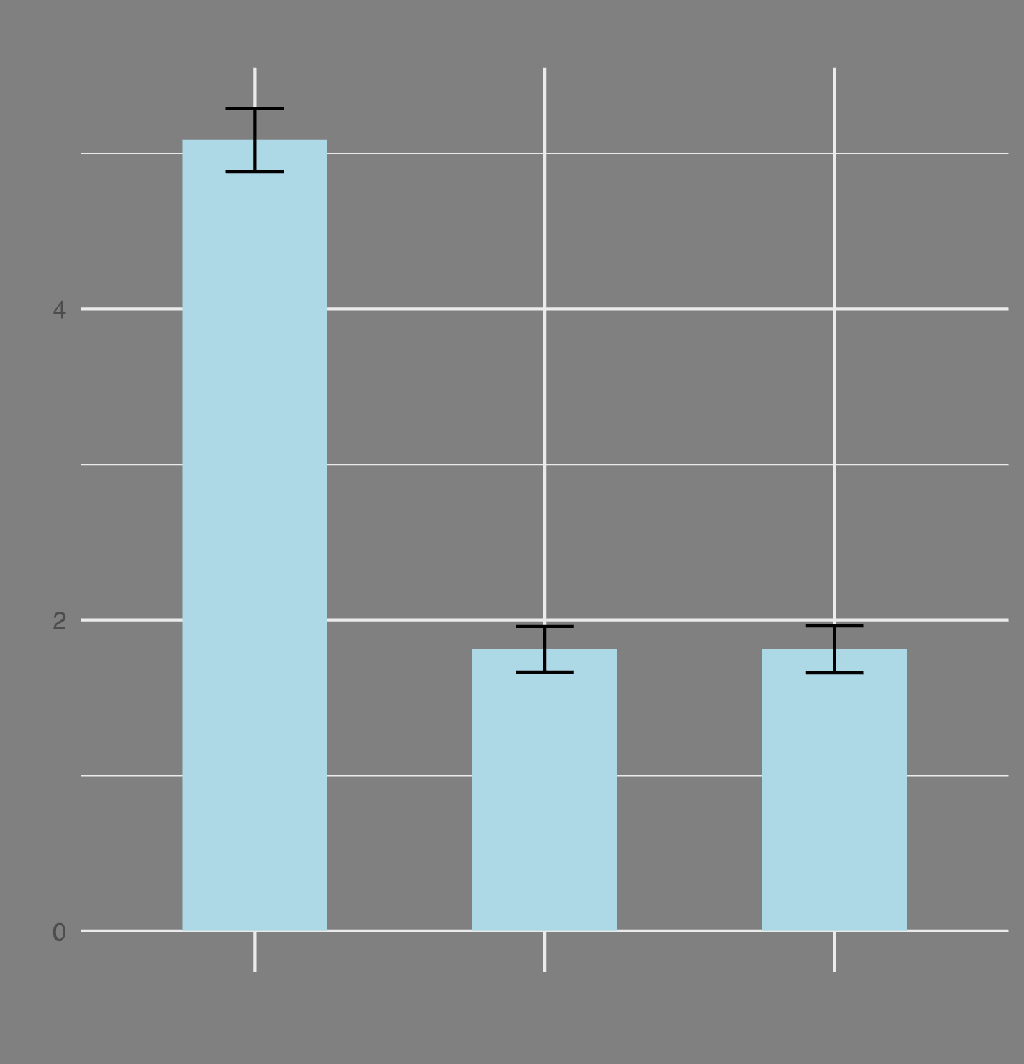
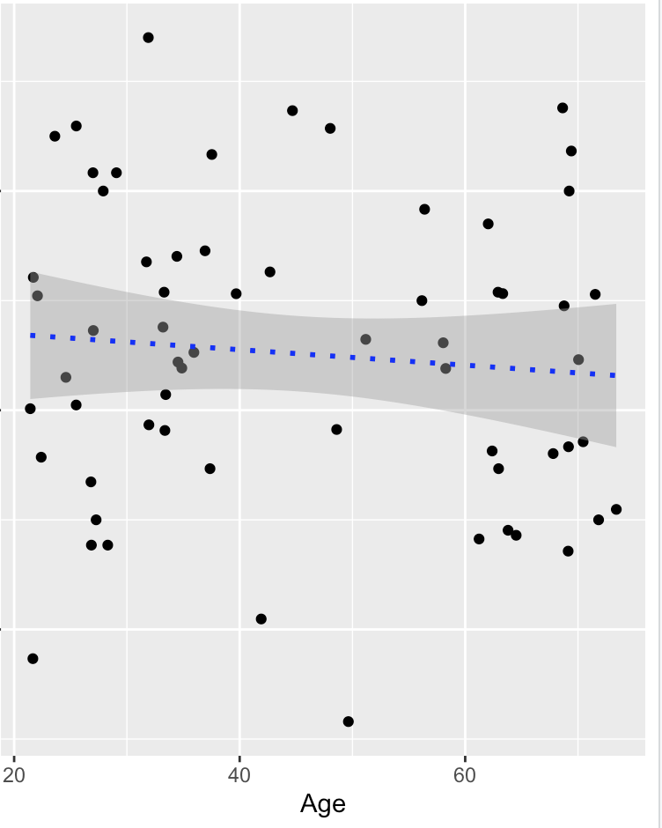
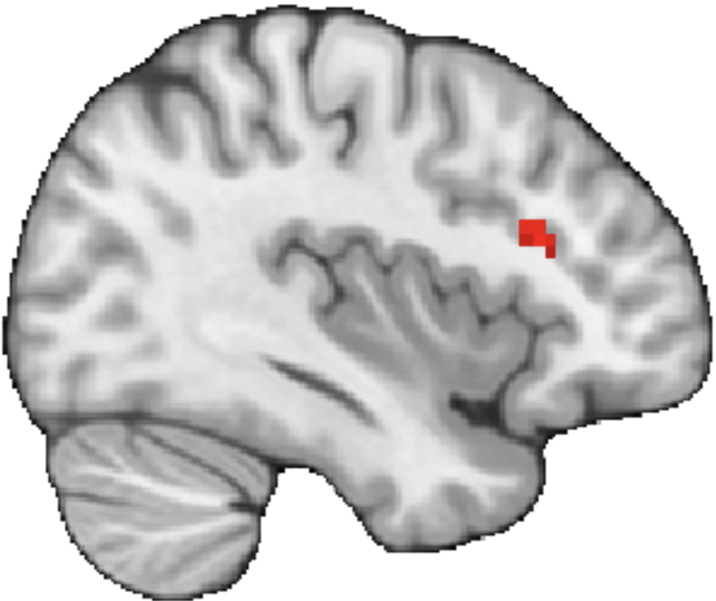
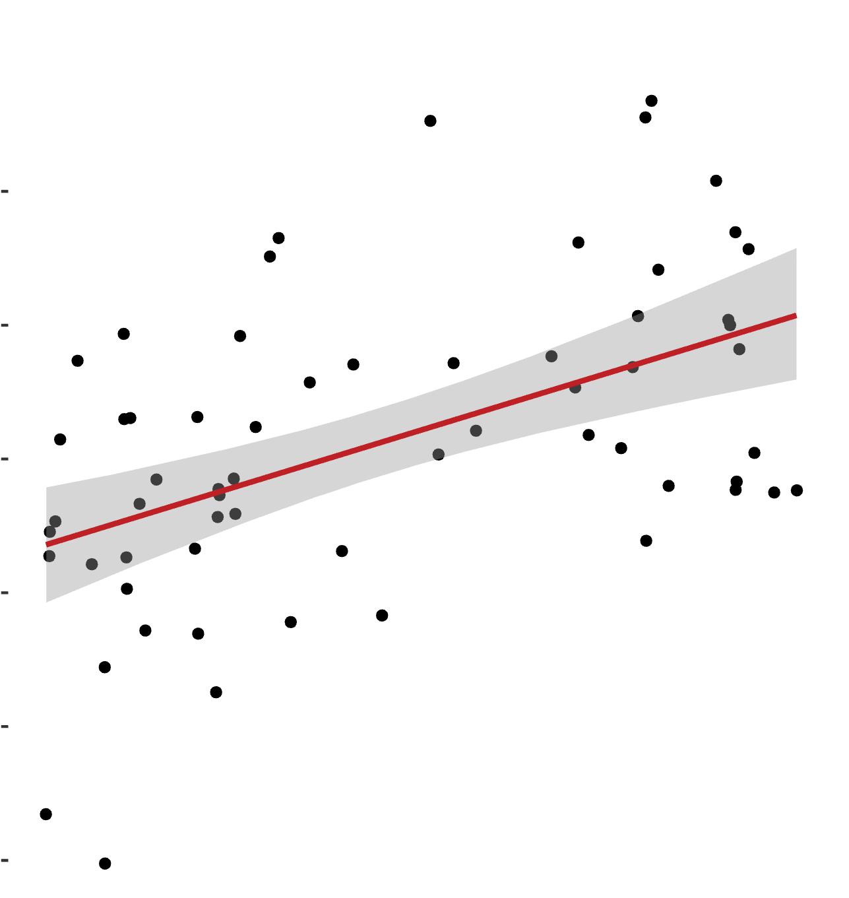
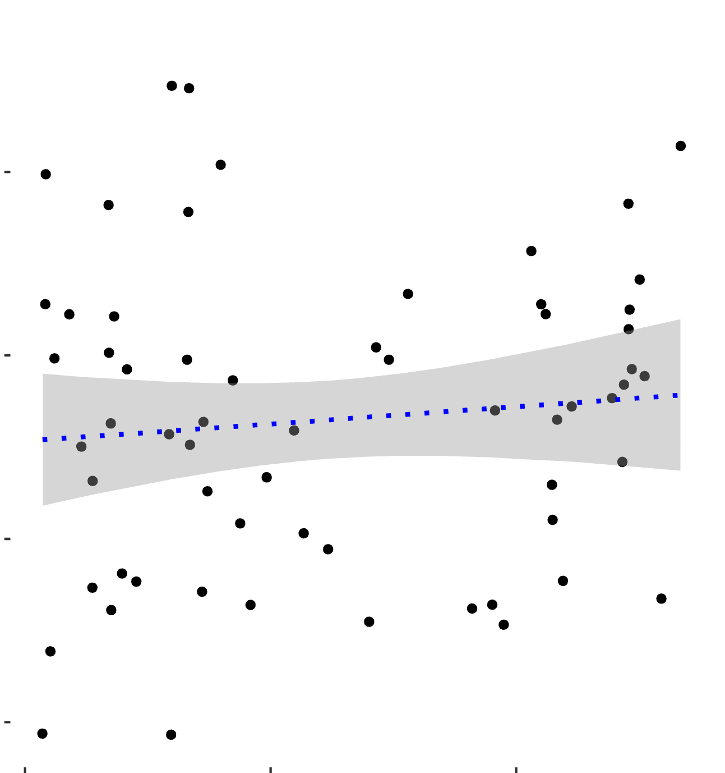
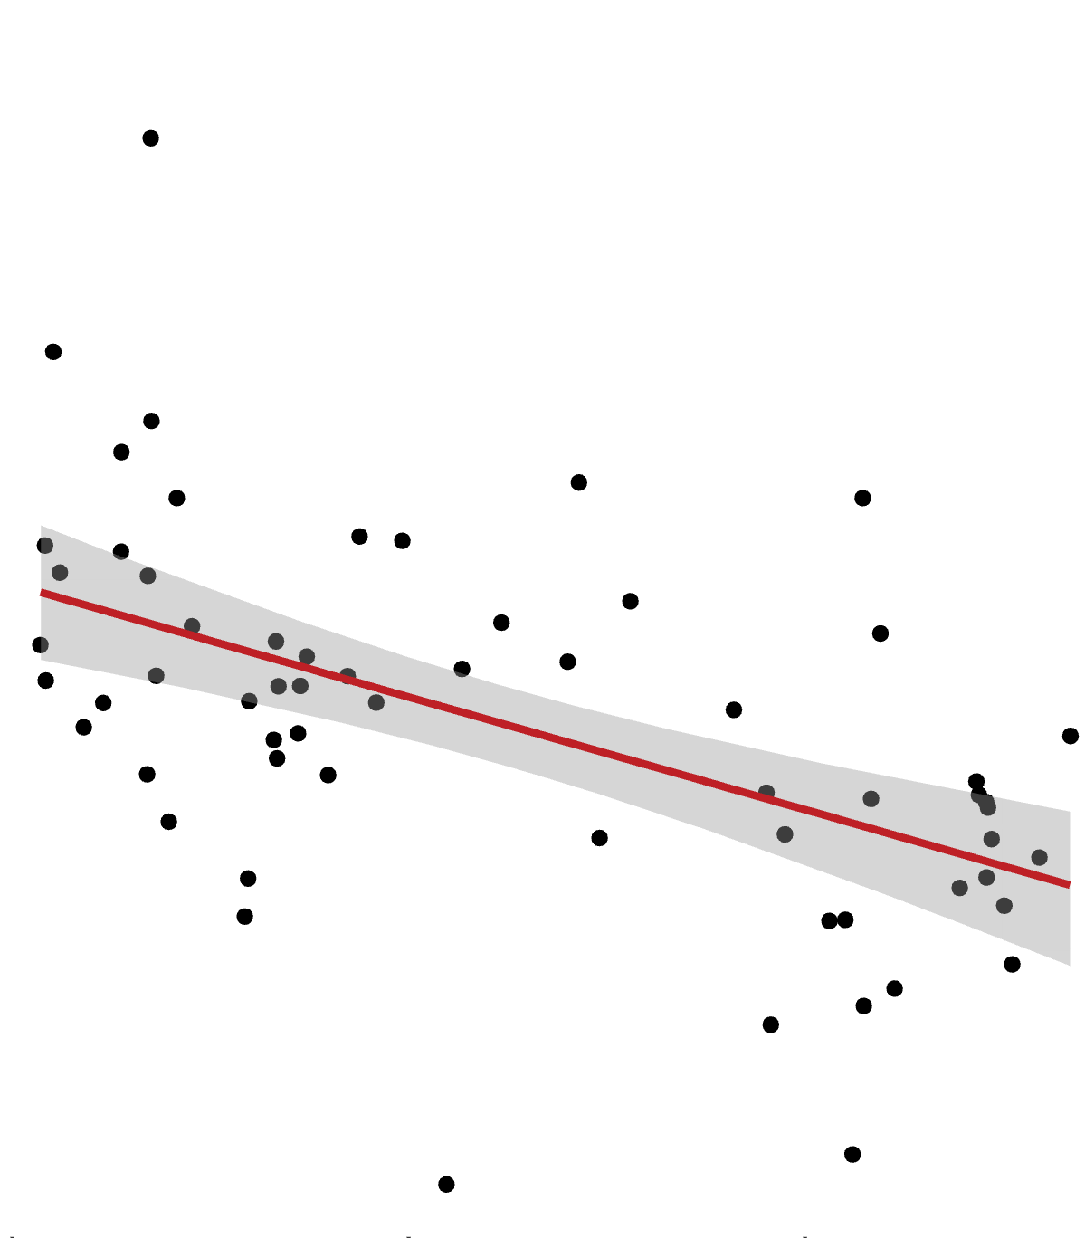
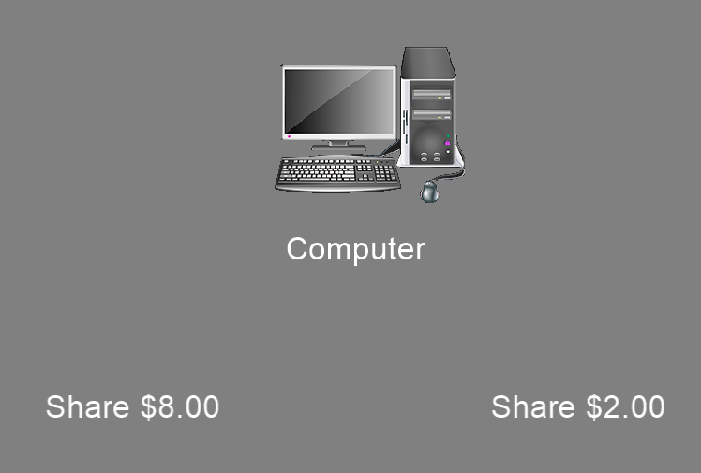
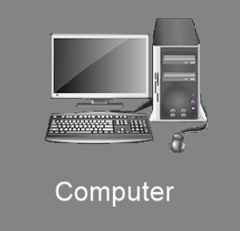


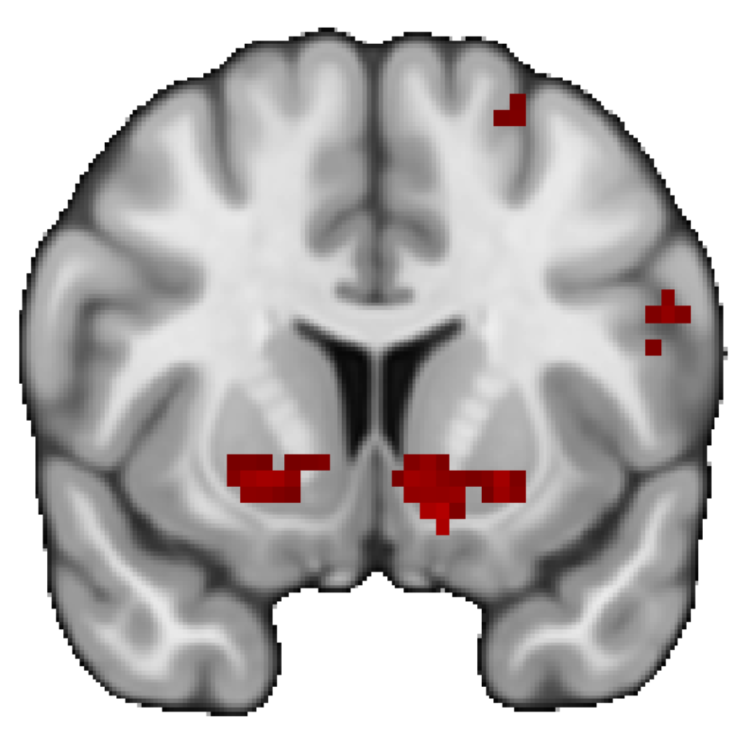
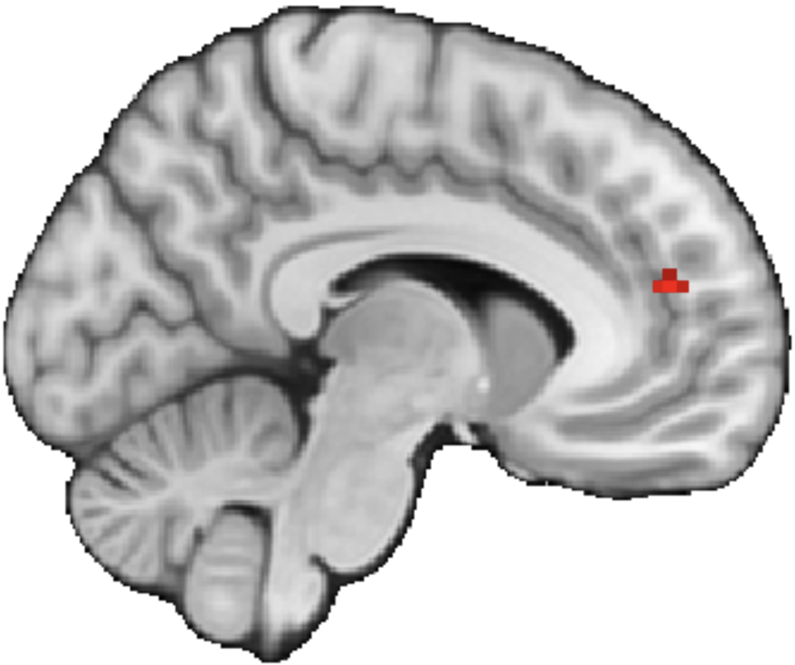


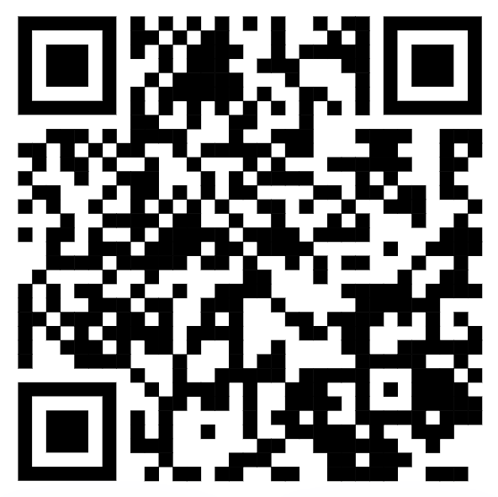


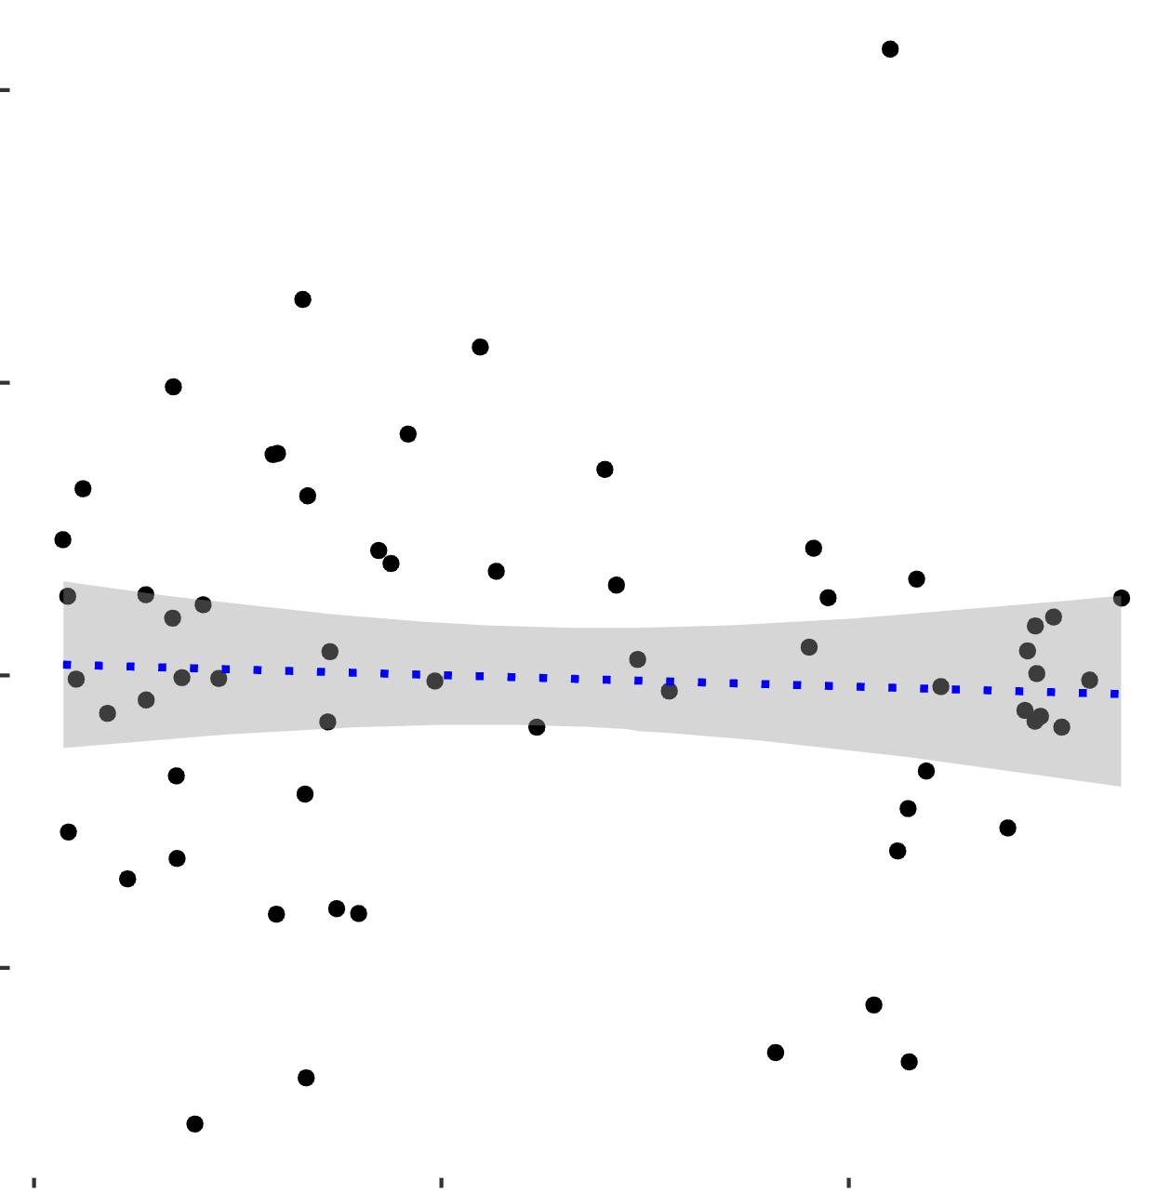
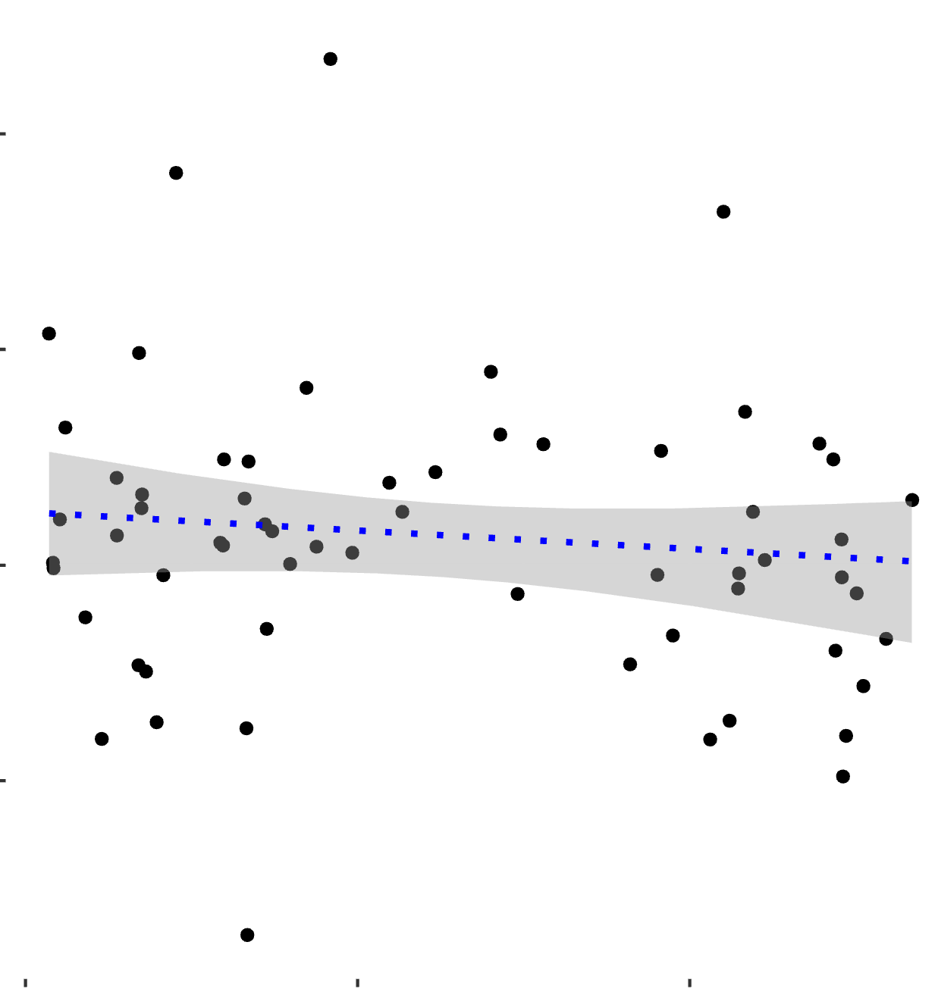
Examining Age-Related Differences in Neural Responses to Trust
Abraham Dachs¹, Cooper J. Sharp¹, Enes Yanilmaz¹, James B. Wyngaarden III¹, Ori Zaff², Tia Tropea¹, Daniel Sazhin¹, Rita Ludwig², Tania Giovannetti¹, Dominic S. Fareri³, David V. Smith¹
1. Temple University, Philadelphia, PA; 2. University of Pennsylvania, Philadelphia, PA; 3. Adelphi University, Garden City, NY
1. Introduction
3. Subjects Are Closer With Friends than With Strangers
6.
Social relationships influence our behaviors and may modulate our neural responses to reward. (Fareri et al., 2015)
The effect of relationships on behavior and reward activation may change as we age. (Fareri et al., 2022)
It remains unclear whether age-related differences in responses to trust are associated with maladaptive outcomes such as financial exploitation.
Friend Defecting > Computer Defecting
X= 52
4
2
200
Sharing with Friend – Sharing with Stranger
2
0
MFG activation
We investigated whether social trust decisions change as we age, and how those changes could be related to financial exploitation.
0
Friend
Stranger
Computer
-2
20
40
60
MFG
Age
IOS(f>c) and Age model
Age Positive
-300
20
Age
60
2. Methods
Participants were asked to rate their closeness with the three partners before the task on a 7-point Likert Scale
We found greater MFG activation in older adults than in younger adults when experiencing friend defecting.
The Ultimatum (UG) and Dictator (DG) Games were used to assess neural and behavioral responses to perceived fairness. We defined strategic behavior as the difference in offers (high vs. low) in the proposer conditions.
4. Ventral Striatal Activation Is not Associated with Age
You are given $8 for the trial.
We found Ventral Striatum (VS) activation for Reciprocate > Defect outcomes
Friend Reciprocating > Computer Reciprocating
Y=9
X= 83
You are assigned a partner.
400
400
Computer
Share $8
Share $2
Scan the QR code to see the
Pre-registration!
Reciprocate > Defect
MFG activation
You choose a higher or lower amount to share with your partner.
Loading…
-200
VS
-200
ACC
20
Age
60
The money you sent is tripled
X3
+
20
Age
60
We found lower ACC activation in older adults than in younger adults when experiencing friend reciprocation.
We found activation in the VS when participants were presented with a reciprocate outcome as opposed to a defect outcome.
Outcome Phase
400
400
7. Conclusions and Future Directions
End of trial
Experiencing reciprocation elicited VS activation
There were no age related effects in the VS
Increase in age was associated with increase in MFG activation
Increase in age was associated with decrease in ACC activation
Friend (Reciprocate > Defect) > Stranger (Reciprocate > Defect)
Friend (Reciprocate > Defect) > Computer (Reciprocate > Defect)
N = 62 Completed the Inclusion of Other in Self Scale and the Older Adults Financial Exploitation and Vulnerability Scale.
Whole brain results were thresholded at Z > 3.1 and Family Wise Error corrected at p > .05
Masks were extracted from Harvard–Oxford and Mars atlases.
-200
-200
20
Age
60
20
Age
60
Data collection is ongoing. We anticipate tripling our sample size
This study was supported by National Institutes of Health grant RF1-AG67011 (David V. Smith). Contact information: Avi.Dachs@temple.edu, Cooper.Sharp@temple.edu
We found that activation in the VS was not related to age

Slide 2
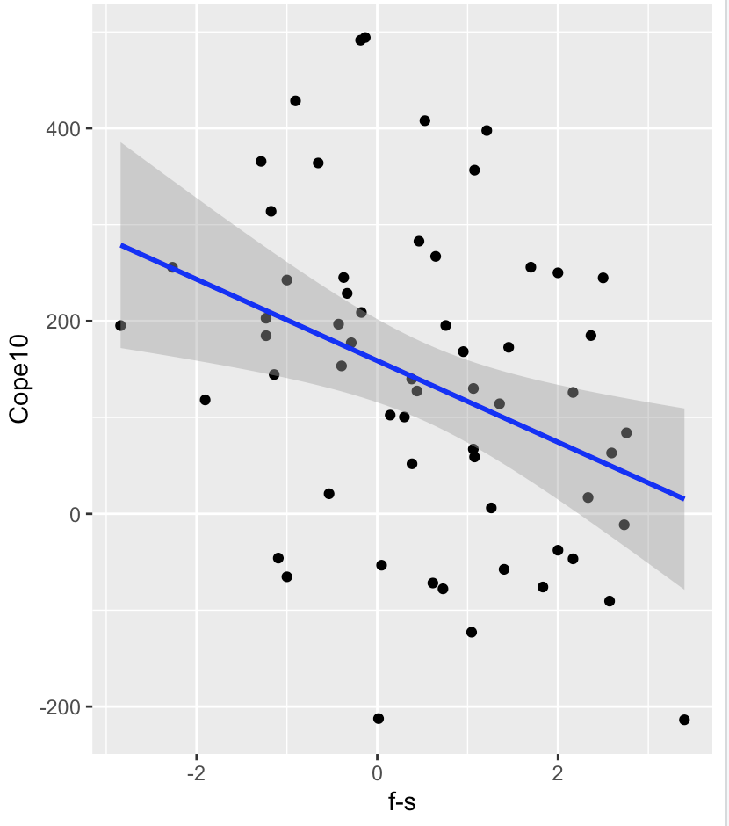
Other
Self
Kyle M. Woosnam,
The inclusion of other in the self (ios) scale
Friend
Stranger
Computer
VS mask Cope 10, f-s behavior

Slide 3
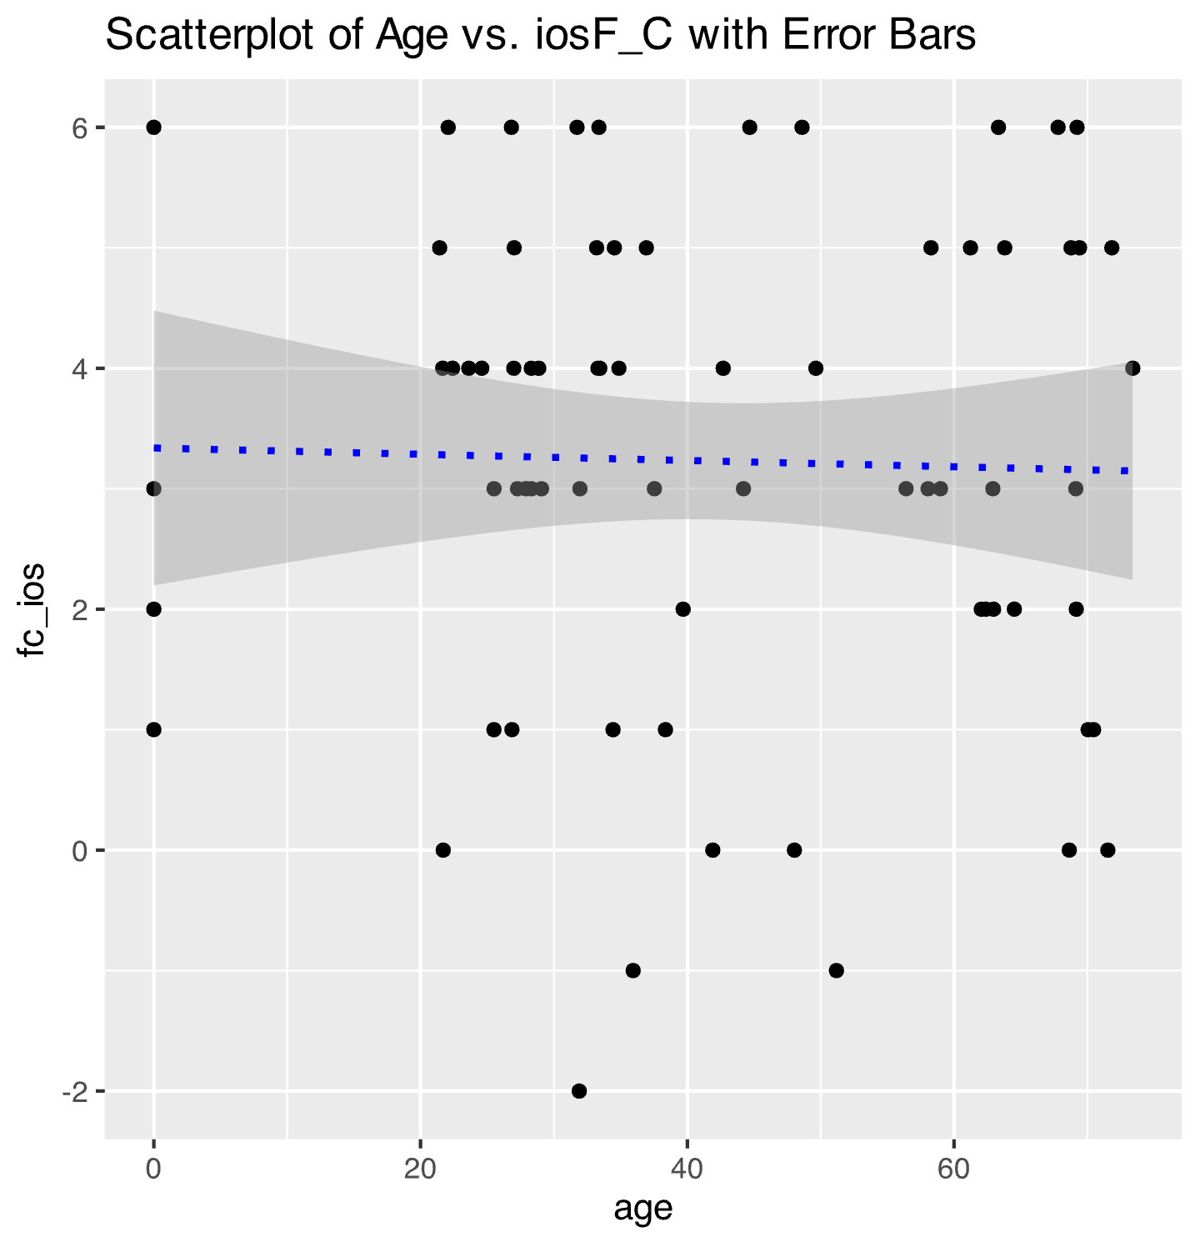
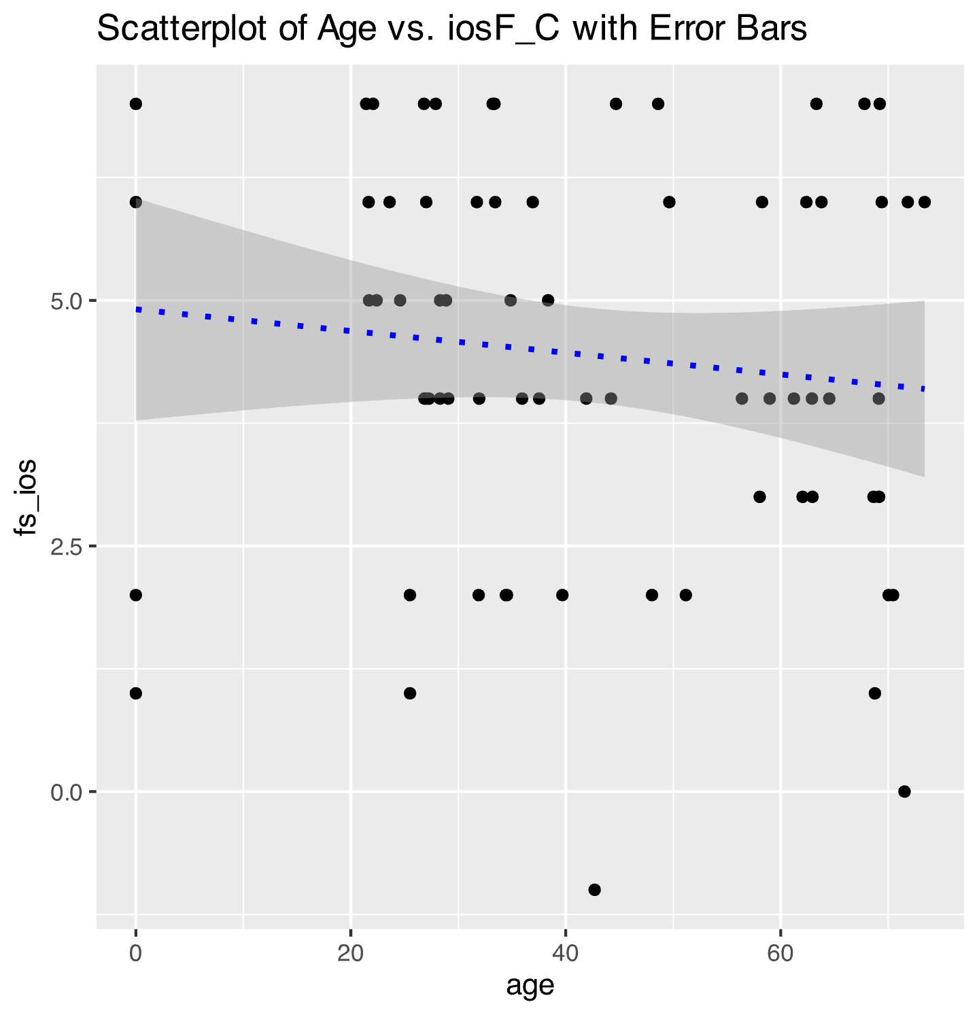

Slide 4
4. Ventral Striatal Activation Is not Associated with Age
We found Ventral Striatum (VS) activation for Reciprocate > Defect outcomes
Y=9
VS
We found activation in the VS when participants were presented with a reciprocate outcome as opposed to a defect outcome.
400
400
400
Friend (Reciprocate > Defect) > Stranger (Reciprocate > Defect)
Friend (Reciprocate > Defect) > Computer (Reciprocate > Defect)
Reciprocate > Defect
-200
-200
20
60
-200
20
Age
60
Age
20
Age
60
We found that activation in the VS was not related to age

