Slide 1
Age-Related Differences in Neural Responses during the Ultimatum Game
Yi “Jen” Yang
Neuroeconomics Lab (PI: David V. Smith)
Temple University
4.26.2025
Notes:
I’m Jen Yang from the Neuroeconomics Lab led by Dr. David Smith at Temple University. In this talk I’m going to share some age-related differences in neural responses we found during the Ultimatum Game.

Slide 2
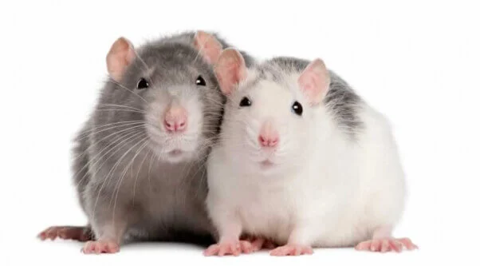
Notes:
In the last talk, Inbal showed us a lovely rat world. In the rat world, when you offer a helping paw to another rat (click), you end up being the saving hero.

Slide 3
Saving
Hero
Saving
Hero
Trapped Buddy
Trapped Buddy
Notes:
In the last talk, Inbal showed us a lovely rat world. In the rat world, when you offer a helping paw to another rat (click), you end up being the saving hero.

Slide 4

Saving
Hero
Trapped Buddy
Notes:
In our human world, however, when you offer a helping hand (click), instead of actually helping someone, you may end up falling prey to financial exploitation, such as older adults who (click) got trapped into grandparent scams.

Slide 5
Exploited Victim
Saving
Hero
Trapped Buddy
Scammer
in Disguise
Notes:
In our human world, however, when you offer a helping hand (click), instead of actually helping someone, you may end up falling prey to financial exploitation, such as older adults who (click) got trapped into grandparent scams.

Slide 6
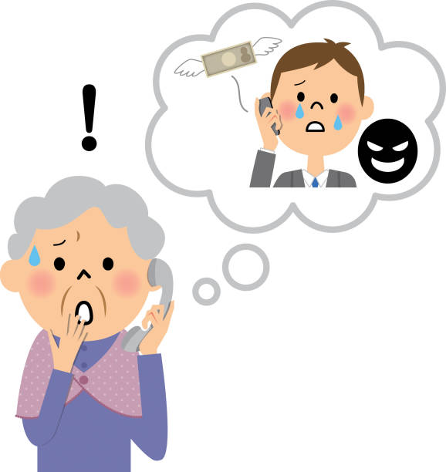

Saving
Hero
$$
Trapped Buddy
Grandparent Scam
Notes:
In our human world, however, when you offer a helping hand (click), instead of actually helping someone, you may end up falling prey to financial exploitation, such as older adults who (click) got trapped into grandparent scams.

Slide 7
Impersonation scams
make up all top 5 scams targeting
older adults.
https://www.ncoa.org/article/top-5-financial-scams-targeting-older-adults/
Notes:
As a matter of fact, impersonation scams such as grandparent scams make up all top 5 scams that target older adults, (click) and elder victims lose 8 billion per year to those imposter strangers.

Slide 8
Impersonation scams
make up all top 5 scams targeting
older adults.
Elder scam victims
lose $8 billion a year to strangers.
https://www.ncoa.org/article/top-5-financial-scams-targeting-older-adults/
https://states.aarp.org/colorado/aarp-report-28-3-billion-a-year-stolen-from-adults-60
Notes:
As a matter of fact, impersonation scams such as grandparent scams make up all top 5 scams that target older adults, (click) and elder victims lose 8 billion per year to those imposter strangers.

Slide 9
Impersonation scams
make up all top 5 scams targeting
older adults.
Elder scam victims
lose $8 billion a year to strangers.
NIA 2024 budget
= $4.5 billion
https://www.ncoa.org/article/top-5-financial-scams-targeting-older-adults/
https://states.aarp.org/colorado/aarp-report-28-3-billion-a-year-stolen-from-adults-60
Notes:
If you’re having a hard time making sense how much money this is, the 2024 budget of National Institute on Aging in NIH is 4.5 billion. (next)

Slide 10
Why older adults?
Notes:
Why do older adults seem to be particularly vulnerable to impersonation scams? (click) One of the reasons might be age-related shifts in motivation and emotional processing.

Slide 11


Why older adults?
Carstensen et al. (1999), American Psychologist
Notes:
Why do older adults seem to be particularly vulnerable to impersonation scams? (click) One of the reasons might be age-related shifts in motivation and emotional processing. (next slide continues)

Slide 12
Why older adults?
Carstensen et al. (1999), American Psychologist
Notes:
As people age, they tend to prioritize emotionally meaningful experiences and focus more on positive information, which can shape their social decision-making, and (next)

Slide 13
Why older adults?
“Seniors are often targeted because they tend to be trusting and polite.”
Carstensen et al. (1999), American Psychologist
https://www.fbi.gov/how-we-can-help-you/scams-and-safety/common-frauds-and-scams/elder-fraud#
Notes:
potentially make them more susceptible to persuasive tactics used in impersonation scams.

Slide 14
Why older adults?
“Seniors are often targeted because they tend to be trusting and polite.”
Carstensen et al. (1999), American Psychologist
https://www.fbi.gov/how-we-can-help-you/scams-and-safety/common-frauds-and-scams/elder-fraud#
Yang et al. (2025), Communications Psychology (accepted in principle)
Notes:
In my previous work examining risk factors for financial exploitation, (click) we found that individuals who are more persuadable or less sensitive to trustworthiness cues are at significantly higher risk of scams, indicating that (next)

Slide 15
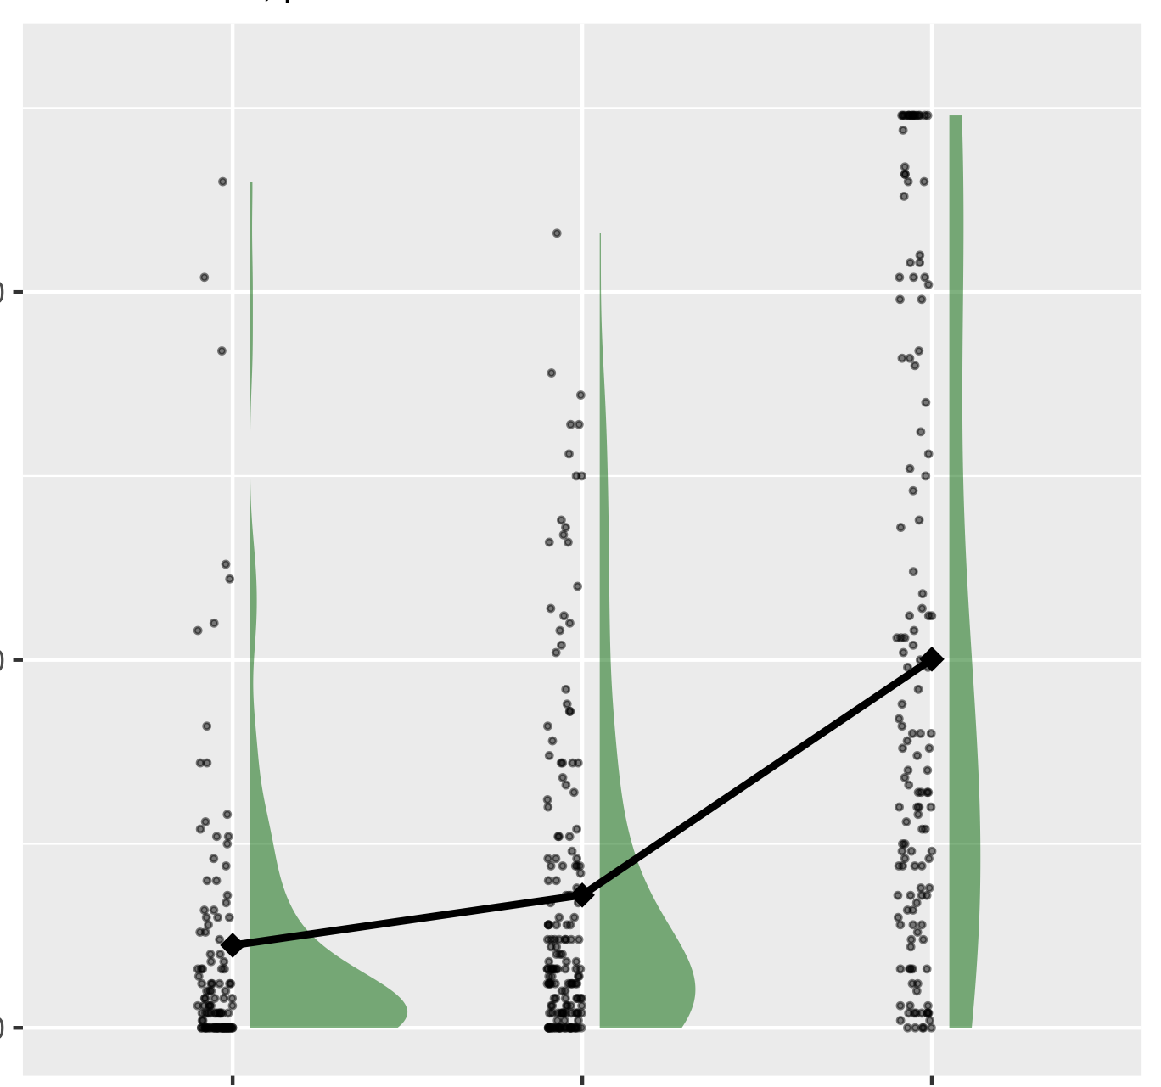
Why older adults?
Self-reported
Financial Exploitation
“Seniors are often targeted because they tend to be trusting and polite.”
lower
higher
Persuadability
Carstensen et al. (1999), American Psychologist
https://www.fbi.gov/how-we-can-help-you/scams-and-safety/common-frauds-and-scams/elder-fraud#
Yang et al. (2025), Communications Psychology (accepted in principle)
Notes:
In my previous work examining risk factors for financial exploitation, (click) we found that individuals who are more persuadable or less sensitive to trustworthiness cues are at significantly higher risk of scams, indicating that (next)

Slide 16
Why older adults?
Self-reported
Financial Exploitation
“Seniors are often targeted because they tend to be trusting and polite.”
lower
higher
Persuadability
Age-related changes in social information processing
Carstensen et al. (1999), American Psychologist
https://www.fbi.gov/how-we-can-help-you/scams-and-safety/common-frauds-and-scams/elder-fraud#
Yang et al. (2025), Communications Psychology (accepted in principle)
Notes:
(Indicating that) age-related changes in social information processing may contribute to older adults’ heightened vulnerability to impersonation scams.

Slide 17
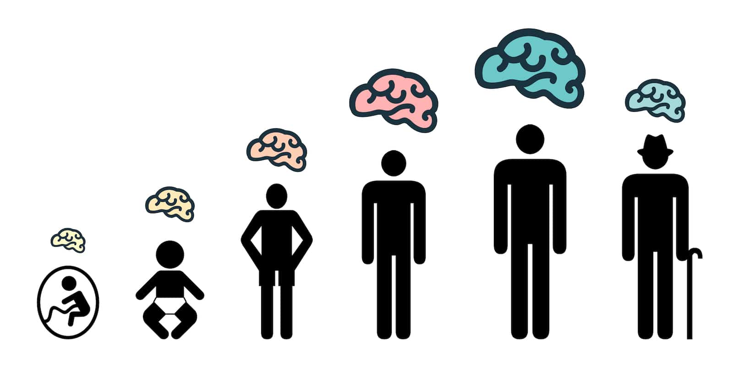
Why older adults?
Notes:
In addition to changes in social information processing, age-related alterations in brain may also play a crucial role.

Slide 18
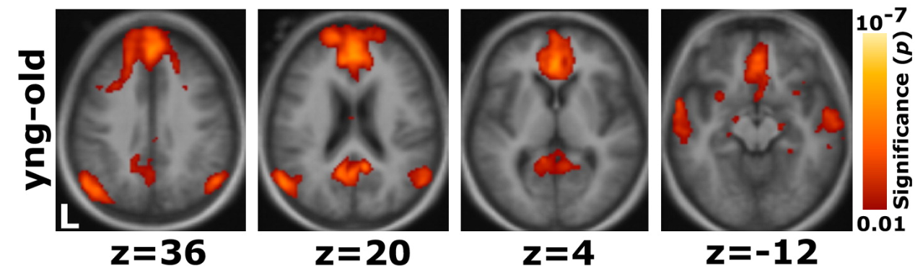
Why older adults?
mPFC-whole brain functional correlation reduction in older adults
Andrews-Hanna et al. (2007), Neuron
Notes:
Previous research has shown significant age-related decreases in correlations between brain regions, and has shown that (next)

Slide 19
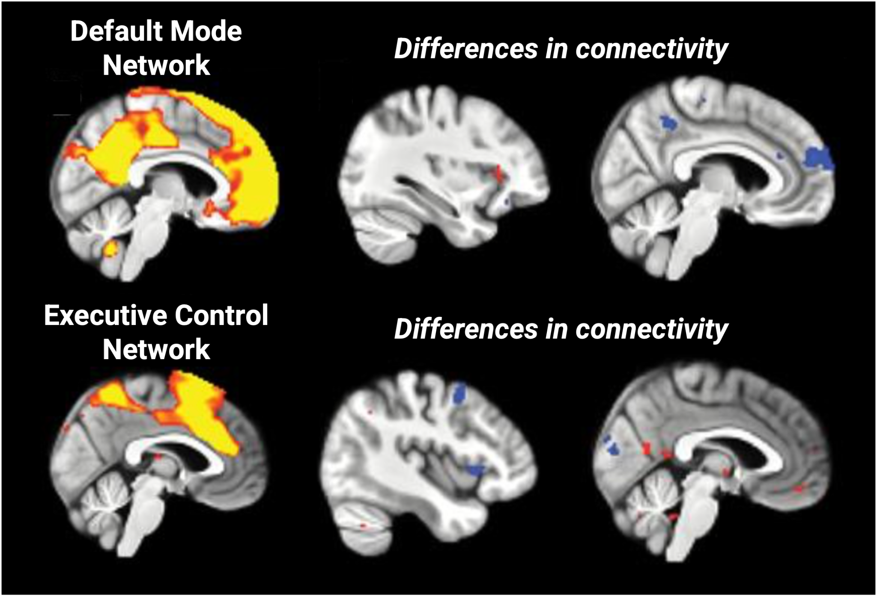
Why older adults?
mPFC-whole brain functional correlation reduction in older adults
Financial exploitation-related
Network connectivity differences
Andrews-Hanna et al. (2007), Neuron
Spreng et al. (2017), Journal of Gerontology
Notes:
(and has shown that) older adult financial exploitation is associated with default mode network and executive control network functional connectivity with other brain regions.

Slide 20
Why older adults?
mPFC-whole brain functional correlation reduction in older adults
Financial exploitation-related
Network connectivity differences
Age-related changes in
network connectivity
Andrews-Hanna et al. (2007), Neuron
Spreng et al. (2017), Journal of Gerontology
Notes:
Age-related changes in network connectivity may affect how older adults process social information, such as (click) during social decision-making that involves evaluation of fairness

Slide 21
Fairness-related social decision-making
Harlé & Sanfey (2012), Neuropsychologia
Notes:
Age-related changes in brain activity may affect how older adults process social information, such as (click) during social decision-making that involves evaluation of fairness in different social context.

Slide 22
Fairness-related social decision-making
Harlé & Sanfey (2012), Neuropsychologia
Notes:
Using the ultimatum game, which I’ll talk more about in later slides, (click) previous research has observed age-related brain activation difference in response to unfairness. (click) Previous study also found that neural responses during fairness evaluation differ depending on whether the interaction involves a human or a computer.

Slide 23
Fairness-related social decision-making
The Ultimatum Game
Harlé & Sanfey (2012), Neuropsychologia
Batten et al. (2023), Nature Human Behavior
Notes:
Using the ultimatum game, which I’ll talk more about in later slides, (click) previous research has observed age-related brain activation difference in response to unfairness. (click) Previous study also found that neural responses during fairness evaluation differ depending on whether the interaction involves a human or a computer.

Slide 24
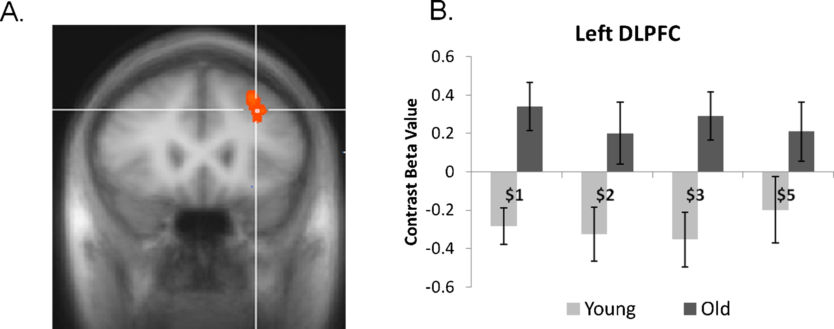
Fairness-related social decision-making
The Ultimatum Game
Age effect
Harlé & Sanfey (2012), Neuropsychologia
Batten et al. (2023), Nature Human Behavior
Notes:
Using the ultimatum game, which I’ll talk more about in later slides, (click) previous research has observed age-related brain activation difference in response to unfairness. (click) Previous study also found that neural responses during fairness evaluation differ depending on whether the interaction involves a human or a computer.

Slide 25
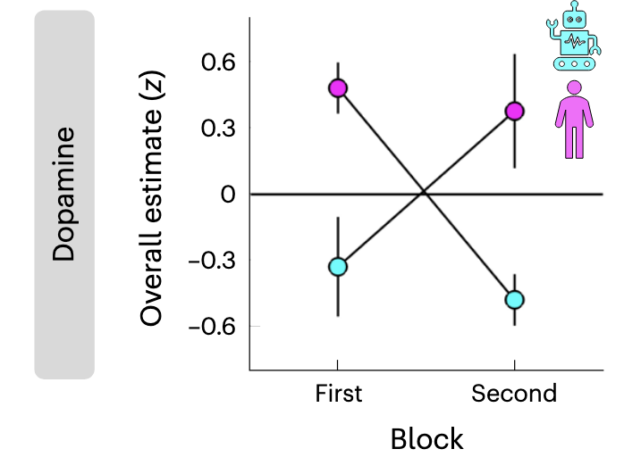
Fairness-related social decision-making
The Ultimatum Game
Social context effect
Age effect
Harlé & Sanfey (2012), Neuropsychologia
Batten et al. (2023), Nature Human Behavior
Notes:
Using the ultimatum game, which I’ll talk more about in later slides, (click) previous research has observed age-related brain activation difference in response to unfairness. (click) Previous study also found that neural responses during fairness evaluation differ depending on whether the interaction involves a human or a computer.

Slide 26
Fairness-related social decision-making
The Ultimatum Game
Social context effect
Age effect
Harlé & Sanfey (2012), Neuropsychologia
Batten et al. (2023), Nature Human Behavior
Notes:
These findings highlight that both age and social context influence how the brain responds to fairness in social decision-making.

Slide 27
Fairness-related social decision-making
The Ultimatum Game
Social context effect
Age effect
$
Grandparent Scam
Harlé & Sanfey (2012), Neuropsychologia
Batten et al. (2023), Nature Human Behavior
Notes:
Given older adults’ particular vulnerability to impersonation scams, (click) there might be a age*social context interaction underneath such vulnerability.

Slide 28
Fairness-related social decision-making
The Ultimatum Game
Social context effect
Age effect
$
Grandparent Scam
Age * social context interaction?
Harlé & Sanfey (2012), Neuropsychologia
Batten et al. (2023), Nature Human Behavior
Notes:
Given older adults’ particular vulnerability to impersonation scams, (click) there might be a age*social context interaction underneath such vulnerability, Therefore as a first step to understand the vulnerability, (next, research outline)

Slide 29
Age * social context interaction?
Fairness: the Ultimatum Game
Functional connectivity - Default Mode Network (DMN) - Executive Control Network (ECN)
Connectivity-behavior association - Fairness norm - Norm violation sensitivity
Notes:
We conducted an fMRI study using the ultimatum game and explored how age and social context may interact to shape neural responses during fairness related social decision-making

Slide 30
Age * social context interaction?
Fairness: the Ultimatum Game
Functional connectivity
Notes:
Building off previous literature, in this study we focused on (click) the default mode network and executive control network functional connectivity with other brain regions.

Slide 31
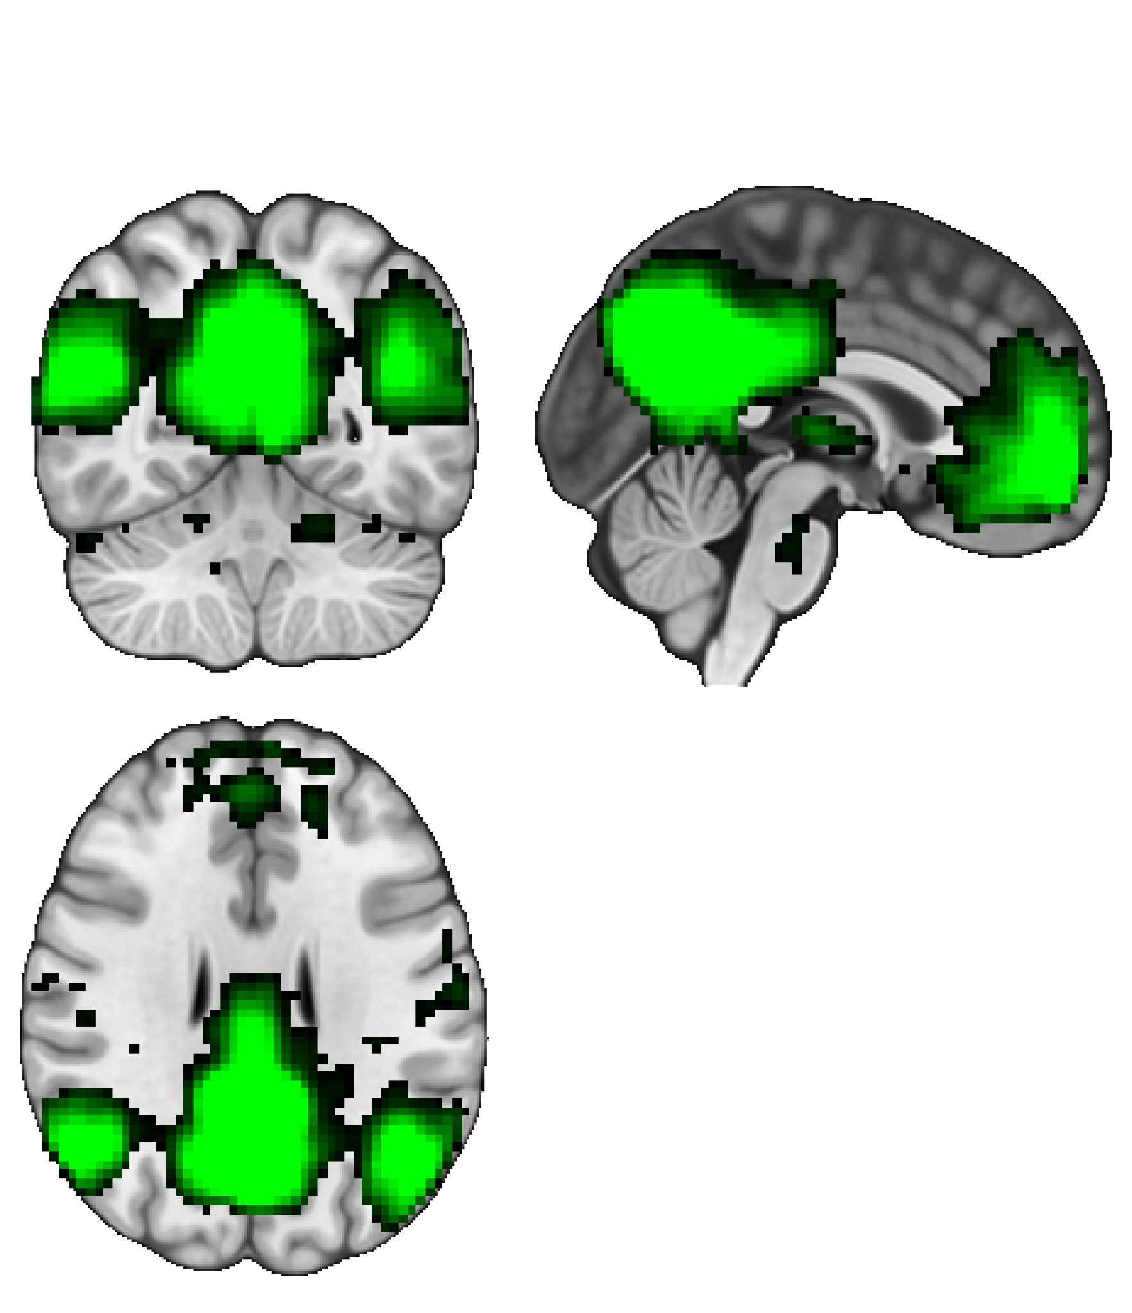
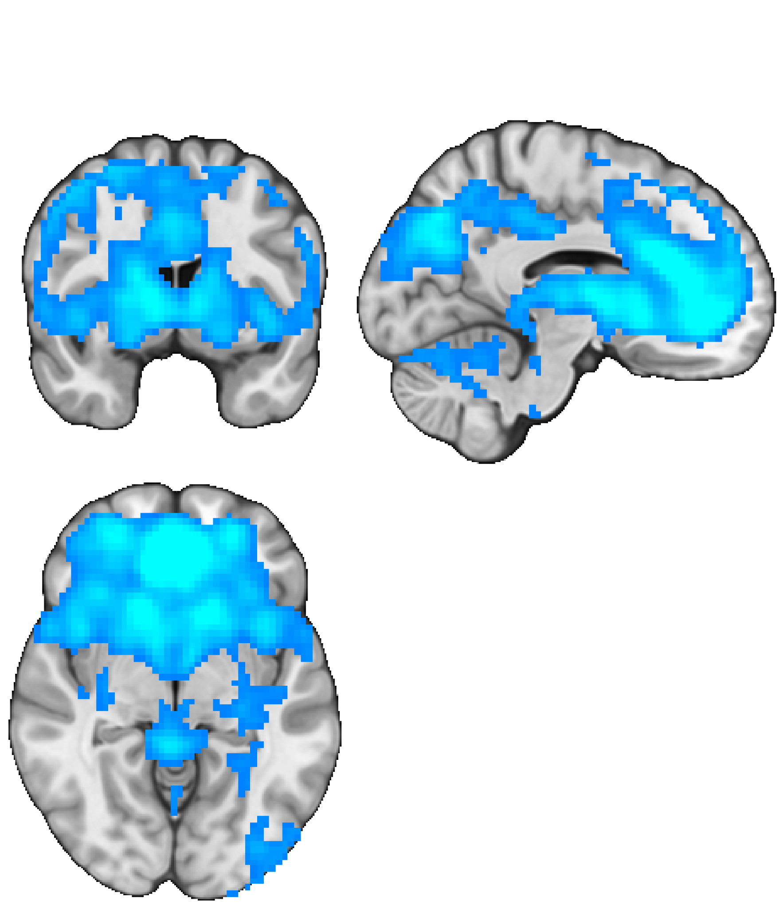
Age * social context interaction?
Fairness: the Ultimatum Game
Functional connectivity - Default Mode Network (DMN) - Executive Control Network (ECN)
Default Mode Network
Executive Control Network
Notes:
Building off previous literature, in this study we focused on (click) the default mode network and executive control network functional connectivity with other brain regions.

Slide 32
Age * social context interaction?
Fairness: the Ultimatum Game
Functional connectivity - Default Mode Network (DMN) - Executive Control Network (ECN)
Connectivity-behavior association
Default Mode Network
Executive Control Network
Notes:
We were also interested how individual behavioral differences such as (click) fairness norm and norm violation sensitivity may correlate with brain activities.

Slide 33
Age * social context interaction?
Fairness: the Ultimatum Game
Functional connectivity - Default Mode Network (DMN) - Executive Control Network (ECN)
Connectivity-behavior association - Fairness norm - Norm violation sensitivity
Default Mode Network
Executive Control Network
Notes:
We were also interested how individual behavioral differences such as (click) fairness norm and norm violation sensitivity may correlate with brain activities.

Slide 34
Age * social context interaction?
Fairness: the Ultimatum Game
Functional connectivity - Default Mode Network (DMN) - Executive Control Network (ECN)
Connectivity-behavior association - Fairness norm - Norm violation sensitivity
Default Mode Network
Executive Control Network
Notes:
To explore these research questions we utilized the Ultimatum Game as our experimental task.

Slide 35
The Ultimatum Game
Notes:
The ultimatum game (click) is a two-player economic game where one person proposes a split of money, and the other person can accept (click) or (click) reject it, with rejection leaving both empty-handed.

Slide 36

The Ultimatum Game
Proposer
Recipient
$$$$
$$
keep
offer
Accept
or
Reject
Notes:
The ultimatum game (click) is a two-player economic game where one person proposes a split of money, and the other person can accept (click) or (click) reject it, with rejection leaving both empty-handed.

Slide 37
The Ultimatum Game
Proposer
Recipient
$$$$
$$
Accept !
or
Reject
Notes:
The ultimatum game (click) is a two-player economic game where one person proposes a split of money, and the other person can accept (click) or (click) reject it, with rejection leaving both empty-handed.

Slide 38
The Ultimatum Game
Proposer
Recipient
$$$$
$$
zero
zero
keep
offer
Accept
or
Reject !
Notes:
The ultimatum game (click) is a two-player economic game where one person proposes a split of money, and the other person can accept (click) or (click) reject it, with rejection leaving both empty-handed.

Slide 39
The Ultimatum Game
Proposer
Recipient
$$$$
$$
keep
offer
Accept
or
Reject
Notes:
In our study, participants played the role of recipient, (click) and here’s how we manipulated fairness, age, and social context based on the task.

Slide 40
The Ultimatum Game
Fairness
Proposer
Recipient
$$$$
$$
Aging
keep
offer
Accept
or
Reject
Social Context
Notes:
In our study, participants played the role of recipient, (click) and here’s how we manipulated fairness, age, and social context based on the task.

Slide 41
The Ultimatum Game
Fairness - Offer size
Fixed $20 endowment
Fairness (Offer size)
= 5% ~ 50% ($1 to $10 )
Proposer
Recipient
$$$$
$$
Aging
keep
offer
Accept
or
Reject
Social Context
Notes:
To manipulate fairness, we adopted a fixed endowment of $20 and changed the percentage of endowment offered to the participant.

Slide 42
The Ultimatum Game
Fairness - Offer size
Fixed $20 endowment
Fairness (Offer size)
= 5% ~ 50% ($1 to $10 )
Proposer
Recipient
$$$$
$$
Aging - Participant Age
Younger adults (18-35, N = 25)
Older adult (65-80, N = 22)
keep
offer
Accept
or
Reject
Social Context
Notes:
For aging, we recruited participants from two distinct age group, younger adults between the age 18-35 older adults between the age 65-80.

Slide 43
The Ultimatum Game
Fairness - Offer size
Fixed $20 endowment
Fairness (Offer size)
= 5% ~ 50% ($1 to $10 )
Proposer
Recipient
$$$$
$$
Aging - Participant Age
Younger adults (18-35, N = 25)
Older adult (65-80, N = 22)
keep
offer
Accept
or
Reject
Social Context
Notes:
For social context (click), we manipulated the age similarity between the participants and their game partner and created two conditions, (click) similar partner condition and dissimilar partner condition. (next) In the similar partner condition (click), participant and their partner’s age is matched, whereas in dissmilar partner condition, their age is mismatched. For example, (next)

Slide 44
The Ultimatum Game
Fairness - Offer size
Fixed $20 endowment
Fairness (Offer size)
= 5% ~ 50% ($1 to $10 )
Proposer
Recipient
$$$$
$$
Aging - Participant Age
Younger adults (18-35, N = 25)
Older adult (65-80, N = 22)
keep
offer
Accept
or
Reject
Social Context - Partner Similarity
Similar partner
Dissimilar partner
Notes:
For social context (click), we manipulated the age similarity between the participants and their game partner and created two conditions, similar partner condition and dissimilar partner condition. (next)

Slide 45
The Ultimatum Game
Fairness - Offer size
Fixed $20 endowment
Fairness (Offer size)
= 5% ~ 50% ($1 to $10 )
Proposer
Recipient
$$$$
$$
Aging - Participant Age
Younger adults (18-35, N = 25)
Older adult (65-80, N = 22)
keep
offer
Accept
or
Reject
Social Context - Partner Similarity
Similar partner = age matched
Dissimilar partner
Notes:
In the similar partner condition, participant and their partner’s age is matched, whereas in dissmilar partner condition (click), their age is mismatched. For example, (next)

Slide 46
The Ultimatum Game
Fairness - Offer size
Fixed $20 endowment
Fairness (Offer size)
= 5% ~ 50% ($1 to $10 )
Proposer
Recipient
$$$$
$$
Aging - Participant Age
Younger adults (18-35, N = 25)
Older adult (65-80, N = 22)
keep
offer
Accept
or
Reject
Social Context - Partner Similarity
Similar partner = age matched
Dissimilar partner = age mismatched
Notes:
In the similar partner condition, participant and their partner’s age is matched, whereas in dissmilar partner condition (click), their age is mismatched. For example, (next)

Slide 47
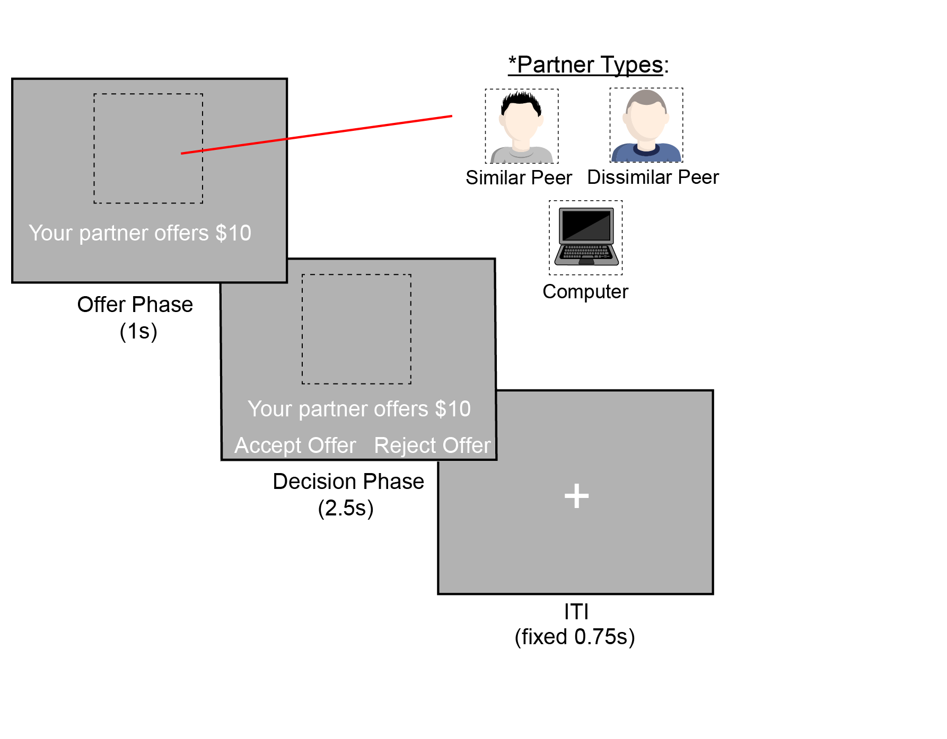
The Ultimatum Game
Fairness - Offer size
Fixed $20 endowment
Fairness (Offer size)
= 5% ~ 50% ($1 to $10 )
Proposer
Recipient
$$$$
$$
Aging - Participant Age
Younger adults (18-35, N = 25)
Older adult (65-80, N = 22)
keep
offer
Accept
or
Reject
Social Context - Partner Similarity
Similar partner = age matched
Dissimilar partner = age mismatched
Notes:
For example, if a participant is an old white male, for similar partner condition he would play the ultimatum game (click) with another old white male. For dissimilar condition, (click) this old white male would instead play the game with a young white male.

Slide 48
The Ultimatum Game
Fairness - Offer size
Fixed $20 endowment
Fairness (Offer size)
= 5% ~ 50% ($1 to $10 )
similar partner (age matched)
Proposer
Recipient
$$$$
$$
Aging - Participant Age
Younger adults (18-35, N = 25)
Older adult (65-80, N = 22)
keep
offer
Accept
or
Reject
Social Context - Partner Similarity
Similar partner = age matched
Dissimilar partner = age mismatched
Notes:
For example, if a participant is an old white male, for similar partner condition he would play the ultimatum game (click) with another old white male. For dissimilar condition, (click) this old white male would instead play the game with a young white male.

Slide 49
The Ultimatum Game
Fairness - Offer size
Fixed $20 endowment
Fairness (Offer size)
= 5% ~ 50% ($1 to $10 )
dissimilar partner (age mismatched)
Proposer
Recipient
$$$$
$$
Aging - Participant Age
Younger adults (18-35, N = 25)
Older adult (65-80, N = 22)
keep
offer
Accept
or
Reject
Social Context - Partner Similarity
Similar partner = age matched
Dissimilar partner = age mismatched
Notes:
For example, if a participant is an old white male, for similar partner condition he would play the ultimatum game (click) with another old white male. For dissimilar condition, (click) this old white male would instead play the game with a young white male.

Slide 50
Partner Type
similar partner (age matched)
dissimilar partner (age mismatched)
Blocks = 18
Trials per block = 8
Total trials = 144
Smith et al. (2024). Scientific Data
Notes:
Here’s how a trial actually looks like in our task. In each trial, participants first see who their partner is and the partner’s offer for 1 second. Then the participant have 2.5 seconds to indicate whether they accept or reject the offer.

Slide 51
Partner Type
similar partner (age matched)
GLM regressor
dissimilar partner (age mismatched)
Blocks = 18
Trials per block = 8
Total trials = 144
Smith et al. (2024). Scientific Data
Notes:
In our GLM model for fMRI analyses, we merged offer phase and decision phase into one regressor. We also included offer-size based parametric modulator to obtain neural sensitivity to fairness.

Slide 52
Age-related changes
Notes:
Before examining age-related changes in the brain, we first looked at age-related changes (click) at the behavioral level.

Slide 53
Age-related changes in choice behaviors
Notes:
Before examining age-related changes in the brain, we first looked at age-related changes (click) at the behavioral level.

Slide 54
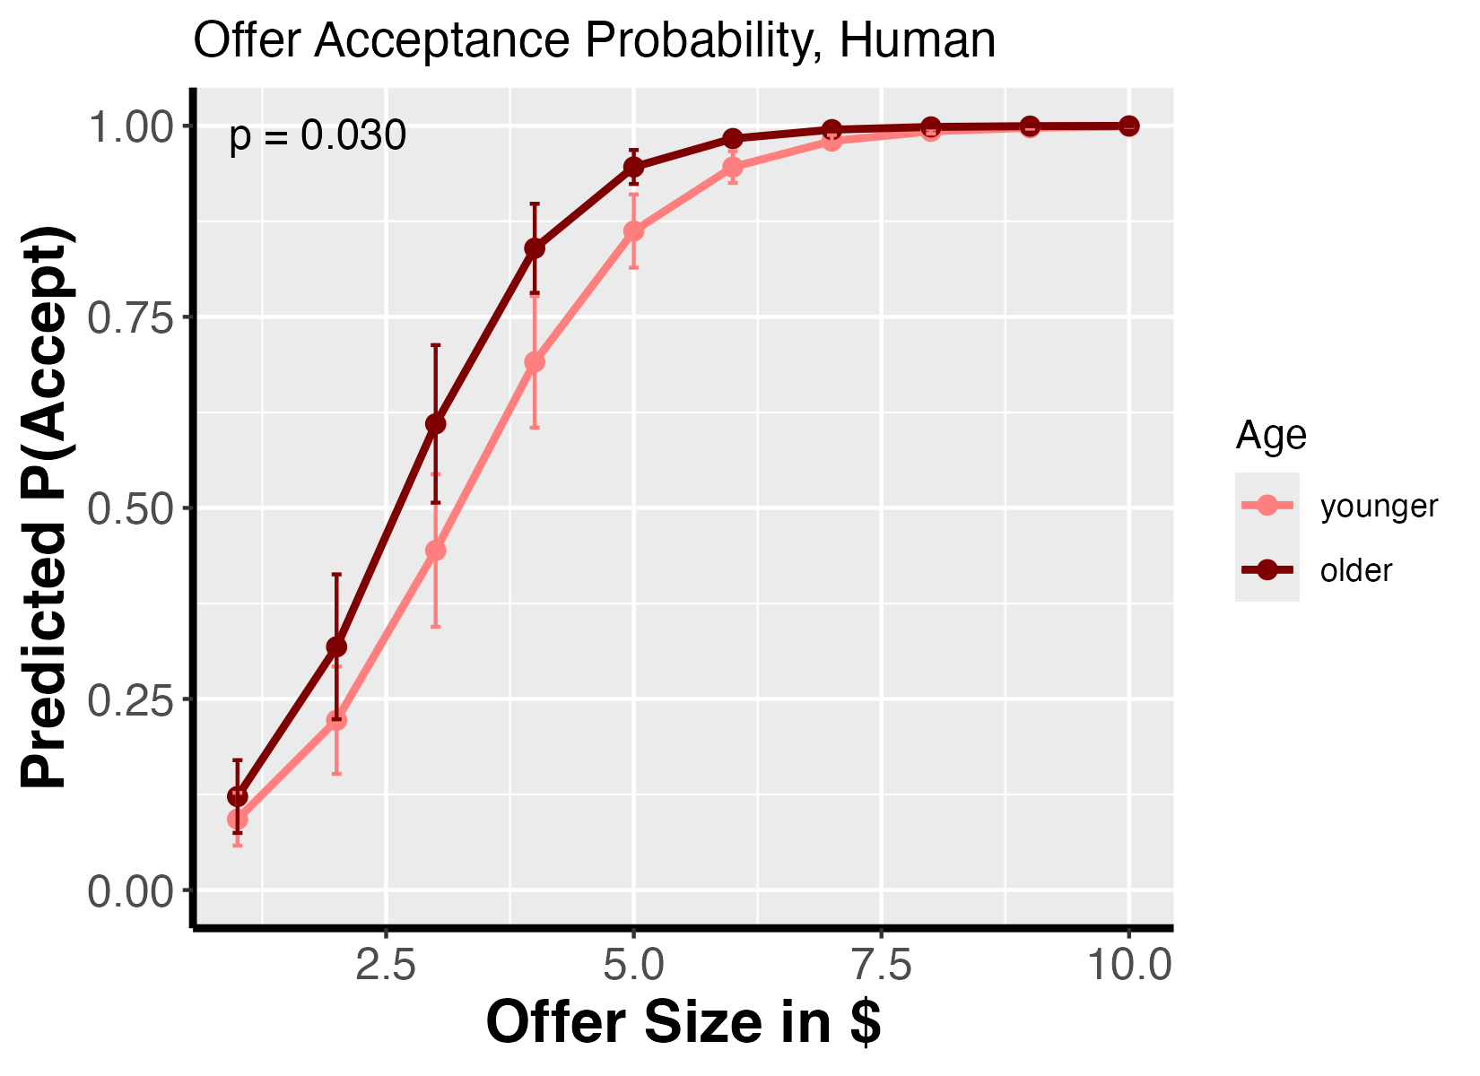
Age-related changes in choice behaviors
- Older, lower threshold to reject
- Older, more sensitive to violation
Yang et al., in prep (1)
Notes:
Overall we found that, compared to younger adults, older adults have lower accept-reject threshold as shown by the 50-50 accept-reject point further to the left, indicating older adults might have a lower fairness norm. In contrast, despite the lower norm, older adults seems to be more sensitive to fairness violation as indicated by the steeper slope around 50-50 chance point.

Slide 55
Age-related changes in choice behaviors
- Older, lower threshold to reject
- Older, more sensitive to violation
- No age * social context interaction or social context main effect
Yang et al., in prep (1)
Notes:
We didn’t find significant behavior level age*social context interaction or main effect of social context. In other words, at the behavioral level, regardless of being younger or older, participants don’t differentiate between playing with an age-similar partner or age-dissimilar partner.

Slide 56
Age * social context interaction in the brain
Functional connectivity - Default Mode Network (DMN) - Executive Control Network (ECN)
Connectivity-behavior association - Fairness norm - Norm violation sensitivity
Default Mode Network
Executive Control Network
Yang et al., in prep (1)
Notes:
How about age and social context effects at the brain level? (click) We first examined functional connectivity of DMN and ECN and found (click) significant age differences in social context-related DMN-dACC fairness sensitivity.

Slide 57
Age * social context interaction in the brain
Functional connectivity - Default Mode Network (DMN) - Executive Control Network (ECN)
Connectivity-behavior association - Fairness norm - Norm violation sensitivity
Default Mode Network
Executive Control Network
Yang et al., in prep (1)
Notes:
How about age and social context effects at the brain level? (click) We first examined functional connectivity of DMN and ECN, and we found (next)

Slide 58
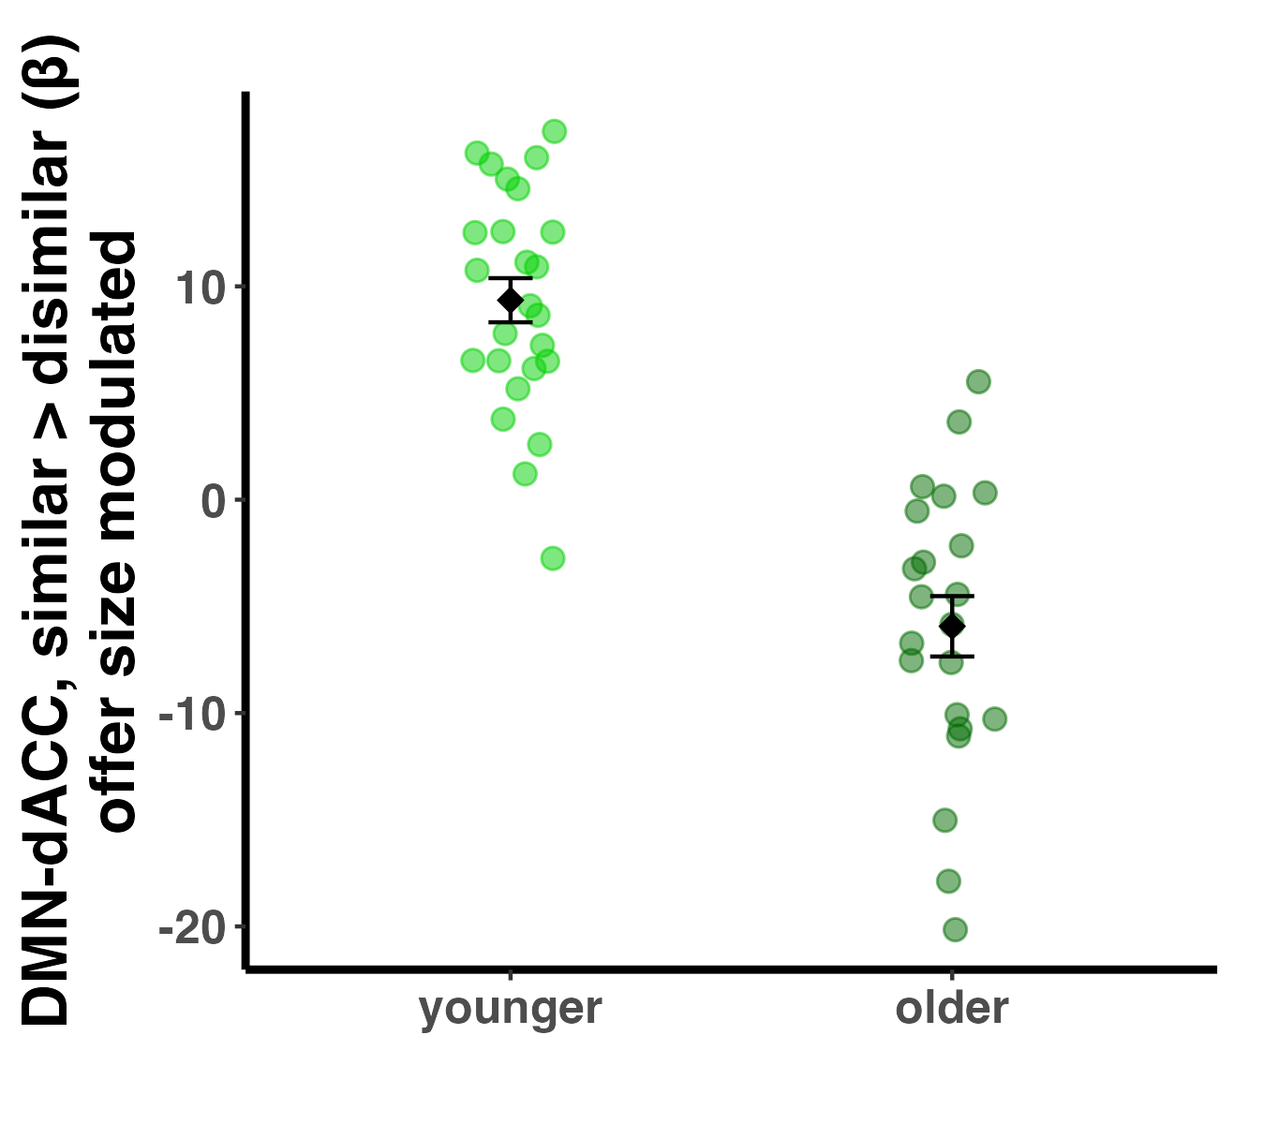
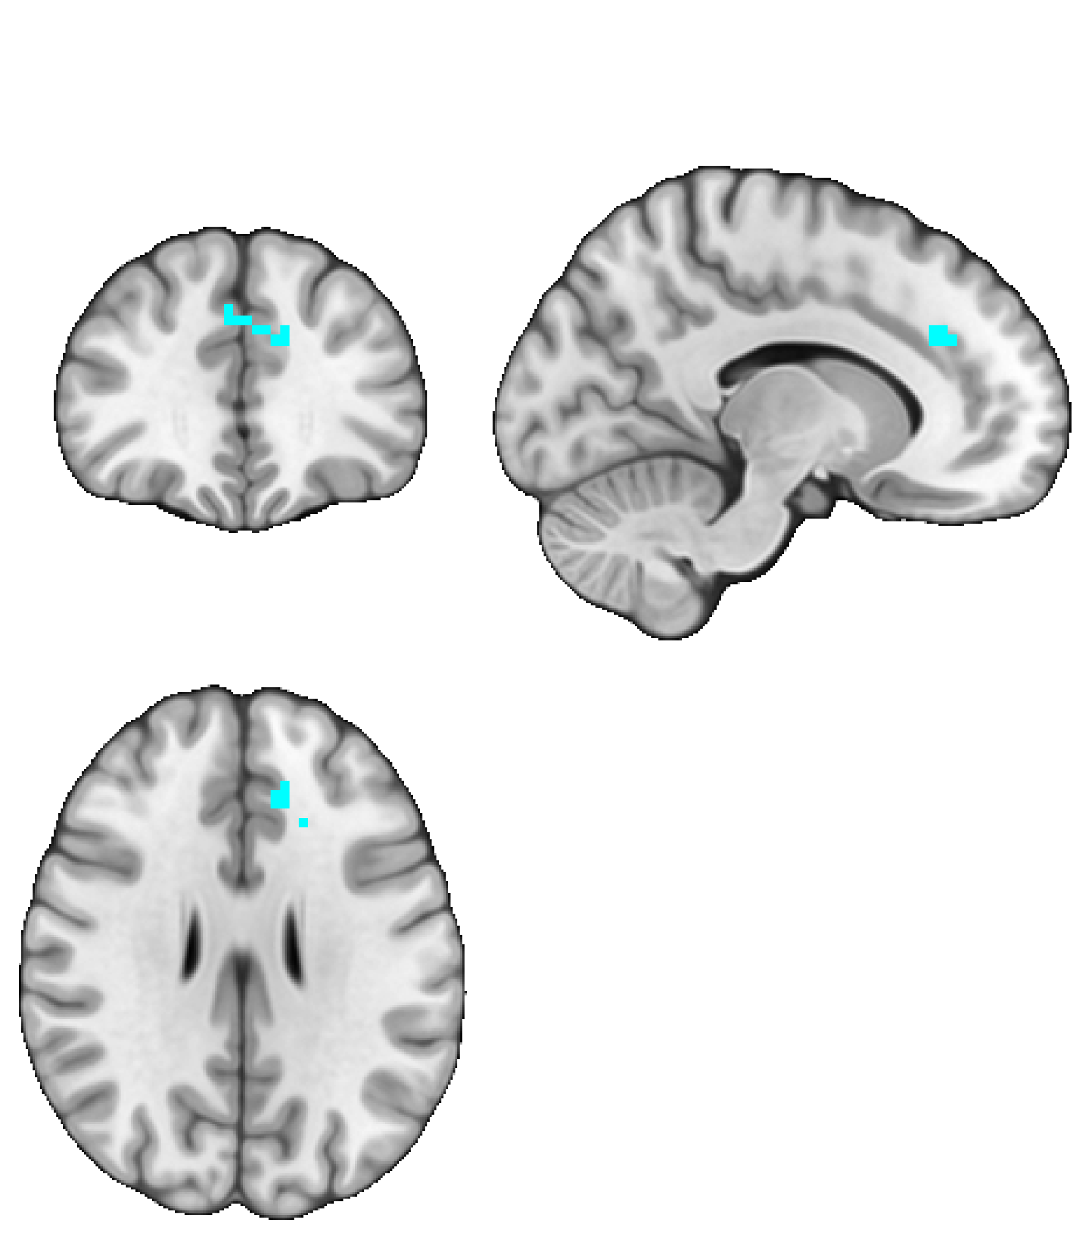
Age affects context differentiation of fairness-related DMN-dACC connectivity
Yang et al., in prep (1)
Notes:
(and we found) significant age difference in context differentiation in DMN-dACC fairness sensitivity

Slide 59
Age affects context differentiation of fairness-related DMN-dACC connectivity
Yang et al., in prep (1)
Notes:
The y axis represent context differentiation in DMN-dACC fairness sensitivity when playing with an age-similar partner versus an age-dissimilar partner. Larger absolute value indicate stronger context differentiation. The x-axis is participant’s age group.

Slide 60
Age affects context differentiation of fairness-related DMN-dACC connectivity
Yang et al., in prep (1)
Notes:
In younger adults, we found a significant context differentiation of fairness related DMN-dACC connectivity that favors age-similar partner.

Slide 61
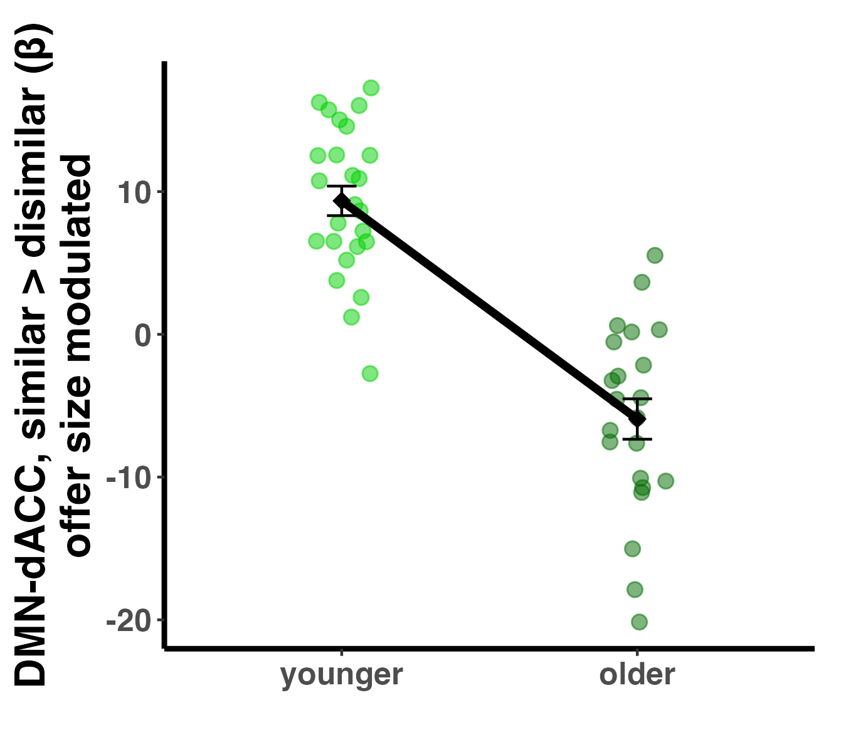
Age affects context differentiation of fairness-related DMN-dACC connectivity
Yang et al., in prep (1)
Notes:
In contrast, for older adults, the context differentiation of fairness related DMN-dACC connectivity is in the opposite direction, …

Slide 62
Age affects context differentiation of fairness-related DMN-dACC connectivity
Different DMN-dACC integration among older adults.
Yang et al., in prep (1)
Notes:
This reversed pattern may indicate differential DMN-dACC integration among older adults compared to younger adults, rather than a uniform age-related decline.

Slide 63
Age * social context interaction?
Functional connectivity - Default Mode Network (DMN) - Executive Control Network (ECN)
Connectivity-behavior association - Fairness norm - Norm violation sensitivity
Default Mode Network
✔
Executive Control Network
Yang et al., in prep (1)
Notes:
DMN functional connectivity, check. We didn’t find any significant results in ECN connectivity.

Slide 64
Age * social context interaction?
Functional connectivity - Default Mode Network (DMN) - Executive Control Network (ECN)
Connectivity-behavior association - Fairness norm - Norm violation sensitivity
Default Mode Network
✔
Executive Control Network
Yang et al., in prep (1)
Notes:
Next, we examined how individual behavioral differences in fairness norm and norm violation sensitivity may correlate with brain activities.
Before showing the results, I’d like to first walk you through how we operationalized fairness norm and norm violation sensitivity at the behavioral level.

Slide 65
Multilevel
Logistic Regression
random + fixed
Norm and Norm Violation Sensitivity
log(p/1-p)
Participant A
0
(50%)
offer size
1
5
10
Yang et al., in prep (1)
Notes:
To quantify fairness norm and norm violation sensitivity, we applied multilevel logistic regression and regressed participant’s accept or reject decisions with a partner onto offer size. The regression line shows the correlation between offer size and the logit of accept, the log transformed odd of accepting an offer. A logit of 0 means 50-50 chance of accepting or rejecting.

Slide 66
Multilevel
Logistic Regression
random + fixed
Norm and Norm Violation Sensitivity
log(p/1-p)
Participant A
(x-intercept)
(slope)
0
(50%)
offer size
1
5
10
Yang et al., in prep (1)
Notes:
The x-intercept corresponds to the predicted offer size where a participant’s acceptance of the offer is at chance level, (click) which approximates the participant’s fairness norm.

Slide 67
Multilevel
Logistic Regression
random + fixed
Norm and Norm Violation Sensitivity
log(p/1-p)
Participant A
Norm
(x-intercept)
(slope)
0
(50%)
offer size
1
5
10
Yang et al., in prep (1)
Notes:
The x-intercept corresponds to the predicted offer size where a participant’s acceptance of the offer is at chance level, (click) which approximates the participant’s fairness norm.

Slide 68
Multilevel
Logistic Regression
random + fixed
Norm and Norm Violation Sensitivity
log(p/1-p)
Participant A
Norm
(x-intercept)
Norm Violation Sensitivity
(slope)
0
(50%)
offer size
1
5
10
Yang et al., in prep (1)
Notes:
The slope of the line indicate how much the behavior would change between accept and reject if a offer is above or below the norm, (click) which approximates the participant’s sensitivity to fairness norm violation.

Slide 69
Multilevel
Logistic Regression
random + fixed
Norm and Norm Violation Sensitivity
log(p/1-p)
Participant B
Participant A
Norm
(x-intercept)
Norm Violation Sensitivity
(slope)
0
(50%)
offer size
1
5
10
Yang et al., in prep (1)
Notes:
For example, if two participants have the same x-intercept but different slope, this indicates that they have the same fairness norm but participant B is more sensitive to norm violation and is more likely to change from accept to reject if their norm is violated or vice versa, compared to Participant A.

Slide 70
Age * social context interaction?
Functional connectivity - Default Mode Network (DMN) - Executive Control Network (ECN)
Connectivity-behavior association - Fairness norm (x-intercept) - Norm violation sensitivity (slope)
Default Mode Network
✔
Executive Control Network
Yang et al., in prep (1)
Notes:
For brain-behavior correlation, on the brain side we again focused on default mode network and executive control network functional connectivity.

Slide 71
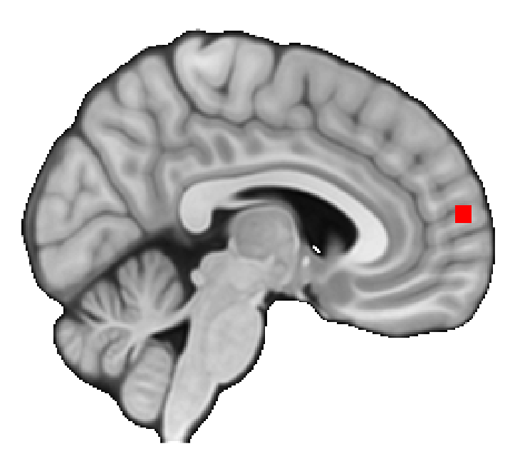
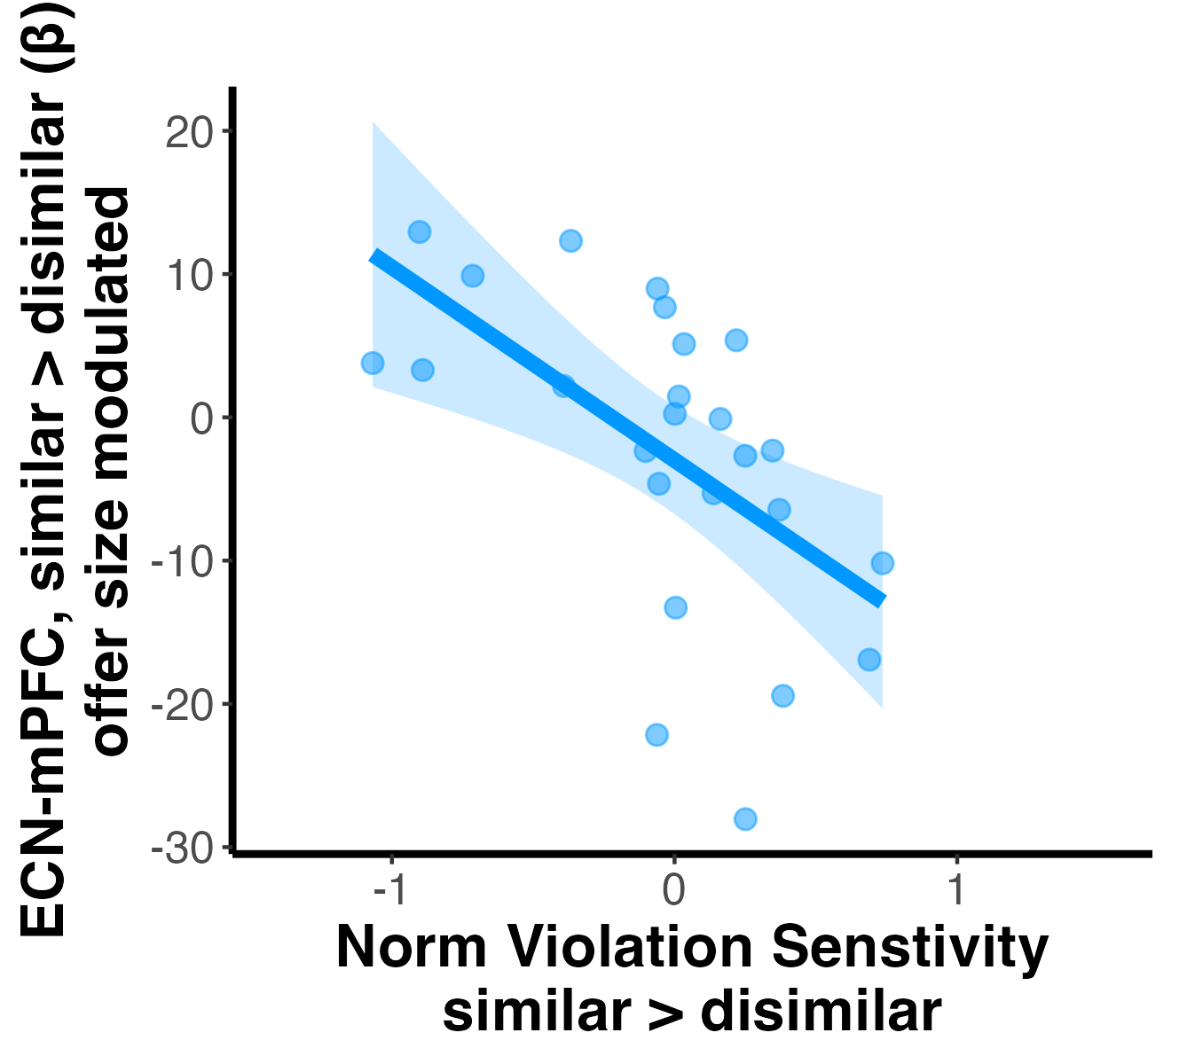
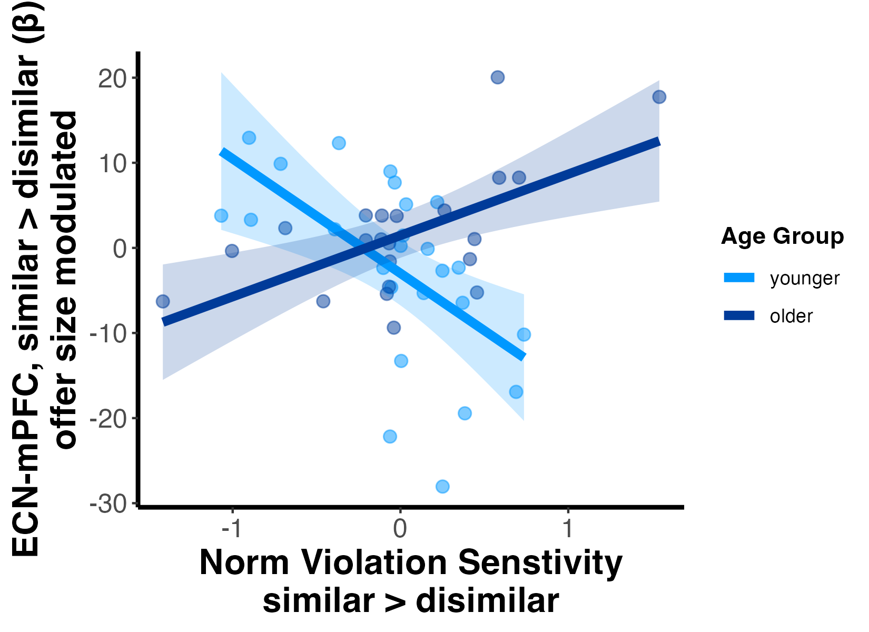
Age moderate the correlation between context differentiation of ECN-mPFC connectivity and norm violation sensitivity
Yang et al., in prep (1)
Notes:
And we found age moderated the correlation between context differentiation of ECN-mPFC connectivity and behavioral norm violation sensitivity.

Slide 72
Age moderate the correlation between context differentiation of ECN-mPFC connectivity and norm violation sensitivity
Yang et al., in prep (1)
Notes:
The y axis is context differentiation of fairness-related ECN-mPFC connectivity, that is, the difference in ECN-mPFC connectivity between similar partner condition and dissimilar partner condition. The x axis is context differentiation of behavioral norm violation sensitivity, that is, the difference in behavioral norm violation sensitivity between similar partner condition and dissimilar partner condition.

Slide 73
Age moderate the correlation between context differentiation of ECN-mPFC connectivity and norm violation sensitivity
Yang et al., in prep (1)
Notes:
We found that younger adults showed a significant negative correlation between contexta differentiation of ECN-mPFC connectivity and behavioral norm violation sensitivity, and such correlation (click) is reversed among older adults.

Slide 74
Age moderate the correlation between context differentiation of ECN-mPFC connectivity and norm violation sensitivity
Yang et al., in prep (1)
Notes:
We found that younger adults showed a significant negative correlation between contexta differentiation of ECN-mPFC connectivity and behavioral norm violation sensitivity, and such correlation (click) is reversed among older adults.

Slide 75
Age moderate the correlation between context differentiation of ECN-mPFC connectivity and norm violation sensitivity
Social information processing might be fundamentally different between younger and older adults.
Yang et al., in prep (1)
Notes:
This age-dependent pattern suggests that neural level social information processing might be fundamentally different between younger and older adults.

Slide 76
Age * social context interaction?
Functional connectivity - Default Mode Network (DMN) - Executive Control Network (ECN)
Connectivity-behavior association - Fairness norm - Norm violation sensitivity
Default Mode Network
✔
Executive Control Network
✔
Yang et al., in prep (1)
Notes:
So, brain-behavior association, check

Slide 77
What do the results tell us?
Notes:
Ok, complicated and interesting results. What do they actually tell us?

Slide 78
What do the results tell us?
DMN-dACC
Aging may affect multiple network connectivity involved in fairness and social context processing.
ECN-mPFC
Notes:
First, (read the point 1)

Slide 79
What do the results tell us?
DMN-dACC
Aging may affect multiple network connectivity involved in fairness and social context processing.
Aging may result in distinctive neural integration patterns in social information processing rather than uniform decline.
ECN-mPFC
Notes:
And, (read the point 1)

Slide 80
How about scam vulnerability?
Exploited Victim
Scammer
in Disguise
Notes:
How about scam vulnerability, where we started?

Slide 81
In progress
ongoing data collection
target N = 350 (current ~230)
multiple tasks, including the Ultimatum Game
financial exploitation measures (and more!)
Smith, … Yang et al. (2024), Data in Brief
Yang et al., in prep (2)
Notes:
End summary with some questions that lead to next slides
Another task that taps into social context

Slide 82
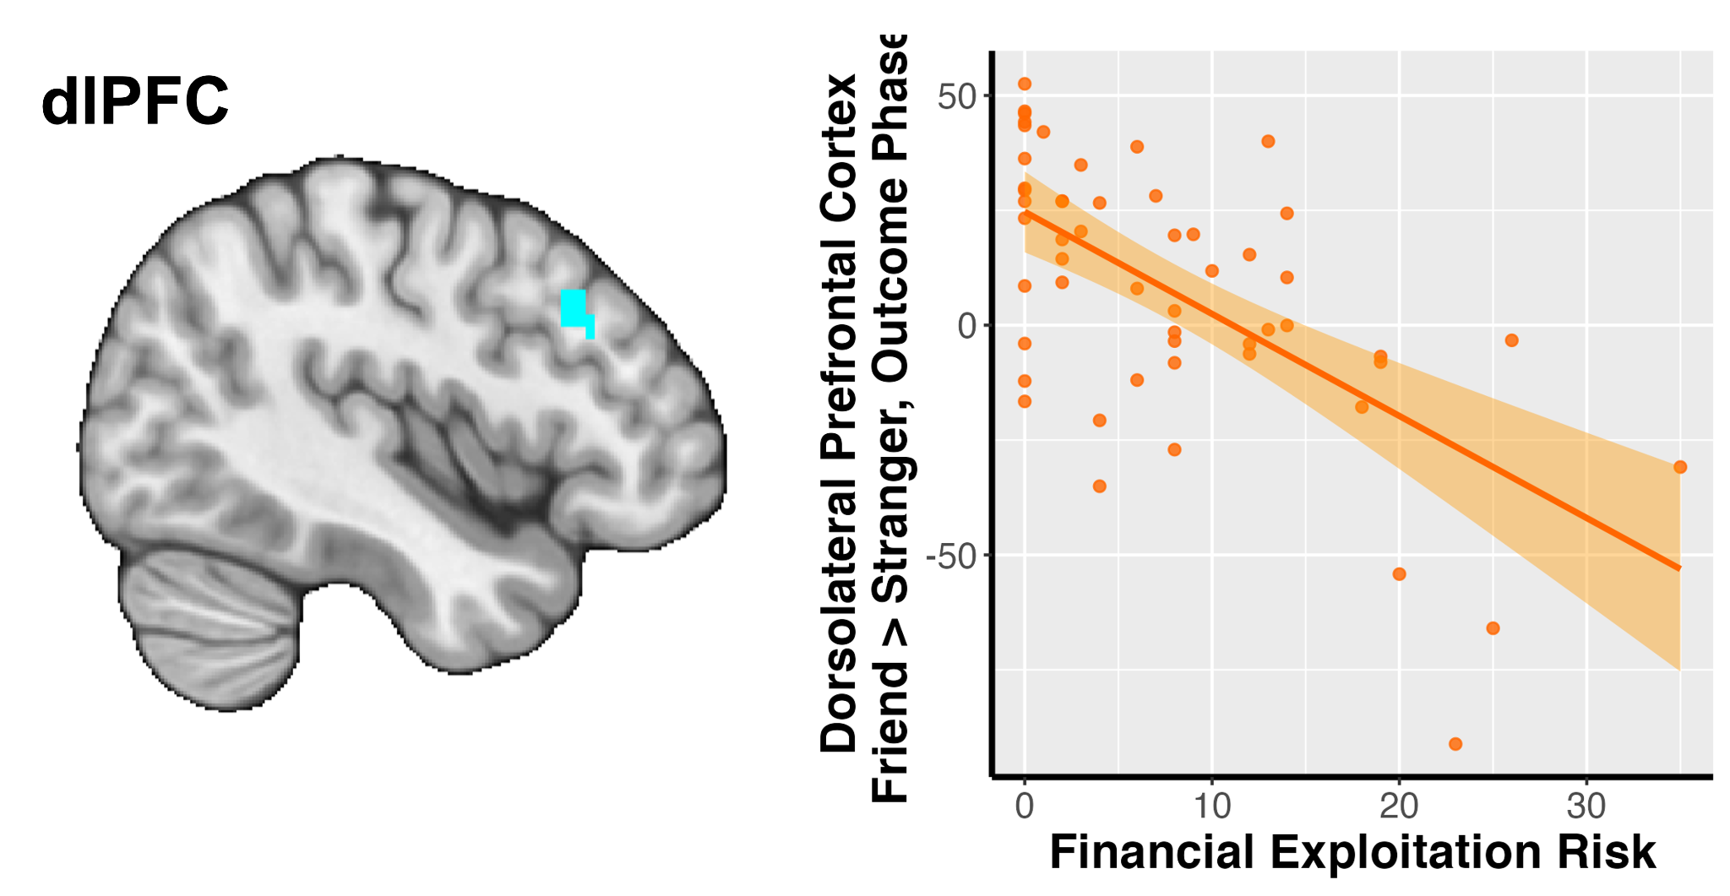
In progress
ongoing data collection
target N = 350 (current ~230)
multiple tasks, including the Ultimatum Game
financial exploitation measures (and more!)
task: sharing monetary outcome with a friend or stranger
preliminary finding: stronger friend>stranger social context differentiation in dlPFC activation, lower financial exploitation risk
dlPFC activation (β) Friend > stranger, outcome
Smith, … Yang et al. (2024), Data in Brief
Yang et al., in prep (2)

Slide 83
In progress
ongoing data collection
target N = 350 (current ~230)
multiple tasks, including the Ultimatum Game
financial exploitation measures (and more!)
SANS 2026
Stay tuned!
task: sharing monetary outcome with a friend or stranger
preliminary finding: stronger friend>stranger social context differentiation in dlPFC activation, lower financial exploitation risk
dlPFC activation (β) Friend > stranger, outcome
Smith, … Yang et al. (2024), Data in Brief
Yang et al., in prep (2)
Notes:
End summary with some questions that lead to next slides
Another task that taps into social context

Slide 84

Acknowledgement
Thank you!

