Slide 1
You’ve Got Data. Now What?
Convert to NIFTI (dcm2niix)
Look at your data (fslview, MRIcroN, etc)
Spatial processing in SPM12 (nii_batch12.m)
Look at your output!
Additional processing and statistics in FSL

Slide 2
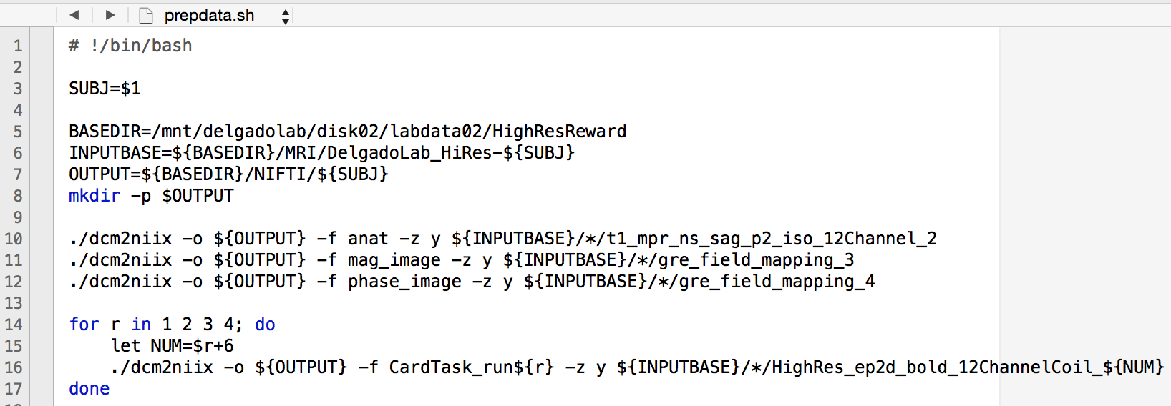
Converting Data (prepdata.sh)

Slide 3
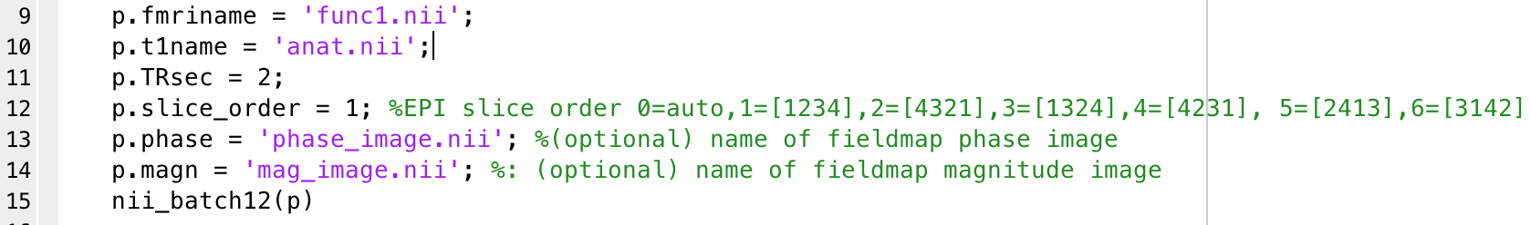
Spatial Preprocessing

Slide 4
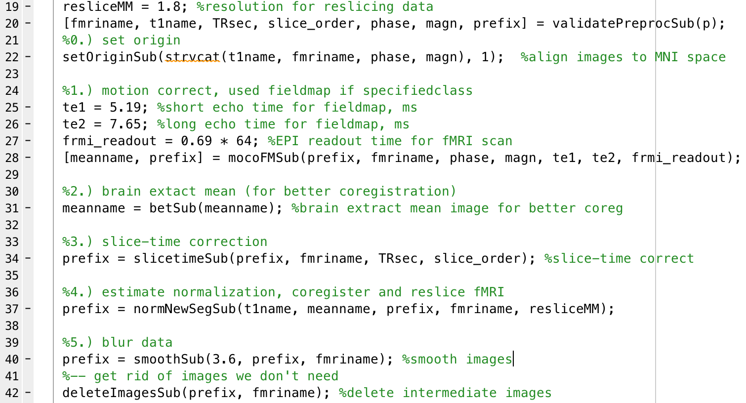
Spatial Preprocessing (nii_batch12.m)

Slide 5
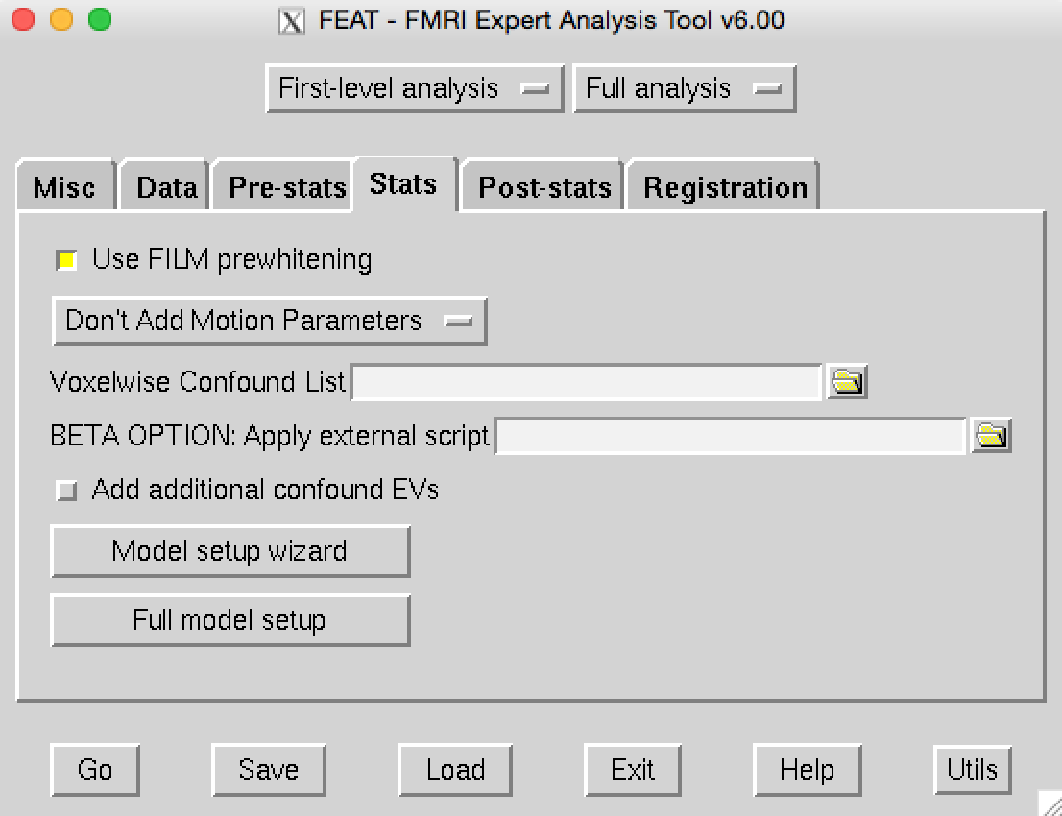
Making a Template…

Slide 6
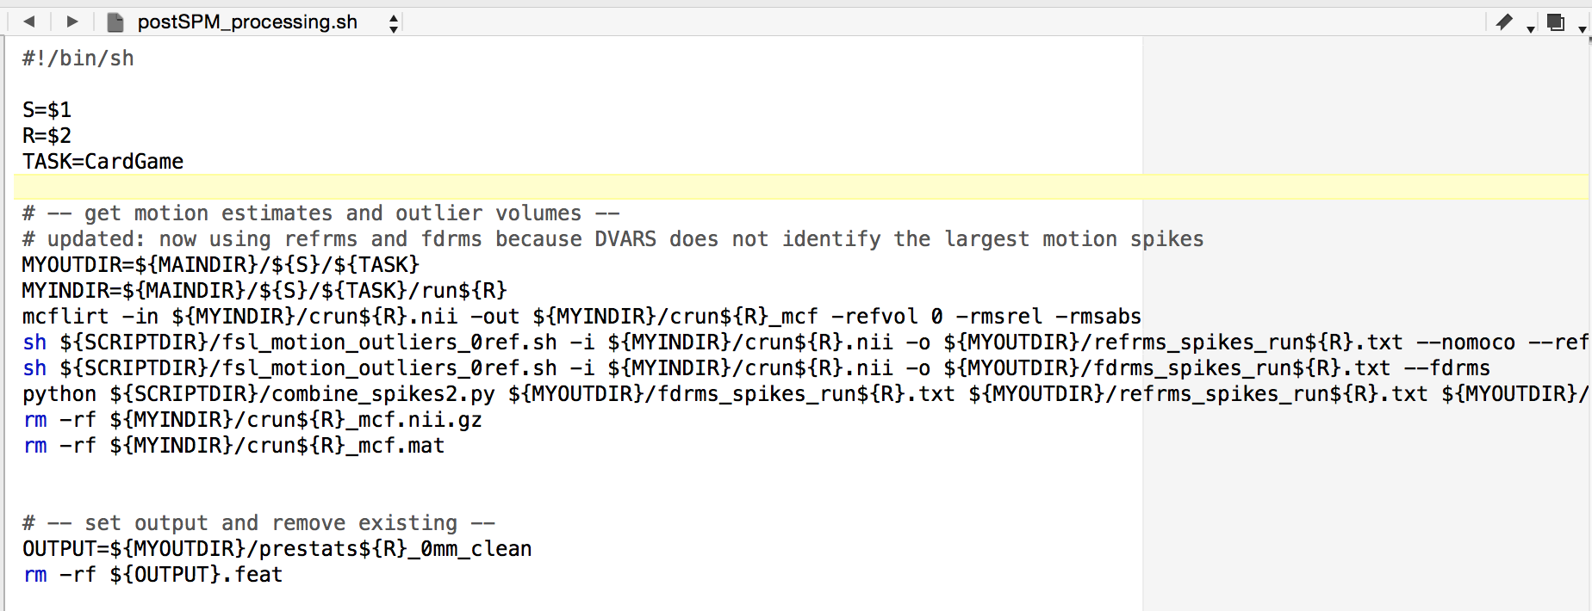
More Preprocessing… (part 1)
scrub_motion.sh
regress out motion and motion spikes

Slide 7
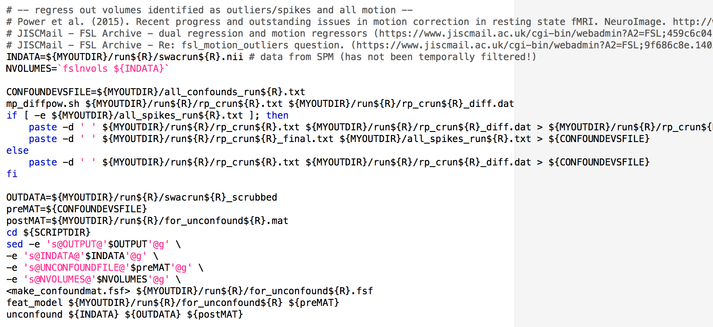
More Preprocessing… (part 2)
scrub_motion.sh
regress out motion and motion spikes

Slide 8
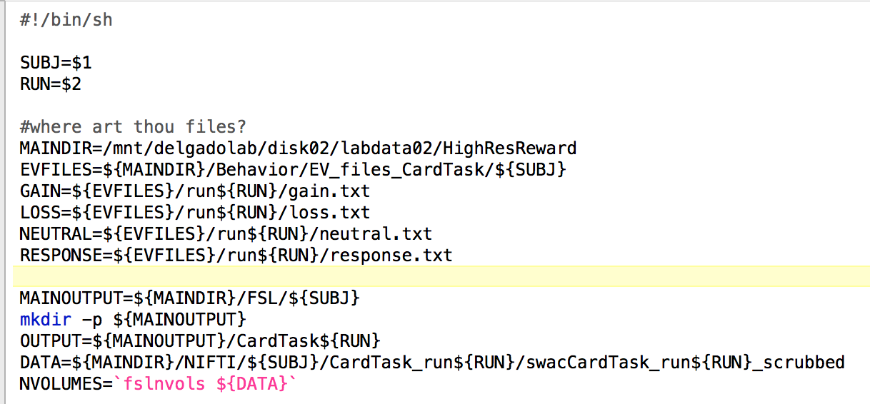
Example Stats (part 1)
L1_CardTask.sh
Example script for stats: set your paths and then do find and replace

Slide 9
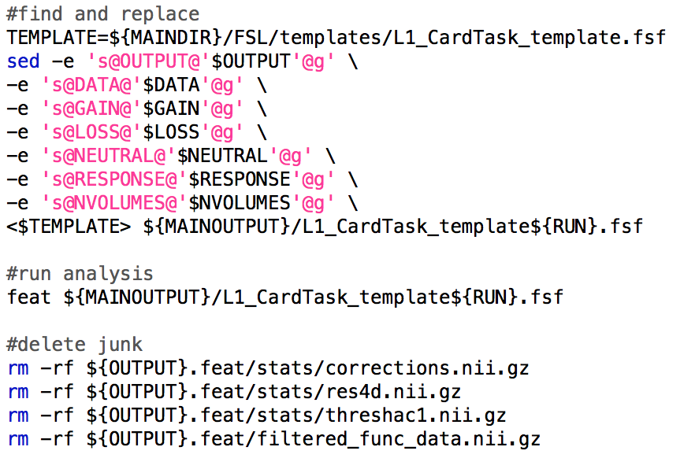
Example Stats (part 2)
L1_CardTask.sh
Example script for stats: set your paths and then do find and replace

