Slide 1
HateBuster:Decoding Toxic Tweets
Paneendra – 23B0992
Yugesh – 23B1026
Date : 04-05-2025

Slide 2
Problem Statement
Input:
The input will be a tweet/text in Portuguese language
Output:
Predicts whether it is hate or not hate speech. Further classifies into type of hate if it is hate.
The project addresses the problem of detecting hate speech and offensive language in Portuguese social media, particularly Twitter.The model should be able to accurately classify the text to hate or not hate which is essential for improving online safety in Portuguese- speaking communities.

Slide 3
Motivation
Hate speech on social media is rising, especially in under-resourced languages like Portuguese.
Challenging task due to language complexity, sarcasm, and context in offensive speech — the same word pairs (bigrams) can appear in both hate and non-hate speech, as seen in the top 10 bigrams of each class.
Real-world impact: Helps platforms and communities detect and reduce toxic content online.

Slide 4
Literature Review
Prior work on hate speech detection mostly focused on English, using datasets like HateBase and models like BERT.
The TuPy-E paper introduced a well-annotated Portuguese dataset and tested models like BERTimbau and LSTM.
We build on this by reproducing their baseline and aim to improve performance through fine-tuning and architectural changes.
To enhance performance, we experimented with various methods, fine-tuning BERTimbau with a standard feedforward network, LSTM, CNN, and by introducing a new model, RoBERTa. Among these approaches, the CNN consistently led to the most significant improvement in accuracy.

Slide 5
Dataset
Example Data Instance:
Input :
Imagino que o Senhor Jesus esteja decepcionado com certos cristãos, que professam serem homens de Deus
Output: Binary classification: 0 (0 for not hate and 1 for hate) Hierarchical classification output will be 1 or 0 for each class:
ageism(0),aporophobia(0),body_shame(0),capacitism(0),lgbtphobia(0),political(0), racism(0),religious_intolerance(0),misogyny(0),xenophobia(0),other(0)
Dataset Source

Slide 6
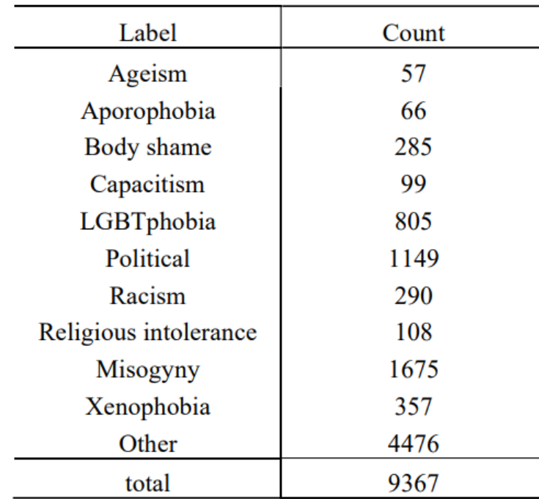
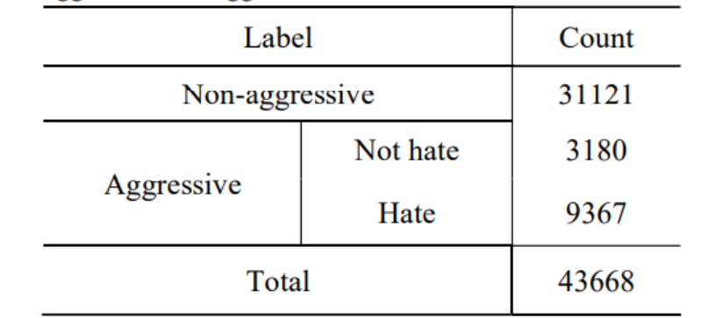
Statistics:
Total no of samples in the Dataset are 43668 texts out of which 9367 are hate and rest 34301 are annotated as not hate . This dataset is a combination of 3 previously published datasets and a newly annotated dataset.
Class Balance

Slide 7
Method/Technique
We initially trained the BERT model on the TuPy-E dataset, following the procedure described in the original paper.
To improve the model, we added a CNN layer on top of the pre-trained BERT model.
Initially, we froze the BERT weights and trained only the CNN layer. We then applied gradual unfreezing, where one BERT layer was unfrozen at each epoch during training.
The CNN layer was used to capture local patterns in the text that might not be fully captured by the transformer layers.Gradual unfreezing helps to preserve the knowledge learned by BERT and also stabilizes the training process.
The libraries used in this project include: torch, transformers, datasets, streamlit, os, re, and pandas.

Slide 8
Results
 | Epochs | Accuracy | Precision | Recall | F1-score
Base_binary | 20 | 0.9149 | 0.91 | 0.91 | 0.91
Large_binary | 10 | 0.9487 | 0.95 | 0.95 | 0.95
CNN_base_binary | 7 | 0.9205 | 0.91 | 0.92 | 0.91
CNN_large_binary | 5 | 0.9511 | 0.95 | 0.95 | 0.95
roBERTa_base_binary | 10 | 0.9258 | 0.92 | 0.93 | 0.92
Base_categorical | 20 | – | 0.84 | 0.85 | 0.84
Large_categorical | 10 | – | 0.84 | 0.85 | 0.84

Slide 9
Error analysis
“trabalha de palhaço é uma palhaçada”
“kkkkkkkkkk que povinho fudido”
“rt @user toda vez que eu vejo alguém escrevendo "garotx" eu tenho vontade de gritar
filho da puta x não é pronome neutro para de usar…”
Imbalanced Dataset: Fewer hate speech examples lead to bias toward non-hate, increasing false negatives.
Overfitting to Explicit Patterns:CNN may overfit to obvious hate terms, failing on diverse or implicit hate speech.

Slide 10
Improvements over the paper
To improve the model, we added a CNN layer on top of the pre-trained BERT model.
Initially, we froze the BERT weights and trained only the CNN layer. We then applied gradual unfreezing, where one BERT layer was unfrozen at each epoch during training.
The CNN layer was used to capture local patterns in the text that might not be fully captured by the transformer layers.Gradual unfreezing helps to preserve the knowledge learned by BERT and also stabilizes the training process.

Slide 11
Learnings
Learnt how to use and fine-tune advanced models, design custom architectures with diverse layer types using the PyTorch library, and explore techniques for integrating and improving state-of-the-art models.

Slide 12
Summary and Conclusion
Problem Recap: To build a model to detect hate speech in Portuguese tweets (TuPy-E) .
Problem Challenges: Tackling implicit hate and imbalances within dataset.
Main Insight: BERT + CNN with gradual unfreezing hit 0.9511 accuracy but struggled with implicit hate due to dataset limits.
Future Work: Enhancing implicit hate detection via data augmentation or contrastive loss.
Open Challenges: Improving categorical models and scaling to multilingual datasets.

