Slide 1
Identity Operators
Operator | Description | Example
is | Returns True if both variables are the same object | x is y
is not | Returns True if both variables are not the same object | x is not y

Slide 2
Membership Operators
Operator | Description | Example
in | Returns True if a sequence with the specified value is present in the object | x in y
not in | Returns True if a sequence with the specified value is not present in the object | x not in y

Slide 3
Bitwise Operators
Operator | Name | Description | Example
& | AND | Sets each bit to 1 if both bits are 1 | x & y
| | OR | Sets each bit to 1 if one of two bits is 1 | x | y
^ | XOR | Sets each bit to 1 if only one of two bits is 1 | x ^ y
~ | NOT | Inverts all the bits | ~x

Slide 4
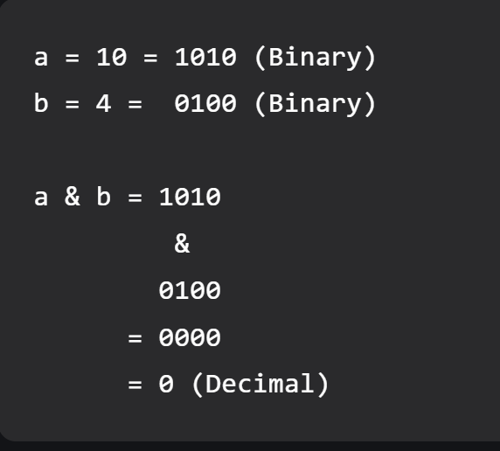
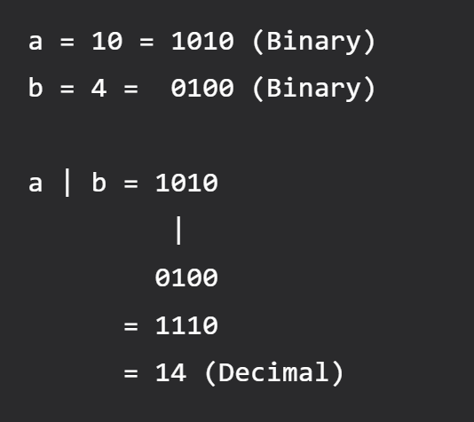
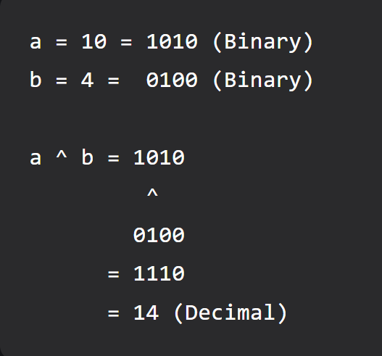

Slide 5
Casting
Syntax:
<variable> = <datatype>(<value>)
To int
To float
To string

Slide 6
Input Statement
Syntax :
<Variable> = input(<message>)
Exampe :
name = input(‘enter your name:’)

