Slide 1

Python

Slide 2
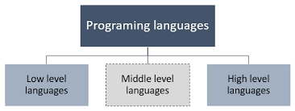
Assembly level languages

Slide 3
Variables
Rules:
A variable name must start with a letter or the underscore character
A variable name cannot start with a number
A variable name can only contain alpha-numeric characters and underscores (A-z, 0-9, and _ )
Variable names are case-sensitive (age, Age and AGE are three different variables)
A variable name cannot be any of the Python keywords.

Slide 4
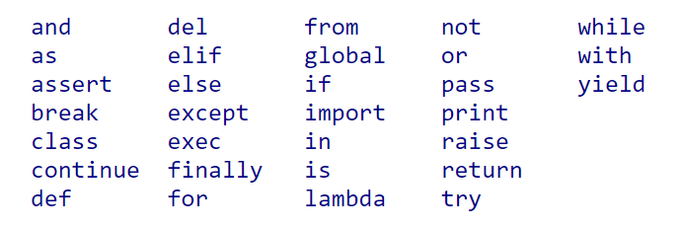
Python Keywords

Slide 5
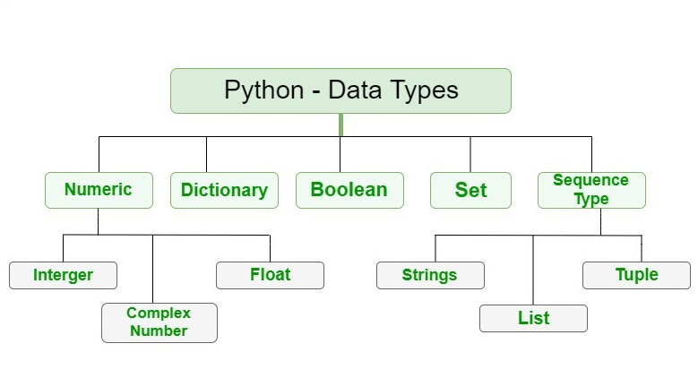
Datatypes in Python

Slide 6
Primitive datatypes in python
Datatype | Key word
Integer | int
Float | float
String | str
Boolean | bool
Complex numbers | complex

Slide 7
Arithmetic Operators
Operator | Name | Example
+ | Addition | x + y
- | Subtraction | x - y
* | Multiplication | x * y
/ | Division | x / y
% | Modulus | x % y
** | Exponentiation | x ** y
// | Floor division | x // y

Slide 8
Assignment Operators
Operator | Example | Same As
= | x = 5 | x = 5
+= | x += 3 | x = x + 3
-= | x -= 3 | x = x - 3
*= | x *= 3 | x = x * 3
/= | x /= 3 | x = x / 3
%= | x %= 3 | x = x % 3
//= | x //= 3 | x = x // 3
**= | x **= 3 | x = x ** 3

Slide 9
Comparison operators
Operator | Name | Example
== | Equal | x == y
!= | Not equal | x != y
> | Greater than | x > y
< | Less than | x < y
>= | Greater than or equal to | x >= y
<= | Less than or equal to | x <= y

Slide 10
Logical Operators
Operator | Description | Example
and | Returns True if both statements are true | x < 5 and x < 10
or | Returns True if one of the statements is true | x < 5 or x < 4
not | Reverse the result, returns False if the result is true | not(x < 5 and x < 10)

Slide 11
Identity Operators
Operator | Description | Example
is | Returns True if both variables are the same object | x is y
is not | Returns True if both variables are not the same object | x is not y

Slide 12
Membership Operators
Operator | Description | Example
in | Returns True if a sequence with the specified value is present in the object | x in y
not in | Returns True if a sequence with the specified value is not present in the object | x not in y

Slide 13
Bitwise Operators
Operator | Name | Description | Example
& | AND | Sets each bit to 1 if both bits are 1 | x & y
| | OR | Sets each bit to 1 if one of two bits is 1 | x | y
^ | XOR | Sets each bit to 1 if only one of two bits is 1 | x ^ y
~ | NOT | Inverts all the bits | ~x

Slide 14
Casting
Syntax:
<variable> = <datatype>(<value>)
To int
To float
To string

Slide 15
Input Statement
Syntax :
<Variable> = input(<message>)

