Slide 1
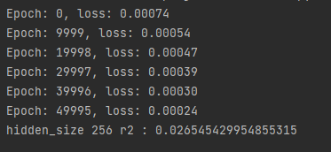
Step size = 65
binary
Step size = 5

