Slide 1
CS203 – Object Oriented Programming
Lab 6
Professor : Mahmut Unan – UAB CS

Slide 2
Agenda
CS-203
File I/O

Slide 3

Reading and Writing Text Files - Reading
Use Scanner class for reading text ﬁles
To read from a disk ﬁle:
Construct a File object representing the input ﬁle
Use this File object to construct a Scanner object:
Use the Scanner methods to read data from ﬁle e.g., next, nextInt, and nextDouble

Slide 4

A loop to process numbers in the input ﬁle:

Slide 5
Writing
To write to a ﬁle, construct a PrintWriter object:
PrintWriter out = new PrintWriter("output.txt");

Slide 6
Writing
To write to a ﬁle, construct a PrintWriter object:
PrintWriter out = new PrintWriter("output.txt");
If ﬁle exists, it is emptied before the new data are written into it. Otherwise, an empty ﬁle is created.

Slide 7
Writing
To write to a ﬁle, construct a PrintWriter object:
PrintWriter out = new PrintWriter("output.txt");
If ﬁle exists, it is emptied before the new data are written into it. Otherwise, an empty ﬁle is created.
Use printf and println to write into a PrintWriter:
out.println("Hello, World!");
out.printf("Total: %8.2f\n", total);

Slide 8
Writing
You must close a ﬁle when you are done processing it (in finally block!):
in.close();
out.close();
Otherwise, not all of the output may be written to the disk ﬁle.

Slide 9
Question
Read a ﬁle containing numbers
Write the numbers in a column followed by their total

Slide 10
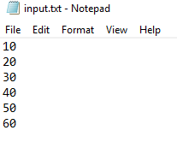
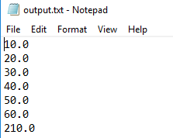

Slide 11
