Slide 1
int main()
{
int n = 100;
int& r = n;
n = 42;
cout << r << endl;
r = 100;
cout << n << endl;
}
n
100

Slide 2
int main()
{
int n = 100;
int& r = n;
n = 42;
cout << r << endl;
r = 100;
cout << n << endl;
}
0x1000
n
100
r

Slide 3
int main()
{
int n = 100;
int* p = &n;
n = 42;
cout << *p << endl;
*p = 100;
cout << n << endl;
}
0x1000
n
100
0x2000
p
0x1000

Slide 4
void Increment1(int x)
{
++x;
}
int main()
{
int x = 10;
Increment1(x);
cout << x << endl;
}
Increment1
x
10
main
값 복사
0x1000
x
10

Slide 5
void Increment2(int* px)
{
++(*px);
}
int main()
{
int x = 10;
Increment2(&x);
cout << x << endl;
}
Increment2
px
0x1000
main
주소 전달
주소 참조
0x1000
x
11

Slide 6
void Increment3(int& rx)
{
++rx;
}
int main()
{
int x = 10;
Increment3(x);
cout << x << endl;
}
Increment3
rx
새로운 이름 부여
main
0x1000
x
11

Slide 7
class Point {
int x;
int y;
public:
void Set(int a, int b)
{
x = a;
y = b;
}
};
int main()
{
Point pt1, pt2;
pt1.Set(10, 20);
// Point::Set(&pt1, 10, 20)
pt2.Set(100, 200);
// Point::Set(&pt2, 100, 200)
}
void Point::Set(Point* this, int a, int b)
{
this->x = a;
this->y = b;
}
pt1
pt2
x
x
y
y

Slide 8
class Point {
int x;
int y;
public:
void Set(int a, int b)
{
x = a;
y = b;
}
};
int main()
{
Point pt1, pt2;
pt1.Set(10, 20);
// Point::Set(&pt1, 10, 20)
pt2.Set(100, 200);
// Point::Set(&pt2, 100, 200)
}
void Point::Set(Point* this, int a, int b)
{
this->x = a;
this->y = b;
}
pt1
pt2
x
10
x
y
20
y

Slide 9
class Point {
int x;
int y;
public:
void Set(int a, int b)
{
x = a;
y = b;
}
};
int main()
{
Point pt1, pt2;
pt1.Set(10, 20);
// Point::Set(&pt1, 10, 20)
pt2.Set(100, 200);
// Point::Set(&pt2, 100, 200)
}
void Point::Set(Point* this, int a, int b)
{
this->x = a;
this->y = b;
}
pt1
pt2
x
10
x
100
y
20
y
200

Slide 10
User(const char* s, int n)
: age(n)
{
name = new char[strlen(s) + 1];
strcpy(name, s);
}
int main()
{
User user1 { "Tom", 42 };
user1.Print();
User other = user1;
other.Print();
}
0x1000
user1
“Tom”
name
0x1000
age
42

Slide 11
User(const char* s, int n)
: age(n)
{
name = new char[strlen(s) + 1];
strcpy(name, s);
}
int main()
{
User user1 { "Tom", 42 };
user1.Print();
User other = user1;
other.Print();
}
0x1000
user1
“Tom”
name
0x1000
age
42
other
name
0x1000
age
42

Slide 12
~User()
{
delete[] name;
}
int main()
{
User user1 { "Tom", 42 };
user1.Print();
User other = user1;
other.Print();
}
0x1000
user1
“Tom”
name
0x1000
age
42
Dangling Pointer 문제
other
name
0x1000
age
42

Slide 13
~User()
{
delete[] name;
}
int main()
{
User user1 { "Tom", 42 };
user1.Print();
User other = user1;
other.Print();
}
0x1000
“Tom”
other
name
0x1000
age
42

Slide 14
0x1000
User(const User& rhs)
: age { rhs.age }
{
name = new char[strlen(rhs.name) + 1];
strcpy(name, rhs.name);
}
user1
“Tom”
name
0x1000
age
42
0x2000
“Tom”
other
name
0x2000
age
42

Slide 15
0x1000
User(const char* s, int n)
: age(n)
{
name = new char[strlen(s) + 1];
strcpy(name, s);
ref = new int { 1 };
}
user1
“Tom”
name
0x1000
age
42
1
ref

Slide 16
0x1000
User(const User& rhs)
: name { rhs.name }
, age { rhs.age }
, ref { rhs.ref }
{
++(*ref); // 참조 계수 증가!
}
user1
“Tom”
name
0x1000
age
42
2
ref
other
name
0x1000
age
42
ref

Slide 17
0x1000
User(const User& rhs)
: name { rhs.name }
, age { rhs.age }
, ref { rhs.ref }
{
++(*ref); // 참조 계수 증가!
}
user1
“Tom”
name
0x1000
age
42
ref
3
other
name
0x1000
age
42
ref
other
name
0x1000
age
42
ref

Slide 18
0x1000
~User()
{
if (--(*ref) == 0) {
delete[] name;
delete ref;
}
}
user1
“Tom”
name
0x1000
age
42
ref
2
other
name
0x1000
age
42
ref
other
name
0x1000
age
42
ref

Slide 19
0x1000
~User()
{
if (--(*ref) == 0) {
delete[] name;
delete ref;
}
}
user1
“Tom”
name
0x1000
age
42
ref
1
other
name
0x1000
age
42
ref

Slide 20
0x1000
~User()
{
if (--(*ref) == 0) {
delete[] name;
delete ref;
}
}
user1
“Tom”
name
0x1000
age
42
ref
0

Slide 21
0x1000
User(const User& rhs)
: age { rhs.age }
{
name = new char[strlen(rhs.name) + 1];
strcpy(name, rhs.name);
}
user1
“Tom”
name
0x1000
age
42
0x2000
“Tom”
other
name
0x2000
age
42

Slide 22
0x1000
User(const User& rhs)
: age { rhs.age }
{
name = new char[strlen(rhs.name) + 1];
strcpy(name, rhs.name);
}
임시객체
“Tom”
name
null
age
42
other
name
age
42

Slide 23
class Point {
// 멤버 데이터: 객체 상태
int x;
int y;
// 정적 멤버 데이터: 클래스 상태
static int count;
};
int Point::count = 0;
Point::count
2
pt1
pt2
x
10
x
100
y
20
y
200

Slide 24
class Dog {
int age;
string name;
};
class Cat {
int age;
int speed;
};
Dog d
Cat c
age
age
name
speed

Slide 25
class Animal {
int age;
};
class Dog : public Animal {
string name;
};
class Cat : public Animal {
int speed;
};
Dog d
Cat c
age
Animal
age
Animal
name
speed

Slide 26
class Shape {
int x;
int y;
};
class Rect : public Shape {
int width;
int height;
};
int main()
{
Shape s;
Rect r;
}
Shape s
Rect r
x
x
y
y
width
height

Slide 27
class Shape {
int x;
int y;
public:
virtual void Draw() const {}
};
class Rect : public Shape {
int width;
int height;
};
int main()
{
Shape s;
Rect r;
}
Shape s
Shape VFT
vfptr
Shape::Draw
x
Shape s
y
vfptr
x
y
Rect VFT
Shape::Draw
Rect r
vfptr
x
y
width
height

Slide 28
class Shape {
int x;
int y;
public:
virtual void Draw() const {}
virtual void Move() {}
};
class Rect : public Shape {
int width;
int height;
};
int main()
{
Shape s;
Rect r;
}
Shape s
Shape VFT
vfptr
Shape::Draw
x
Shape s
Shape::Move
y
vfptr
x
y
Rect VFT
Shape::Draw
Rect r
Shape::Move
vfptr
x
y
width
height

Slide 29
class Shape {
int x;
int y;
public:
virtual void Draw() const {}
virtual void Move() {}
};
class Rect : public Shape {
int width;
int height;
public:
void Move() override {}
};
int main()
{
Shape s;
Rect r;
Shape* p = &s;
p->Move();
p = &r;
p->Move();
}
Shape s
Shape VFT
vfptr
Shape::Draw
x
Shape s
Shape::Move
y
vfptr
x
y
Rect VFT
Shape::Draw
Rect r
Rect::Move
vfptr
x
y
width
height

Slide 30
class Shape {
int x;
int y;
public:
virtual void Draw() const {}
virtual void Move() {}
};
class Rect : public Shape {
int width;
int height;
public:
void Move() override {}
};
int main()
{
Shape s;
Rect r;
Shape* p = &s;
p->Move();
p = &r;
p->Move();
}
Shape s
Shape VFT
vfptr
Shape::Draw
x
Shape::Move
y
Shape*p
Rect VFT
Shape::Draw
Rect r
Rect::Move
vfptr
x
y
width
height

Slide 31
class Shape {
int x;
int y;
public:
virtual void Draw() const {}
virtual void Move() {}
};
class Rect : public Shape {
int width;
int height;
public:
void Move() override {}
};
int main()
{
Shape s;
Rect r;
Shape* p = &s;
p->Move();
// (p->vfptr[1])(p);
p = &r;
p->Move();
}
Shape s
Shape VFT
vfptr
Shape::Draw
x
Shape::Move
y
Shape*p
Rect VFT
Shape::Draw
Rect r
Rect::Move
vfptr
x
y
width
height

Slide 32
class Shape {
int x;
int y;
public:
virtual void Draw() const {}
virtual void Move() {}
};
class Rect : public Shape {
int width;
int height;
public:
void Move() override {}
};
int main()
{
Shape s;
Rect r;
Shape* p = &r;
p->Move();
// (p->vfptr[1])(p);
}
Shape s
Shape VFT
vfptr
Shape::Draw
x
Shape::Move
y
Shape*p
Rect VFT
Shape::Draw
Rect r
Rect::Move
vfptr
x
y
width
height

Slide 33
10
1
2
3
0
2
1

Slide 34

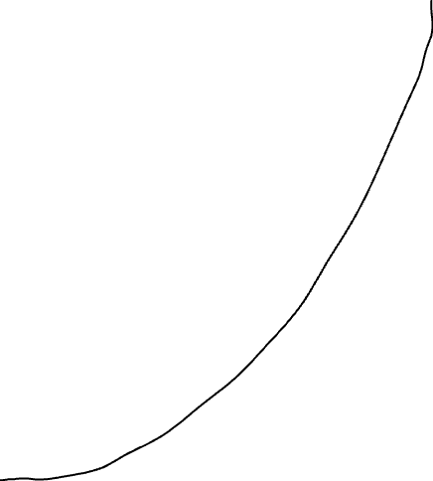
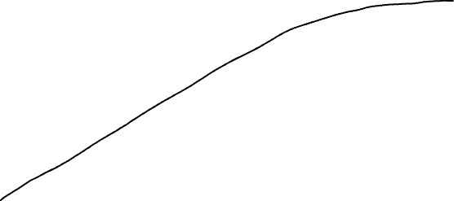
시간
데이터 개수

