Slide 1
第一次培训
html + css
jex

Slide 2
几个概念
http://validator.w3.org
The World Wide Web Consortium http://www.w3.org/html/
HyperText Markup Language
Cascading Style Sheets
jex

Slide 3
tag
tag
opening and closing tags
<head></head>
<body></body>
stand-alone tag
<br/>
<hr/>
<input/>
<img/>
<h1></h1>
<u></u> underline
<b></b> bold
<i></i> italics
<em></em>
<p></p> & <span></span>
<pre></pre>
jex

Slide 4
Phrase Elements
Element | Example | Usage
<b> | bold text | Text that has no extra importance but is styled in bold font by usage and convention
<em> | emphasized text | Causes text to be emphasized in relation to other text; usually displayed in italics
<i> | italicized text | Text that has no extra importance but is styled in italics by usage and convention
<mark> | mark text | Text that is highlighted in order to be easily referenced (HTML5 only)
<small> | small text | Legal disclaimers and notices (“fine print”) displayed in small font-size
<strong> | strong text | Strong importance; causes text to stand out from surrounding text; usually displayed in bold
<sub> | _{sub} text | Displays a subscript as small text below the baseline
<sup> | ^{sup} text | Displays a superscript as small text above the baseline
jex

Slide 5
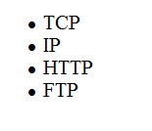
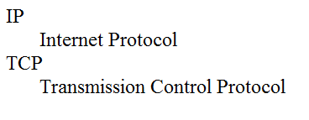
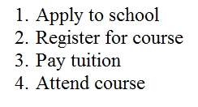
Unordered List
ordered List
<ul>
<li>TCP</li>
<li>IP</li>
<li>HTTP</li>
<li>FTP</li>
</ul>
<ol>
<li>Apply to school</li>
<li>Register for course</li>
<li>Pay tuition</li>
<li>Attend course</li>
</ol>
<dl>
<dt>IP</dt>
<dd>Internet Protocol</dd>
<dt>TCP</dt>
<dd>Transmission Control Protocol</dd>
</dl>
description list
jex

Slide 6
sample
<!DOCTYPE html> <!-- DOCumentTYPE -->
<html lang="en"> <!-- language = “english” -->
<head>
<title>Lab</title>
<meta charset="utf-8">
<link rel="stylesheet" type="text/css" href="../css/lab.css">
<link rel="icon" href="picture.ico" type="image/x-icon"/>
</head>
<body>
<header>HEAD</header><div>DIV</div><footer>FOOTER</footer>
</body> </html>
jex

Slide 7
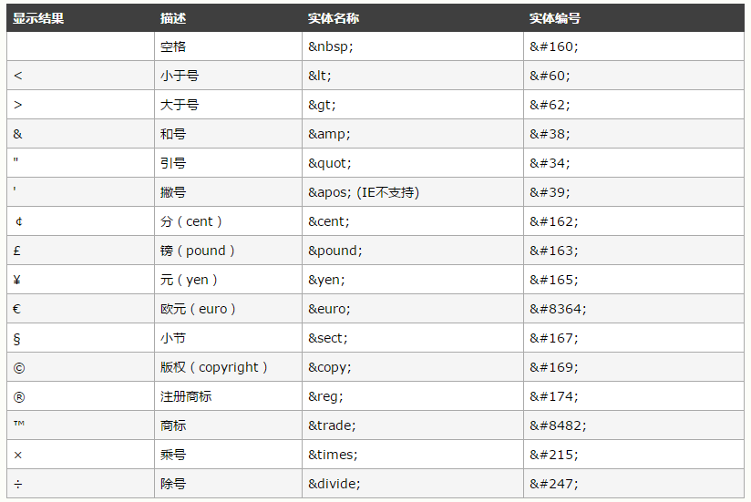
字符实体
jex

Slide 8
div
jex

Slide 9
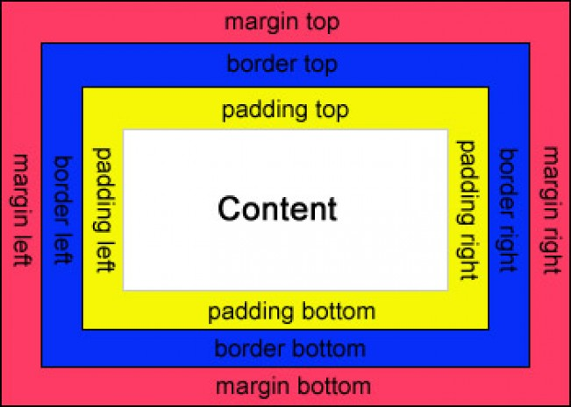
margin & padding & boder
margin 两个标签的距离
padding 标签内部,边界和内容的距离
boder 边框
eg.整个标签大小40px * 40 px, 设置boder = 20px后, 整个 = 60px * 60px, 内容还是 40px * 40px;
上右下左
eg. margin : 5px 6px 7px 8px;
margin-top : 5px; margin-left : 6px; ...
jex

Slide 10
css
selector{ property : value;} // html element , class, id
body{ color : blue;
background-color: grey;
height: 800px;
width: 80%} color : 0-255 , 16进制 , #0000FF blue
a:hover{
font-size: 20px;
border-bottom: 3px solid pink;}
background-color & color & font-family & font-size &font-style &font-weight & line-height & margin & text-align & text-decoration & width
<style>
body { background-color: #000000;
color: #FFFFFF;
}
</style>
jex

Slide 11
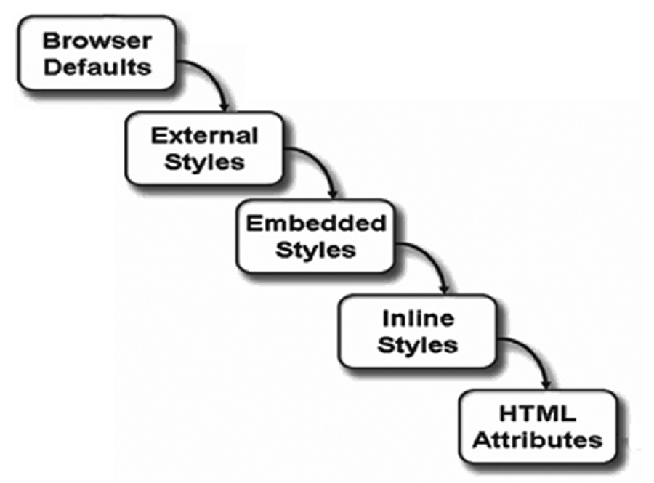
jex

Slide 12
http://jigsaw.w3.org/css-validator/
jex

Slide 13
<p style = “3
<head>
<style>2</style>
</head>
==
div{ 1 }
browser 5
jex

Slide 14
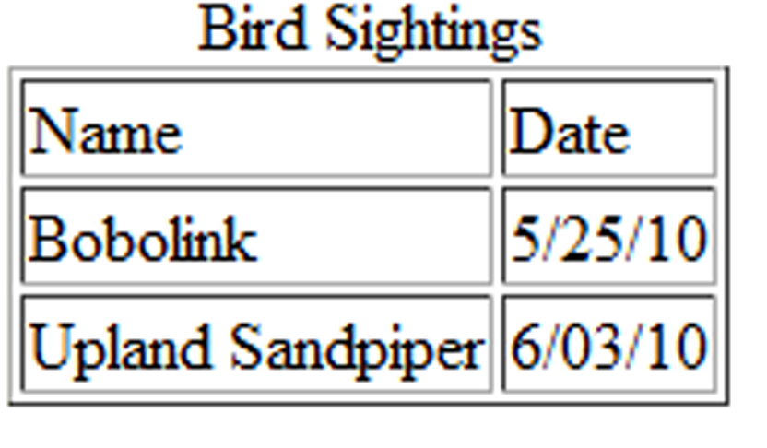
HTML Table Elements
<table> Contains the table
<tr> Contains a table row
<td> Contains a table cell
<caption> Configures a description of the table
<th> Element Contains a table header cell
jex

Slide 15
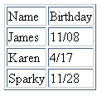
HTML Table Example
<table border="1"> <caption>Birthday List</caption>
<tr>
<td>Name</td>
<td>Birthday</td>
</tr>
<tr>
<td>James</td>
<td>11/08</td>
</tr>
<tr>
<td>Karen</td>
<td>4/17</td>
</tr>
<tr>
<td>Sparky</td>
<td>11/28</td>
</tr>
</table>
Birthday List
jex

Slide 16
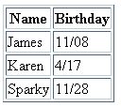
HTML Table Example 2
<table border="1">
<tr>
<th>Name</th>
<th>Birthday</th>
</tr>
<tr>
<td>James</td>
<td>11/08</td>
</tr>
<tr>
<td>Karen</td>
<td>4/17</td>
</tr>
<tr>
<td>Sparky</td>
<td>11/28</td>
</tr>
</table>
Using the <th> Element
jex

Slide 17
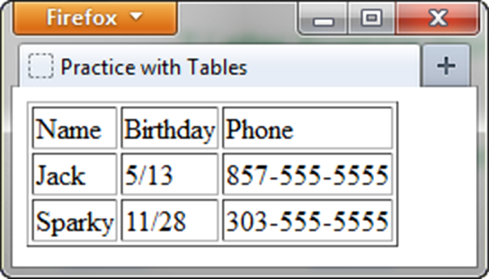
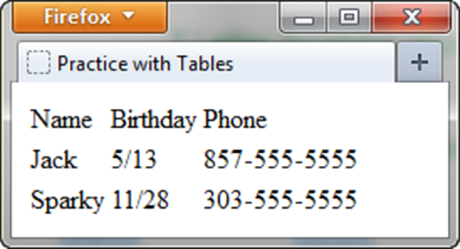
HTML border Attribute
Indicates the table is specifically not used for page layout
Optional
border=“1” Visible browser default border
border=“” No visible browser default border.
jex

Slide 18

HTML colspan Attribute
<table border="1">
<tr>
<td colspan=“2”> Birthday List</td>
</tr>
<tr>
<td>James</td>
<td>11/08</td>
</tr>
<tr>
<td>Karen</td>
<td>4/17</td>
</tr>
</table>
jex

Slide 19
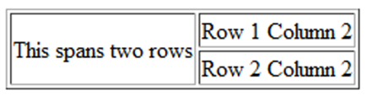
HTML rowspan Attribute
<table border="1"> <tr> <td rowspan="2">This spans two rows</td> <td>Row 1 Column 2</td> </tr> <tr> <td>Row 2 Column 2</td> </tr> </table>
jex

Slide 20
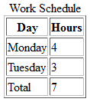
Accessibility: headers & id Attributes
<table>
<caption> Word Schedule</caption>
<tr>
<th id="day">Day</th>
<th id="hours">Hours</th>
</tr>
<tr>
<td headers="day">Monday</td>
<td headers="hours">4</td>
</tr>
<tr>
<td headers="day">Tuesday</td>
<td headers="hours">3</td>
</tr>
<tr>
<td headers="day">Total</td>
<td headers="hours">7</td>
</tr>
</table>
jex

Slide 21
Using CSS to Style a Table
HTML Attribute | CSS Property
align | Align a table: table { width: 75%; margin: auto; } Align within a table cell: text-align
bgcolor | background-color
cellpadding | padding
cellspacing | border-spacing or border-collapse
height | height
valign | vertical-align
width | width
border | border, border-style, or border-spacing
--- | background-image
--- | caption-side
jex

Slide 22
Table Row Groups
<table>
<caption>Work Schedule</caption>
<thead>
<tr>
<th>Day</th>
<th>Hours</th>
</tr>
</thead>
<tbody>
<tr>
<td>Monday</td>
<td>4</td>
</tr>
<tr>
<td>Tuesday</td>
<td>3</td>
</tr>
</tbody>
<tfoot>
<tr>
<td>Total</td>
<td>7</td>
</tr>
</tfoot>
</table>
<thead> table head rows
<tbody > table body rows
<tfoot> table footer rows
jex

Slide 23
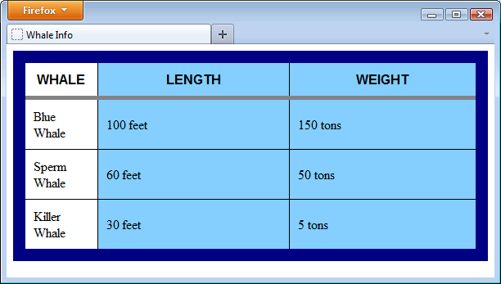
Tables - add'l context tags
<table>
<thead>
<tr>
<th>Whale</th>
<th>Length</th>
<th>Weight</th>
</tr>
</thead>
<tbody>
<tr>
<td>Blue Whale</td>
<td>100 feet</td>
<td>150 tons</td>
</tr>
...
</tbody>
</table>
<style>
table {
border: 15px solid navy;
border-collapse: collapse;
}
th, td {
border: 1px solid black;
padding:10px;
}
thead {
font-family:sans-serif, arial;
text-transform:uppercase;
border:5px solid gray
}
</style>
jex

Slide 24
Tables - colgroup
<style>
.whaleinfo {background-color:LightSkyBlue; width: 300px}
.whale {width:100px}
...
</style>
<table>
<colgroup>
<col class="whale"></col>
<col class="whaleinfo"></col>
<col class="whaleinfo"></col>
<colgroup>
...
jex

Slide 25
HTML Using Forms
<form> tag
Contains the form elements on a web page
Container tag
<input> tag
Configures a variety of form elements including text boxes, radio buttons, check boxes, and buttons
Stand alone tag
<textarea> tag
Configures a scrolling text box
Container tag
<select> tag
Configures a select box (drop down list)
Container tag
<option> tag
Configures an option in the select box
Container tag
jex

Slide 26
The Form Element <form>
Container Tag
The form element attributes:
action
Specifies the server-side program or script that will process your form data
method
get – default value, form data passed in URL
post – more secure, form data passed in HTTP Entity Body
name
Identifies the form
id
Identifies the form
jex

Slide 27

The Input Element Text Box <input>
Accepts text information
Common Attributes:
type=“text”
name
id
size
maxlength
value
required (HTML5)
placeholder (HTML5)
jex

Slide 28

The Input Element Password Box <input>
Accepts text information that needs to be hidden as it is entered
Common Attributes:
type=“password”
name
id
size
maxlength
value
required (HTML5)
placeholder (HTML5)
jex

Slide 29
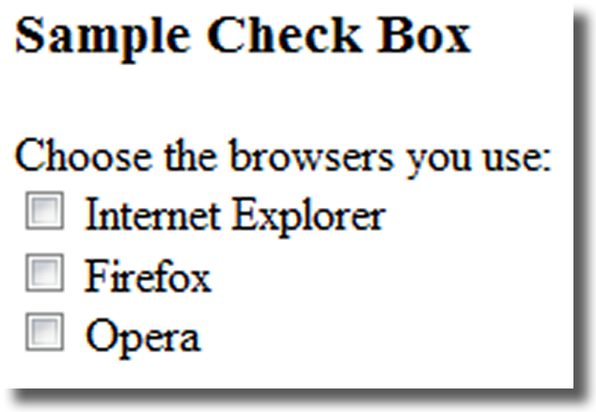
The Input Element Check box <input>
Allows the user to select one or more of a group of predetermined items
Common Attributes:
type=“checkbox”
name
id
checked
value
jex

Slide 30
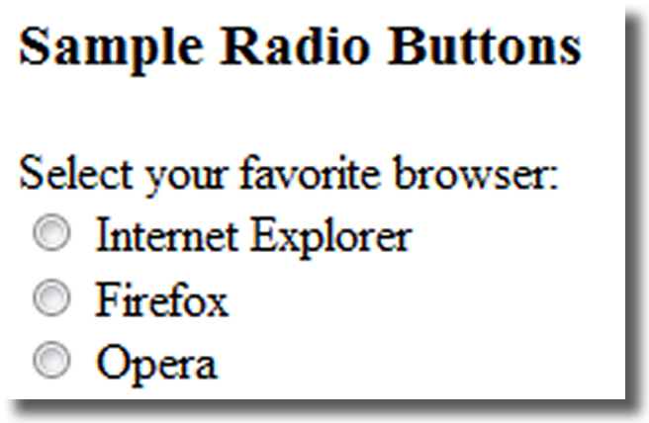
The Input Element Radio Button <input>
Allows the user to select exactly one from a group of predetermined items
Each radio button in a group is given the same name and a unique value
Comon Attributes:
type=“radio”
name
id
checked
value
jex

Slide 31
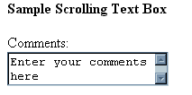
The Textarea Element <textarea>
Configures a scrolling text box
Common Attributes:
name
id
cols
rows
jex

Slide 32

The Select Element <select>
Configures a select list (along with <option> tags)
Also known as: Select Box, Drop-Down List, Drop-Down Box, and Option Box.
Allows the user to select one or more items from a list of predetermined choices.
Common Attributes:
name
id
size
multiple
jex

Slide 33
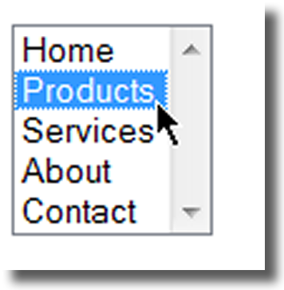
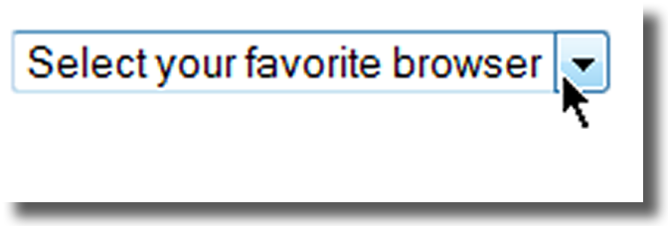
The Option Element <option>
Configures the options in a Select List
Attributes:
value
selected
jex

Slide 34
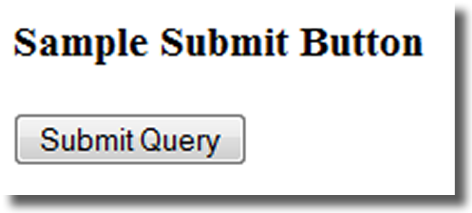
The Input Element Submit Button <input>
Submits the form information
When clicked:
Triggers the action method on the <form> tag
Sends the form data (the name=value pair for each form element) to the web server.
Attributes:
type=“submit”
name
id
value
jex

Slide 35
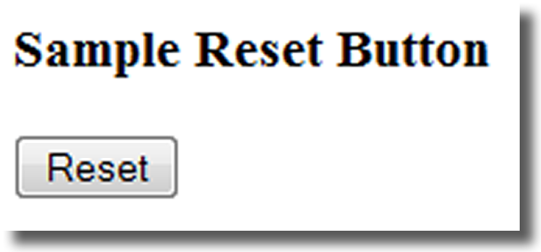
The Input Element Reset Button <input>
Resets the form fields to their initial values
Attributes:
type=“reset”
name
id
value
jex

Slide 36
The Input Element Hidden Field <input>
This form control is not displayed on the Web page.
Hidden form fields
Can be accessed by both client-side and server-side scripting
Common Attributes:
type=“hidden”
name
id
value
jex

Slide 37
The Label Element <label>
Associates a text label with a form control
Two Different Formats: <label>Email: <input type="text" name="CustEmail" id ="CustEmail"></label>
Or <label for="email">Email: </label> <input type="text" name="CustEmail" id= "email" />
jex

Slide 38
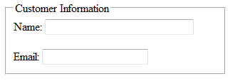
The Fieldset & Legend Elements
The Fieldset Element <fieldset>
Container tag
Creates a visual group of form controls on a web page
The Legend Element <legend>
Container tag
Creates a text label within the fieldset
<fieldset><legend>Customer Information</legend>
<label>Name: <input type="text" name="CName" id="CName" size="30"></label> <br><br >
<label>Email: <input type="text" name="CEmail" id="CEmail"></label>
</fieldset>
jex

Slide 39
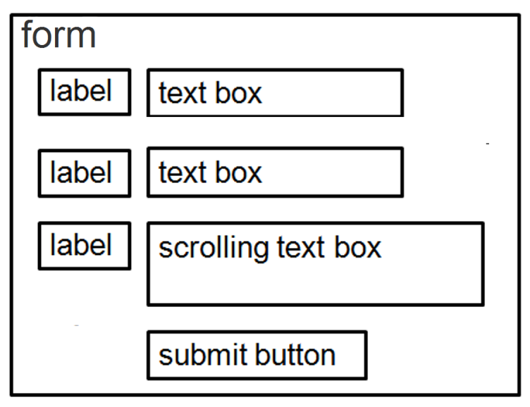
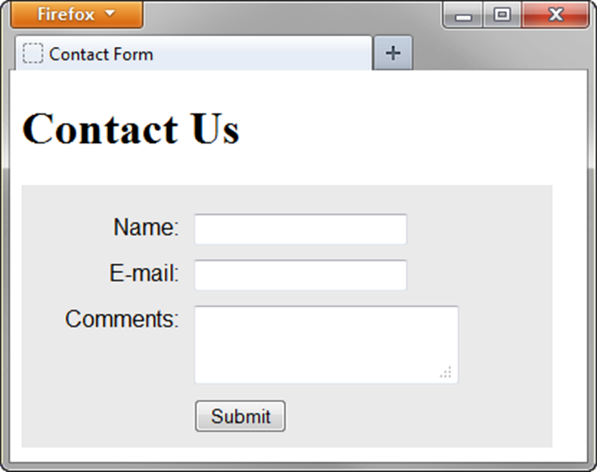
Using CSS to Style a Form
form { background-color:#eaeaea; font-family: Arial, sans-serif;
width: 350px; padding: 10px;}
label { float: left; clear: left; display: block; width: 100px;
text-align: right; padding-right: 10px; margin-top: 10px; }
input, textarea { margin-top: 10px; display: block;}
input[type= "submit"]{ margin-left: 110px; }
jex

Slide 40
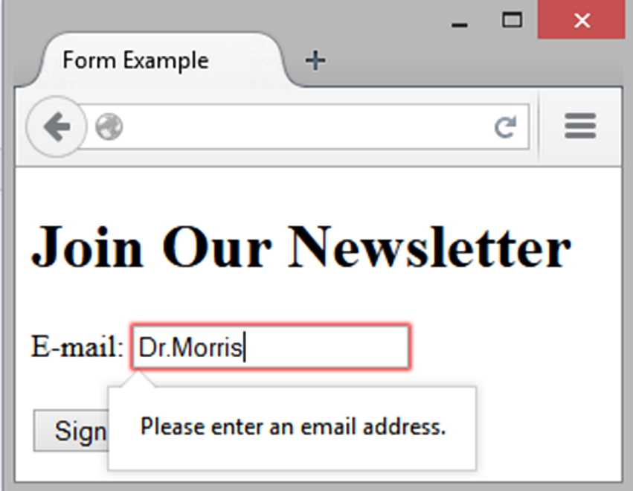
HTML5: Email Text Box <input>
Accepts text information in e-mail address format
Common Attributes:
type=“email”
name
id
size
maxlength
value
placeholder
required
jex

Slide 41
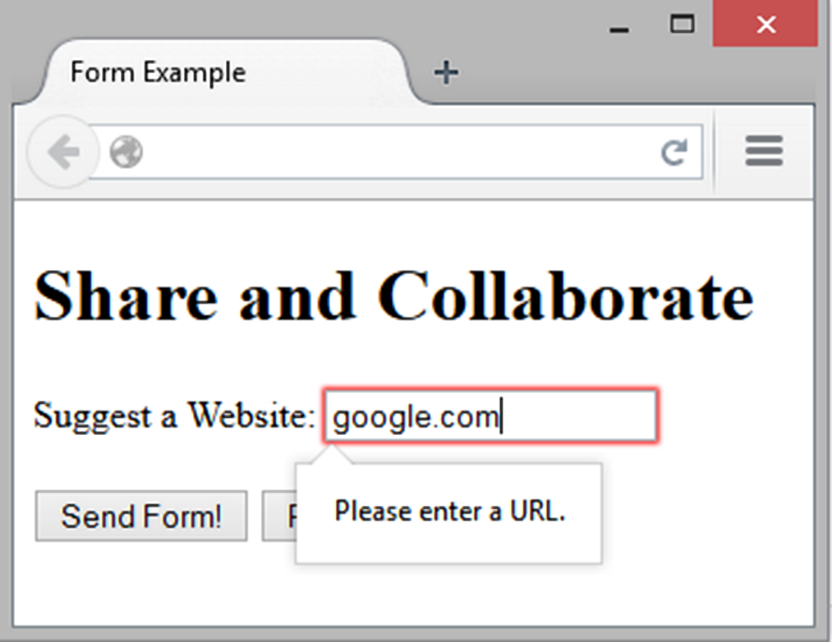
HTML5: URL Text Box <input>
Accepts text information in URL format
Common Attributes:
type=“url”
name
id
size
maxlength
value
placeholder
required
jex

Slide 42
HTML5: Telephone Number Text Box <input>
Accepts text information in telephone number format
Common Attributes:
type=“tel”
name
id
size
maxlength
value
placeholder
required
jex

Slide 43
HTML5: Search Text Box <input>
Accepts search terms
Common Attributes:
type=“search”
name
id
size
maxlength
value
placeholder
required
jex

Slide 44
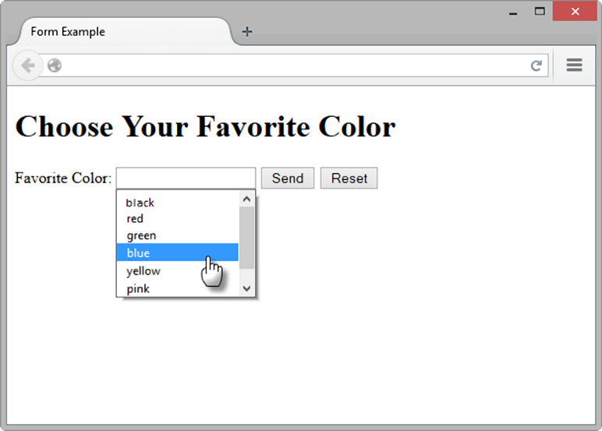
HTML5: Datalist Control
<label for="color">Favorite Color:</label> <input type="text" name="color" id="color" list="colors" >
<datalist id="colors">
<option value="red">
<option value="green">
<option value="blue">
<option value="yellow">
<option value="pink">
<option value="black">
</datalist>
jex

Slide 45
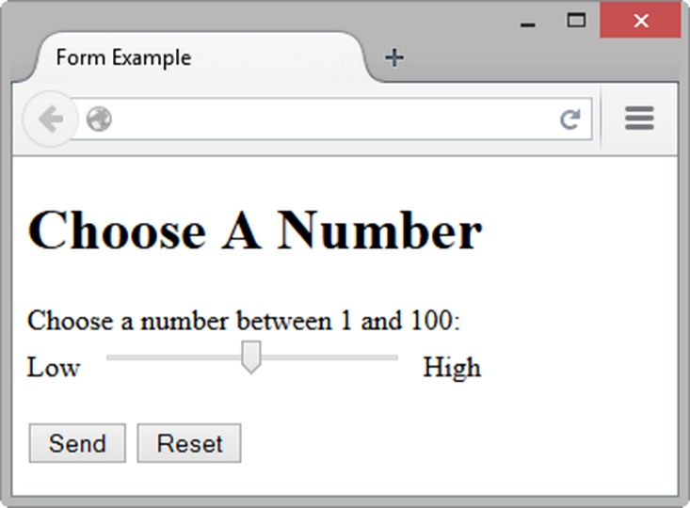
HTML5: Slider Control <input>
<label for="myChoice">
Choose a number between 1 and 100:</label><br>
Low <input type="range" name="myChoice" id="myChoice"> High
jex

Slide 46
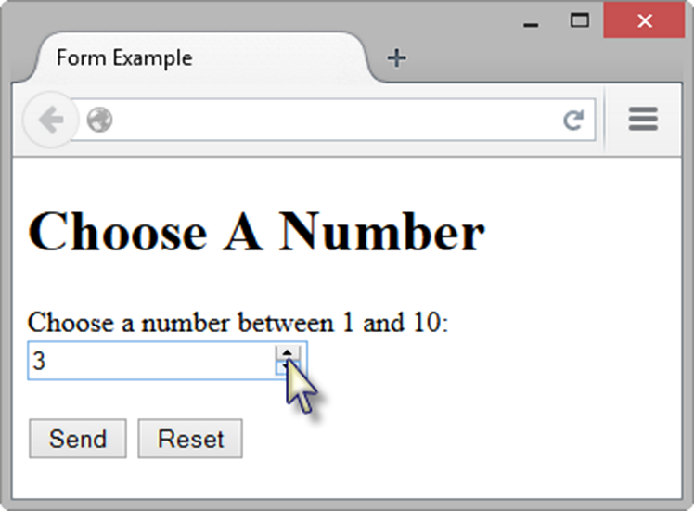
HTML5: Spinner Control <input>
<label for="myChoice">Choose a number between 1 and 10:</label> <input type="number" name="myChoice" id="myChoice"
min="1" max="10">
jex

Slide 47
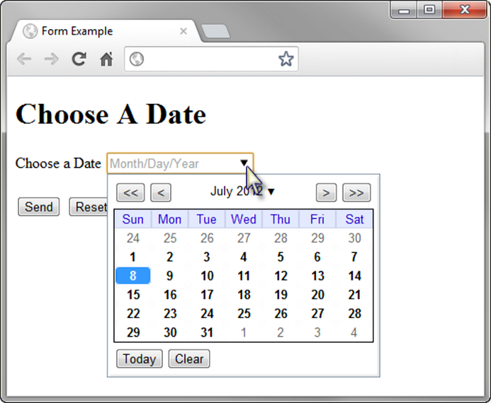
HTML5: Calendar Control <input>
<label for="myDate">Choose a Date</label> <input type="date" name="myDate" id="myDate">
jex

Slide 48
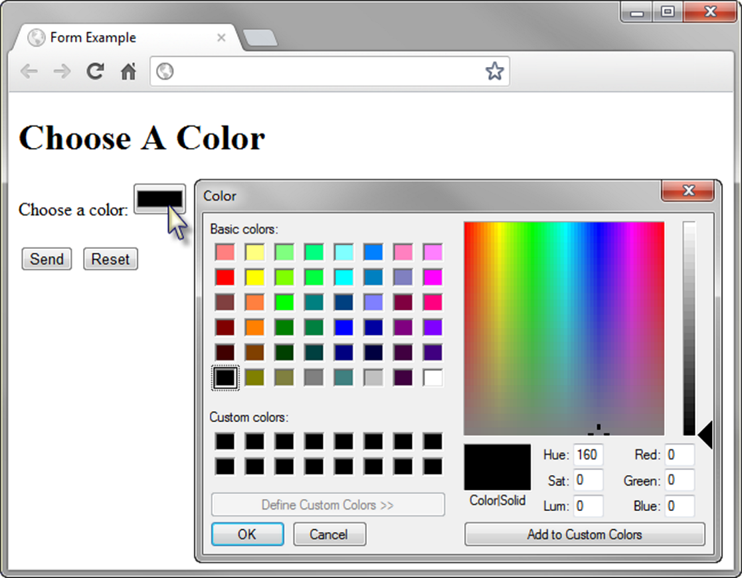
HTML5 Color-well Control
<label for="myColor">Choose a color:</label>
<input type="color" name="myColor" id="myColor">
jex

Slide 49
THANKS
jex

