Slide 1
PSU Weather Data Science Club
Meeting 2
April 8, 2021

Slide 2
Welcome!
Meeting agenda:
Review coding challenge #1
Interactive Git/GitHub tutorial
Introduce coding challenge #2
Reminder: sign up for a GitHub account to participate in the tutorial
If you do not have access to the JupyterLab server yet, send Karl your psu access id (xyz1234) via a zoom chat private message and I will add you prior to the tutorial
GroupMe link: https://groupme.com/join_group/62417485/ImOlt7rK
If you are not on the club ListServ and would like to be, please send Karl a private zoom chat message with your Penn State email address

Slide 3
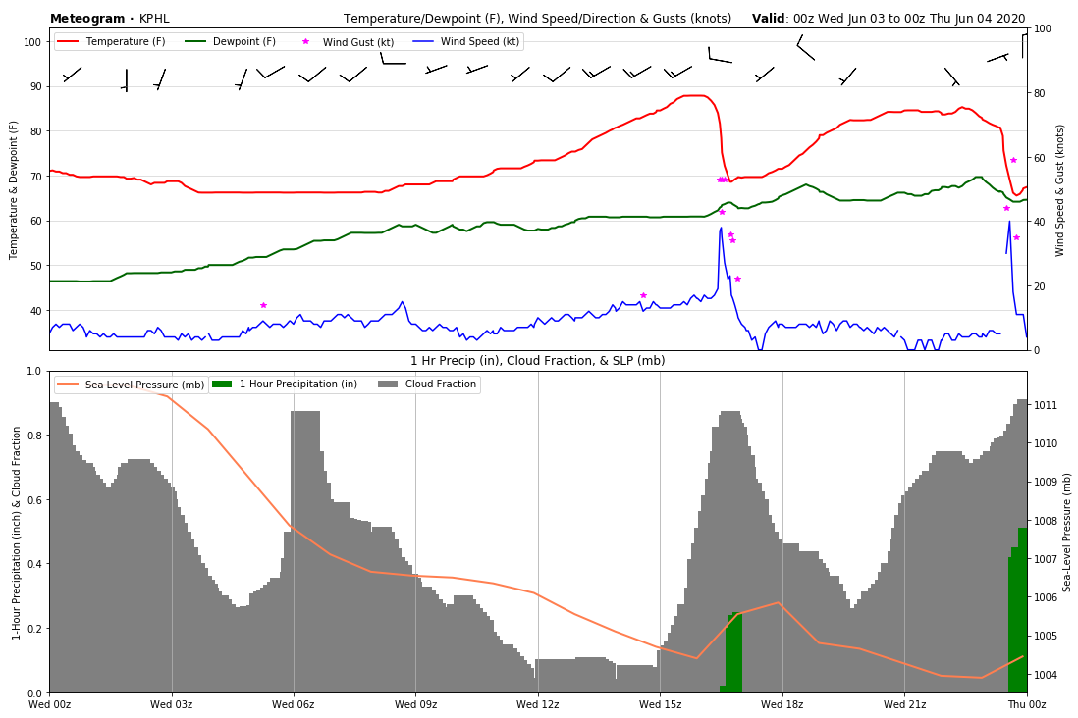
Coding Challenge #1 Review
Review progress on challenge 1
Grab screen share and show code on JupyterHub
1-2 min explanation of what you did
What worked well?
What did you struggle with?

Slide 4

GitHub Tutorial!
Tutorial is in the repository: https://github.com/karlwx/wxdatasci

Slide 5
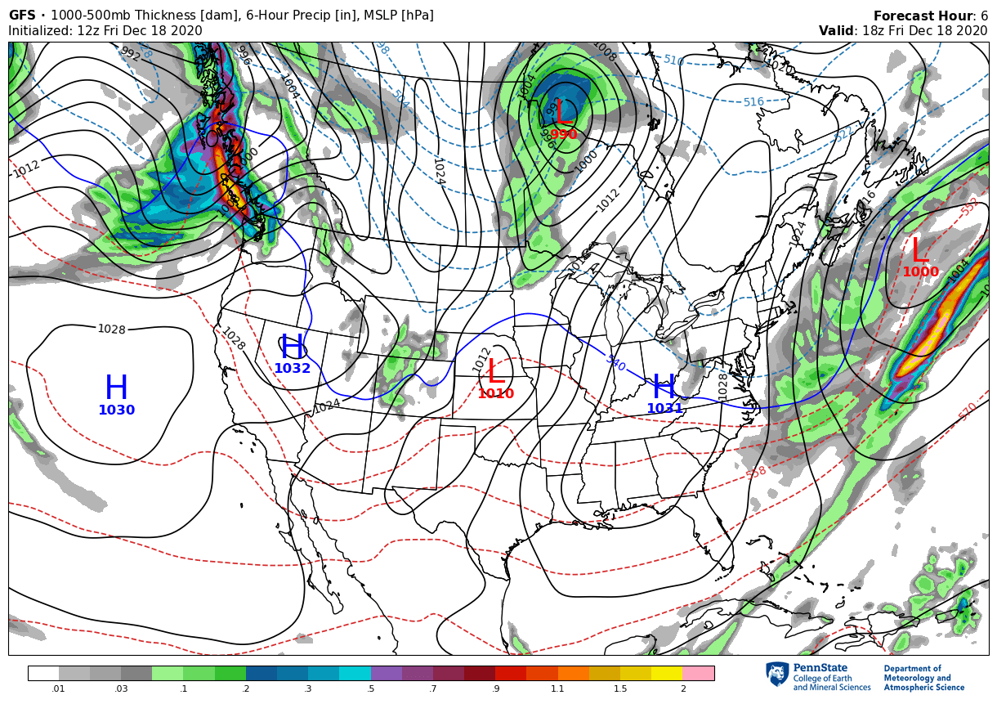
Coding Challenge! Weather Map
Learn to read and plot gridded weather data easily with xarray and cartopy (Python)
Work in a group or by yourself
Use our JupyterHub server, meteo linux, or your personal computer
We will review and discuss each group’s progress at our next meeting
Be creative!
Interest form: https://forms.gle/mDWEseX53QMaQ3Ma9

Slide 6
Accessing the JupyterLab Server
Go here: http://149.165.171.185/
Login with your Penn State access ID (without @psu.edu)
IMPORTANT: The first time you type your password when logging into the JupyterLab Server will be your permanent password
We will add you to the server as soon as possible! If you have issues logging in, please contact Karl: kps5442@psu.edu

Slide 7
What’s next?
Next meeting: Week of 4/26
Review progress on coding challenge 2
Live demo: setting up Python/Anaconda on your personal computer (?)
Suggestions for summer coding projects (e-Wall?)
GroupMe link (ask any questions about the coding challenge here!): https://groupme.com/join_group/62417485/ImOlt7rK
Expect a recap email soon!

