Slide 1

PSU Weather Data Science Club

Slide 2

Goals of the Club
Facilitating a mentor-mentee relationship for coding!
Help students develop useful coding skills!
Upgrade/maintain the PSU E-Wall

Slide 3

What you can gain from joining!
Useful coding skills for your future career, whether that is in the private industry, academia, or government
Knowledge in Python BEFORE taking METEO 473
Resume Builder by contributing to a project that is public viewable
Penn State E-Wall

Slide 4
Contributions you can make!
Many plots from E-Wall used in METEO courses
YOU can help make them easier to read!
The E-Wall was one of the first pages on the internet with NWP output!
YOU can set the standard for NWP pages on the internet.
Other popular pages nowadays: Tropical Tidbits, Pivotal Weather

Slide 5
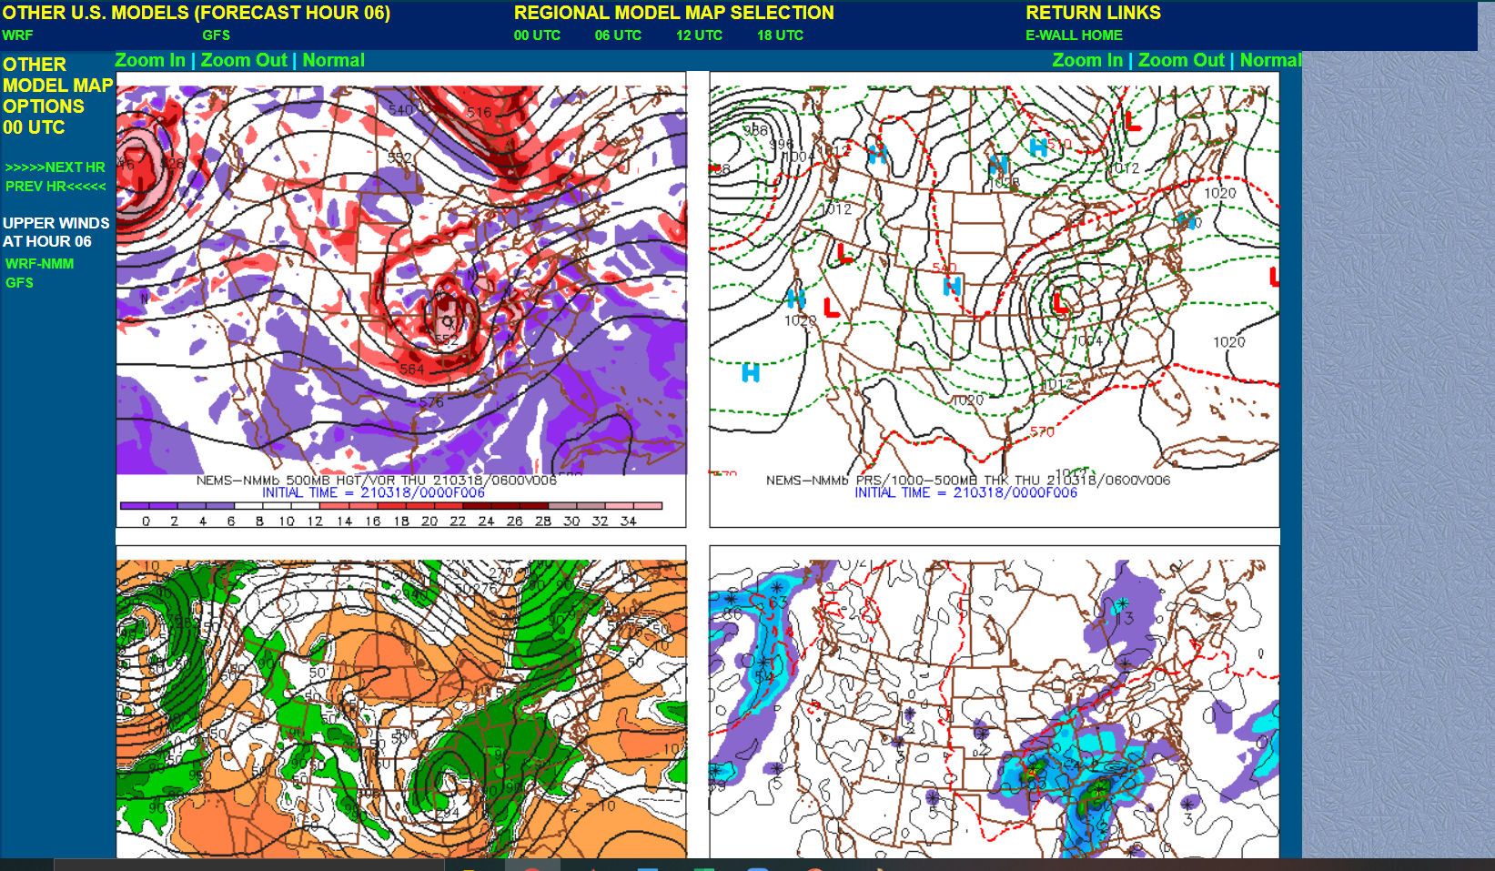
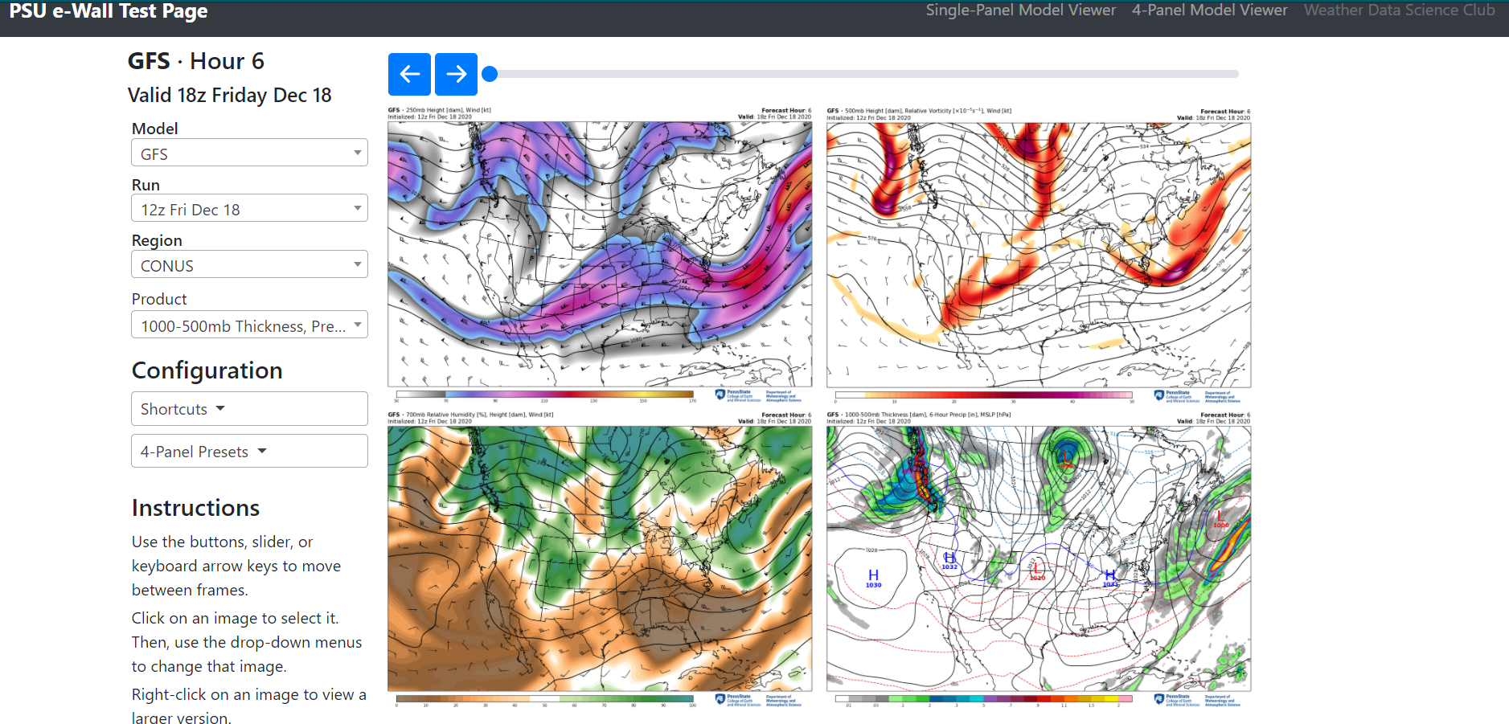
Transformation Example: 4 Panel Plot

Slide 6
First Meeting
Next Wednesday 3/24
6 PM-7PM
Please fill out interest form!
Interest Form: https://forms.gle/TMEgTcWcn9jRd3Sr5
Zoom link: https://psu.zoom.us/j/99203155710
Contact: Karl Schneider (Our Club’s Graduate Advisor)
Email: kps5442@psu.edu
Contact: Alvin Cheung (President)
Email: aac5510@psu.edu

