Slide 1



In Demand Jobs and Skills
Dontai Wilson
February 2023

Slide 2

OUTLINE
Executive Summary
Introduction
Methodology
Results
Visualization – Charts
Dashboard
Discussion
Findings & Implications
Conclusion
Appendix

Slide 3

EXECUTIVE SUMMARY
Our purpose was to collect data from various sources and identify trends for emerging skills and jobs
Collecting the top programming skills that are in demand from various sources such as:
Job Postings
Training Portals
Surveys
Taking the collected data from those sources and analyzing it for trends such as:
What are the top programming languages in demand?
What are the top database skills in demand?
What are popular IDE’s
Presenting my findings:
Can we see a trend with the data that’s been collected?
What Programming Languages do people wish/intend to learn?
What type of background do successful programmers have?
What will the future going to hold?

Slide 4

INTRODUCTION
With programming jobs and database skills in high demand, our company has been tasked with analyzing different sources and identifying emerging trends.
With the data that we’ve collected we are able to spot the trends of the showing the relationships of job postings, website data, and surveys to accurately show multiple points of interest.
Skills of interest form developers currently established
Programming Languages that are in demand from job postings
Data Base skills that are emerging as needed/wanted
Highest paid salaries of in demand languages and skills

Slide 5

METHODOLOGY
The methodology that we took in our approach to ethically analyzing the data:
Choosing reliable sources:
Job Postings from sources such as Git Hub
Extracting Data from websites such as programming language, and its average annual salary.
Reviewing and analyzing surveys filled out by software developers, pulling relevant information such as:
Current Job
Educational Background
Current Programming Skills
Desired Programming Skills
Current Salary
Plus more.
By going to trusted and recognized sites, and professionals we were able to analyze the data with the upmost confidence in our results.

Slide 6
RESULTS
Presenting my findings with simple graphics and explanations to provide answers regarding which programming languages and database skills are in demand.

Slide 7
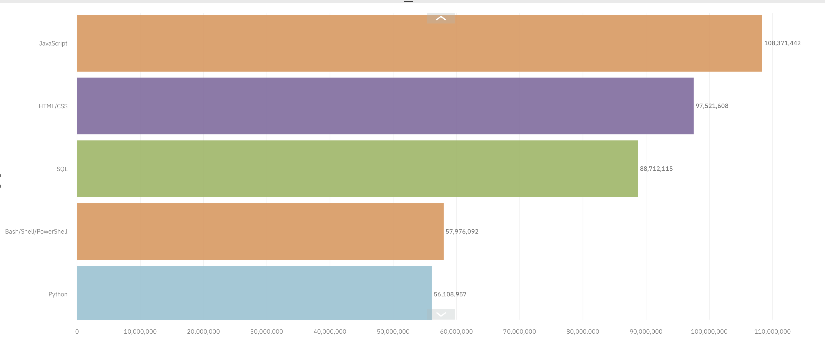
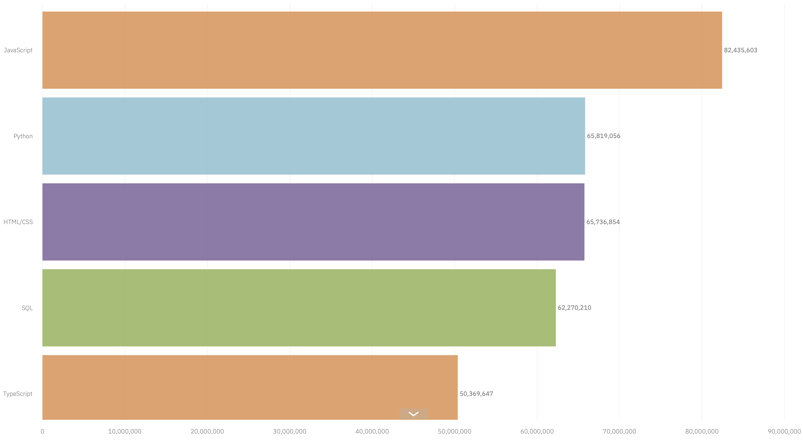
PROGRAMMING LANGUAGE TRENDS
Current Year Top 5
Next Year Top 5
<Bar chart of top 5 programming languages for the current year goes here.>
< Bar chart of top 5 programming languages for the next year goes here.>
Java
HTML/CSS
SQL
BASH SHELL/ POWER SHELL
PYTHON
Java
Python
HTML/CSS
SQL
Type Script

Slide 8
PROGRAMMING LANGUAGE TRENDS - FINDINGS & IMPLICATIONS
Findings
When we pulled the data about the top programming languages for the current year we found:
Java, Html, SQL, Bash Shell/Power Shell, and Python were the top 5 Programming Languages.
Most current programmers would like to learn languages such as Java, Python, HTML, SQL, and Type Script. For the upcoming year.
Implications
With the data that we’ve analyzed it we’ve drawn the following implications:
Java, HTML, SQL, and Python remain in the top list of known and desired programming skills.
Bash Shell/Power Shell descending the list from known skills implying the need is lower
Type Script is trending up as a desired skill to be learned which implies that its need is rising

Slide 9
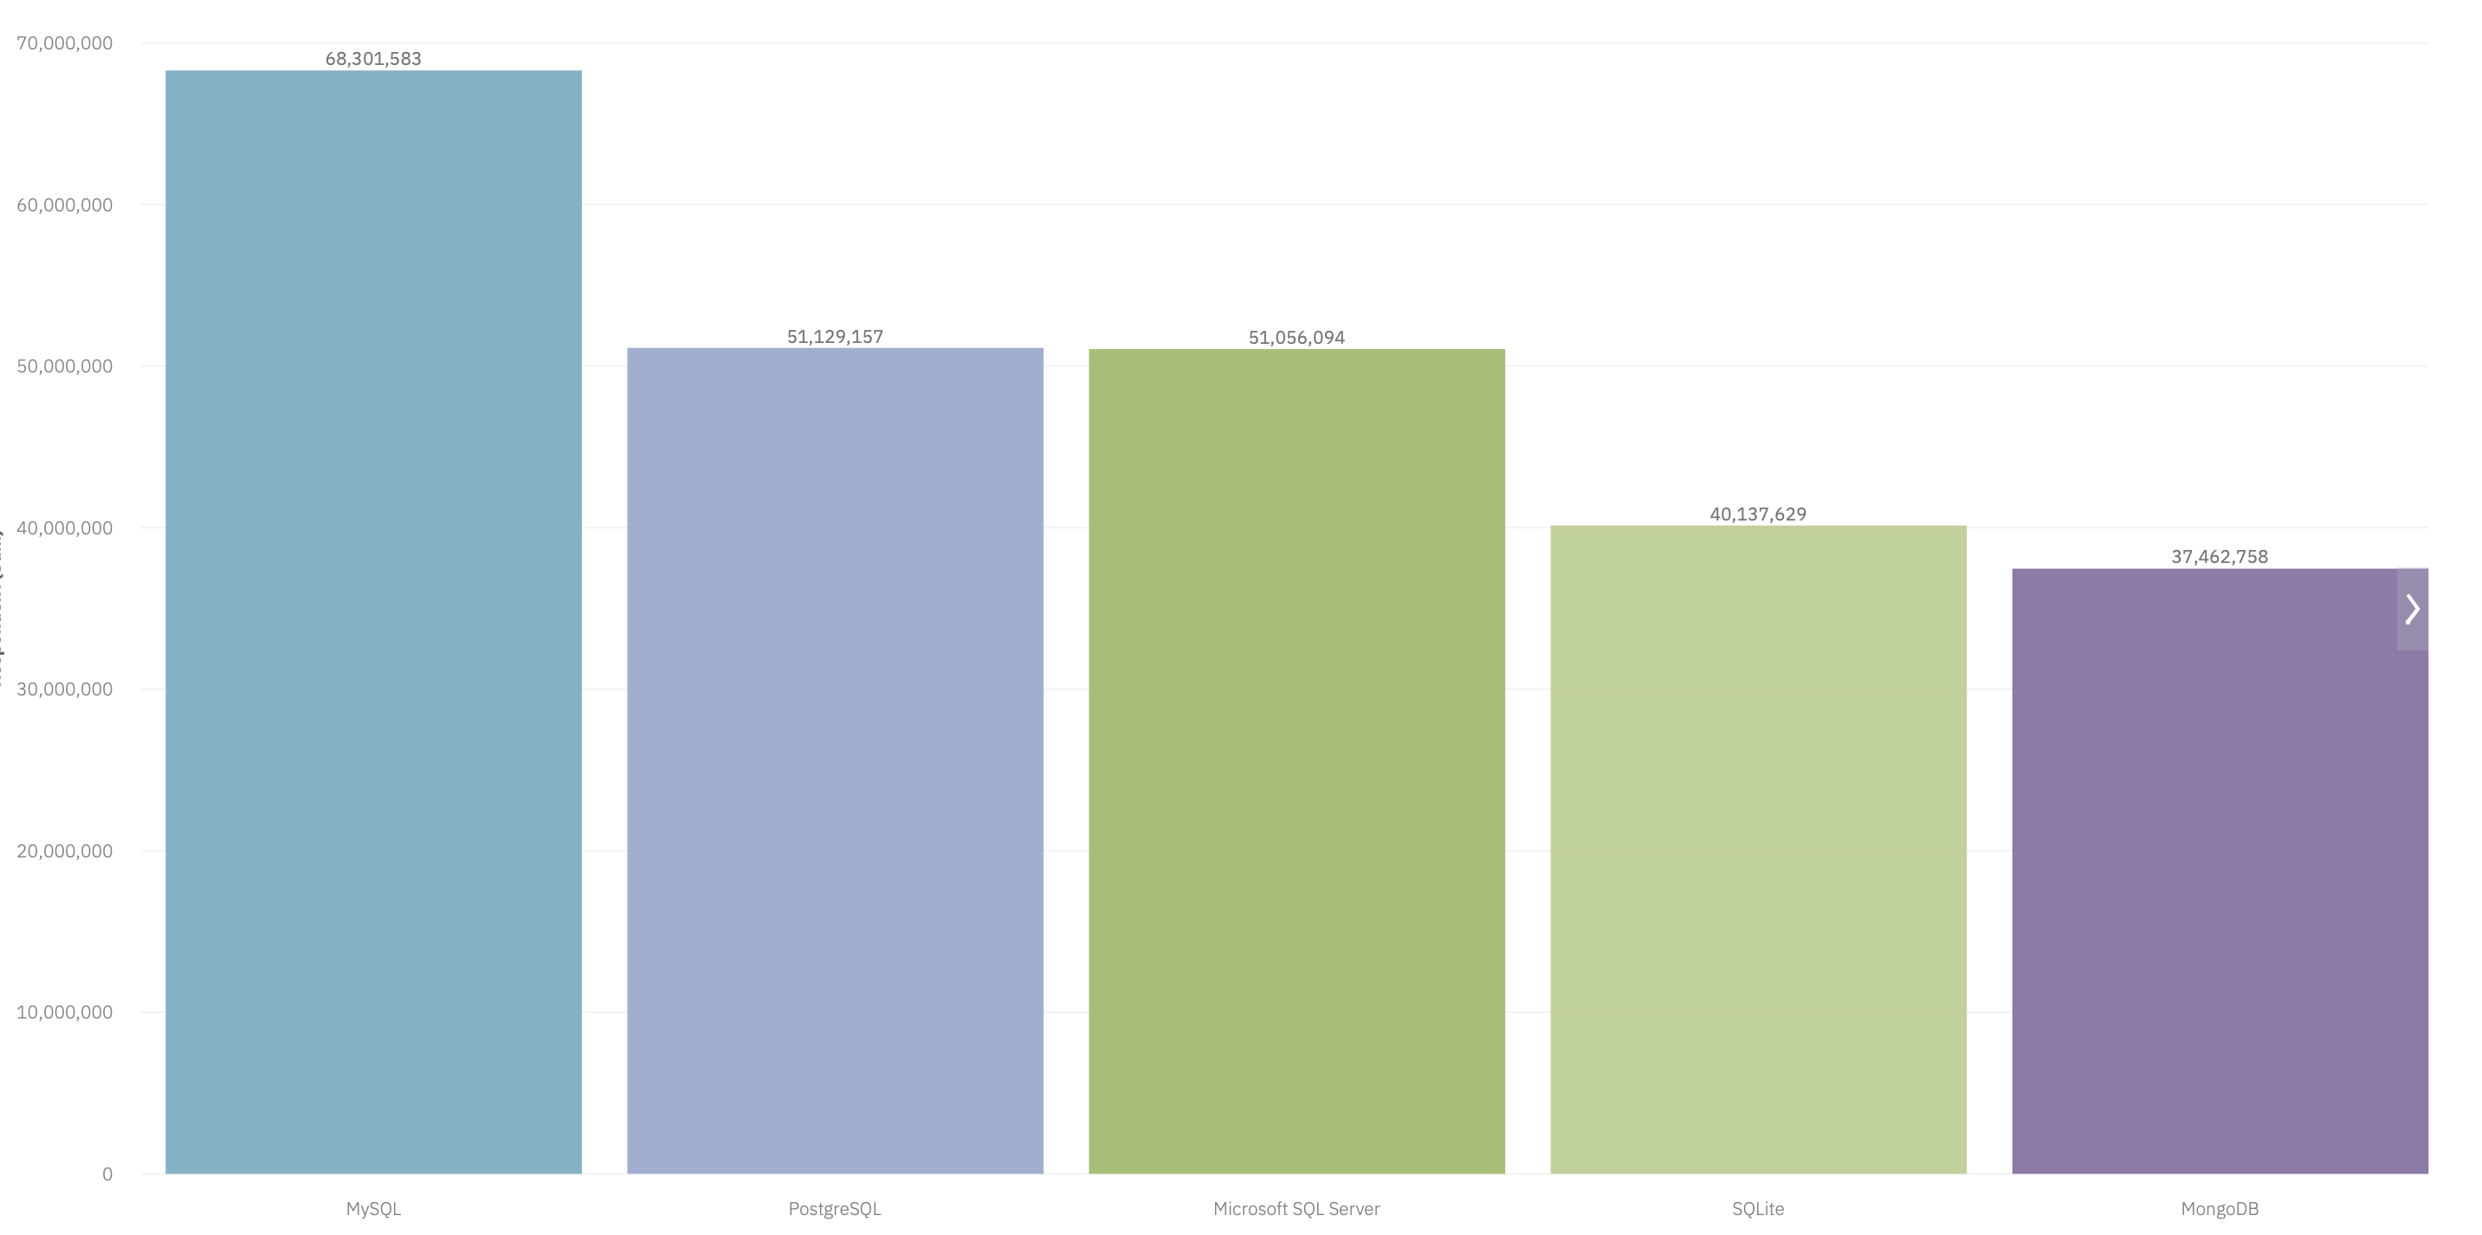
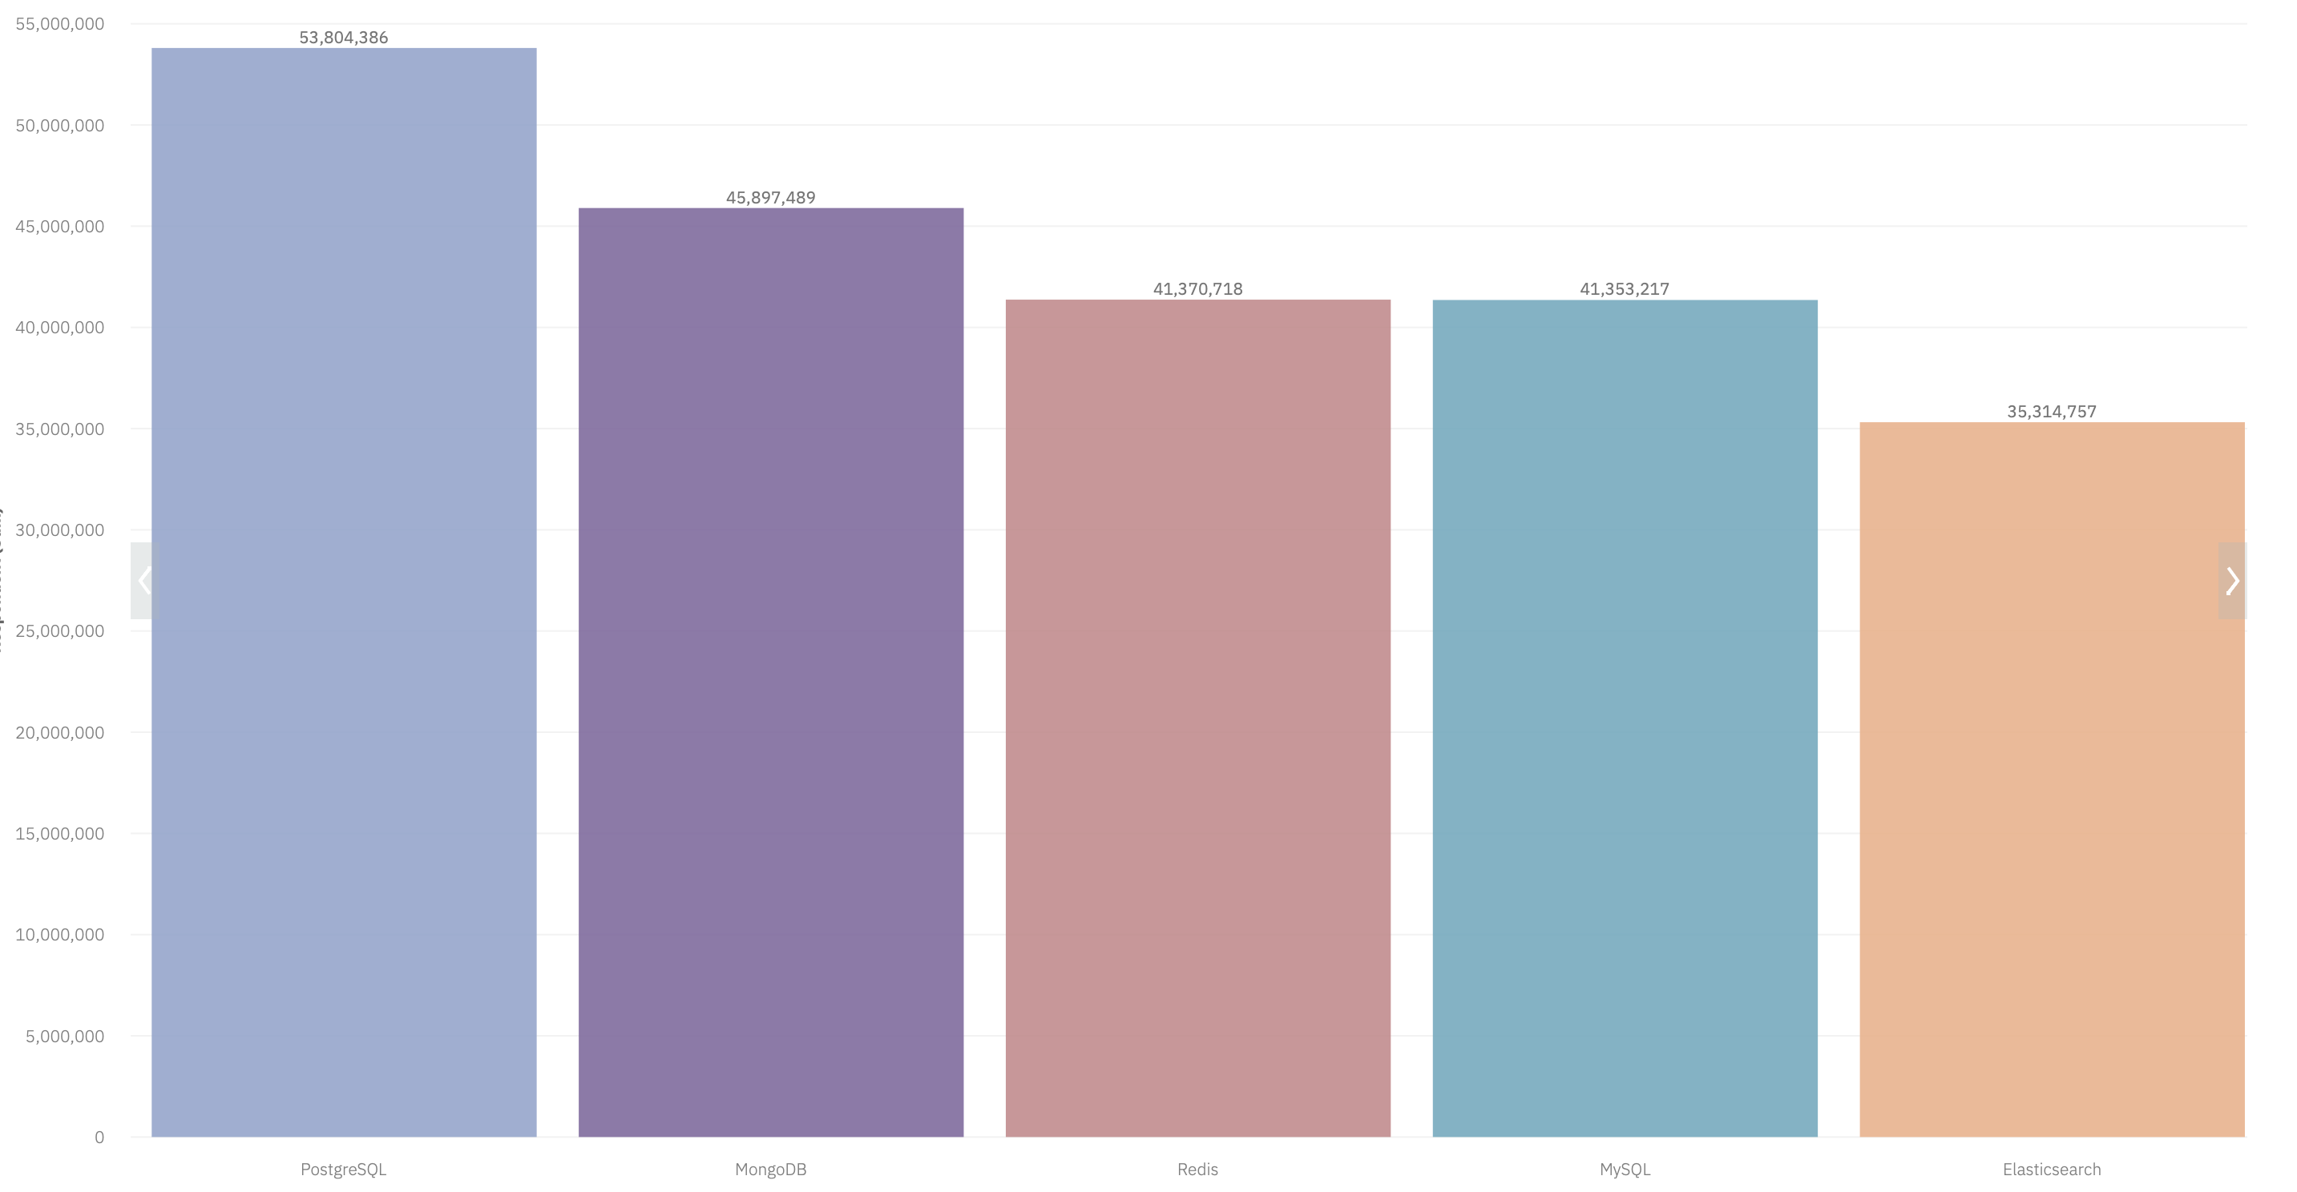
DATABASE TRENDS
Current Year
Next Year
< Bar chart of top 5 databases for the current year goes here >
< Bar chart of top 5 databases for the next year goes here.>
MySQL
PostgreSQL
Microsoft SQL Server
SQLite
MongoDB
PostgreSQL
MongoDB
Redis
MySQL
Elasticsearch

Slide 10
DATABASE TRENDS - FINDINGS & IMPLICATIONS
Findings
Current Database Trends
MySQL, PostgreSQL, Microsoft SQL Server, SQLite, MonoDB are the top 5 Databases’ current programmers are working with
PostgreSQL, MonoDB, Redis, MySQL, and Elasticsearch are the top 5 Databases’ current programmers would like to learn
Implications
After analyzing the data we have drawn the following implications:
MySQL, PostgreSQL, MonoDB remain in demand as known and desired skills
Microsoft SQL, and SQLite are trending downward meaning they may no longer be high demand database skills
Redis, and Elasticsearch are trending upwards as desired skills to learn

Slide 11

DASHBOARD
Dash Board of Data Trends Current and New

Slide 12
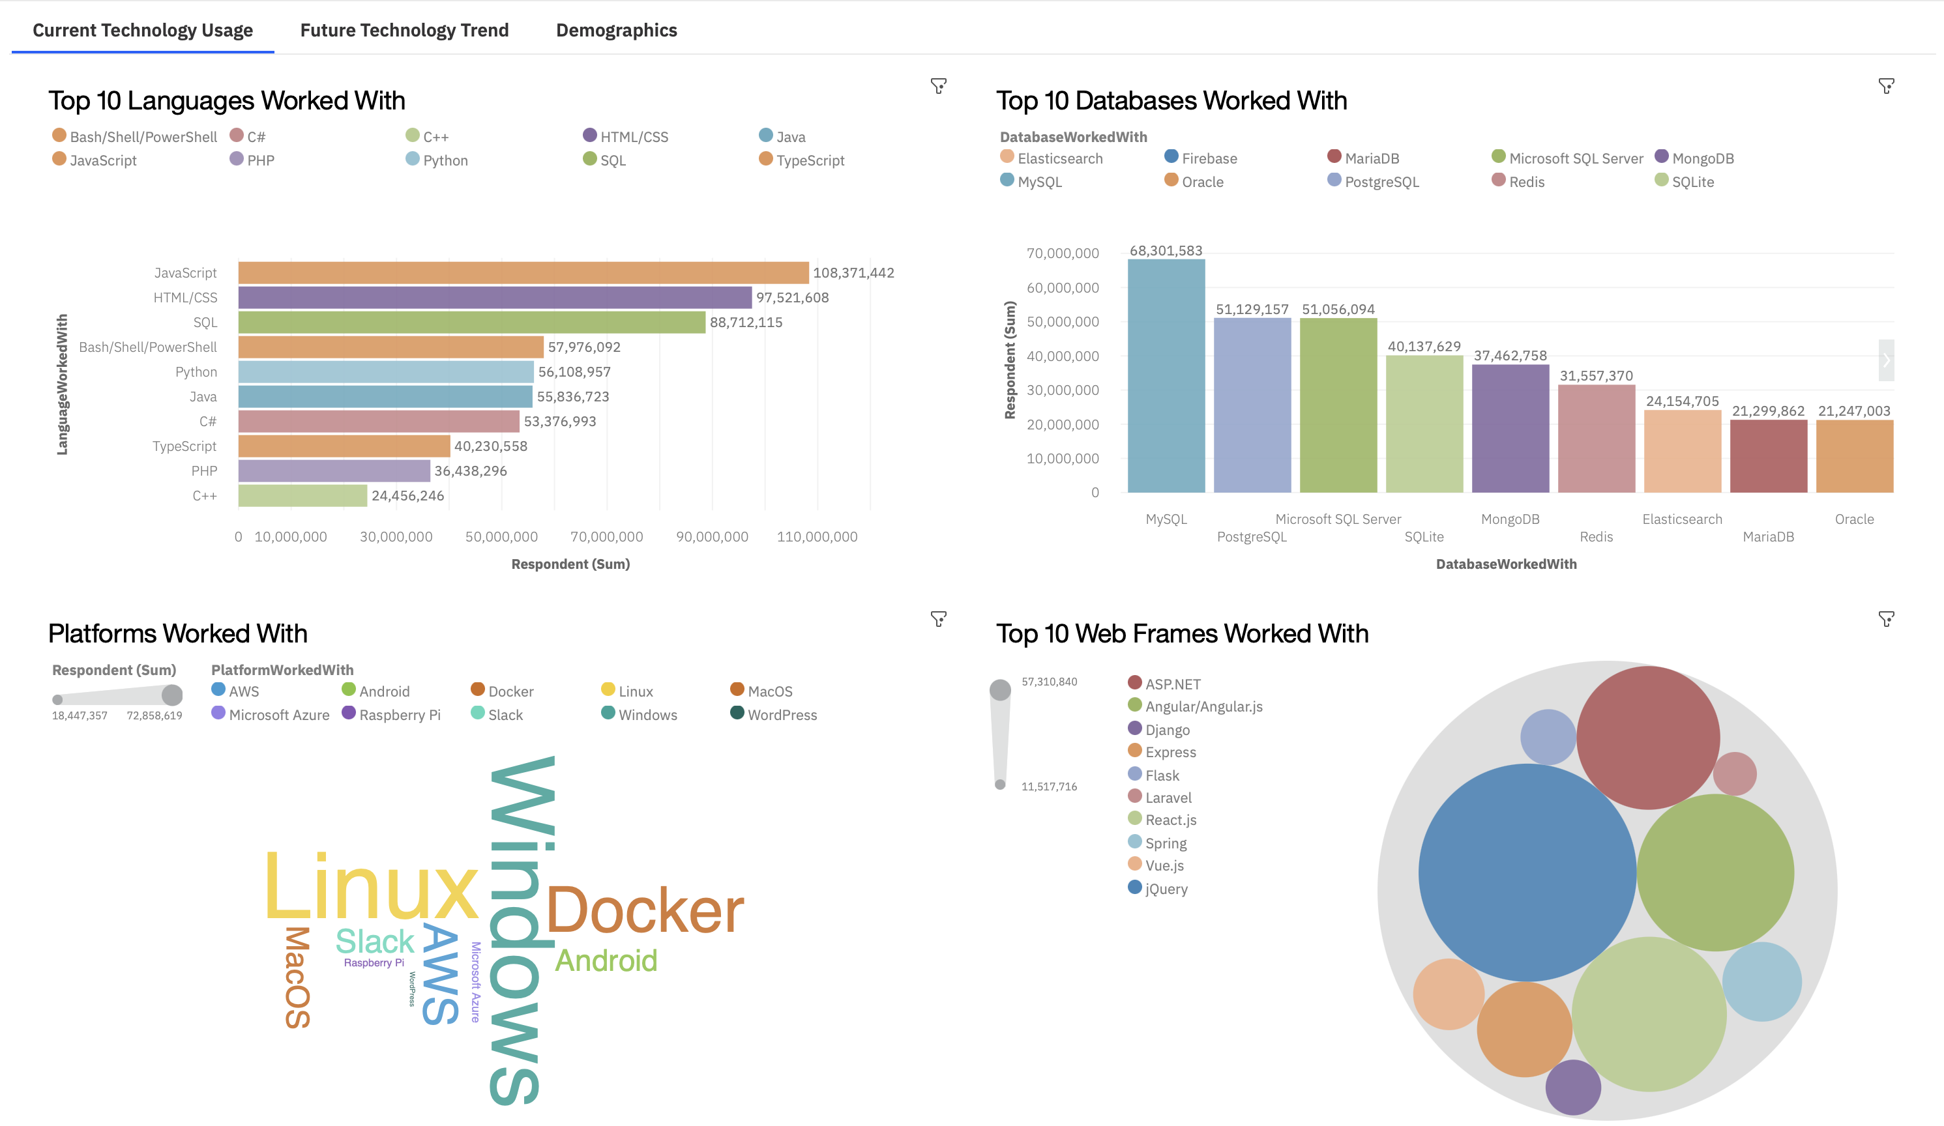
DASHBOARD CURRENT SKILLS/TECH
Screenshot of dashboard tab 1 goes here

Slide 13
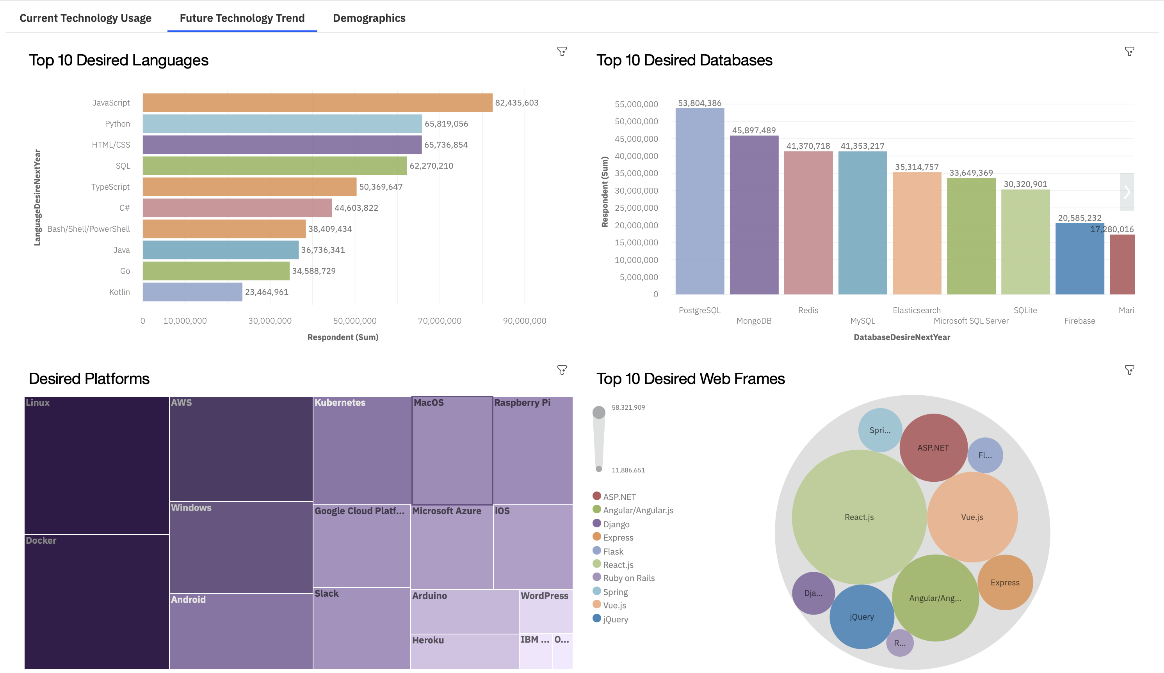
DASHBOARD DESIRED SKILLS/TECH
Screenshot of dashboard tab 2 goes here

Slide 14
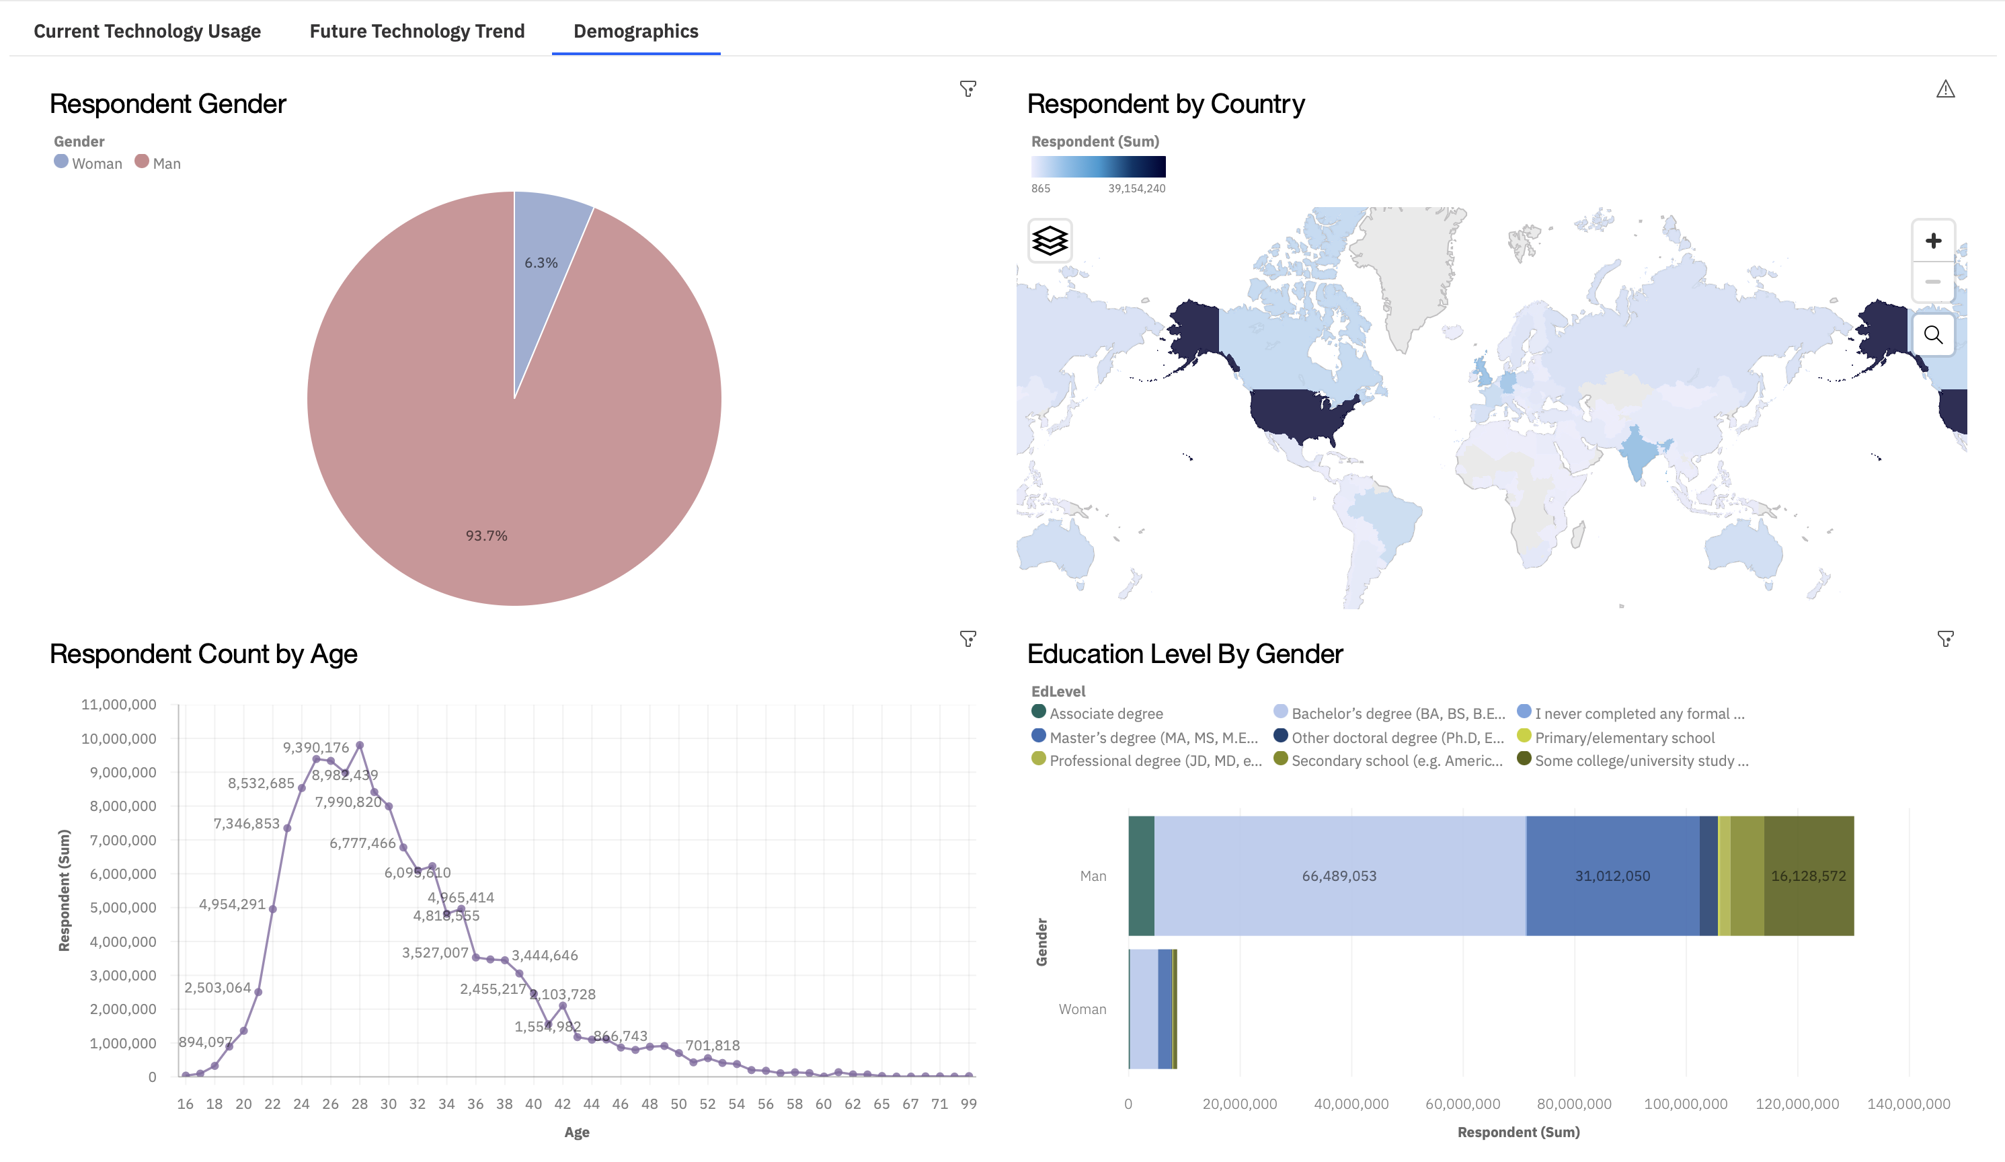
DASHBOARD RESPONDENT DEMOGRAPHICS
Screenshot of dashboard tab 3 goes here

Slide 15
DISCUSSION
After carefully collecting and analyzing the data, we are able to answer the question about what programming languages, databases, and demographic are skills that are in demand today, but also which skills and databases’ are trending and becoming more main stream as desired skills.

Slide 16
OVERALL FINDINGS & IMPLICATIONS
Findings
After our analysis we found:
Programming languages such as HTML, Python, and SQL are still in demand
Data Bases Such as MySQL, PostgreSQL, MonoDB are still in demand
There a rise in programming languages such as, TypeScript, and databases such as Elastisearch
Implications
After our analysis that data implies:
HTML, Python, and SQL remain as skills that are known and still in demand
MySQL, PostgreSQL, and MonoDB are databases that are known and still in demand
Learning programming languages such as TypeScript, and databases such as Elastisearch are tracking as desired skills

Slide 17

CONCLUSION
For new upcoming Programmers, keep Python, HTML, SQL on your list of desired/needed programming skills
Keep MySQL, PostgreSQL, and MonoDB on your list of desired/needed database skills
The current job market, and desired skills from established programmers would suggest that adding TypeScript, and Elasticsearch to your list of desired programming and database skills would prove beneficial for the foreseeable future

Slide 18

APPENDIX: In Order of Presentation
Data Sets:
m5_survery_data_demographics.csv
m5_survery_data_technologies_normalized.csv
Jobs API: Git Hub Jobs API
Web Scraping: Popular_Languages_CSV
The datasets, were collected, wrangled, and normalized using Skills Network Lab
The datasets were uploaded into IBM Db2 for sql queries and data was plotted using Pandas and Matplotlib packages
Dashboard was created using IBM Cognos Analytics Dashboard, Actual Dashboard Link

