Slide 1

Fundamental project ims
Daniel Wrotkowski

Slide 2

INTRODUCTION
work planning
designing how the code should look like
creating individual classes
creating all functions of the methods
testing
send to github in individual branches
documentation

Slide 3
Consultant Journey:
Version Control System: Git
Source Code Management: GitHub
Kanban Board: Jira
Database Management System: MySQL Server 5.7 (local or GCP instance)
Programming Language: Java
Build Tool: Maven
Unit Testing: JUnit

Slide 4

Testing
FOR CLASS:
- customers
- items
- orders
- order items
- accounts
- CONTROLERS
- DOMIANS
-DAO
- EXCEPTIONS
FOR CLASS:​
- customers​
- items​
- orders ​
- order items ​
- accounts

Slide 5
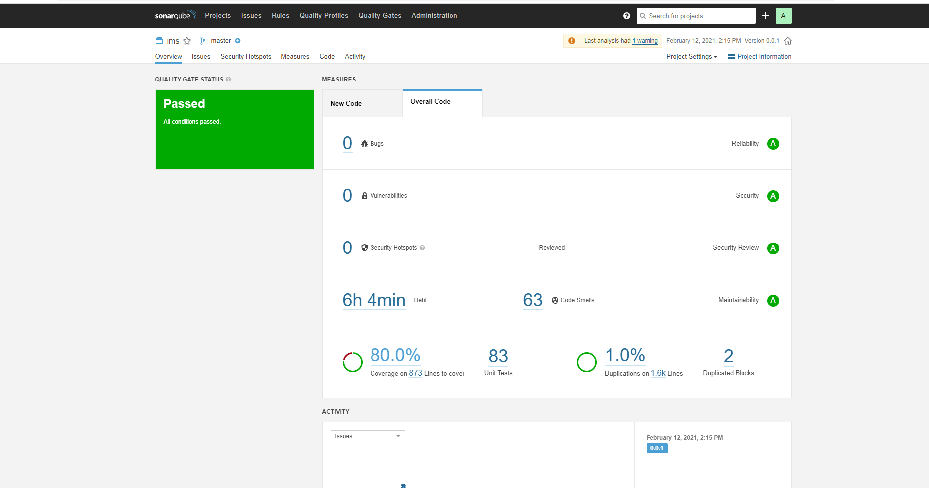

Slide 6
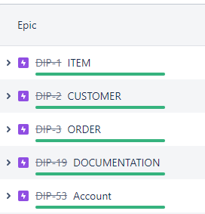
Demonstration:
USER STORIES:
- item
- customer
- order
- account
- documentation

Slide 7
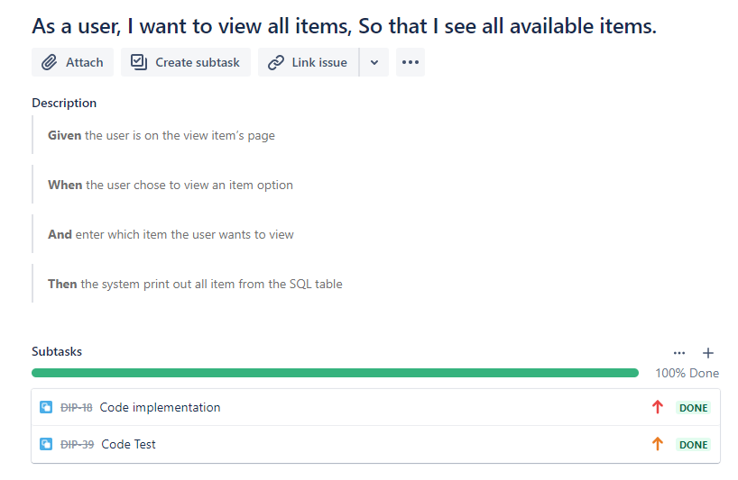
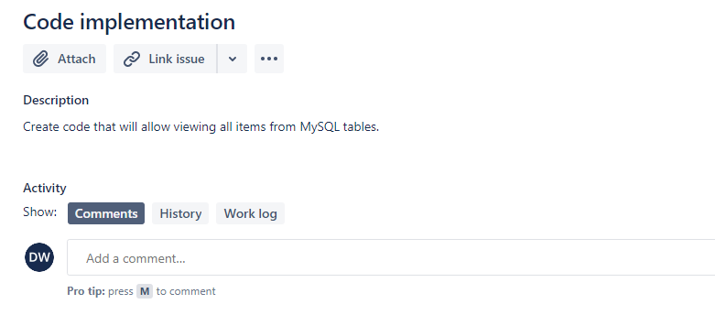
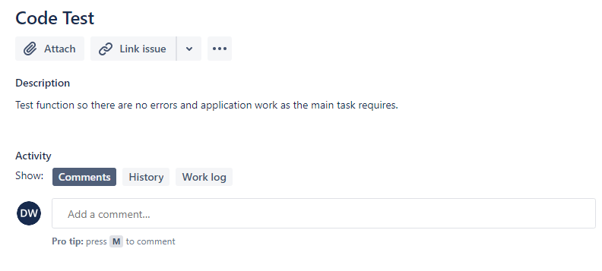
Item:

Slide 8
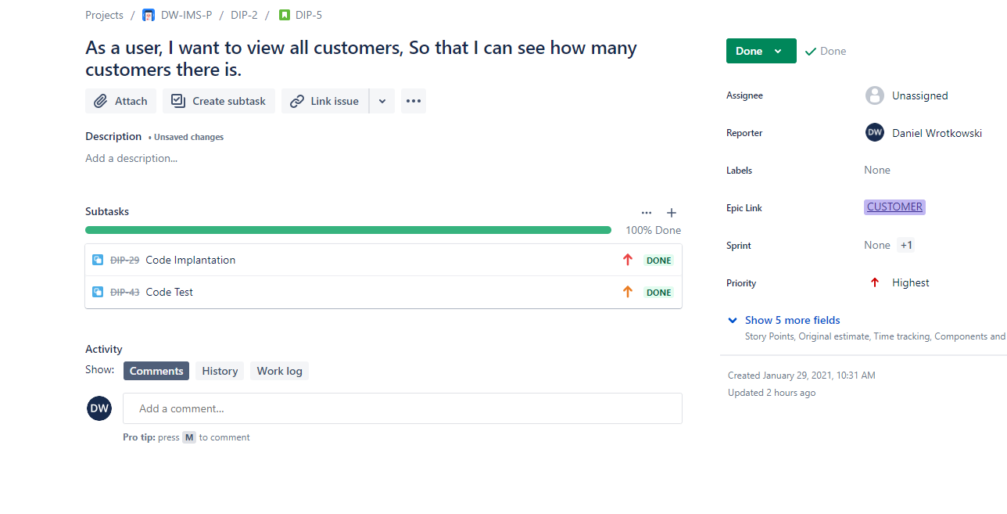
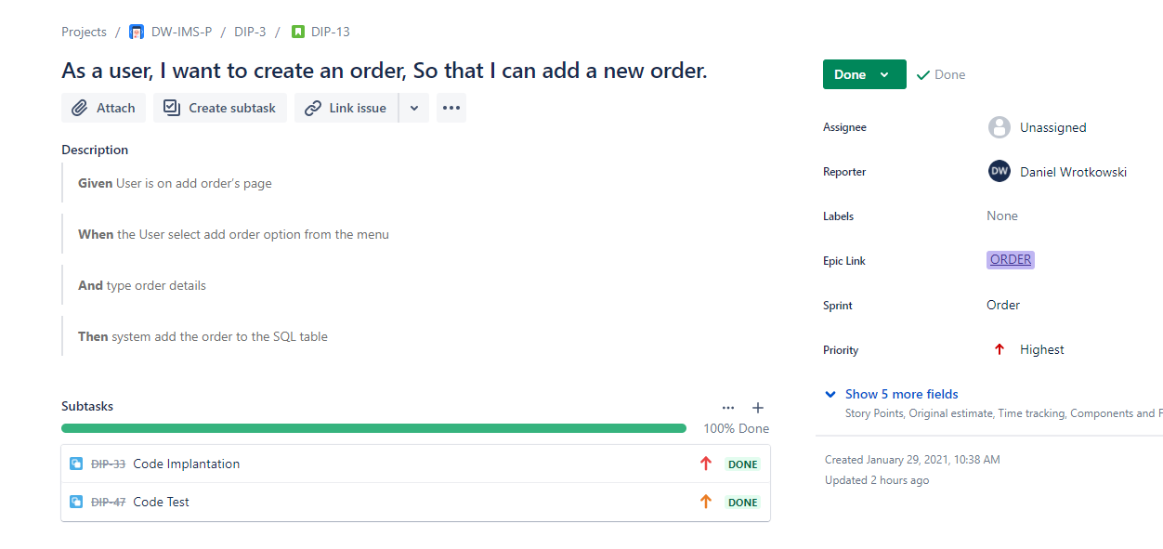
Customer And order
CUSTOMER: ORDER:

Slide 9
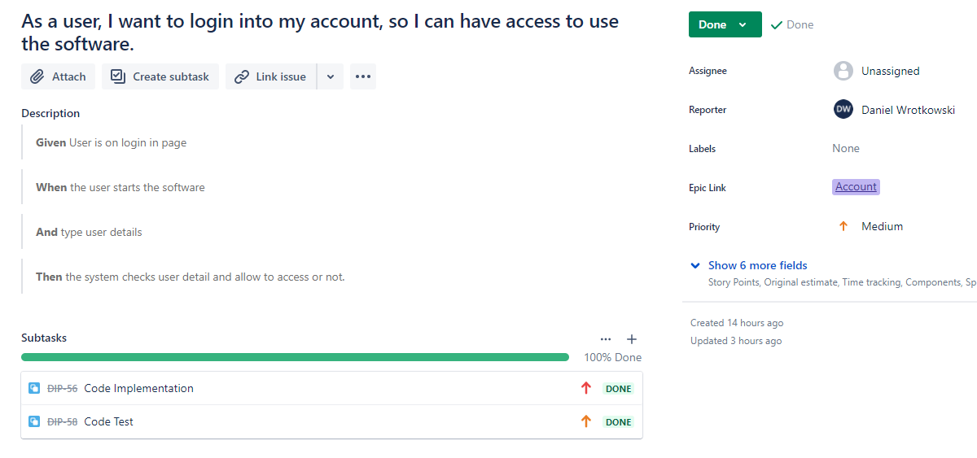
Accounts

Slide 10
Sprint review:
Codebase
Testing in 79%
Git repository
A build of the application
project management board
README.md
Risk assessment
ERD and UML diagram

Slide 11

Sprint retrospective:
What went well:
code development
UML and ERD diagrams
readme file
Jira
I had some problems:
- maven
- test
- GitHub

Slide 12

What could be improved
MORE KNOWLEDGE ON HOW TO BETTER USE DIFFERENT FUNCTIONS IN JAVA
CREATING CODE TO MAKE THE PROGRAM EASIER FOR THE USER
MORE TESTS
IMPROVEMENTS IN FUNCTIONS TO SHOW ALL THE INFORMATION NEEDED FOR THE USER
DATA BACK LOG
USER ACCESS AND ACCESS LEVELS

Slide 13

Conclusion:
Reflections on the project
future steps

Slide 14


