Slide 1
FINDIT
✓
PROJECT FOCUS
Campus lost and found
Target users
University students
Core value
Faster, safer item recovery
Lost it? Find it. Return it.
A university lost-and-found mobile app that helps students report missing belongings, discover found items, and arrange safe returns.
PROJECT TEAM
Jana Sadek • Gena Sadek • Rokaya Mostafa • Adham Ahmed
Abdelrahman Waleed • Mohamed Ismail
PHASE 1 • UNIVERSITY APP PROJECT

Slide 2
The Problem & the Gap
PROBLEM
PROBLEM DEFINITION
THE PROBLEM
THE GAP
Students regularly misplace everyday belongings on campus: ID cards, keys, wallets, chargers, notebooks and earphones.
Finding an item often depends on asking friends, checking scattered group chats, or visiting different offices.
There is no single, easy place for students to report lost items, post found belongings and search reports across campus.
Important details can get buried, and owners may never see a post about their item.
THE OPPORTUNITY • One campus-based platform to make reporting, searching and returning belongings easier.
02 / 10

Slide 3
Target Users & Our Solution
USERS AND SOLUTION
USERS AND SOLUTION
TARGET USERS
OUR SOLUTION
PRIMARY USERS
OUR IDEA
OUR SOLUTION
• University students who lose personal belongings
• Students who find items and want to return them
• Campus staff who help manage lost property
Find It is a mobile app for one university campus. Students can create lost-item or found-item reports and search listings using clear filters.
A shared item board with possible-match suggestions, private in-app contact and a claim-check process before an item is handed over.
DESIGN PRINCIPLE • Quick to use, easy to search, and careful with students’ personal information.
04 / 10

Slide 4
Three Ideas — and Why FindIt
IDEA SELECTION
IDEA SELECTION
01 FINDIT
02 UNIFLOW
03 CAMPUSMATE
Problem: Students find it hard to organize deadlines and schedules.
User: University students.
Value: Brings academic tasks into one planner.
Problem: Students may struggle to locate campus rooms and services.
User: University students.
Value: Helps students navigate campus facilities.
Problem: Students struggle to recover belongings lost on campus.
User: University students.
Value: Connects item owners with people who find their belongings.
OUR CHOICE
OUR CHOICE • FindIt has a focused purpose, a clear user journey and features that are realistic to prototype and test within a university project.
04 / 10

Slide 5
Research & Evidence Plan
RESEARCH
RESEARCH
WHERE WE SEARCHED
SEARCH TERMS & FILTERS
WHAT WE WILL RECORD
WHERE TO RESEARCH
SEARCH TERMS
WHAT WE NEED TO LEARN
• Google Scholar
• PubMed
• Federal Trade Commission (FTC)
• Google Scholar
• University lost-property policies
• Student services / campus security guidance
• Student interviews and short surveys
• University lost and found systems
• Campus lost property process
• Student experience losing belongings
• Privacy and trust in item recovery apps
• Which items are most often lost?
• Where do students report them now?
• What information helps identify an item?
• What makes a return process feel safe?
05 / 0

Slide 6
Weighted Idea Evaluation
DECISION-MAKING
DECISION-MAKING
Each idea was rated from 1 (low) to 5 (high) against five criteria. Weighted totals are preliminary team assessments, not survey results.
FINDIT • 89 / 100
CAMPUSMATE • 81 / 100
UNIFLOW • 78 / 100
User need 5/5 • Feasibility 4/5
Gap 4/5 • Mobile fit 5/5
Risk 4/5
Highest overall score
User need 4/5 • Feasibility 5/5
Gap 3/5 • Mobile fit 4/5
Risk 4/5
Strong feasibility
User need 3/5 • Feasibility 5/5
Gap 3/5 • Mobile fit 5/5
Risk 4/5
Useful but highly competitive idea
CRITERIA WEIGHTS • User need 30% | Feasibility 25% | Gap 20% | Mobile fit 15% | Risk 10%
06 / 10

Slide 7
Project Evaluation: SWOT & Value
PROJECT EVALUATION
Business Case
PROJECT EVALUATION
STRENGTHS
WEAKNESSES
Focused problem • Simple reporting flow • Useful search filters • Clear campus audience
Relies on students posting honestly • Match suggestions may be inaccurate • Requires active use
STRENGTHS
weakness
OPPORTUNITIES
THREATS / RISKS
Partner with student services • Add campus-specific locations • Expand to multiple campuses later
False ownership claims • Personal-data exposure • Outdated listings • Inappropriate posts
OPPORTUNITIES
RISKS / THREATS
COSTS: development time, testing, basic hosting and moderation. BENEFITS: easier recovery, less searching and stronger campus cooperation.
07 / 10

Slide 8
App Features & Project Scope
SCOPE
SCOPE
PROJECT OBJECTIVE
OBJECTIVE • Build a mobile app prototype that helps students report, search for and safely recover belongings lost on campus.
MUST-HAVE FEATURES (MVP)
ADDITIONAL FEATURES
MUST-HAVE FEATURES (MVP)
NICE-TO-HAVE FEATURES
1. Lost Item Report — item name, category, last-seen location, date and optional photo.
2. Found Item Report — details and optional photo of an item found.
3. Search & Filters — category, location, date and keywords.
4. Possible Matches & Claim — show similar listings and ask ownership-check questions before return.
• In-app private messaging or contact request
• Report status: open, possible match, returned
• Notifications for possible matches
• Admin review of suspicious or inappropriate posts
• Campus-specific building and location list
PROJECT BOUNDARY • The first version is for one campus; it does not guarantee a match or independently prove ownership.
08 / 10

Slide 9
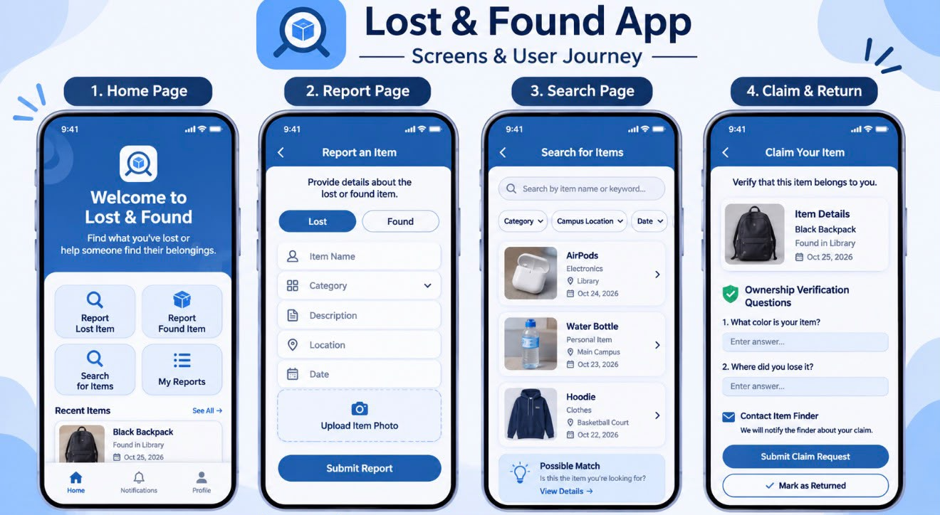
App Screens & User Journey
USER EXPERIENCE
USER EXPERIENCE
JOURNEY • Open app → report or search → review possible match → verify ownership → arrange return → close report.
09 / 10

Slide 10
Validation & Success Criteria
VALIDATION
CUSTOMER DISCOVERY
CUSTOMER DISCOVERY
STAKEHOLDERS
SUCCESS CRITERIA
CUSTOMER DISCOVERY
KEY STAKEHOLDERS
SUCCESS CRITERIA
Ask students:
1. Have you lost or found an item on campus?
2. How did you report it or search for it?
3. What details would help identify an item?
4. What would make the app feel safe and useful?
• Students: report, search and test
• Student services: advise on existing processes
• Campus security / reception: support item handover
• Project team: design, build and evaluate
• Lecturer: review project quality
• 4 out of 5 test users submit a report without help
• 80% find a relevant listing using search
• All core screens work during testing
• Claim process avoids public display of personal contact details
NEXT STEP • Collect student feedback, refine the screens, build the MVP and test the full lost-to-return journey.
10 / 10

Slide 11
FindIt in Action: A Realistic Campus Scenario
USER SCENARIO
Mariam leaves her student ID card in the university library. Later, she realises it is missing and uses FindIt to try to recover it.
1 REPORT LOST
2 FOUND ITEM POSTED
3 POSSIBLE MATCH
4 VERIFY & RETURN
Mariam opens FindIt and selects “Report Lost”. She enters “student ID card”, chooses the library as the last-seen location, adds the date and submits the report.
A student finds an ID card in the library and creates a “Report Found” post with its location and a photo that does not expose sensitive details.
FindIt displays the found-item post as a possible match. Mariam reviews the details and sends a private claim request.
The finder asks Mariam to confirm a detail not shown publicly. They arrange collection at campus reception, then mark the report as returned.
RESULT
SAFETY BUILT INTO THE JOURNEY
Mariam recovers her ID card without relying on scattered group chats or asking around campus.
Personal phone numbers are not displayed publicly. A possible match is not proof of ownership; checks happen before return.
11 / 11

