Slide 1

Sports Statisticians of UGA
Python Workshop 2

Slide 2
Note:
You do not have to do this prior to the meeting.
I will walk you through all of it.

Slide 3
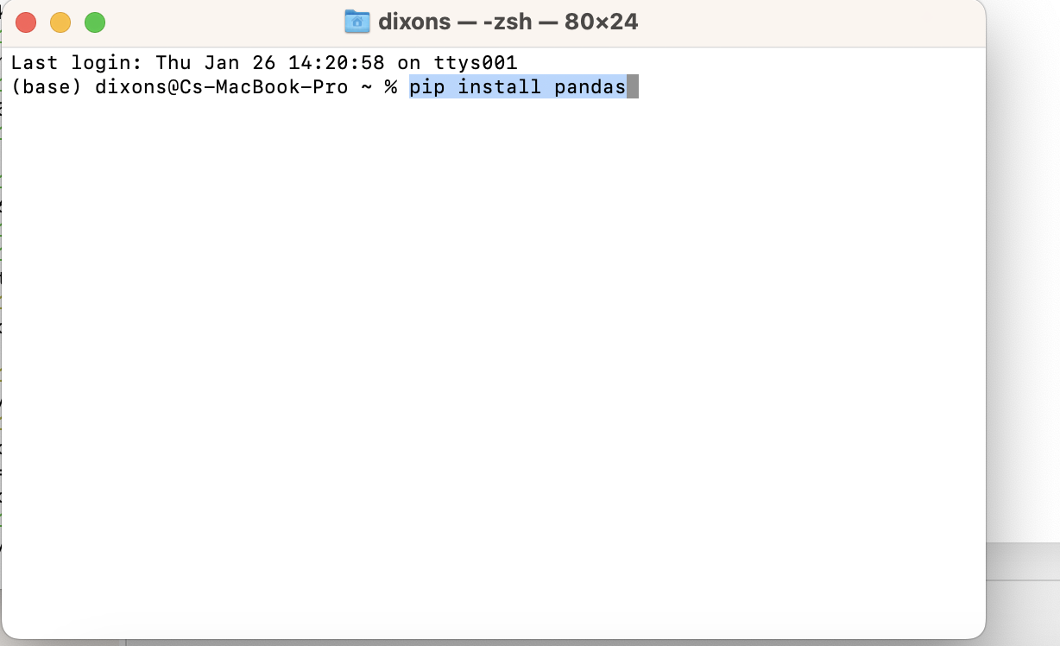
Install numpy and pandas [MAC]
conda install numpy
conda install pandas
pip install numpy
pip install pandas

Slide 4
Github desktop
https://docs.github.com/en/desktop/installing-and-configuring-github-desktop/installing-and-authenticating-to-github-desktop/installing-github-desktop
Not required but extremely useful.
https://github.com/DXNSTATISTICS?tab=repositories
Code found here
Will explain how to download at the workshop

Slide 5
Lesson Plan
0. Encouragement
Pandas
Numpy
For/While Loops
Basic Functions

