Slide 1
Đặc tả chức năng
THÊM SINH VIÊN

Slide 2
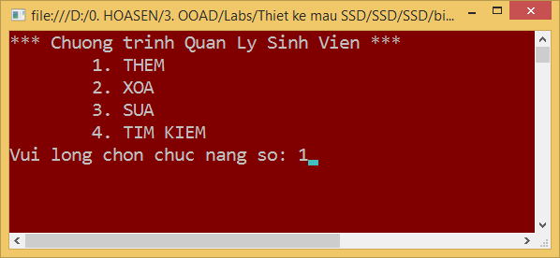
Bước 1 (1)
static void Main(string[] args)
{
Console.WriteLine("*** Chuong trinh Quan Ly Sinh Vien *** ");
Console.WriteLine("\t1. THEM");
Console.WriteLine("\t2. XOA");
Console.WriteLine("\t3. SUA");
Console.WriteLine("\t4. TIM KIEM");
Console.Write("Vui long chon chuc nang so: ");
string chucnangso = Console.ReadLine();
}
Notes:
08

Slide 3
Bước 1 (2)
class Program
{
static void Main(string[] args)
{
Console.WriteLine("*** Chuong trinh Quan Ly Sinh Vien *** ");
Console.WriteLine("\t1. THEM");
Console.WriteLine("\t2. XOA");
Console.WriteLine("\t3. SUA");
Console.WriteLine("\t4. TIM KIEM");
Console.Write("Vui long chon chuc nang so: ");
string chucnangso = Console.ReadLine();
}
}
class Program
{
static void Main(string[] args)
{
DisplayMenu(); //line 1-5
InputFuncNumber(); //line 6-7
}
}
Notes:
08

Slide 4
Bước 1 (3)
class Program
{
static void Main(string[] args)
{
Console.WriteLine("*** Chuong trinh Quan Ly Sinh Vien *** ");
Console.WriteLine("\t1. THEM");
Console.WriteLine("\t2. XOA");
Console.WriteLine("\t3. SUA");
Console.WriteLine("\t4. TIM KIEM");
Console.Write("Vui long chon chuc nang so: ");
string chucnangso = Console.ReadLine();
}
}
class Program
{
static void Main(string[] args)
{
System.DisplayMenu();
System.InputChoiceNumber();
}
}
Notes:
08

Slide 5
Bước 1 (4)
class Program
{
static void Main(string[] args)
{
Console.WriteLine("*** Chuong trinh Quan Ly Sinh Vien *** ");
Console.WriteLine("\t1. THEM");
Console.WriteLine("\t2. XOA");
Console.WriteLine("\t3. SUA");
Console.WriteLine("\t4. TIM KIEM");
Console.Write("Vui long chon chuc nang so: ");
string chucnangso = Console.ReadLine();
}
}
class Program
{
static void Main(string[] args)
{
System.GetChoiceNumber();
}
}
Notes:
08

Slide 6
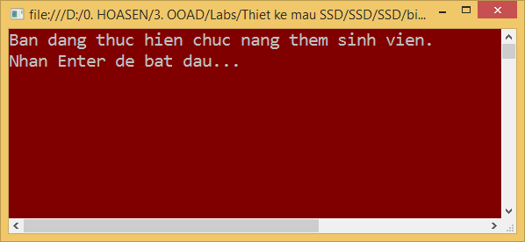
Bước 2
DisplayAddStudentScr()
System.Console.Clear();
Console.WriteLine("Ban dang thuc hien chuc nang them sinh vien.");
Console.Write("Nhan Enter de bat dau...");
Notes:
08

Slide 7
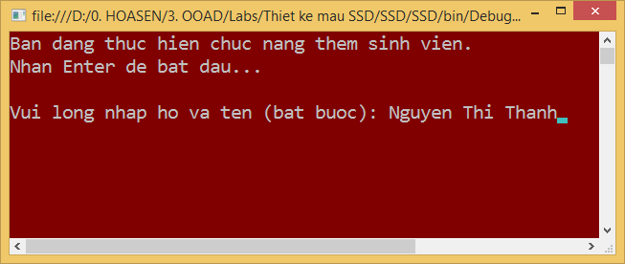
Bước 3
InputName()
Console.Write("\nVui long nhap ho va ten (bat buoc): ");
string hovaten = Console.ReadLine();
//kiem tra ho ten khong hop le thi xuat thong bao va yeu cau nhap lai
ValidateName()
Notes:
08

Slide 8
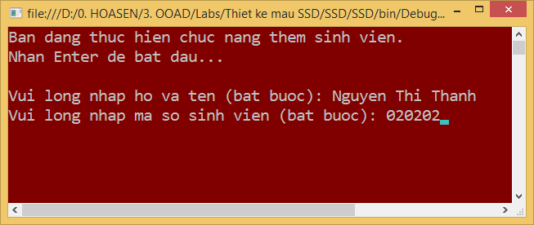
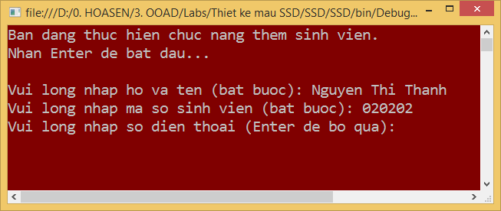
Bước 4-5
Notes:
08

Slide 9
Bước 3-4-5
InputStudentInfo()
Notes:
08

Slide 10
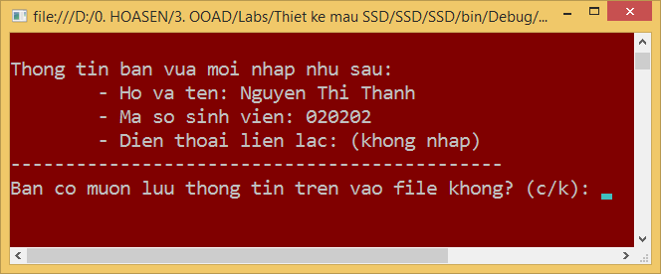
Bước 6
Notes:
GetSavingConfirmation()

Slide 11
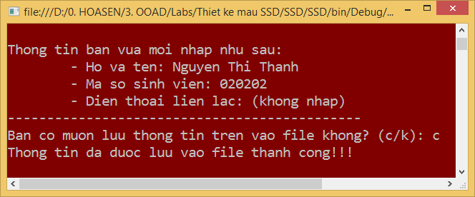
Bước 7
Notes:
Save()
ShowSavingResult()

Slide 12
static public void ThemSV()
{
sinhvien sv1 = new sinhvien ();
System.Console.Clear();
Console.WriteLine("Ban dang thuc hien chuc nang them sinh vien.");
Console.Write("Nhan Enter de bat dau...");
Console.ReadKey();
Console.Write("\nVui long nhap ho va ten (bat buoc): ");
string hovaten = Console.ReadLine();
//kiem tra ho ten khong hop le thi xuat thong bao va yeu cau nhap lai
Console.Write("Vui long nhap ma so sinh vien (bat buoc): ");
string mssv = Console.ReadLine();
Console.Write("Vui long nhap so dien thoai (Enter de bo qua): ");
string sodt = Console.ReadLine();
Console.WriteLine("\nThong tin ban vua moi nhap nhu sau: ");
Console.WriteLine("\t- Ho va ten: {0}", hovaten );
Console.WriteLine("\t- Ma so sinh vien: {0}", mssv );
if (sodt == string.Empty) sodt = "(khong nhap)";
Console.WriteLine("\t- Dien thoai lien lac: {0}", sodt);
Console.WriteLine("---------------------------------------------");
Console.Write("Ban co muon luu thong tin tren vao file khong? (c/k): ");
string traloi = Console.ReadLine();
if (traloi.ToLower() == "c")
if (sv1.Them()==1)
Console.WriteLine("Thong tin da duoc luu vao file thanh cong!!!");
else if (traloi.ToLower() == "k")
//ve menu chinh
return;
else
Console.WriteLine("Vui long nhap lai cau tra loi");
}
static public void ThemSV()
{
//Hien thi man hinh ThemSV
ChuyenDenManHinhChucNang("them");
NhapTen();
//kiem tra ho ten khong hop le thi
//xuat thong bao va yeu cau nhap lai
KiemtraTen();
NhapMSSV();
KiemtraMSSV();
NhapSoDT();
KiemtraSoDT();
//Hien thi thong tin da nhap
HienthiTTSV();
//Hien thi thong bao xac nhan
//co luu TT vao file khong
HienthiTBXacnhan("Them");
//Hien thi ket qua them sv
HienthiKQThem();
}
Notes:
08

Slide 13
static public void ThemSV()
{
sinhvien sv1 = new sinhvien ();
System.Console.Clear();
Console.WriteLine("Ban dang thuc hien chuc nang them sinh vien.");
Console.Write("Nhan Enter de bat dau...");
Console.ReadKey();
Console.Write("\nVui long nhap ho va ten (bat buoc): ");
string hovaten = Console.ReadLine();
//kiem tra ho ten khong hop le thi xuat thong bao va yeu cau nhap lai
Console.Write("Vui long nhap ma so sinh vien (bat buoc): ");
string mssv = Console.ReadLine();
Console.Write("Vui long nhap so dien thoai (Enter de bo qua): ");
string sodt = Console.ReadLine();
Console.WriteLine("\nThong tin ban vua moi nhap nhu sau: ");
Console.WriteLine("\t- Ho va ten: {0}", hovaten );
Console.WriteLine("\t- Ma so sinh vien: {0}", mssv );
if (sodt == string.Empty) sodt = "(khong nhap)";
Console.WriteLine("\t- Dien thoai lien lac: {0}", sodt);
Console.WriteLine("---------------------------------------------");
Console.Write("Ban co muon luu thong tin tren vao file khong? (c/k): ");
string traloi = Console.ReadLine();
if (traloi.ToLower() == "c")
if (sv1.Them()==1)
Console.WriteLine("Thong tin da duoc luu vao file thanh cong!!!");
else if (traloi.ToLower() == "k")
//ve menu chinh
return;
else
Console.WriteLine("Vui long nhap lai cau tra loi");
}
static public void ThemSV()
{
//Hien thi man hinh ThemSV
ChuyenDenManHinhChucNang("them");
NhapTTSV();
//bao gom kiem tra thong tin nhap
//Hien thi thong tin da nhap
HienthiTTSV();
//Hien thi ket qua them sv
LuuVaoFile();
}
Notes:
08

